Slide 1
Short introduction to JavaScript
Jozsef Gal
Nyíregyháza – 2022/03/16

Slide 2
Agenda
01
JavaScript
02
DOM
03
Asynchronous model
04
Callbacks, Promises
05
AJAX, Fetch API
06
Exercises

Slide 3
JavaScript
What is JavaScript?
Basics: types, functions, classes

Slide 4









What is JavaScript?
JavaScript
High level interpreted programming / scripting language
Prototye based
Functional oriented with possibility of OO usage
Synchronous
Loosely / dinamically typed
Originally designed for browsers, but now it’s used in many other aspects
Standard: ECMAScript
Widely used version: ES2015 / ES6
Current version: ES2022 / v13
ES.Next: dynamic name for the next version under development

Slide 5
JavaScript – types
JavaScript
The language is pretty similar to C
Basic types:
undefined
Boolean
Number
BigInt
String
Symbol
Structural types:
Object
Array, Map, Set, WeakMap, WeakSet
Function
Structural root primitive:
null
Variables
var: old-fashioned way of create a function scoped variable
let: block scope variable, the value can be changed
const: block scope variable, cannot be changed
Globals: window or global (environment dependent)
Functions
Anonymous function
Named function
Inner function
Immediately Invoked Function Expression
Arrow function
Objects
Key-value pairs
Prototype (and constructor)
JSON
https://developer.mozilla.org/en-US/docs/Web/JavaScript/Data_structures

Slide 6

JSON
JavaScript
JavaScript Object Notation
A lightweight data interchange format
Readable to humans
Easily processed by programs
Subset of JavaScript
MIME type: application/json
Can contain:
Number
String
Boolean
Array
Null
Object
{
"id": 1,
"name": "Json Statham",
"hasGun": true, "movies": [
"Crank",
"The Transporter"
],
"killedBy": null
}

Slide 7
Variables and scopes
JavaScript
Variable scope: a block of code within a variable makes sense
You can interpret scopes as scope of an object (even functions are objects)
Global scope: window (browsers) / global (headless browsers or Node)
Function & Global
Block scope
1.
var a = 42;
try {
var a = 90;
} catch (err) {
console.log(err);
}
console.log(a);
2.
const a = 42;
try {
const a = 90;
} catch (err) {
console.log(err);
}
console.log(a);
3.
const a = 42;
try {
a = 90;
} catch (err) {
console.log(err);
}
console.log(a);
4.
let a = 42;
try {
let a = 90;
} catch (err) {
console.log(err);
}
console.log(a);
5.
let a = 42;
try {
a = 90;
} catch (err) {
console.log(err);
}
console.log(a);
* hoisting

Slide 8
Functions
JavaScript
Function declaration
function myFunction(param1, param2) {...}
Function expression (anonymous, IIFE)
const myFunction = function(param1, param2) {...};
Shorthand method definition
const collection = { myFunction: function(param1, param2) {...}, };
Arrow function
const myFunction = () => {...};
Generator function
Returns a generator object
Can be exited and re-entered
Save context across re-entrances
Function as object instance
const numberA = "numberA"; const numberB = "numberB"; const sumFunction = new Function( numberA,
numberB,
"return numberA + numberB„
); sumFunction(10, 15); // => 25
Functions are first-class citizens of JavaScript – can be:
passed as an argument
returned
assigned to a variable
The number of arguments passed to a function depends on the caller (not the declaration)
Highly depends on context from where it’s called:
„this” does not mean the same thing as in Java
(Re-)Define scope with:
Call
Apply
Bind
https://developer.mozilla.org/en-US/docs/Web/JavaScript/Reference/Functions

Slide 9
Arrays
JavaScript
Definitions:
const array = [];
const array2 = new Array();
Traversing
for (let i=0; i<array.length; i++) {
console.log(array[i]);
}
for (let i in array) {...}
for (let i of array) {console.log(i);} array.forEach((item, index) => {
console.log(`${index}: ${item}`);
});
Notable methods:
filter: find multiple matching items
find: find the first matching item (=> findLast)
forEach: traversing
includes: does it contain? (for primitives)
map: transform
reduce: reduce the array to a single value
some: has at least one match (=> every)
The most likely used structured types after functions
Iterable object
Stores a collection of multiple items under a single variable name
Has members for performing common array operations
Not primivite: resource type
Resizable and can contain a mix of different data types (not suggested – use typed arrays)
Elements must be accessed using nonnegative integers
Zero indexed
Array-copy: shallow copy
https://developer.mozilla.org/en-US/docs/Web/JavaScript/Reference/Global_Objects/Array

Slide 10
Classes
JavaScript
class Computer {
constructor(name) {
this.name = name;
this.portable = false;
}
describe = () => {
console.log(this.name);
return ` It's ${this.name} – ${this.portable ? "portable" : "standard"} computer`;
};
}
class Notebook extends Computer {
constructor(name) {
super(name);
this.portable = true;
}
}
const notebook = new Notebook("HP G8");
notebook.describe();
Template for creating objects
Before ES6: house of horror
ES6: class expression
Constructor
Only „public” elements can be defined (no restriction definition)
Prototype:
JS implements prototype-based inheritance
Mechanism by which JS objects inherit features from one another
Chain: every objects has a prototype, which can also have a (different) one
__proto__ property: how to resolve methods?
https://developer.mozilla.org/en-US/docs/Learn/JavaScript/Objects/Object_prototypes
https://developer.mozilla.org/en-US/docs/Web/JavaScript/Reference/Classes

Slide 11
Document Object Model
HTML, CSS and JavaScript combined

Slide 12
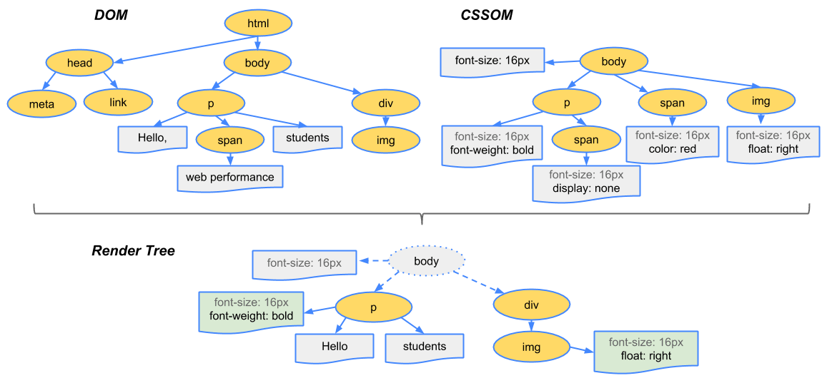
What is DOM?
Document Object Model
Programming interface for HTML and XML documents
Has its own structure
Defacto standard: tree data model
API provides us a way to access and modify the DOM elements
HTML: non-standard XML
Related: CSSOM (CSS Object Model)
Needed for rendering the page
HTML page: combined DOM & CSSOM

Slide 13
JavaScript & DOM
Document Object Model
JS main purpose: add functionality to a website
Add the possibility to react on different events:
Mouse (over, hover)
Keyboard events (key pressed)
Form and Input events (submit data or value changes)
DOM manipulation
Create, remove or update nodes in the DOM dinamically
Access elements and modify attributes
Root element: window.document
And more:
Single Page Applications
Web applications
Access elements:
document.getElementById
document.querySelector
document.querySelectorAll
Events:
element.addEventListener("click", callbackFn)
element.removeEventListener("click", callbackFn)
Content manipulation:
element.innerHtml
document.createElement
document.createTextNode
node.appendChild

Slide 14
SCRIPT tag
Document Object Model
Default loading: synchronous
When browser met a script tag it loads the file and execute it
During this the rendering is stoped
Asynchronous:
Async attribute
Download in the background at a low priority (same in defer)
Can interrupt page rendering to execute
Executes as soon as possible without particular order
Defer attribute
Won’t interrupt page rendering to execute
Executes in sequence just before the DOMContentLoaded event
Suggested method
Move every SCRIPT tag at the end of the BODY
Benefits:
The whole page is rendered when the browser loads the script
Already visible page for the user
Separated logic from display mode

Slide 15
Create HTML with JavaScript
Document Object Model
<main id="app">
<header class="page-head">
<h1>Hello world</h1>
<p>a little description here</p>
</header>
</main>
const app = document.createElement("MAIN");
app.setAttribute("id", "app");
const pageTitle = document.createElement("H1");
pageTitle.innerText = "Hello world";
const description = document.createElement("P");
description.appendChild( document.createTextNode("a little description here") );
const header = document.createElement("HEADER");
header.classList.add("page-head");
header.appendChild(pageTitle);
header.appendChild(description);
app.appendChild(header);
document.body.appendChild(app);
Notes:
Check: 1-create-html-with-js.html

Slide 16
Event handling
Document Object Model
<div id="app">
<input name="content" />
<button class="button">Click here</button>
<ul class="list"></ul>
<p>0</p>
</div>
const list = document.querySelector("#app .list");
const addElement = () => { const input = document.querySelector( "input[name='content']" ); const element = document.createElement("LI");
element.innerText = input.value.trim();
list.appendChild(element);
document.querySelector("#app p").innerText = list.children.length; };
const button = document.querySelector(".button");
button.addEventListener("click", addElement);
Notes:
Check: 2a-event-handling.html & 2b-event-handling.html

Slide 17
Thank you!
For more information, contact
Jozsef Gal
Senior Software Engineer
jozsef_gal@epam.com
EPAM Debrecen
Tüzér street 4.
HU-4028 Debrecen

