Slide 2

Predicting Air Quality in Italy Using Fuzzy and Neuro-Fuzzy Modelling
INTELLIGENT SYSTEMS
Afonso Duarte (103913)

Slide 3
Introduction
Rapid urbanization and industrial growth have significantly altered atmospheric composition, leading to increased air pollution.
Accurate air quality forecasting is essential for effective environmental monitoring and public health protection.
Fuzzy and Neuro-Fuzzy models offer robust tools to handle uncertainty and nonlinear relationships in environmental data.
Main Objective: Compare the performance of Fuzzy, Neuro-Fuzzy, and Deep Learning (LSTM) models for air quality prediction.

Slide 4
Dataset Evaluation a Preparation
Air Quality dataset from the UCI Machine Learning Repository
Contains 9,358 hourly measurements collected between March 2004 and February 2005;
The original dataset includes 15 numerical attributes:
Date, Time, CO(GT), PT08.S1(CO), NMHC(GT), C6H6(GT), PT08.S2(NMHC), NOx(GT), PT08.S3(NOx), NO2(GT), PT08.S4(NO2), PT08.S5(O3), T, RH, and AH.

Slide 5
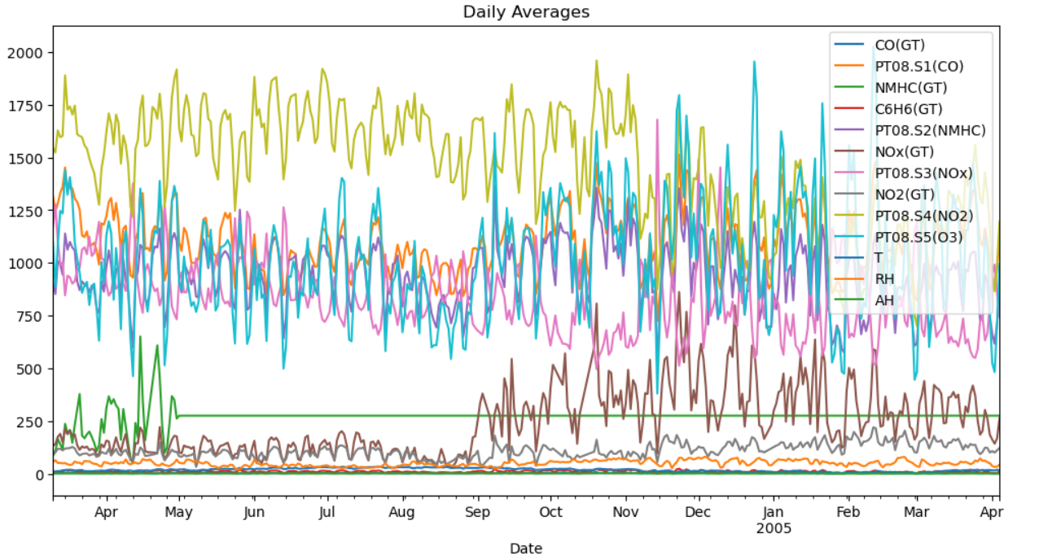
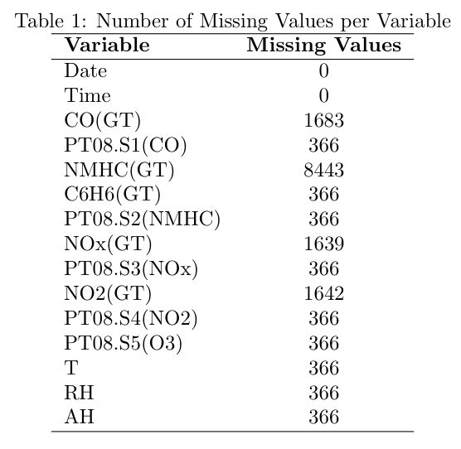
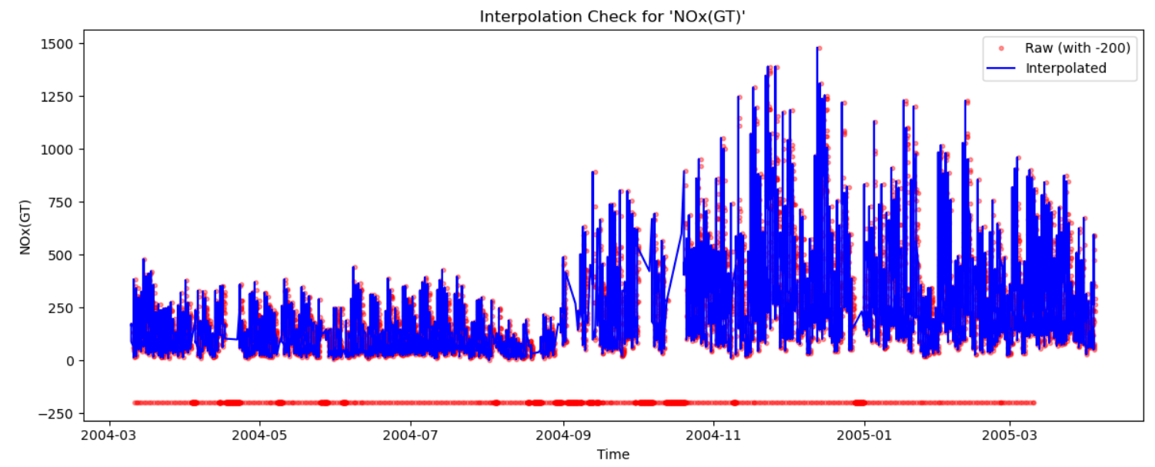
Dataset Evaluation and Preparation

Slide 6
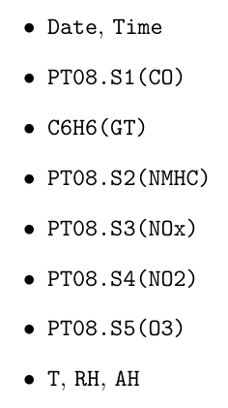
Features
Not features
Target:
Carcinogenic effects at low concentrations

Slide 7
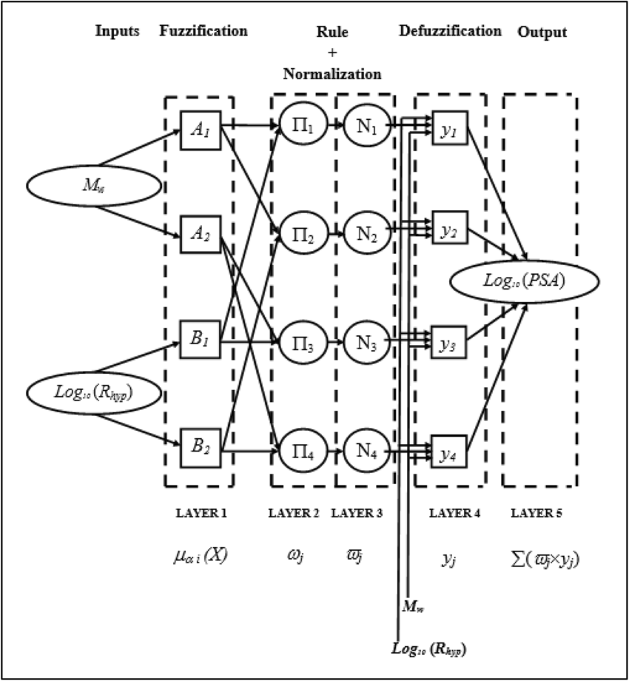
Evaluation of Each Model
ANFIS model
ANFIS Architecture: First-order Takagi–Sugeno–Kang (TSK) structure with five Gaussian membership functions per input, combining fuzzy rules with linear consequents to model nonlinear relationships while maintaining interpretability.

Slide 8
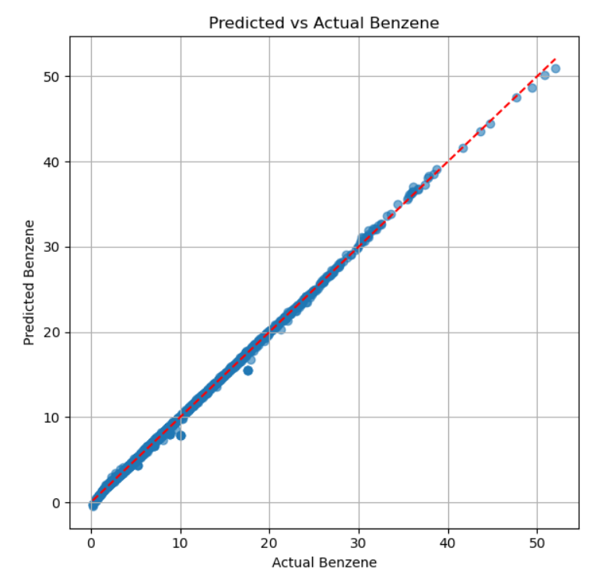
Evaluation of Each Model
Fuzzy Model Optimized with Least Squares
Fuzzy rules generated via Fuzzy C-Means and Gaussian MFs initialized and rule outputs trained using Least Squares regression.
RMSE = 0.2196;

Slide 9
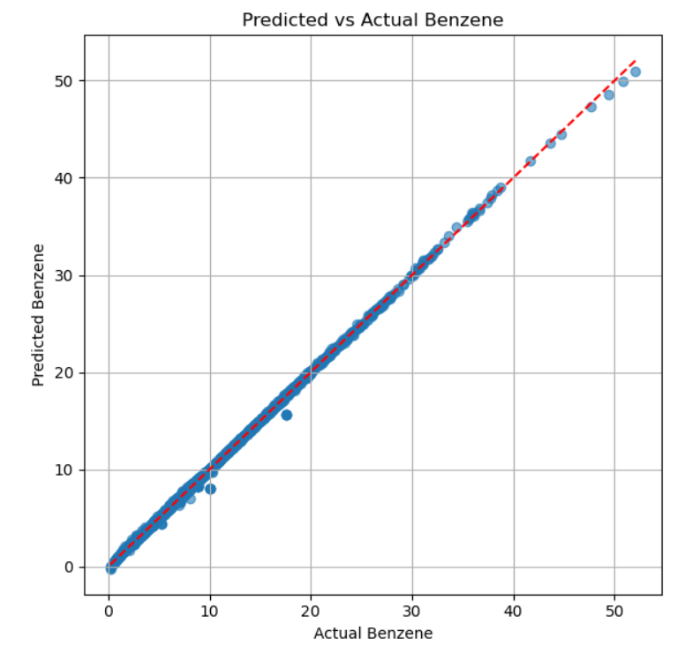
Evaluation of Each Model
ANFIS model Hybrid Optimization
Antecedent parameters (membership functions) initialized via Fuzzy C-Means clustering; training alternates between gradient descent for antecedents and least squares for consequent (linear) parameters.
Learning rate of 0.001, batch size of 32, and 10 hybrid iterations (each with 20 GD epochs), enabling efficient convergence and high predictive accuracy.
RMSE = 0.1911;

Slide 10
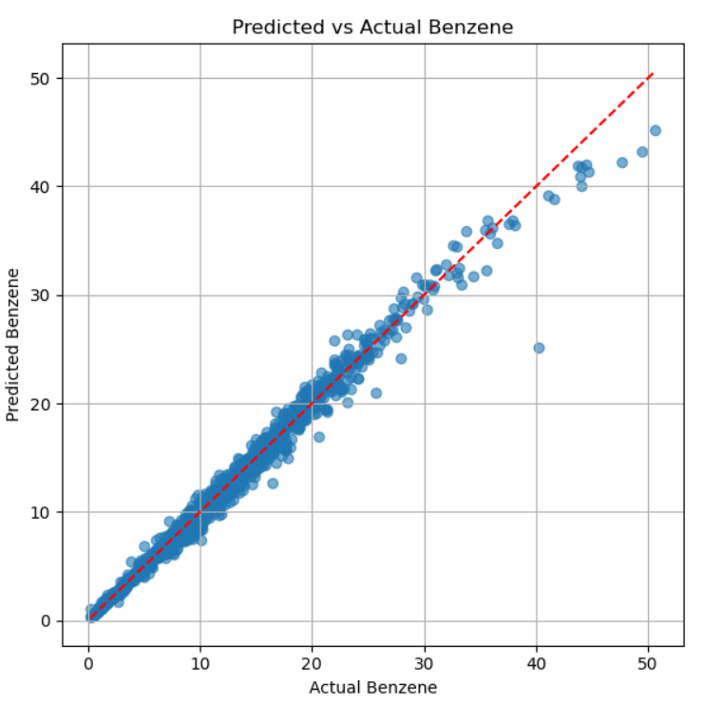
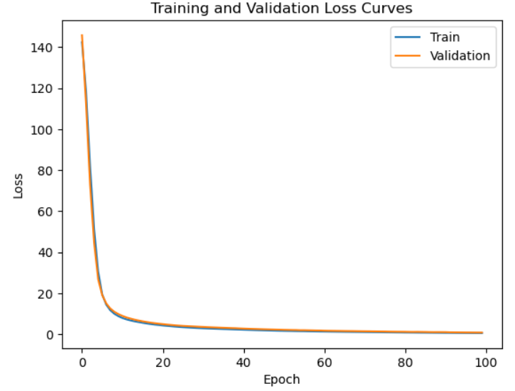
Evaluation of Each Model
ANFIS model Fully Neural Optimization
All parameters (membership functions and consequents) are jointly optimized using backpropagation with the Adam optimizer, without clustering-based initialization (random MF initialization).
Same architecture as the hybrid ANFIS; trained for 100 epochs with learning rate 0.001 and batch size 32, monitoring training and validation losses to ensure convergence.
RMSE = 0.7982;

Slide 11
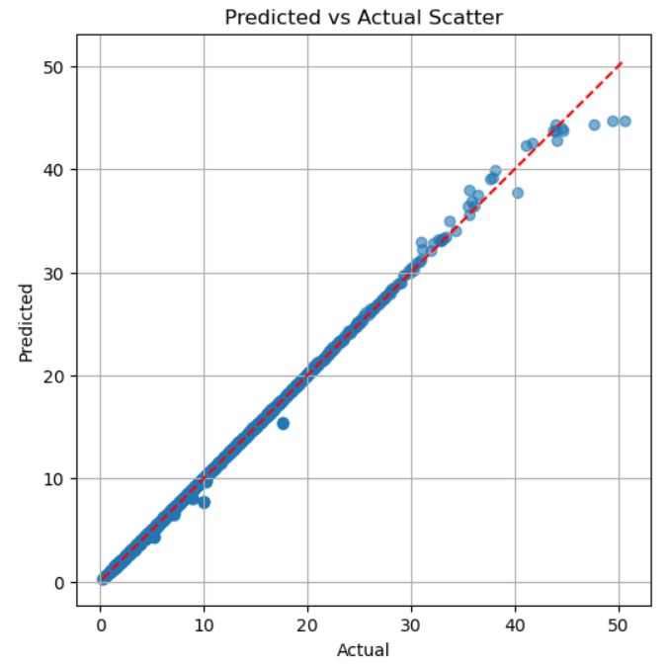
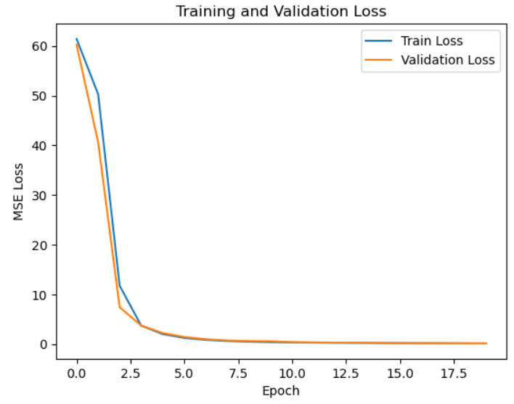
Evaluation of Each Model
LSTM Training and Testing
LSTM Architecture: Two-layer network with 128 hidden units per layer, designed to learn temporal dependencies from past sensor data to predict future benzene concentrations.
Training Setup: Input sequences of 10 time steps, trained for 20 epochs using the Adam optimizer and MSE loss (batch size 32, learning rate 0.001).

Slide 12
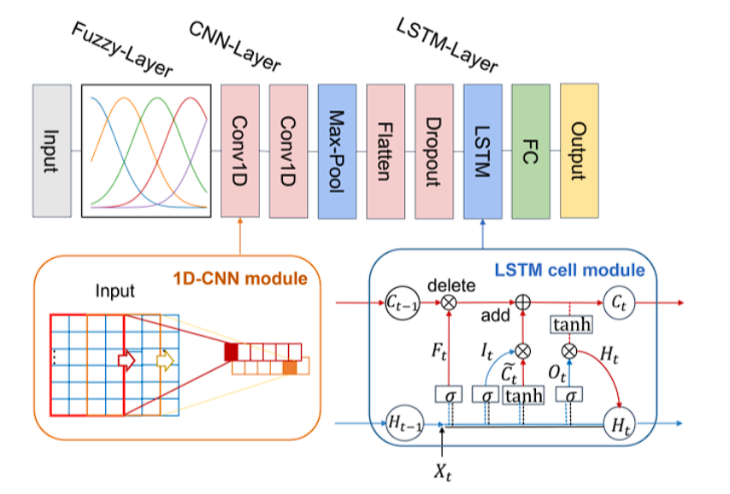
Evaluation of Each Model
FZ-CNN-LSTM Architecture
Integrates fuzzy logic, convolutional, and recurrent components to model nonlinear and time-dependent pollutant behaviour; fuzzy Gaussian memberships convert raw inputs into linguistic features, enhancing interpretability and robustness to uncertainty.

Slide 13
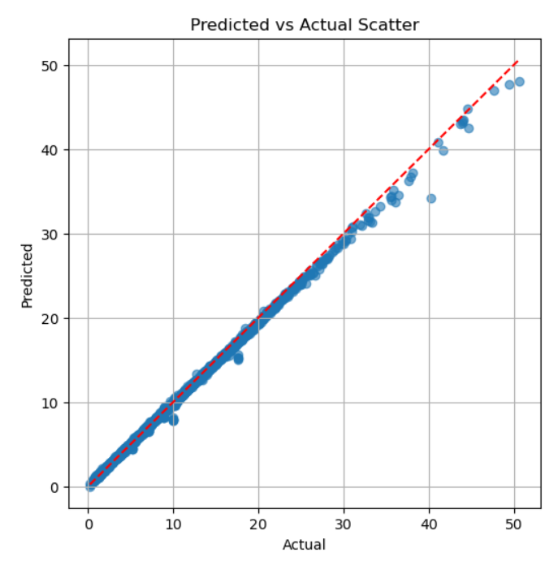
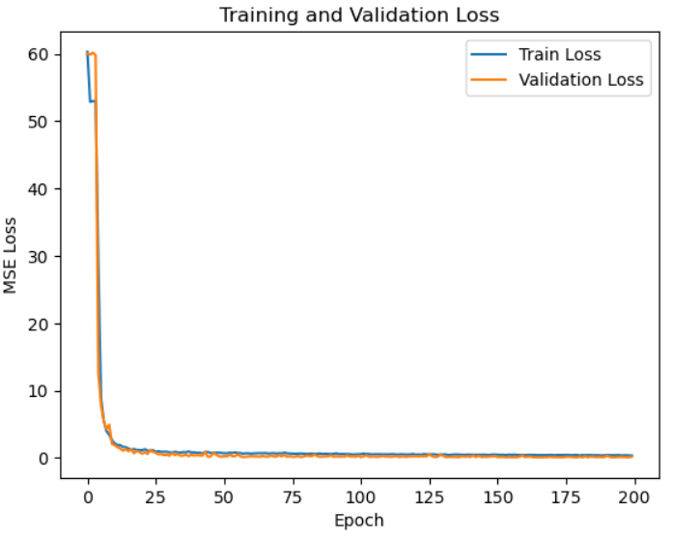
Evaluation of Each Model
FZ-CNN-LSTM Training and Testing
Fixed learning rate of 0.001, batch size 32, sequence length 10, 200 epochs; fuzzy layer initialized with five Gaussian membership functions.
RMSE: 0.4149.

Slide 14
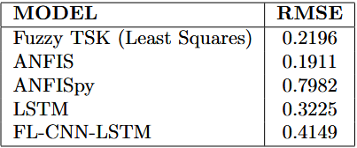
Conclusion
Hybrid Models Lead in Balance: ANFIS and other hybrid approaches achieved the best trade-off between predictive accuracy, interpretability, and computational stability, effectively capturing nonlinear relationships while remaining understandable.
Deep Learning Limitations: LSTM and FL-CNN-LSTM captured temporal dependencies but showed modest accuracy improvements due to limited data, short temporal windows, and sensitivity to noise and overfitting.
Fuzzy Systems’ Robustness: Simpler fuzzy models demonstrated strong resilience to noise and missing data, highlighting that interpretability and reliability can outweigh model complexity in data-constrained scenarios.

