Slide 1
Assignment 2 L.EIC – IART
Afonso Delca Araújo – up202306547

Slide 2
Customer
Customer: “ShopSmart”, fictional e-commerce company
Description: Online retail company focused on improving conversion rates and reducing advertising costs
John Doe: Digital Marketing Manager
Phone number : +321 1234 2451 32
E-mail: john.doe.marketing@gmail.com

Slide 3
Problem
Problem Definition: The company wants to predict whether a user is or isn’t LIKELY to complete a purchase
Current Approach:
Generic advertising campaigns;
Manual customer segmentation;
No predictive personalization;

Slide 4
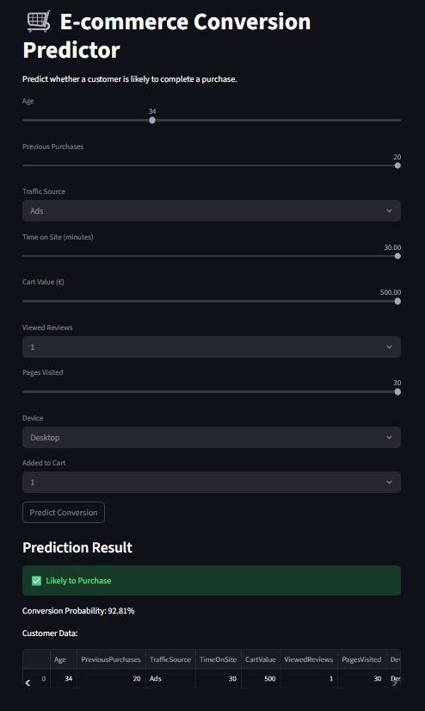
Available Data
Available Data:
Age;
Previous Purchases;
Traffic Source;
Time on Site;
Cart Value;
Viewed Reviews;
Pages Visited;
Device;
Added to Cart;

Slide 5
Solution Overview
Developed in:
Data Set Generation
(Using AI)
“generate_dataset.py”
Machine Learning Model Creation
“train_model.py”
WebApp “Creation”
“app.py”
Result Analysis
“compare_models.py”

Slide 6
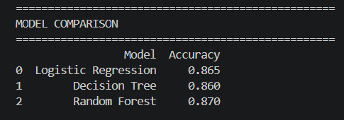
Predictive Model
Predictive model:
Problem Type: Binary Classification;
Target Variables: Converted
0 = (Probably) Not Converted;
1 = (Probably) Converted;
Algorithms Used:
Logistic Regression;
Decision Tree;
Random Forest;

Slide 7
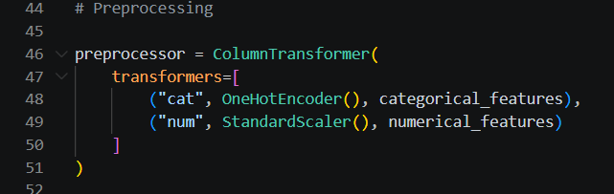
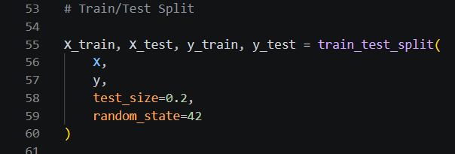
Empirical Study: Setup
Empirical Study Setup:
Artifical dataset generation;
Preprocessing:
OneHotEncoding
StandardScaler
Train/Test Split: 80-20
Evaluation Metrics:
Accuracy
Precision
Recall
F1_score

Slide 8
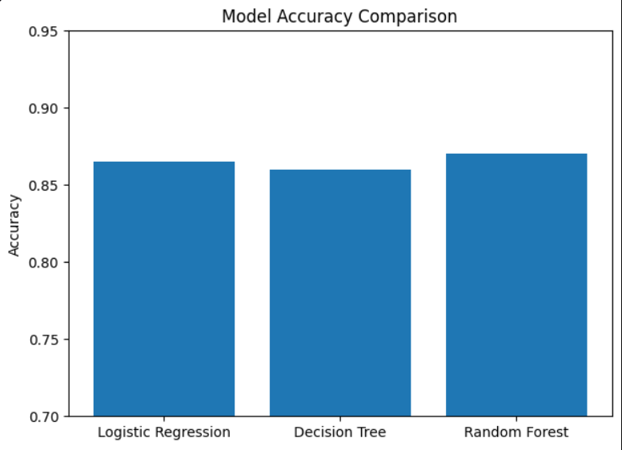
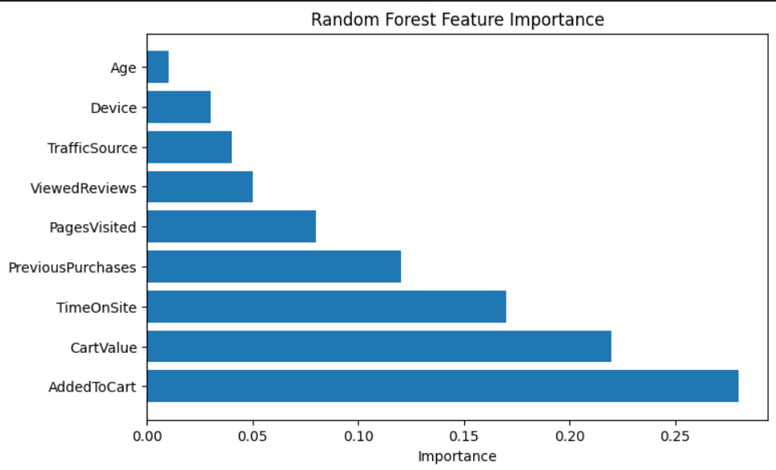
Empirical Study: Results
Empirical Results:
Logistic Regression Accuracy: 86.5%
Decision Tree Accuracy: 86.0%
Random Forest: 87.0%
Best Model:
Random Forest achieved the best generalization performance.

Slide 9
Stakeholders
Digital Marketing Team
E-commerce Managers
Data Analysts
Customers
IT/Development Team

Slide 10
Expected Challenges During Development and Deployment
Technical
Artificial Data Realism
Avoiding Overfitting
Feature Selection
Organizational
Integration into company workflow
Trust in AI predictions
Adoption by Marketing Teams

Slide 11
Unavailable Data
Unavailable Data
Detailed customer demographics
Historical browsing sessions
Product categories viewed
Seasonal shopping behavior
Marketing campaign history
Geographic location data
Long-term purchase history
Challenges in Collecting Data
Privacy and GDPR restrictions
User tracking limitations
High data storage requirements
Integration between multiple systems
Cost of collecting real-world data
Incomplete or noisy customer data

Slide 12
Ethical Risks
Mitigation:
Transparent data usage
Regular model evaluation
Ethical handling of costumer data
Ethical Risks:
User privacy concerns
Potential algorithmic bias
Incorrect customer profiling

