Slide 1

SIRS - Segurança Informática em Redes e Sistemas
Medical Records Database (MED-DB)
Group 28: Afonso Garcia – 70001
José Góis – 79261
João Santos – 76276

Slide 2

MED-DB Main Goals
Create/Define a structured Medical Database;
Define access policies based on authentication;
Assure confidentiality;
Define access policies based on dynamic roles.

Slide 3
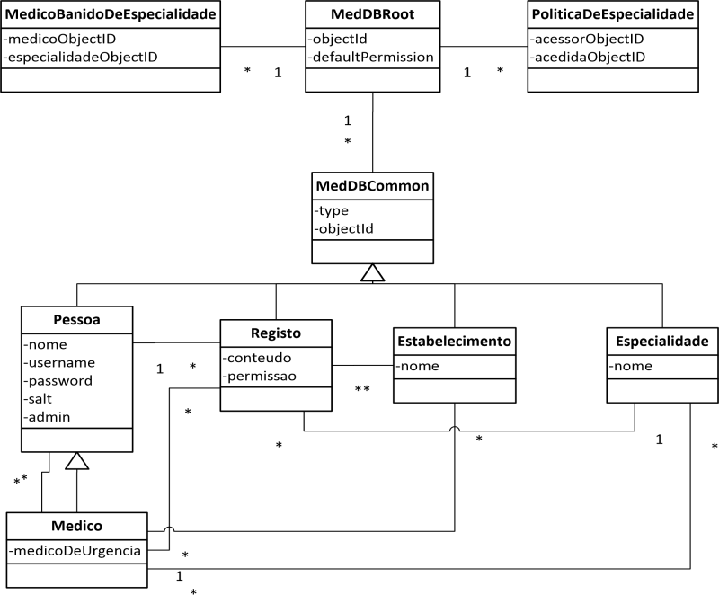
MED-DB Domain Model

Slide 4
Security Implementations(1/4)
Authentication
Users must have an unique username and password;
6 to 18 characters long password;
White spaces are not allowed neither sequences like “QUERTY”;
Dictionary check (most common words, names and places);
Password is stored in DB using hash and salt: SHA1(password||salt);
Salt -> SecureRandom from Java.

Slide 5
Security Implementations(2/4)
Confidentiality
Critical data is cyphered with symmetric key from system (Registers Data is considered critical);
The key is automatically generated during system initialization;
Permissions based on roles that are defined based on medic specialties.
System
2.Check permission based on roles
1.“I need register A”
User
3.Decypher Register using Key
4.”Here’s register A”

Slide 6
Security Implementations(3/4)
Politics
Define access permissions to registers during their creation;
Which specialties are allowed to access registers from some specialty;
If a medic can’t access some specialty.
(they can be changed in runtime at administration zone)

Slide 7
Security Implementations(4/4)
They can also be composed using boolean operators (And, OR, NOT)
Permissions
PermissaoMedicoDaEspecialidade – Allows medics from that register specialty;
PermissaoMedicoDaPessoa – Allows medics from that person;
PermissaoMedicoDeUrgencia – Allows access from urgency service;
PermissaoMedicoDoEstabelecimento – Allows medics from the medical center where register belongs;
PermissaoMedicoDoRegisto – Allows access to medic which created the regster;
PermissaoPacienteDoRegisto – Allows access to the patient from register;
PermissaoPublica – Open Register.
PermissaoPoliticaDaEspecialidade – Allows medics which specialties have access to register specialty;
PermissaoMedico – Allows a certain medic to access to register;

Slide 8
Attack Resistance/Weak Points
SQL Injection
Fenix Framework prevents them;
Cross Site Scripting
It’s a local application;
Stack and Buffer Overflow
Java uses dynamic memory allocation and pointers;
Non Repudiation
It’s a very important aspect to achieve a higher security level, but due to project deadline, we weren’t able to accomplish a viable mechanism;
Brute Force Attacks

