Slide 1
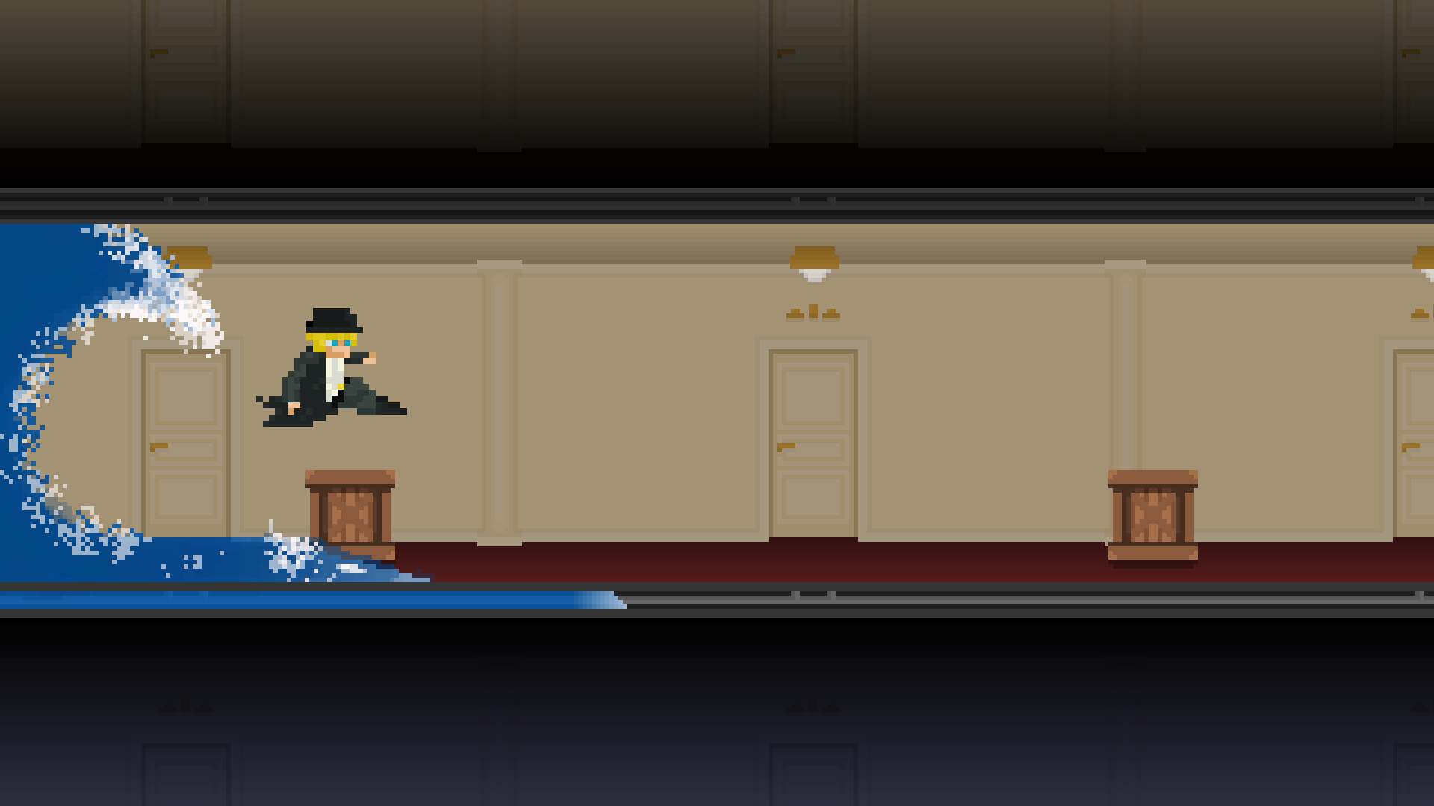

Rising Waters
Licenciatura de Videojogos
Desenvolvimento de Jogos Digitais 1
2019/2020
Pitch
by:
Os Iniciados
Afonso Lage - 21901381 André Santos – 21901767 Rui Vilar - 21902960

Slide 2

Titanic (1997)
Synopsis:
A poor artist and a young rich woman meet and fall in love while in the Titanic.
Although she is married to a soon to be successful business owner, she defies her family and friends in search of the one true love.

Slide 3

Movie to Game Process
We aim to preserve the movie’s tragic side emotions, such as:
Fear
Despair
Rush
Chaos

Slide 4
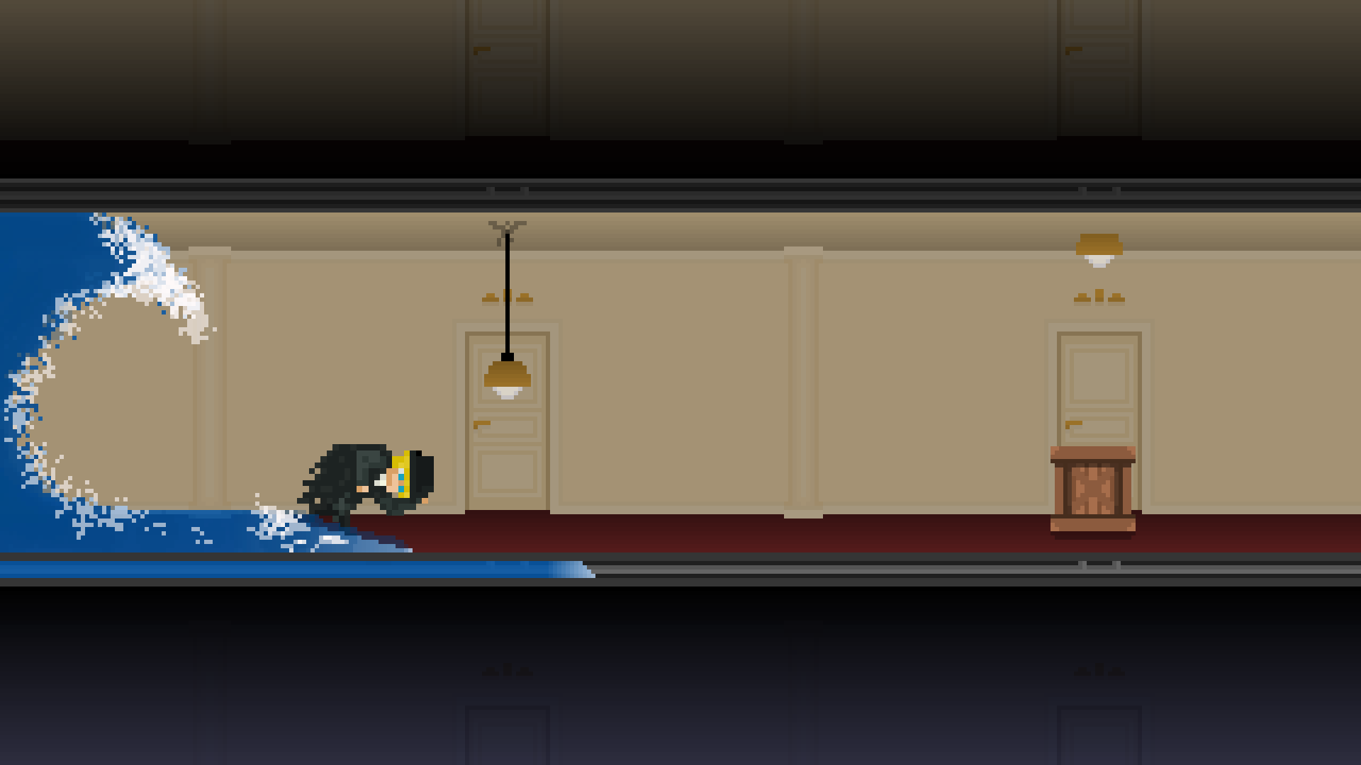
The Game
2D
Side-view
Platformer
Jump n’ Duck
Pixel

Slide 5
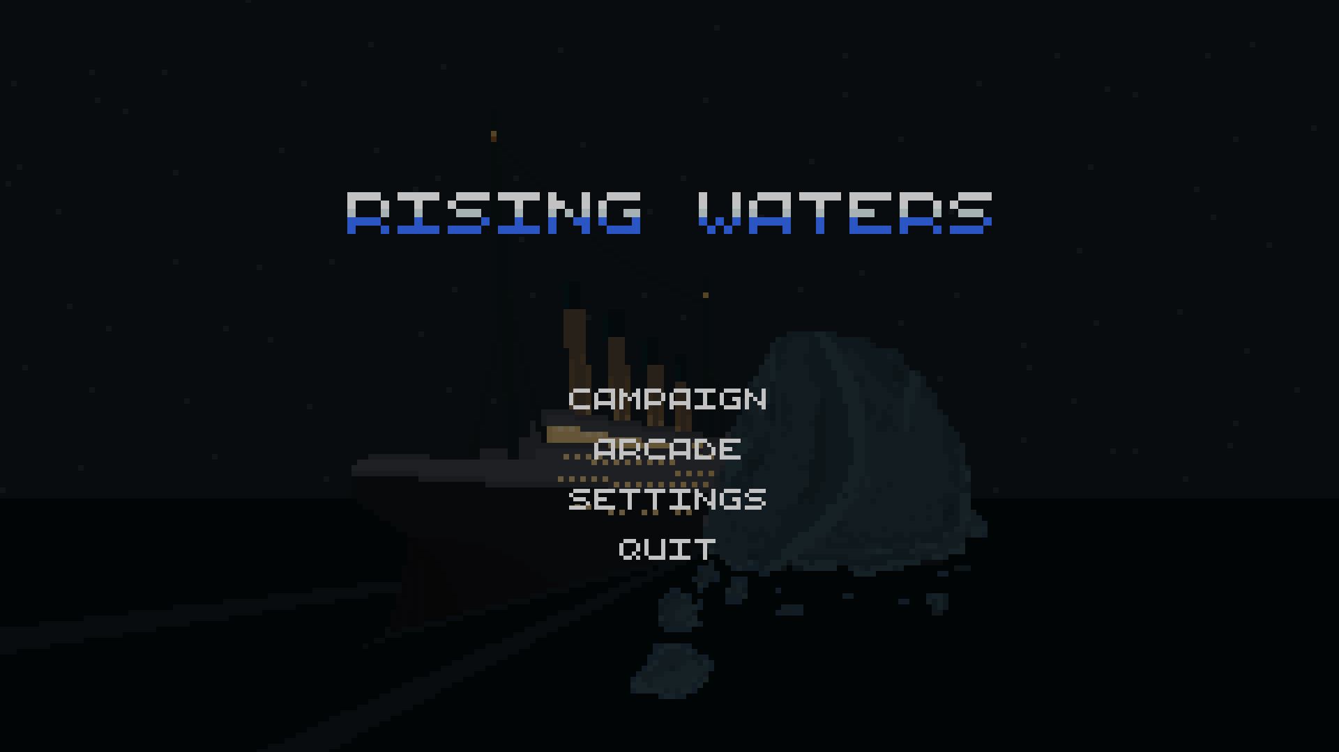

Slide 6


Slide 7

Campaign
The player has to run from the water that is flooding the Titanic corridors while avoiding various obstacles either by jumping over or ducking under them.
Divided in levels, increasingly difficult.
Progress is saved after each level completed.
Hitting an obstacle causes the wave to get closer.
The player is wiped if he trips while the wave is close.

Slide 9
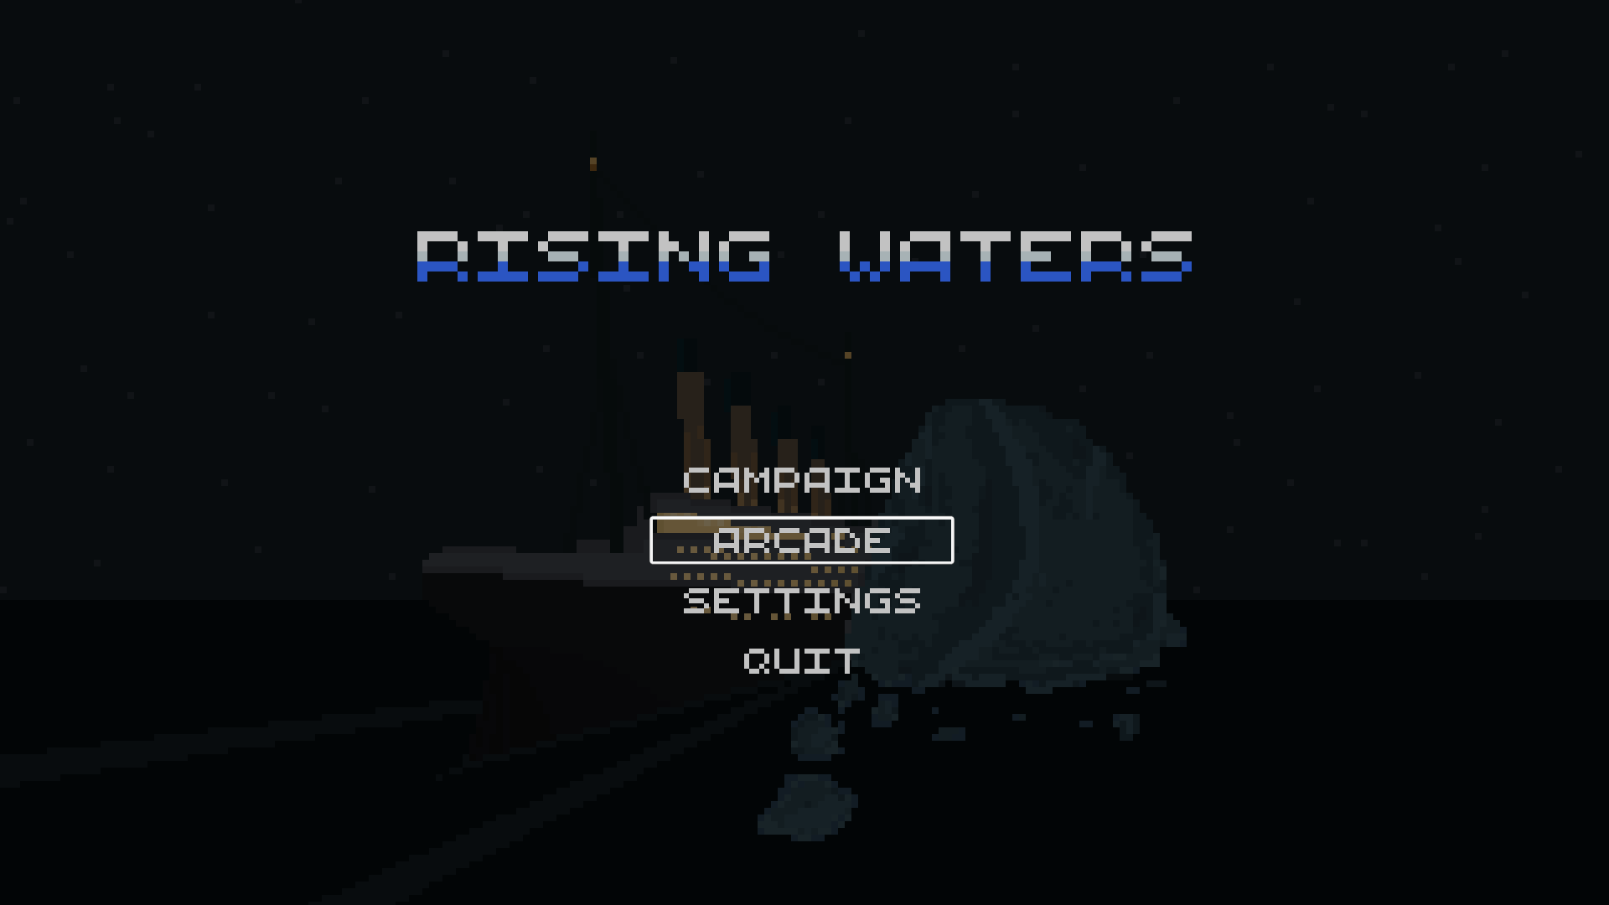

Slide 10
Arcade
Endless Runner based on Campaign mode.
Hall is infinite and objects are randomly generated.
As time passes and the ship sinks, the hall rotates slightly and the obstacles fall faster.
Score is directly related with time survived.

Slide 11


Slide 12

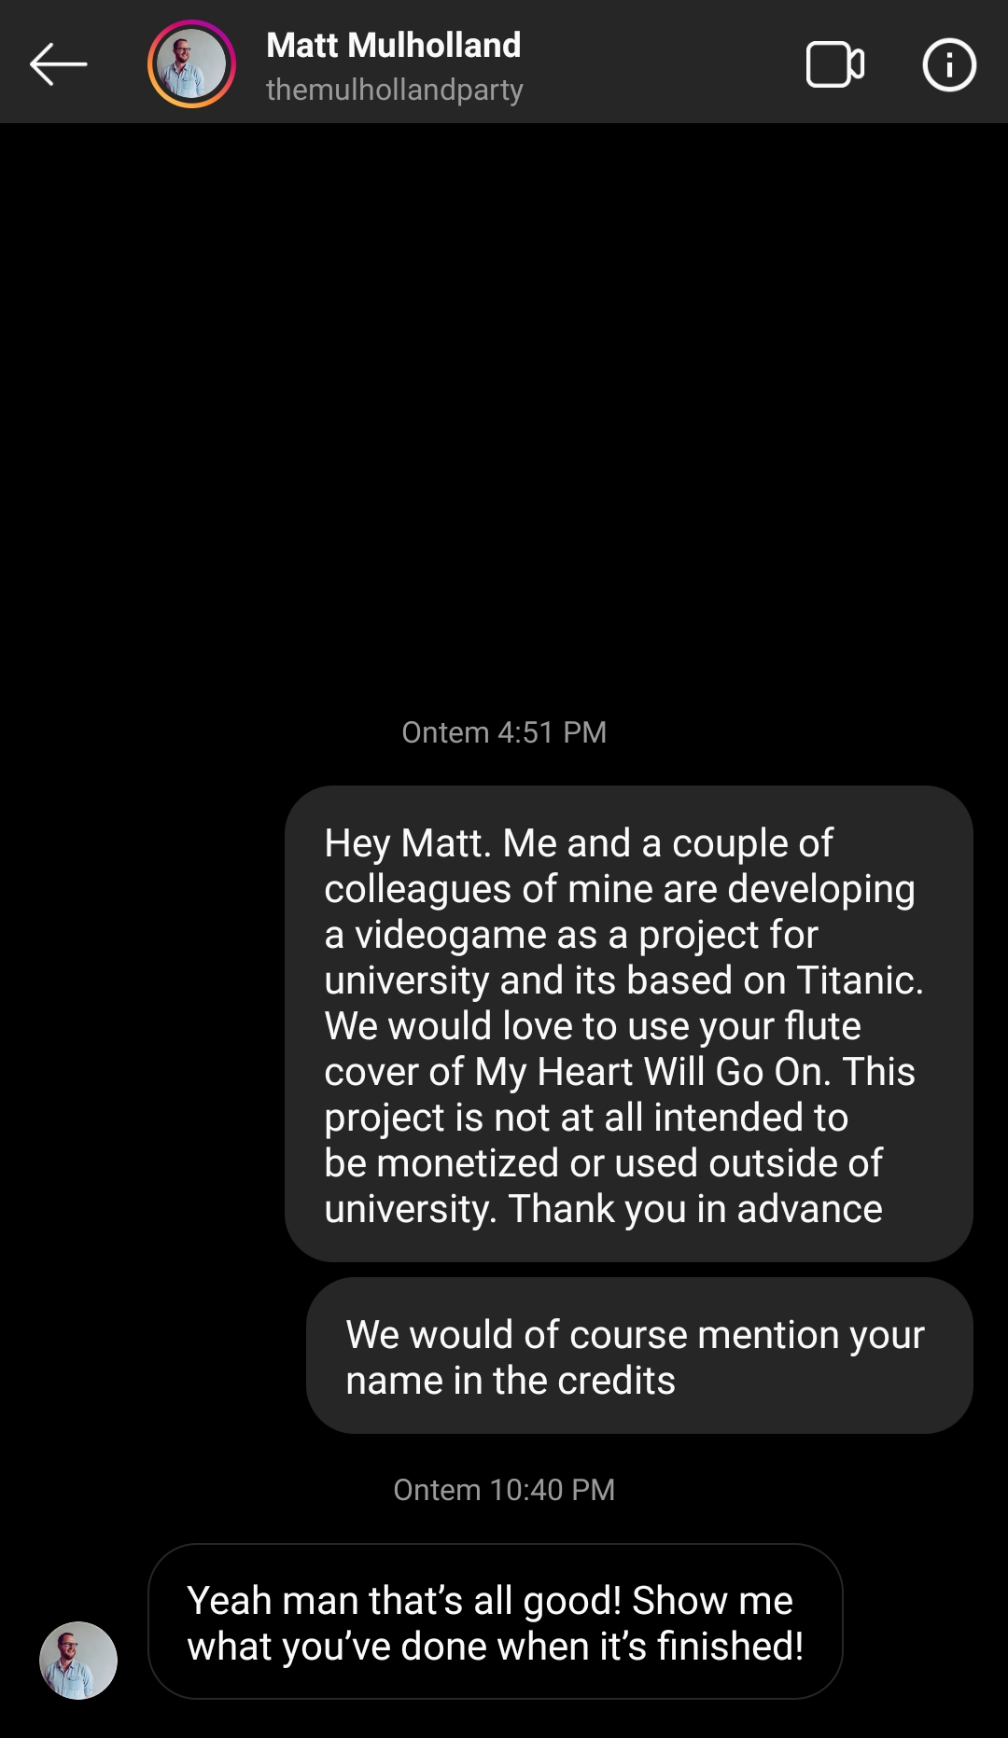

Slide 13
