Slide 1

All That Remains
Licenciatura de Videojogos
Desenvolvimento de Jogos Digitais 2
2020/2021
What you remember may be the final piece
Concept Pitch
Afonso Lage - 21901381 André Santos – 21901767 Miguel Feliciano - 22002782

Slide 2
Genre
3D
First-Person
Adventure
Puzzle
Low-Poly

Slide 3
The Game
Explore your memories
Investigate your childhood home
Find your missing parents
Solve puzzles to progress
Collect the tapes left by your parents

Slide 4
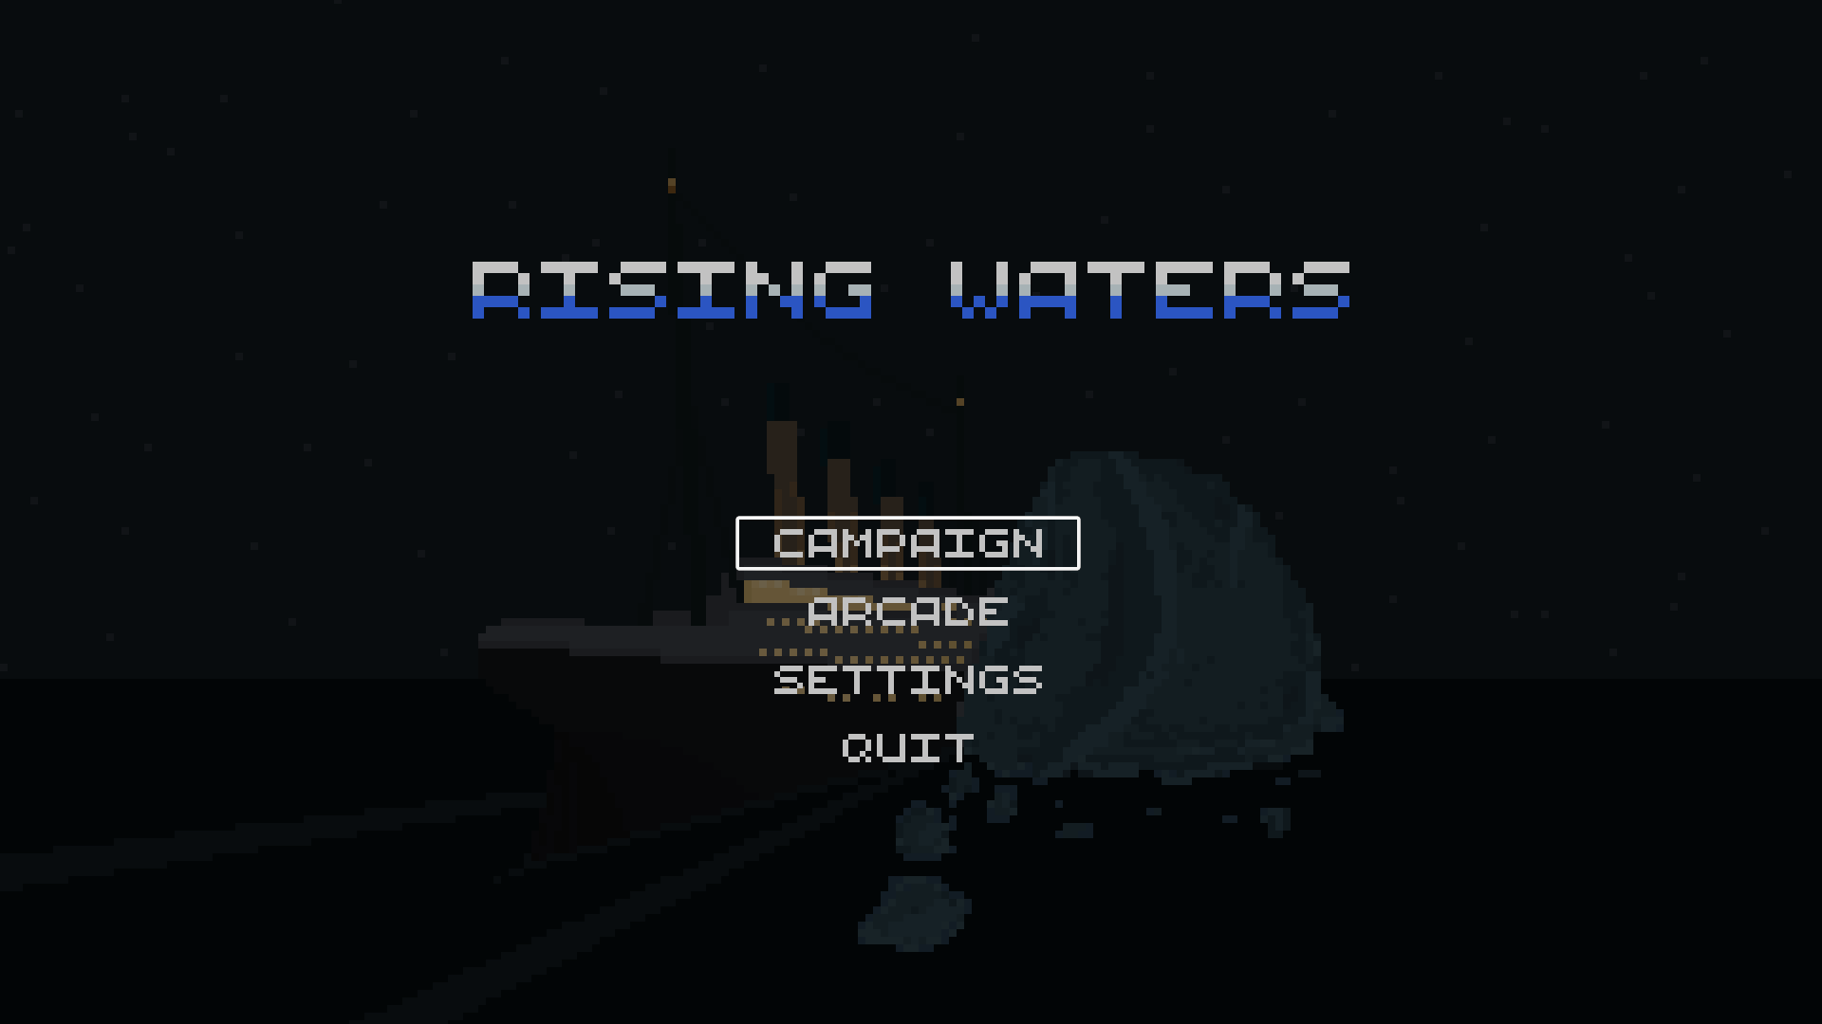

Slide 5
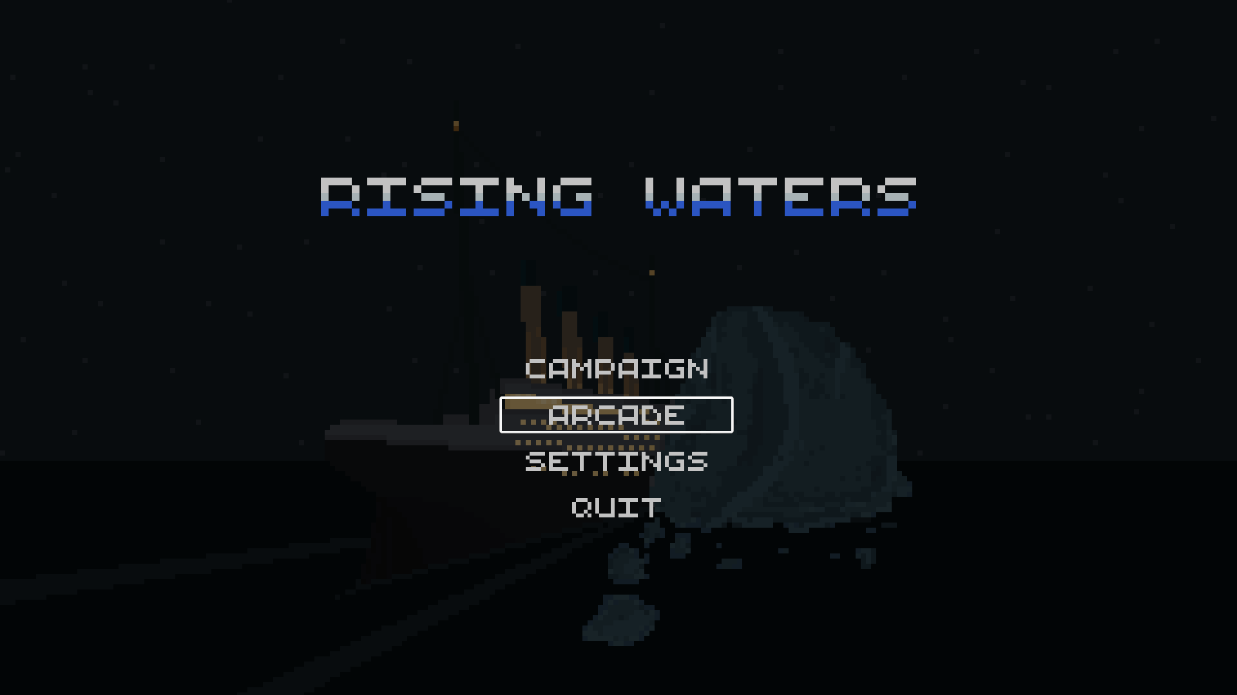

Slide 6
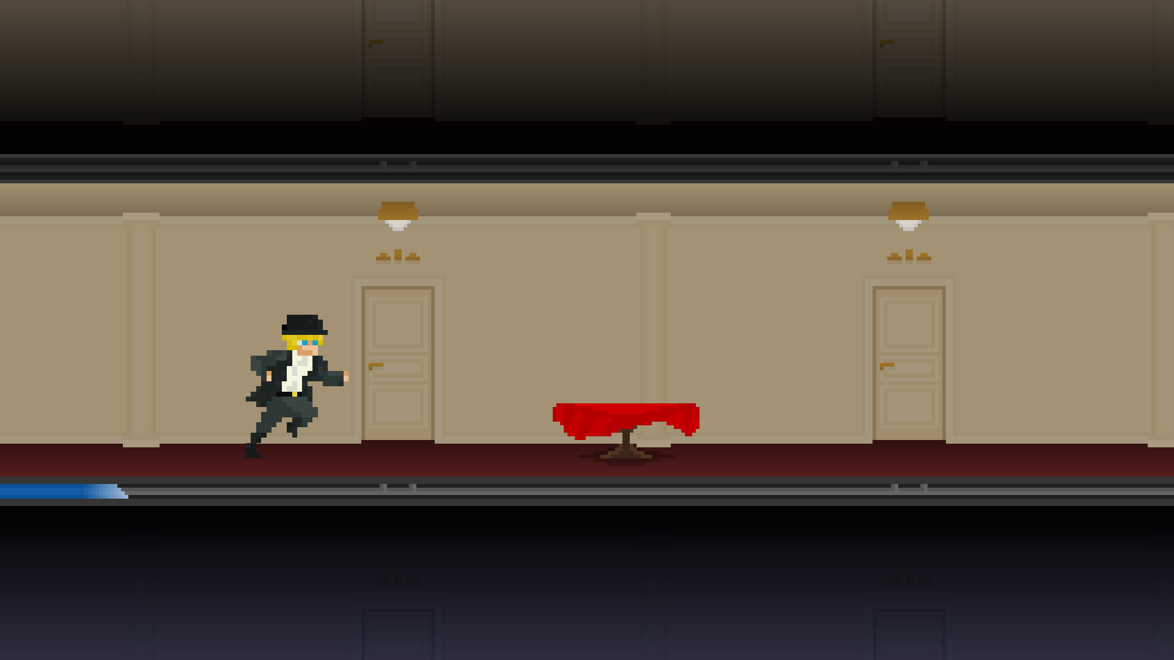
Arcade
Endless Runner based on Campaign mode.
Hall is infinite and objects are randomly generated.
As time passes and the ship sinks, the hall rotates slightly and the obstacles fall faster.
Score is directly related with time survived.

Slide 7
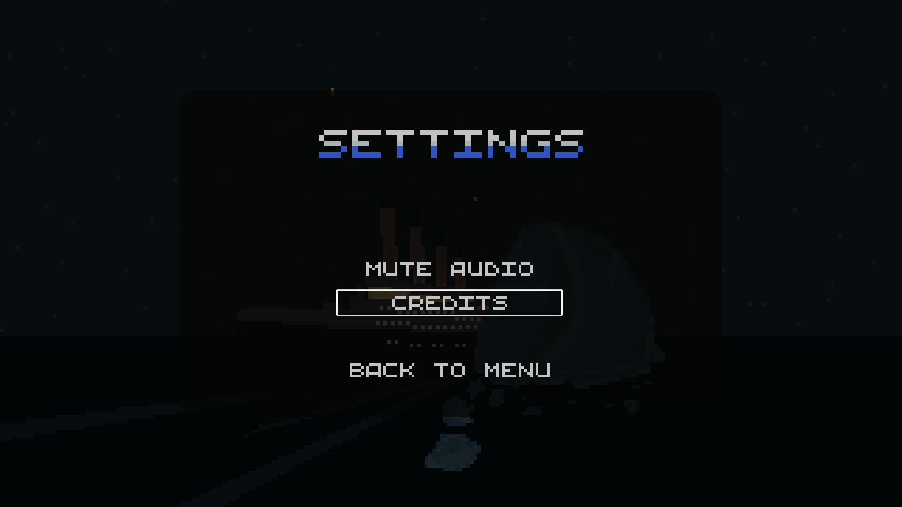

Slide 8
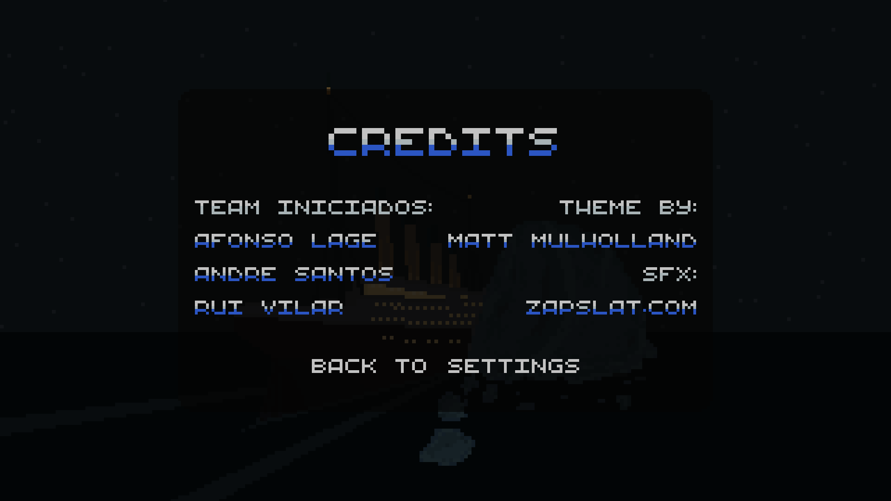
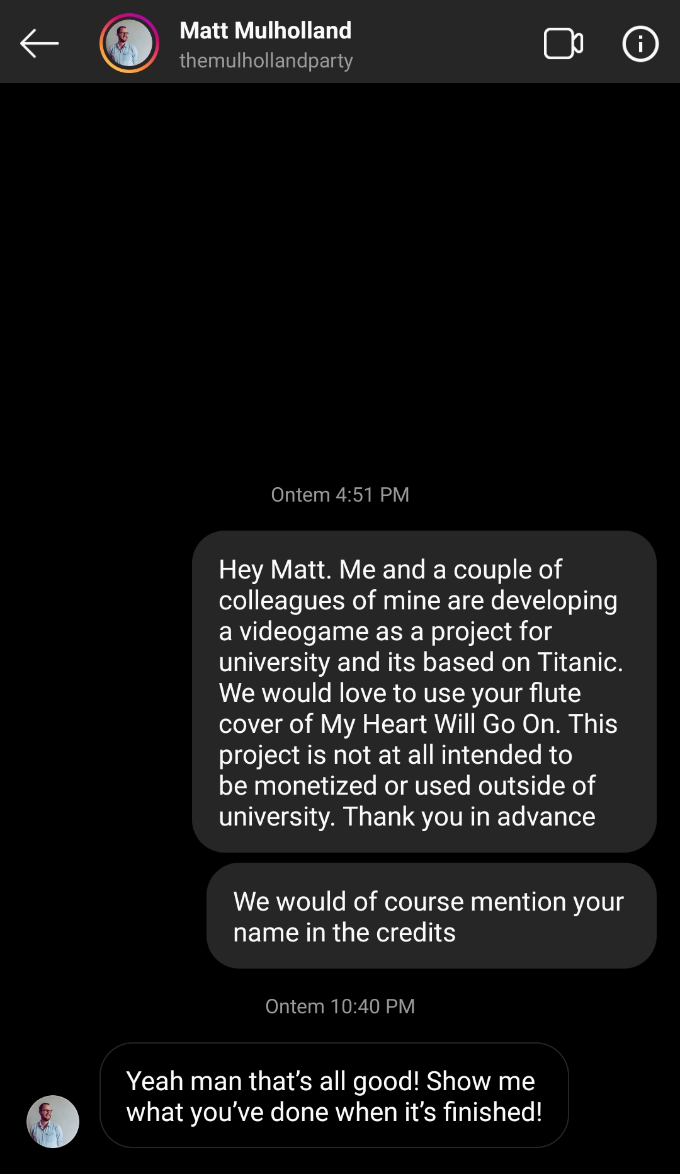

Slide 9
