Slide 1

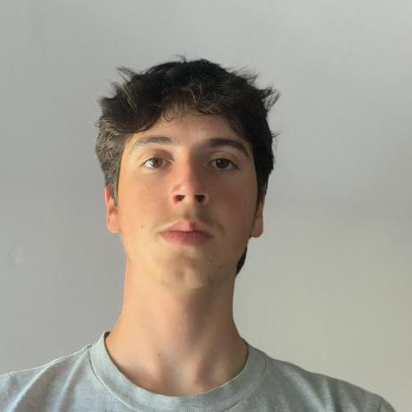

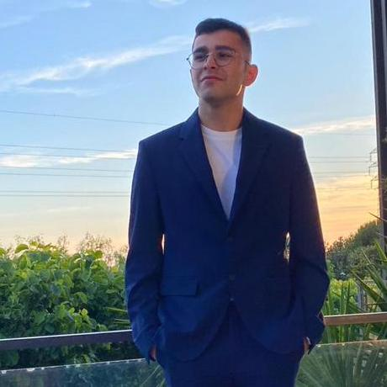

LAPR3 2025/2026
Class 2DI Group 92 SPRINT 3
Marília Lopes 1241243 | Miguel Pereira 1241187 | José Oliveira 1241277 | Diogo Oliveira 1241883 | Afonso Machado 1241182

Slide 2
Sprint planning – Sprint 2
Planned Start Date: 27/10/2025 Real Start Date: 03/11/2025
Planned End Date: 23/11/2025 Real End Date: 23/10/2025
SPRINT BACKLOG
Number of stories | 26
Number of bugs | 17
Number of tasks | 6
Number of Management Tasks (Scrum) | 13
Number of team members | Planned: 5 Actual: 5
Total planned estimation vs execution | Planned hours: 114 Executed hours: 132,5

Slide 3
Sprint 2 planning
Assigned User Stories (as stated in the project assignment) | Commited? Yes / No (according to team planning) | Todo | Doing | Testing | Done | Blocked
USLP08 | Yes |  |  |  | X
USLP09 | Yes |  |  |  | X
USLP010 | Yes |  |  |  | X
USEI11 | Yes |  |  |  | X
USEI12 | Yes |  |  |  | X
USEI13 | Yes |  |  |  | X
USEI14 | Yes |  |  |  | X
USEI15 | Yes |  |  |  | X

Slide 4
Sprint 2 planning
Assigned User Stories (as stated in the project assignment) | Commited? Yes / No (according to team planning) | Todo | Doing | Testing | Done | Blocked
USBD31 | Yes |  |  |  | X
USBD32 | Yes |  |  |  | X
USBD33 | Yes |  |  |  | X
USBD35 | Yes |  |  |  | X
USBD37 | Yes |  |  |  | X
USBD36 | Yes |  |  |  | X
USBD38 | Yes |  |  |  | X
USBD40 | Yes |  |  |  | X
USBD41 | Yes |  |  |  | X
USBD43 | Yes |  |  |  | X
USBD45 | Yes |  |  |  | X

Slide 5
Sprint 2 planning
Assigned User Stories (as stated in the project assignment) | Commited? Yes / No (according to team planning) | Todo | Doing | Testing | Done | Blocked
USAC10 | Yes |  |  |  | X
USAC11 | Yes |  |  |  | X
USAC12 | Yes |  |  |  | X
USAC13 | Yes |  |  |  | X
USAC14 | Yes |  |  |  | X
USAC15 | Yes |  |  |  | X
USAC16 | Yes |  |  |  | X

Slide 6
Work assigned by team member (Sprint 3)

Slide 7
Work by team member (All Sprints)
Brief justification:
Notes:
Se compilaram o registo de horas colocar as horas de trabalho, caso contrario utilizar o numero de tarefas ou algo que reflita a distribuição de trabalho.

Slide 8
Work assigned by type (componente)

Slide 9
Sprint Burndown Chart
Brief comment:

Slide 10
Issues / Assumptions / unanswered questions
Description | Responsible | Date / sprint | Related issue / item in Git

Slide 11
Daily Meetings (Sprint 3)
Date | Place / duration | Team member 1 | Team member 2 | Team member 3 | Team member 4 | Team member 5
15/10/2024 | Class / 15 min | x | x | x |  | x
Notes:
Podem criar mais páginas se estas não forem suficientes

Slide 12
LLM assessment (ChatGPT, Copilot, or other)
 | With daily meeting records | With daily meeting records, status report and project assignment
LLM Evaluation (0-10): |  |  | Team Evaluation (0-10):
LLM team and project assessment summary output:

Slide 13
Comments on LLM Evaluation: |  | Team valuation on LLM comments (Very Good, Good, Medium, Bad)::
 | LLM improvement ideas
Ask LLM for 4 improvements ideas:
Which ideas would you implement? (1, 2, 3, 4?)

Slide 14
LLM performance assessment
Include here as attachment a file with the input and output prompt

Slide 15
Final Sprint Retrospective (FLAP) Date:
Future considerations:
Lessons Learned:
Problem Areas:
Accomplishments:

Slide 16

Overall Final Project Mood:
Independently on the team performance, what's the final Team feeling:
Brief justification:

Slide 17


