Slide 1

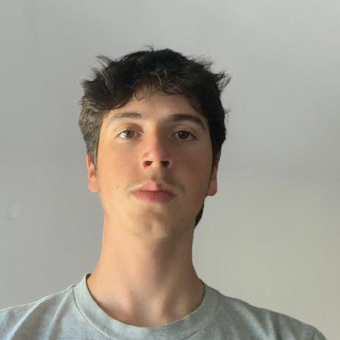

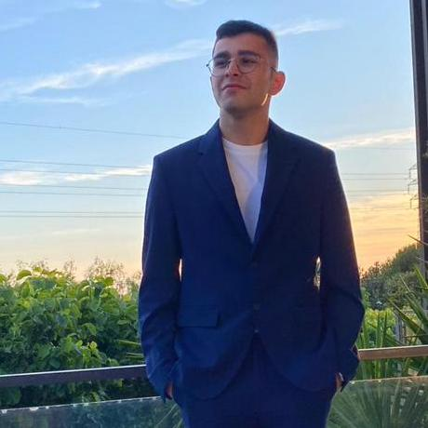

Logistics on Rails - SPRINT 1
G092
LAPR3 2025/2026
Marília Lopes 1241243 | Miguel Pereira 1241187 | José Oliveira 1241277 | Diogo Oliveira 1241883 | Afonso Machado 1241182

Slide 2
Sprint planning – Sprint 1
Planned Start Date: 29/09/2025 Real Start Date: 03/10/2025
Planned End Date: 26/10/2025 Real End Date: 25/10/2025
SPRINT BACKLOG
Number of stories | 16
Number of bugs | 4
Number of tasks | 6
Number of Management Tasks (Scrum) | 4
Number of team members | Planned: 4 Actual: 5
Total planned estimation vs execution | Planned hours: 32 Executed hours: 40

Slide 3
Sprint 1 planning
Assigned User Stories (as stated in the project assignment) | Commited? Yes / No (according to team planning) | Todo | Doing | Testing | Done | Blocked
USLP01 | Yes |  |  |  | X
USLP02 | Yes |  |  |  | X
USLP03 | Yes |  |  |  | X
USEI01 | Yes |  |  |  | X
USEI02 | Yes |  |  |  | X
USEI03 | Yes |  |  |  | X
USEI04 | Yes |  |  |  | X
USEI05 | Yes |  |  |  | X

Slide 4
Sprint 1 planning
Assigned User Stories (as stated in the project assignment) | Commited? Yes / No (according to team planning) | Todo | Doing | Testing | Done | Blocked
USBD01 | Yes |  |  |  | X
USBD02 | Yes |  |  |  | X
USBD03 | Yes |  |  |  | X
USBD04 | Yes |  |  |  | X
USBD06 | Yes |  |  |  | X
USBD11 | Yes |  |  |  | X
USBD15 | Yes |  |  |  | X
USBD17 | Yes |  |  |  | X

Slide 5
Work assigned by team member

Slide 6
Work assigned by type (componente)

Slide 7
Issues / Assumptions / unanswered questions
Description | Responsible | Date / sprint | Related issue / item in Git
Bug when the USEI02 was called by the US03 menu, the interface wasn´t getting the information for the allocations from the USEI02, but instead was always assuming non-existance of allocations. | Miguel Pereira | 22/10/2025 | USPL02
Questions about how to import data into USEI04, having to get .csv from USEI02 and USEI03. | Marília Lopes | 23/10/2025 | USEI04
Database errors on Oracle Live SQL, server downtime, and errors related to reserved words. | Diogo Oliveira and Marília Lopes | 20/10/2025 | USDB03 and USBD04

Slide 8
Daily Meetings
Date (of the meeting) | Place / duration | Team member 1 | Team member 2 | Team member 3 | Team member 4 | Team member 5
02/10/2025 | Class / 1 hour | x | x | x | x | x
06/10/2025 | Online / 1 hour | x | x | x | x | x
08/10/2025 | Class / 1 hour | x | x | x | x | x
11/10/2025 | Online / 45 min | x | x | x | x | x
12/10/2025 | Online / 30 min | x | x | x | x | x
18/10/2025 | Online / 25 min | x | x | x | x | x
19/10/2025 | Online / 45 min | x | x | x | x | x
21/10/2025 | Online / 30 min | x | x | x |  | x
24/10/2025 | ISEP / 1:30 hours | x | x | x | x | x

Slide 9
LLM performance assessment (Google Gemini)
Source file (File 1): Also used the project guide and a .zip file of our project repository.
Input (write down the prompt you used to ask for the performance assessment) :
Do a performance assessment on our team using the given files, make sure your response is split into an output file and another output (the first is a generalized assessment, and the second is a Team Member specific assessment). The Output file is in a readme and the output for the team members is 1 line only for each member.

Slide 10
LLM performance assessment - Output
Output file (File)
Output:
Marília Lopes: Led documentation (USLP01, Global Artifacts) and completed the complex USEI04 (Pick Path Sequencing) while managing data import and DB issues.
Miguel Pereira: Handled a high volume of cross-disciplinary tasks (USLP02, USBD15, UI design) and was central to the complex USEI01/USEI02 stories and bug-fixing.
José Oliveira: Delivered key BDDAD stories (USBD06, USBD11) and was a core contributor to the complex ESINF stories USEI01 and USEI02.
Diogo Oliveira: Built the database foundation by delivering the relational model (USBD02, USBD03) and tackled the USEI03 (Picking Plans) story while co-managing DB downtime.
Afonso Machado: Took ownership of the complex USEI05 (Returns & Quarantine) story and key BDDAD tasks USBD01 (Data dictionary) and USBD17.
Team Members’ Opinion about the A.I. output:

Slide 11
Sprint Retrospective Date: 26/10
What went well?
We completed all of our assigned tasks
We maintained frequent communication
Our board was always updated according to our work
We had a constant work rhythm
We managed to help each other
Had frequent daily meetings
What went wrong?
Encountered various bugs, that slowed down our progress
What we learned?
Overcoming barriers in our progress, by searching alternatives
Checking up on each others work and offer help to speed up work rhythm

Slide 12
Sprint Retrospective Date: 26/10
Action items:

Slide 13

Overall Project performance:
Comments: Our group is very satisfied with the results and performance during Sprint 1.
LLM evaluation:
How do you grade your performance (0-5): 5
How do you grade your results (0-5): 5

Slide 14


