Slide 1
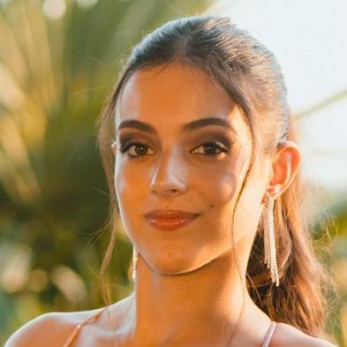
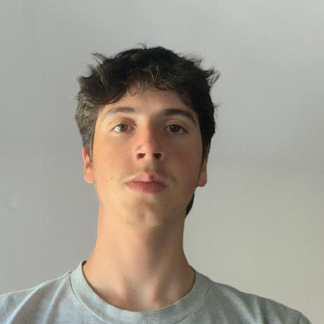

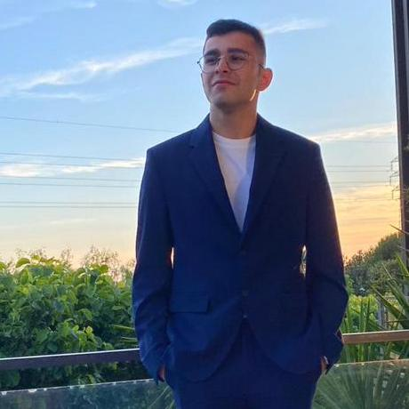

Logistics on Rails - SPRINT 3
G092
LAPR3 2025/2026
Marília Lopes 1241243 | Miguel Pereira 1241187 | José Oliveira 1241277 | Diogo Oliveira 1241883 | Afonso Machado 1241182

Slide 2
Sprint planning – Sprint 2
Planned Start Date: 27/10/2025 Real Start Date: 03/11/2025
Planned End Date: 23/11/2025 Real End Date: 23/10/2025
SPRINT BACKLOG
Number of stories | 26
Number of bugs | 17
Number of tasks | 6
Number of Management Tasks (Scrum) | 13
Number of team members | Planned: 5 Actual: 5
Total planned estimation vs execution | Planned hours: 114 Executed hours: 132,5

Slide 3
Sprint 2 planning
Assigned User Stories (as stated in the project assignment) | Commited? Yes / No (according to team planning) | Todo | Doing | Testing | Done | Blocked
USLP08 | Yes |  |  |  | X
USLP09 | Yes |  |  |  | X
USLP010 | Yes |  |  |  | X
USEI11 | Yes |  |  |  | X
USEI12 | Yes |  |  |  | X
USEI13 | Yes |  |  |  | X
USEI14 | Yes |  |  |  | X
USEI15 | Yes |  |  |  | X

Slide 4
Sprint 2 planning
Assigned User Stories (as stated in the project assignment) | Commited? Yes / No (according to team planning) | Todo | Doing | Testing | Done | Blocked
USBD31 | Yes |  |  |  | X
USBD32 | Yes |  |  |  | X
USBD33 | Yes |  |  |  | X
USBD35 | Yes |  |  |  | X
USBD37 | Yes |  |  |  | X
USBD36 | Yes |  |  |  | X
USBD38 | Yes |  |  |  | X
USBD40 | Yes |  |  |  | X
USBD41 | Yes |  |  |  | X
USBD43 | Yes |  |  |  | X
USBD45 | Yes |  |  |  | X

Slide 5
Sprint 2 planning
Assigned User Stories (as stated in the project assignment) | Commited? Yes / No (according to team planning) | Todo | Doing | Testing | Done | Blocked
USAC10 | Yes |  |  |  | X
USAC11 | Yes |  |  |  | X
USAC12 | Yes |  |  |  | X
USAC13 | Yes |  |  |  | X
USAC14 | Yes |  |  |  | X
USAC15 | Yes |  |  |  | X
USAC16 | Yes |  |  |  | X

Slide 6
Work assigned by team member

Slide 7
Work assigned by type (componente)

Slide 8
Daily Meetings
Date (of the meeting) | Place / duration | Team member 1 | Team member 2 | Team member 3 | Team member 4 | Team member 5
26/11/2025 | Class / 15 min | x | x | x | x | x
03/12/2025 | Class / 15 min | x | x | x | x | x
08/12/2025 | Online / 20 min | x | x | x | x | x
10/12/2025 | Class / 15 min | x | x | x | x | x
13/12/2025 | Online / 20 min | x | x | x | x | x
17/12/2025 | Class / 15 min | x | x | x | x | x
22/12/2025 | Online / 25 min | x | x | x | x | x
28/12/2025 | Online / 25 min | x | x | x | x | x
29/12/2025 | Online / 20 min | x | x | x | x | x
02/01/2026 | Online / 20 min | x | x | x | x | x

Slide 9
Issues / Assumptions / unanswered questions
Description | Responsible | Date / sprint | Related issue / item in Git
Solve BDDAD problems with the database | Diogo Oliveira | Sprint 3 | -
Correction of the Domain Model | Marília Lopes | Sprint 3 | -
Error in USEI13 commits | Marília Lopes | Sprint 3 | -
ARQCP Sprint 3 Unit Tests | José Oliveira | Sprint 3 | #146

Slide 10
LLM performance assessment - Input (use Copilot with GPT-5 mandatory)
Source file (attach the file you have used: (input below)
Input (write down the prompt you used to ask for the performance assessment):
- I want you to analyze the daily meetings from our GitHub Board, and write a summary evaluating each team member, and the overall group performance.

Slide 11
LLM performance assessment - Output
Output file (File) also in the repository, sourcefile.pdf
Output:
Afonso Machado: Afonso consistently delivers medium‑to‑large tasks with solid accuracy and reliability, showing strong ownership across ESINF and BDDAD. His steady pace and clear task execution make him a dependable contributor throughout the sprint.
Miguel Pereira: Miguel is one of the team’s most versatile and high‑impact developers, handling complex algorithms, UI work, and cross‑domain tasks with confidence. Even when tackling large or demanding items, he maintains strong productivity and technical depth.
Marília Lopes: Marília contributes across multiple layers of the project, from development to architectural corrections and documentation. Her involvement in foundational tasks shows a strong sense of responsibility for project quality and structure.
José Oliveira: José demonstrates consistent delivery and reliability, especially in ARQCP and BDDAD tasks, and plays an important role in testing. His steady performance and attention to detail strengthen the team’s overall stability.
Diogo Oliveira: Diogo shows strong technical capability in ESINF and backend‑related work, completing tasks efficiently and with minimal overruns. His involvement in database problem‑solving highlights his value in maintaining system integrity.

Slide 12
LLM performance assessment – Critical Insight
Team Members’ Opinion about the A.I. output
- All team members agreed with their AI output
-Regarding the Weaknesses in the output, they resulted from the AI considering backlogs items as still “pending”, which is not correct.
Improvement Suggestion from LLM:Give me 1 paragraph on ways to improve our team performance.
Improving our team performance starts with tightening the way we collaborate and communicate. Keeping daily meetings focused on progress and blockers helps everyone stay aligned without losing momentum, while breaking large tasks into smaller, clearer units makes planning more predictable and reduces last‑minute stress. Rotating code reviewers and sharing ownership of complex areas prevents knowledge silos and strengthens the team’s overall resilience. Protecting dedicated focus time allows each person to dive deeper into their work, and documenting decisions as they happen avoids confusion later in the sprint. Together, these habits create a smoother workflow, stronger teamwork, and a more efficient development rhythm.

Slide 13
Sprint Retrospective Date: 4/1/26
What went well?
Our team completed all of the assigned US’s.
We made frequent daily meetings
We were able to keep our board updated to realistically match our efforts
We were able to maintain a consistent workflow
We greatly improved out communication between members
We had significant improvement on our estimation of estimated hours, in comparison to other sprints
What went wrong?
Struggled with understanding a few user stories
What we learned?
To debate together as a team to reach an understanding on project concepts
Ways to improve our communication

Slide 14
Sprint Retrospective Date: 4/1/26
Action items:
Spend more time reunited and helping each other understand our work.

Slide 15

Overall Project Performance:
LLM evaluation: I’d place the team’s overall performance at 4.6 out of 5. The group shows strong coordination, consistent task completion, and solid technical execution across all domains, with only minor estimation deviations preventing a perfect score.
Team evaluation: 5
Team feeling: Very satisfied
Notes:
Add any slide you consider relevant.

Slide 16
Checklist Sprint 2
Item | Objective
US detailed in the Backlog | Mandatory
Start Sprint 2 | Mandatory
Priorities | Mandatory
Estimate US (hours) | Mandatory
Create Subtasks | Mandatory
Customize board | Mandatory
Integrate with Git | Mandatory
Create milestones | Discretionary
Item | Objective
Create Sprint planning Task Sprint 2 | Mandatory
Create tasks for Daily meetings (3 per week avg) | Mandatory
Update US and task status on board | Mandatory
Submit working hours | Mandatory
Include outstanding items from Sprint 1 | Discretionary
Include outstanding items from Retrospective | Mandatory
Estimate using Planning Poker | Mandatory

Slide 17


