Slide 1


IRONHACK
01
The Ultimate Escape Room Game

Slide 2
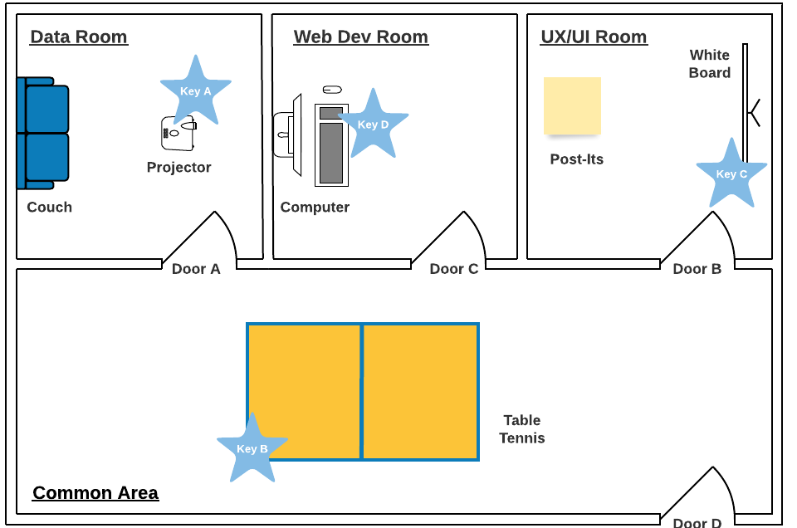

Overview
"You were coding until late and you fell asleep. Everyone else has left the building. You wake up on the couch of the data room, and now you need to find a way to get out of Ironhack. Good luck!"
02

Slide 3

Features
Presentations are communication tools that can be used as demonstrations, lectures, speeches, re
Presentations are communication tools that can be used as demonstrations, lectures, speeches, re
Presentations are communication tools that can be used as demonstrations, lectures, speeches, re
Presentations are communication tools that can be used as demonstrations, lectures, speeches, re
Library: speech_recognition
UNCOVERED KEY RESEARCH TRENDS
UNCOVERED KEY RESEARCH TRENDS
UNCOVERED KEY RESEARCH TRENDS
18
Voice Recognition
Image Display
Text-to-Speech
Sounds

Slide 4


09

Slide 5



Group Members
Group 1A
02
Lucky Perez
Janna Patterson
Elvis Radisson
Scientist and
Researcher
Scientist and Encoder
Statistician

Slide 6

"You were coding until late and you fell asleep. Everyone else has left the building. You wake up on the couch of the data room, and now you need to find a way to get out of Ironhack. Good luck!"
Overview of the project
Presentations are communication tools that can be used as demonstrations, lectures, speeches, reports, and more.
It is mostly presented before an audience. It serves a variety of purposes, making presentations powerful tools for convincing and teaching.
To create a stunning presentation, it's best to simplify your thoughts. Start with an outline of topics and identify highlights, which can be applied to whatever subject you plan on discussing.
04

Slide 7




The Problem
05
What we want to solve
Hypothesis
Presentations are communication tools that can be used as demonstrations, lectures, speeches, reports, and more.
Start with an outline of topics and identify highlights, which can be applied to whatever subject you plan on discussing.

Slide 8
Presentations are communication tools that can be used as demonstrations, lectures, speeches, reports, and more.
Objectives
Make sure you do enough research to support your points. It’s also a good idea to pair data with visual aids like charts, graphs, or images.
What we want to achieve
06
Remember to keep your presentation easy-to-read. Avoid overloading a slide with too many words and choose a color palette that won't distract the audience

Slide 9
Significance
of the Project
07
In terms of scope
In terms of resources
In terms of time
Presentations are communication tools that can be used as demonstrations, lectures, speeches, reports, and more.
Start with an outline of topics and identify highlights, which can be applied to whatever subject you plan on discussing.
You can include photos
of your team, descriptions
of products, or your goals as
a company.

Slide 10

Methods
08
Part 02

Slide 11



Qualitative Methods
Presentations are communication tools that can be used as demonstrations, lectures, speeches, reports, and more.
10
Quantitative Methods
Make sure you do enough research to support your points. It’s also a good idea to pair data with visual aids like charts.

Slide 12
Project Timeline
Phase 02
Phase 04
Start with an outline of topics and identify highlights, which can be applied to whatever subject you plan on discussing.
Avoid overloading
a slide with too many words and choose a color palette that
won't distract the audience.
11
01
02
03
04
05
Phase 01
Phase 03
Phase 05
Presentations are communication tools that can be used as demonstrations, lectures, speeches, reports, and more.
Make sure you do enough research to support your points. It’s also a good idea to pair data with visual aids like charts or images.
Remember to keep your presentation easy-to-read. Avoid overloading a slide with too many words and choose a color palette.

Slide 13
Data Collection Methods
Steps and Action Items
12
Step 01
Step 02
Step 03
Presentations are communication tools that can be used as demonstrations, lectures, speeches, reports, and more.
Make sure you do enough research to support your points. It’s also a good idea to pair data with visual aids like graphs.
Avoid overloading a slide with too many words and choose a color palette that won't distract the audience.

Slide 14

Results
13
Part 03

Slide 15
Highlight 1
Presentations are communication tools that can be used as demonstrations, lectures, speeches, reports, and more.
Qualitative Results
Highlight 2
Make sure you do enough research to support your points. It’s also a good idea to pair data with visual aids like charts, graphs, or images.
14
Research findings
and highlights
Highlight 3
Avoid overloading a slide with too many words and choose a color palette that won't distract the audience.

Slide 16


Avoid overloading a slide with too many words
and choose a color palette that won't
distract the audience.
15

Slide 17
50
Quantitative Results
40
Presentations are communication tools that can be used as demonstrations, lectures, speeches, reports, and more.
It is mostly presented before an audience. It serves a variety of purposes, making presentations powerful tools for convincing and teaching.
To create a stunning presentation, it's best to simplify your thoughts. Start with an outline of topics and identify highlights, which can be applied to whatever subject you plan on discussing.
30
16
20
10
0
Item 1
Item 2
Item 3
Item 4
Item 5

Slide 18
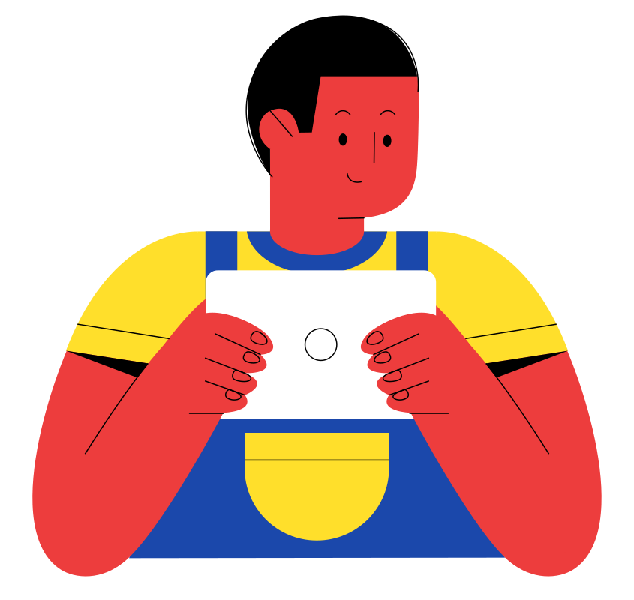
Conclusion
17
Part 04

Slide 19
Contributions of the
Project
Address
123 ANYWHERE ST., ANY CITY, ST 12345
Phone Number
19
123-456-7890
Suggestions for future research
hello@reallygreatsite.com

