Slide 1
Project name: Student Registration Form
Using Java Swing and MySQL Data Base
By- Afroz Parveen

Slide 2
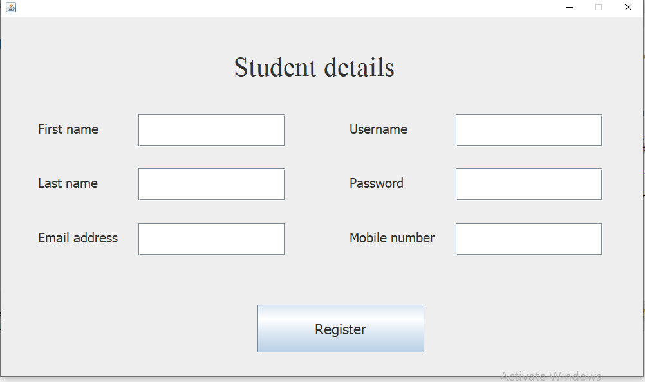
Student Form

Slide 3
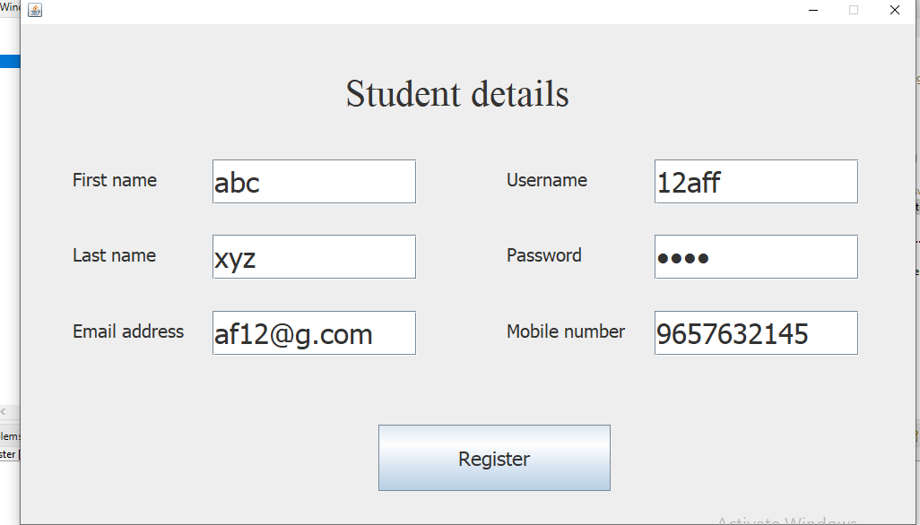
Enter Student details

Slide 4
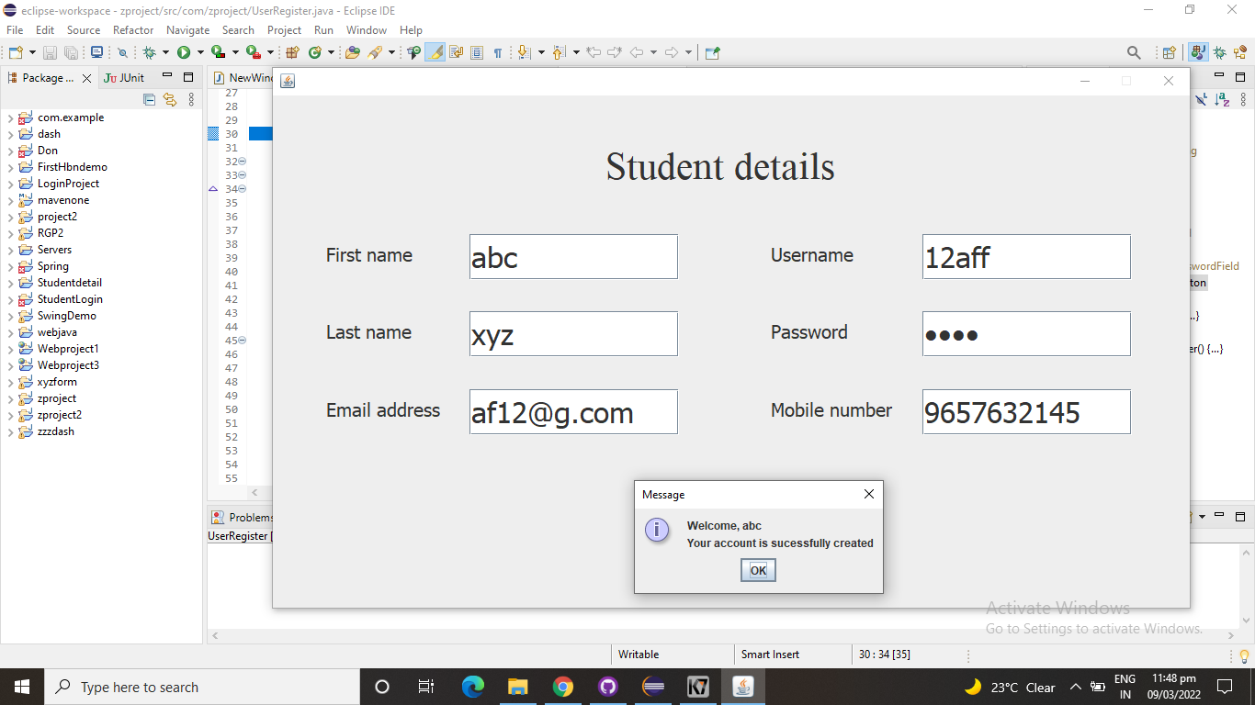
Click on register to save on data base

Slide 5
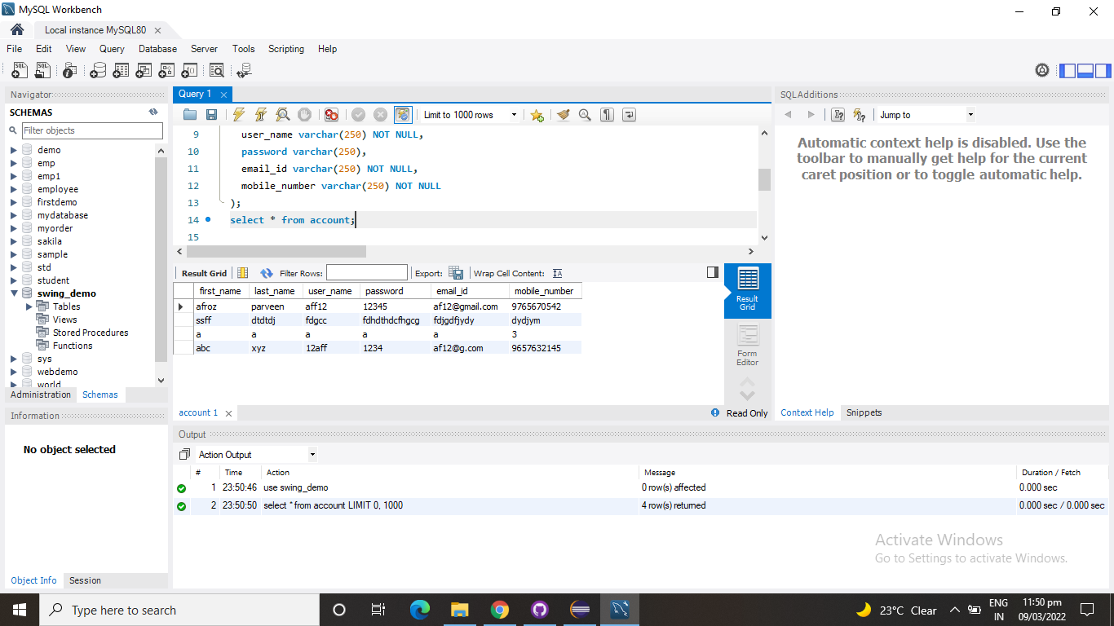
Student details stored in database

