Slide 1
Mini front-end project using HTML,CSS and Javascript
Project name:
AFROZ Multi-Cuisine Restaurant

Slide 2
Home page
Home page have options like Home, Speaciality, Gallery and Contact Us.
You can select any options you want, it will go to that part.
And when you click the ORDER NOW button, it will display the dishes that are available in our restaurant.

Slide 3
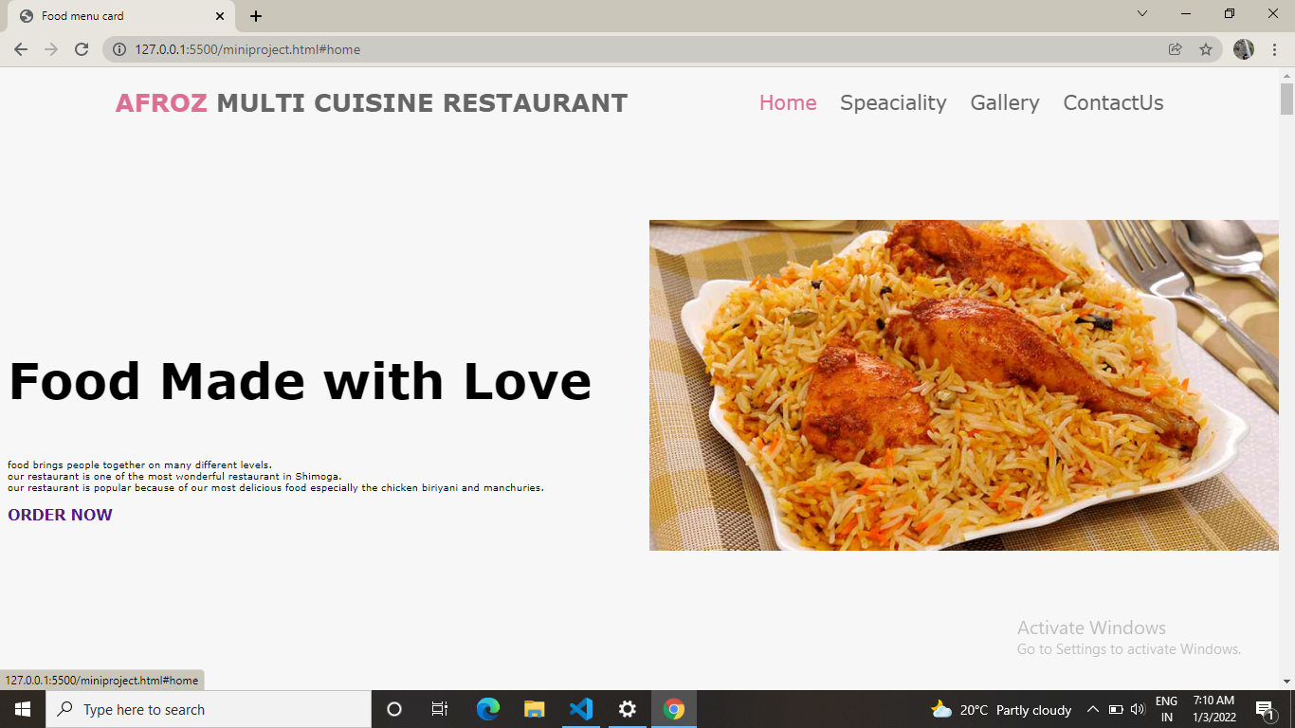
Home page

Slide 4
Speaciality
This speaciality option displays the special dishes available in our restaurant. With the food description and price of the dish.
And can you click the Order Now button to place your order.

Slide 5
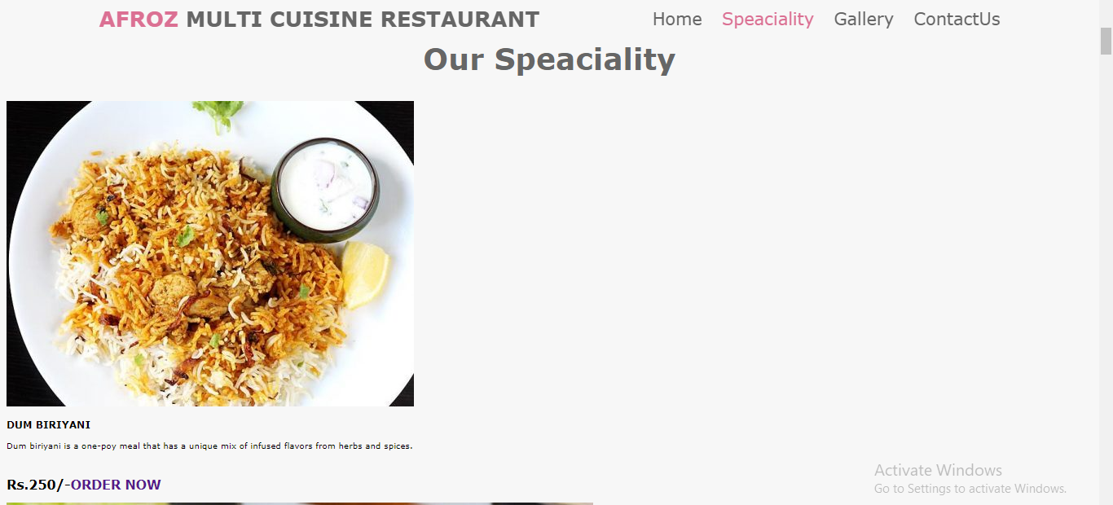
Speaciality image-1

Slide 6
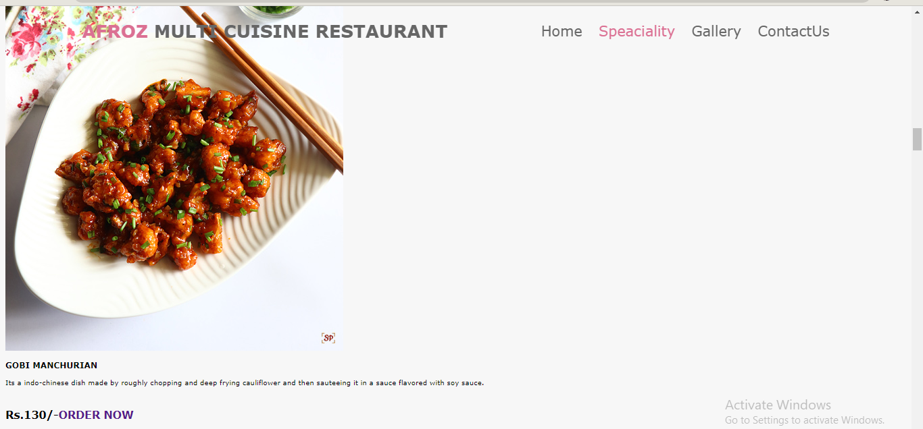
Speaciality image-2

Slide 7
Gallery
This gallery option display each and every dishes that are available in our restaurant with the dish name and price, and also you can order any dish you want using the ORDER NOW button.

Slide 8
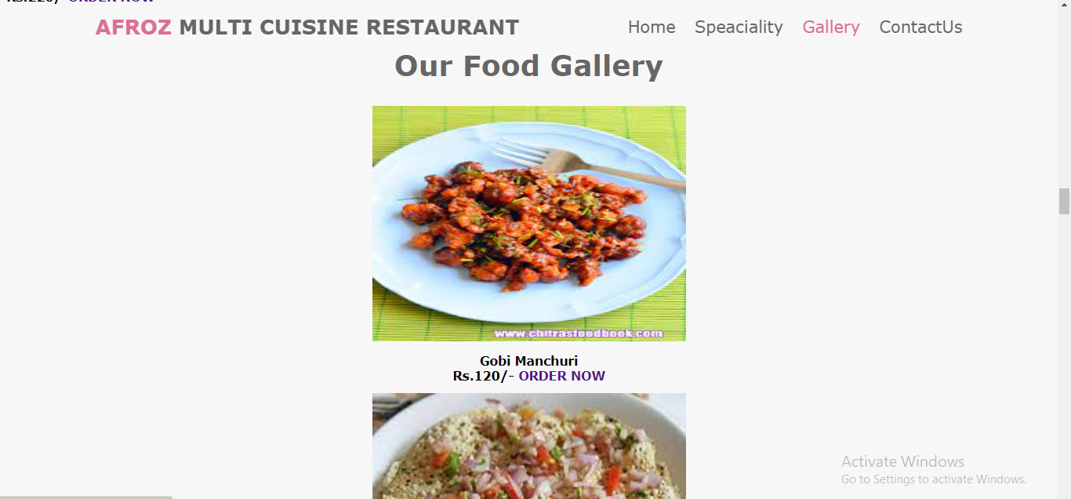
Gallery image-1

Slide 9
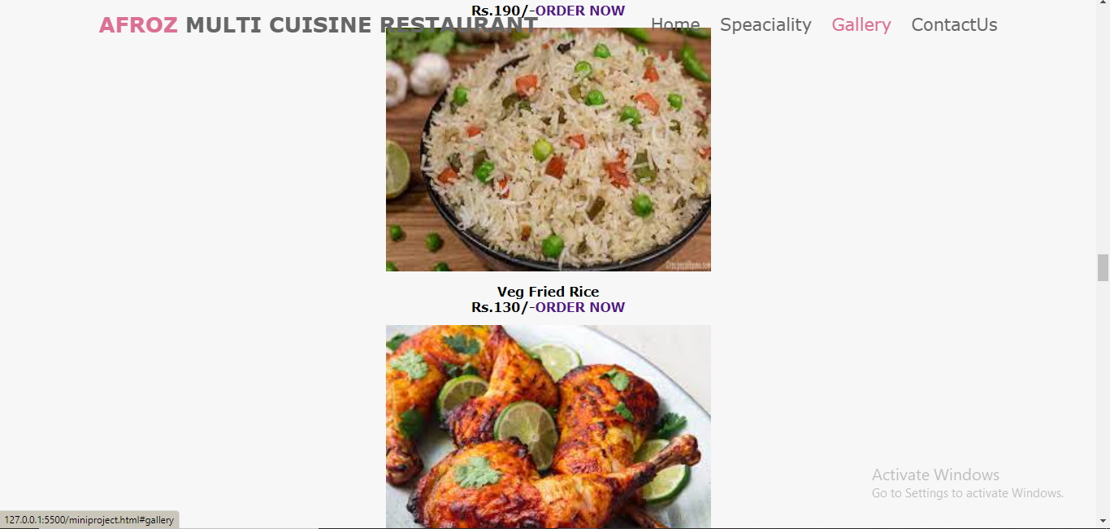
Gallery image-2

Slide 10
ORDER NOW button
When you click the order now button, it will display three options like Name, Phone number and Address.. And you have to fill these three options to place your order.
Validations are available for each options like, you have to enter only numbers in phone no option and it must cantain 10 digits ,and blank options are not allowed and only characters in name.
After that you can click the Submit button to place your order.
Then order confirmation notification is displayed.

Slide 11
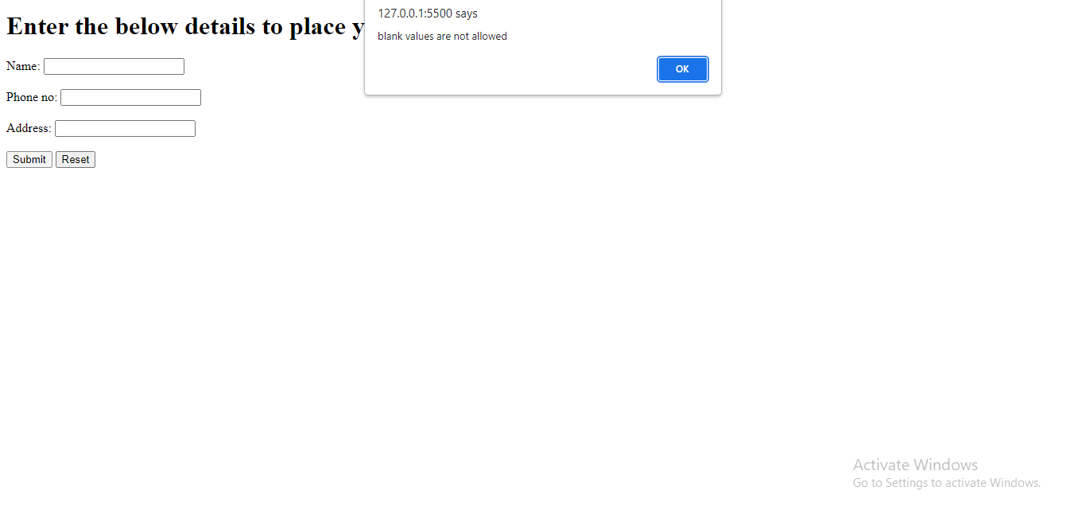
Order now(blank values validation)

Slide 12
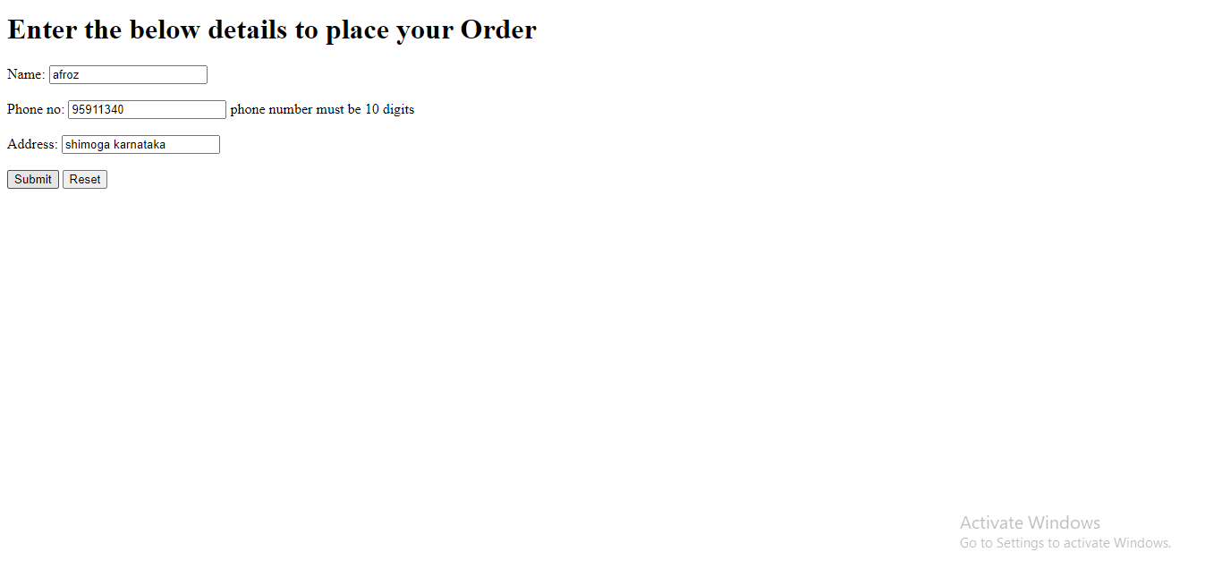
Order now(less or greater than 10 digits)

Slide 13
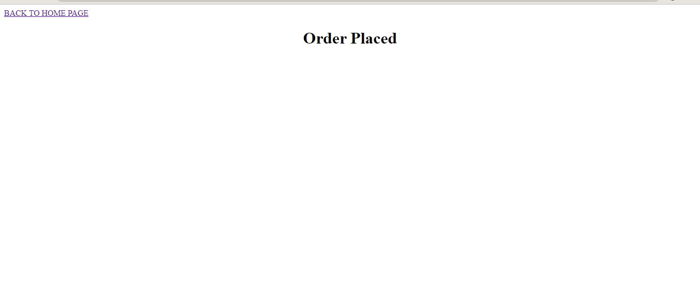
Order placed confirmation message

Slide 14
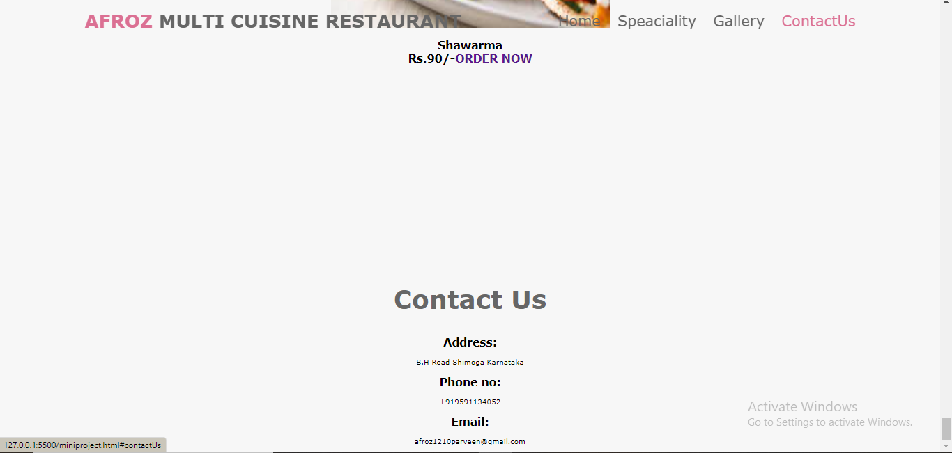
Contact Us

