Slide 1
SECURE DATA HIDING IN IMAGE USING STEGANOGRAPHY
CAPSTONE PROJECT
Presented By :
AFRAH KULSUM
College Name : MANIPAL UNIVERSITY JAIPUR
Department : BCA

Slide 2
OUTLINE
Problem Statement
Technology used
Wow factor
End users
Result
Conclusion
Git-hub Link
Future scope

Slide 3
Problem Statement
Develop a system to hide secret messages within an image by altering its pixel values in a secure and reversible way. The system should allow users to encrypt the message with a passcode and later retrieve it using the same passcode. It should ensure the image has enough space to store the message, handle errors like missing files, and prevent unauthorized access during decryption.

Slide 4
Technology used
Libraries Used:
tkinter - For creating the graphical user interface (GUI).
PIL (Pillow) - For handling and processing image files.
stegano - For implementing LSB steganography (hiding and revealing messages in images).
os - For file path and directory handling.
filedialog and messagebox (from tkinter) - For file selection and user notifications.
Programming Language: Python
Integrated Development Environment (IDE): VSCode
Platform: Python (cross-platform)

Slide 5
Wow factors
Data Hiding with LSB Steganography:
Embeds messages securely within image files using the Least Significant Bit (LSB) technique.
Password Protection:
Ensures only authorized users with the correct secret key can access or hide messages.
Interactive GUI: Built using tkinter, featuring a clean and responsive design with buttons for "Open Image," "Hide Data," "Show Data," and "Save Image.“
File Type Compatibility: Supports multiple image formats, including .png and .jpg, ensuring flexibility for users.
Error Handling & Notifications: User-friendly error messages, including file validation and feedback for successful/failed operations.

Slide 6
End users
Cybersecurity Enthusiasts: Individuals looking to explore secure data hiding methods.
Corporate Users: For securely sharing sensitive data like passwords or confidential messages.
Educators and Students: As a demonstration or learning tool for cryptography and steganography concepts.
Government/Defense Personnel: For secure communications and covert data sharing.

Slide 7
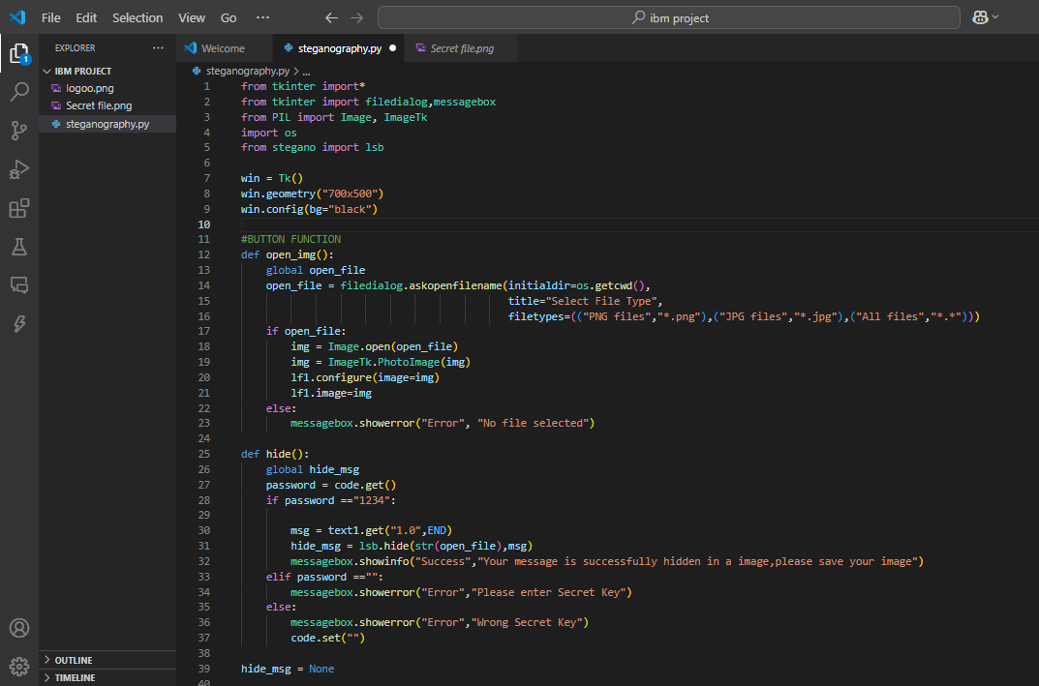
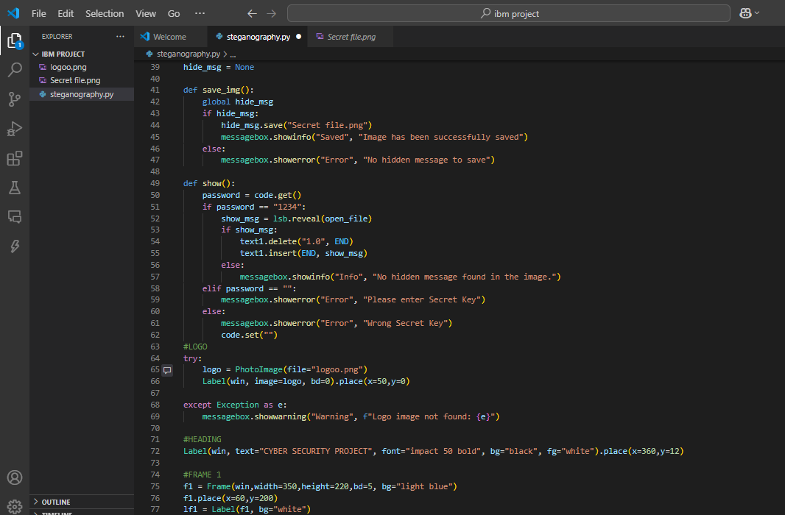
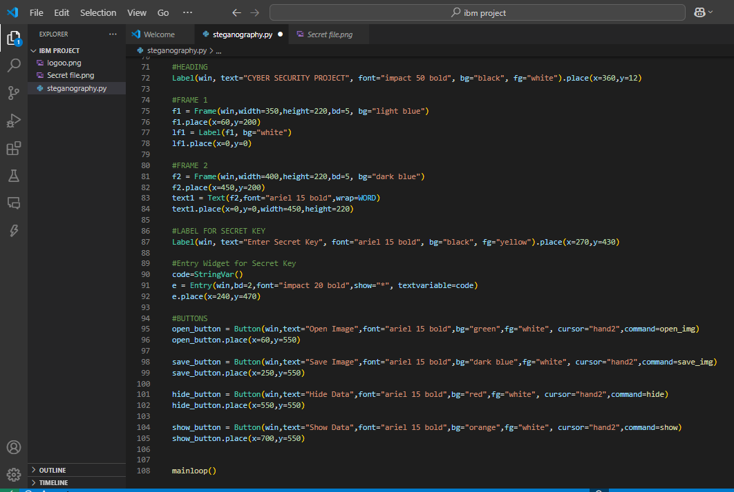
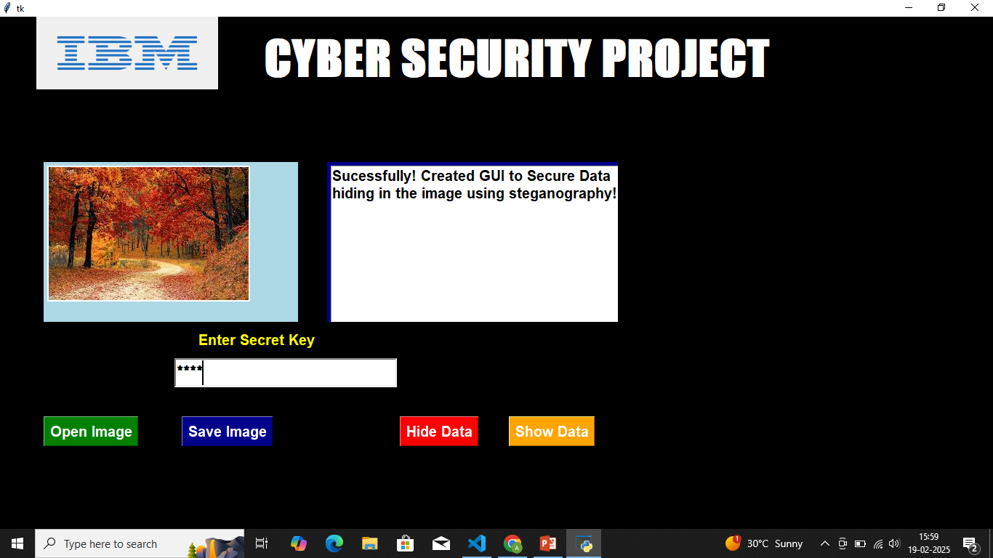
Results SOURCE CODE
OUTPUT

Slide 8
Conclusion
This project demonstrates an innovative approach to securely embedding and retrieving secret messages within images using pixel manipulation and passcode protection. By ensuring proper error handling, data integrity, and restricted access, the system provides a reliable method for secure communication. This solution highlights the potential of steganography as an effective tool for data privacy in modern digital communication.

Slide 9
GitHub Link
https://github.com/Afra-25/AICTE_IBM_INTERN_PROJECT.git

Slide 10
Future scope(optional)
Cross-Platform Accessibility: Build a mobile or web-based version for greater accessibility on smartphones and browsers.
Integration with Other Technologies: Combine with blockchain for secure and immutable storage of hidden data.Use in secure messaging platforms to embed hidden messages in shared media files.
Broader Applications: Use in secure government communications, military data transmission, or corporate espionage protection.Adapt it for industries where covert data exchange is essential, such as journalism.

Slide 11
THANK YOU

