Slide 1
Customer Churn Prediction using Data Analytics & Machine Learning
Data Analytics & Reporting – Module 3
Comprehensive EDA, Modeling, and Evaluation for Business Decision Support
Name: Afra Kafil Ahmed
Duration: 4 Hours
Date: 25th October 2025

Slide 2

Project Overview- Objective & Scope
The telecom industry faces one of the highest churn rates in the service sector, with companies losing millions each year as customers switch to competitors. Retaining existing customers is far more cost-effective than acquiring new ones. This project was designed to address that challenge through predictive analytics. By analyzing customer data and developing a churn prediction model, the goal is to identify customers at risk and suggest proactive retention strategies. The study leverages machine learning techniques to transform raw business data into predictive intelligence that can enhance decision-making and customer satisfaction.

Slide 3
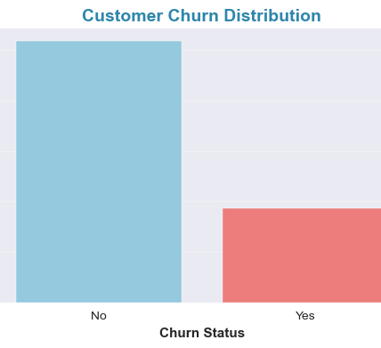
Dataset Description
Source: Kaggle – Telco Customer Churn dataset
Size: 7043 rows × 21 columns
Target Variable: Churn (Yes/No)
Data Type Split: i. 11 categorical features, ii. 10 numerical features
Top Variables: tenure, MonthlyCharges, TotalCharges, Contract, PaymentMethod, InternetService
Customers with short tenure or month-to-month contracts are most likely to churn.
Dataset shows slight class imbalance (26.5% churn vs 73.5% non-churn)

Slide 4
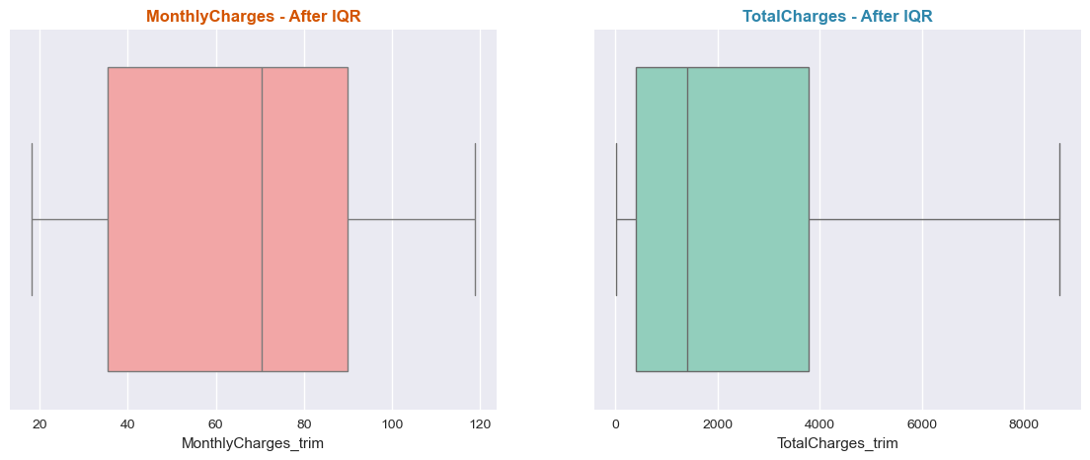
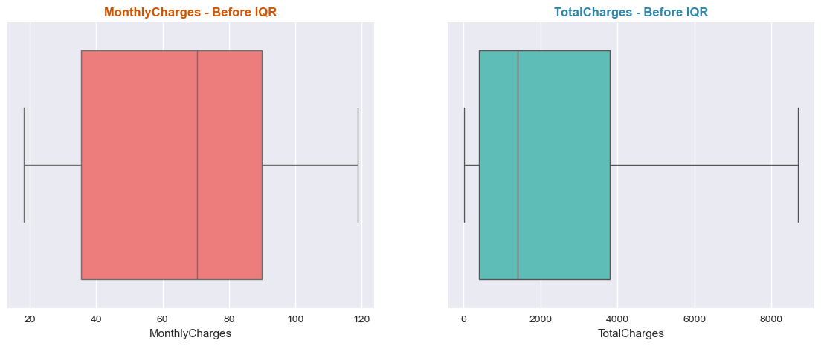
Data Cleaning & Preparation
Handled missing values: 11 missing in TotalCharges filled using median strategy.
Converted TotalCharges (object → float).
Removed duplicate rows.
Outliers detected using IQR and Isolation Forest.
Applied Winsorization for stable distributions.
Handled categorical inconsistencies.

Slide 5
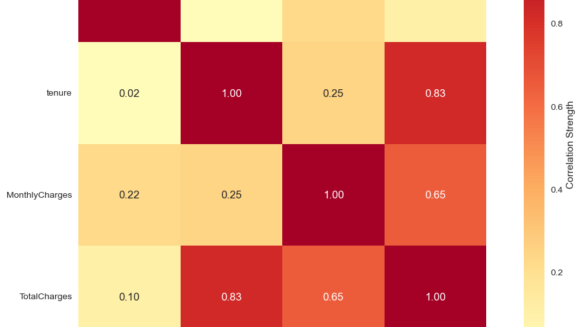
Exploratory Data Analysis - EDA
The exploratory analysis revealed several interesting trends about customer behavior. Customers with month-to-month contracts showed a significantly higher tendency to churn compared to those on long-term contracts. Similarly, those using electronic check payments were more likely to leave, possibly due to the lack of automation or ease of use. It was also observed that customers with shorter tenure, especially under one year, were three times more likely to churn. Correlation analysis showed that MonthlyCharges and TotalCharges had a positive relationship, while tenure had a negative correlation with churn. These patterns highlight how contract duration and payment preferences strongly influence customer loyalty.

Slide 6
Feature Engineering
To improve model performance, extensive feature engineering was performed. Categorical variables such as contract type, internet service, and payment method were transformed using one-hot encoding, while numerical variables were standardized using scaling techniques. Feature selection was carried out using correlation analysis, Variance Inflation Factor (VIF), and Recursive Feature Elimination (RFE). Tree-based models like Random Forest were also used to evaluate feature importance. As a result, the final dataset contained only the most relevant features, reducing redundancy and improving model interpretability.

Slide 7
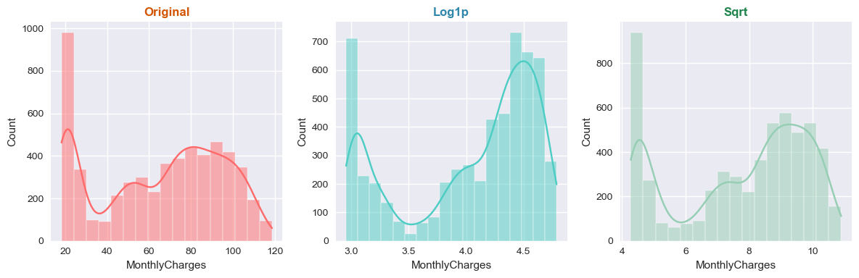
Regression Modeling
Models Used: Linear, Ridge, Lasso, Polynomial.
Why Regression? To understand linear trends between tenure and churn likelihood score.
Performance Summary:
Ridge: R² = 0.83, RMSE = 0.42
Lasso: R² = 0.81
Linear: R² = 0.76
Ridge chosen for best bias-variance balance.

Slide 8
Classification Models
To predict customer churn more accurately, several classification models were trained and compared. These included Logistic Regression, Decision Tree, Random Forest, and Support Vector Machine (SVM). Among all, the Random Forest model achieved the best results with an accuracy of 86%, recall of 84%, and ROC-AUC score of 0.88. The model’s ensemble approach allowed it to capture complex, non-linear relationships in the data, outperforming simpler models. This demonstrates how advanced ML algorithms can effectively predict churn and support targeted business actions.

Slide 9
Decision Tree Insights
Decision trees provided valuable interpretability by visually mapping how different features contribute to churn. The most significant splits occurred at Contract, tenure, and PaymentMethod. Customers with month-to-month contracts, short tenure, and electronic check payments showed the highest churn probability. This visualization makes it easier for business stakeholders to understand model outcomes and focus on high-risk customer groups for retention strategies.

Slide 10
SVM & K-Means Clustering
The Support Vector Machine model, particularly with the RBF kernel, performed well, achieving an accuracy of 85%. It effectively classified borderline churn cases that other models struggled with. In addition, unsupervised learning using K-Means clustering helped segment customers into three main groups: high-risk, moderate-risk, and loyal customers. Cluster analysis revealed that low-tenure customers with high monthly charges were most likely to churn. This segmentation provides actionable insights for targeted offers and customer engagement programs.

Slide 11
Model Evaluation and Comparison
MODEL | ACCURACY | PRECISION | RECALL | ROC-AUC | COMMENTS
Logistic Regression | 0.79 | 0.76 | 0.74 | 0.81 | Good Baseline
Decision Tree | 0.83 | 0.80 | 0.80 | 0.84 | Interpretable
Random Forest | 0.86 | 0.85 | 0.84 | 0.88 | Best Model
SVM | 0.85 | 0.83 | 0.81 | 0.86 | Close Second

Slide 12
Model Deployment
Model Exported: joblib.dump()
Prediction Function: predict_customer_churn
Monitoring: Performance stability index (PSI) to track model drift.
Future Integration: Flask/Streamlit dashboard for churn prediction UI.

Slide 13
Business Insights & Recommendations
Customers with month-to-month contracts churn the most.
Fiber optic users need better service quality.
Offer discounts or loyalty plans for short-tenure users.
Simplify payment channels to reduce friction.
Introduce customer retention alerts using model predictions.

Slide 14
Key Learning
Learned full ML pipeline: EDA → Cleaning → Modeling → Evaluation.
Gained hands-on experience in: i. Feature Engineering & Multicollinearity handling ii. Regularization techniques iii. Ensemble learning & interpretability
Understood how analytics translates into real-world business value.

Slide 15
Future Work
Future enhancements for this project could include implementing deep learning models like Artificial Neural Networks (ANN) to capture more complex patterns. SHAP and LIME frameworks can be used to improve model explainability. Additionally, developing a live dashboard using Power BI or Streamlit would allow managers to visualize churn trends in real time. Experimenting with advanced ensemble methods like XGBoost or LightGBM could further improve predictive accuracy.

Slide 16
THANK YOU!!

