Slide 1

MOTIVATION
A motive etymologically means that 'which moves.

Slide 2
definitions
A need gives rise to one or more motives. A motive is a rather specific process which has been learned. It is directed towards a goal.
-Carol (1969)
A motive may be defined as a readiness or disposition to respond in some ways and not others to a variety of situations.
-Rosen, Fox and Gregory (1972)

Slide 3

Concepts of motivation
Motivation is generated through basic needs or drives.
It compels an individual to respond by creating a kind of tension or urge to act.
It is goal - directed activity pursued till the attainment of the goal.
Attainment of the goal helps to release tension aroused by specific motive.
Any change in goal may bring an alteration in nature and strength of the motive.
Motivation is an innate state and aroused feeling .
We experience motives as feelings of needs,wants and desires.
Motive may be considered as a learned response or tendancy and also an innate experience.
We cannot see motives directly but must infer them from the b huehavior of people.

Slide 4

Types of motives
Psychologists have divided motives into two main categories.
innate & acquired
Types of motives are:
physiological or primary motives
Social or secondary motives
Personal motives
UnConscious motives

Slide 5
PHysiological or biological or primary motives
Physiological motives are called biological or organic motives.
these includes
hunger,thirst,need for oxygen,need for rest,need for elimination of waste,sex motive.

Slide 6
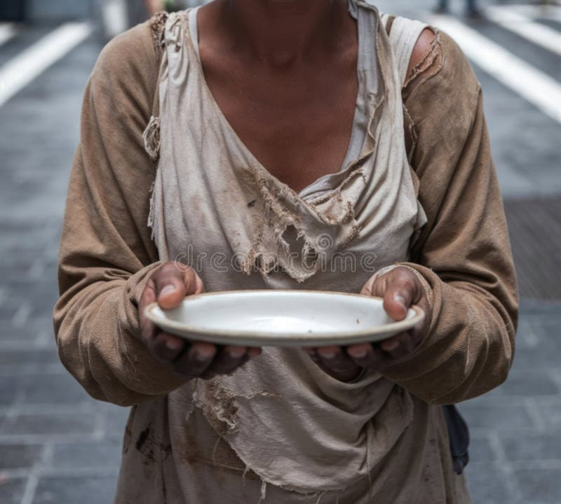
Hunger motive
Hunger motive
Is seen to be a very dominant motive
If hunger motive is not adequately satisfied the person has to undergoes a serious of changes which include lowering of their morale
When food supply exhausted certain biochemical changes takes place in tissues of body.This causes stomach to contract resulting in hunger pains.hunger must satisfied for a physiological balance or homeostasis

Slide 7

Thirst motive
Thirst motive
When there is a deficiency of water over a long period of time the individual becomes excessively restless and needs intake of water.the tissues of the body lose fluid in the absence of fluid intake.As a result the mucous membrane of throat become dry and cause sensation of thirst

Slide 8

It is the drive for air and oxygen.one cannot survive for a long period without a regular supply of air or oxygen.When an individual suffers from oxygen deficiency,his memory,sensory activity and muscular control are seriously impaired
Respiration motive
It is the drive for air and oxygen.one cannot survive for a long period without a regular supply of air or oxygen.When an individual suffers from oxygen deficiency,his memory,sensory activity and muscular control are seriously impaired

Slide 9
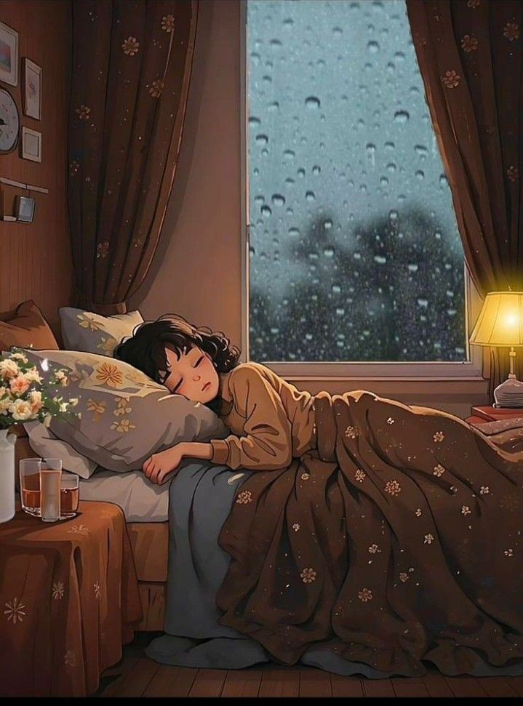
Need for rest and sleep
Need for rest is another physiological motive.when the body continues to perform activities for a long time without adequate rest or sleep it is possible that fatigue, confusion or discomfort are experienced

Slide 10
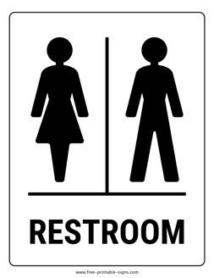
Need for elimination of waste
When bladder or intestine becomes distended with waste material they cause pressure & discomfort.The person becomes restless until the waste material are disposed and pressure is relieved

Slide 11

Sex motive
The motivation for reproduction and sexual behaviour is driven by the biological need for procreation and continuation of species.hormonal and neurological signals trigger sexual desire and activity.These motives are linked to the release of neurotransmitters like dopamine,which provides pleasure and reinforcement

Slide 12
Social or secondary motives
Human beings are not only biological but also social beings. Therefore human behavior is activated by social motives such as affiliation motive,need for status,power motives and social approval.

Slide 13
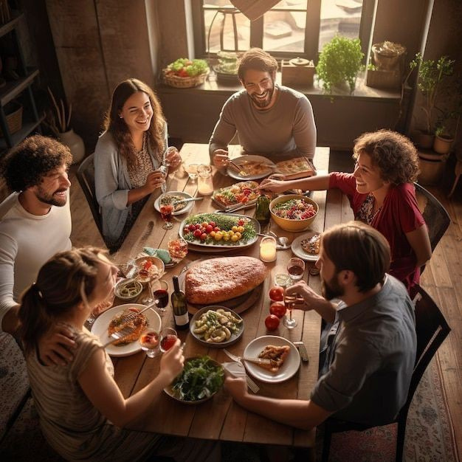
Affiliated motives
In general ,human beings love company and resent loneliness as pleasures of life cannot be enjoyed alone.Even the simple routine activities of eating and drinking cannot be enjoyed without company.The need to be attached to others through friendship,sociability or group membership

Slide 14

Need for status
Most individuals have a desire to demonstrate some standing or position among the people of their society or group. Nobody likes to be considered inferior

Slide 15

Power motive
The desire to be in a position of control, to be the boss, to give orders, to command respect and obedience is called the power motive. Power motive directs the behavior of dictators, gang leaders and the builders of fraudulent financial empires

Slide 16

Social approval
We try our best to avoid doing anything that may evoke social disapproval. We often show an almost compulsive tendency to conform to the norms set by our social group.

Slide 17
Personal motives
Though allied with physiological needs and common social motives they are no longer common as they are so much individualised need for achievement,vocational ambitious and life goals,specific interest,habits and attitudes,levels of aspiration,curiosity and fear are our personal motives

Slide 18

need for achievement
Achievement motivation refers to a drive towards some standard of excellence
People with high need for achievement prefer tasks which would promise success and are moderately difficult
David C Mclellad has found that while high achievers tend to succeed,low achievers tend to avoid failures
High achievers challenge failures and work harder while low achievers accept failure and go for less difficult task

Slide 19

Vocational Ambitions and Life Goals
These desires are common to many others but there is something unique about each ones desires.
These are powerful determinants of our behaviour

Slide 20
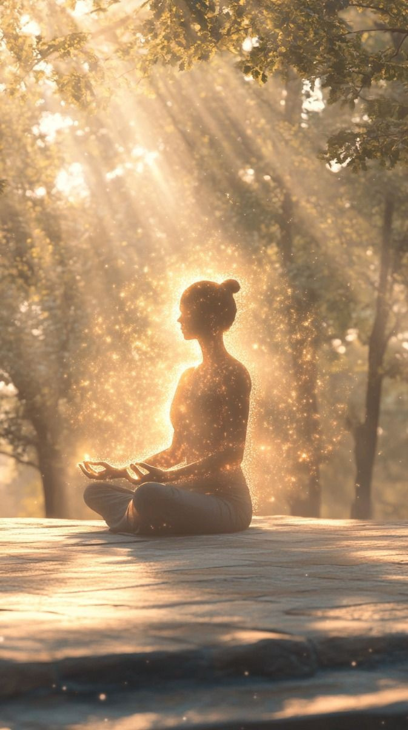
Levels of aspiration
it imply the degree of expectations which a person has
I.e,how much he expects to achieve
in general people tendto set their goals slightly higher than the level of sure of attaining.this is healthy tendency for progress
there are a few who set their level of aspiration much higher or lower in comparison to their actual level of performance leading to frustration and disappoinment

Slide 21
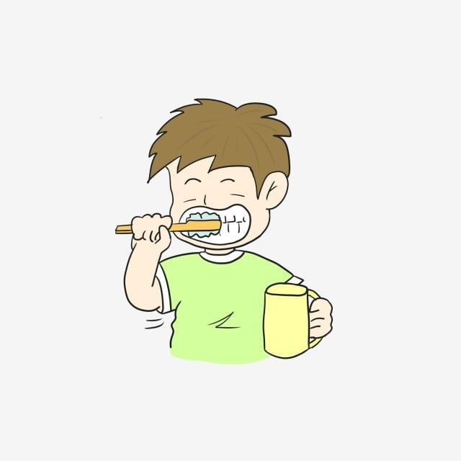
force of habit
once we have formed a certain habit ,it is difficult to change
A habit which has been formed acts as a drive and compels us to continue the accustomed ways of doing things
In other words once formed persist and influence our behaviour greatly

Slide 22
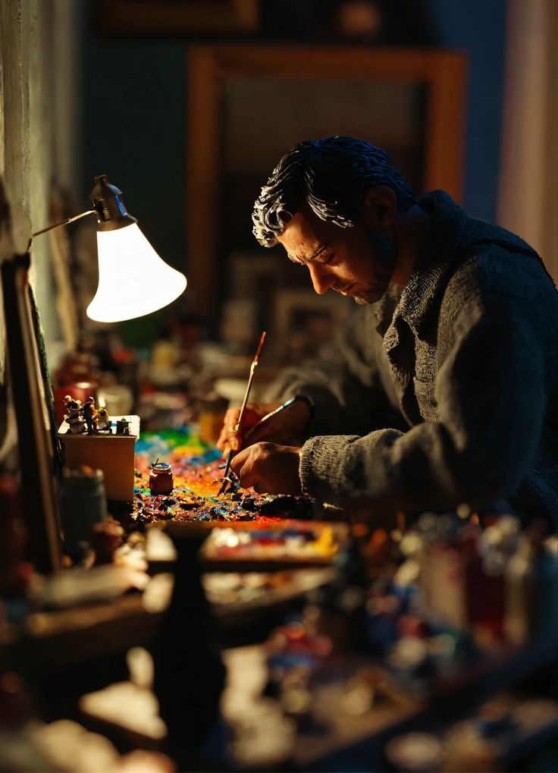
interests and attitudes
Interest and attitude are another set of personal motives
The interests we have developed and the attitudes we have formed color our everyday behaviour in many ways
Interest are one such group that they can predict our choice

Slide 23

Curiosity
This is a motive which is close to exploration
The extent of man's knowledge and experience widens as a result of this drive
Curiosity this adds to our competency

Slide 24
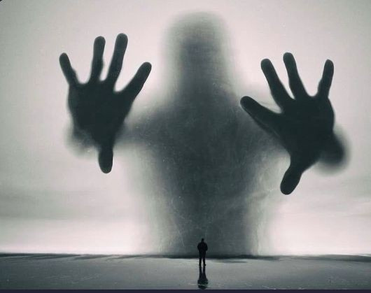
fear
Fear is a learned motive
It motivates individuals to escape from fear producing situation

Slide 25
Unconscious motives
Unconscious motives are those of which we are not aware of
They may be in the form of our repressed desires or wishes or complexes.

Slide 26
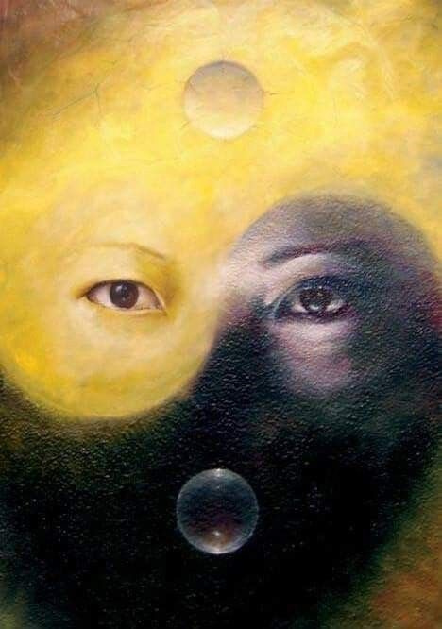
They determine our irrational fears or phobies,eccentric likes and dislikes, chronic headache and gastric troubles(for which we have no organic causes) and also neuroses and insanities.
according to Freud,it is the unconscious mind that guids, directs and motivates dreams.the root cause of mental diseases is ttraceed to the unconscious mind

Slide 27
Thankyou

