Slide 1

APPLICATION OF SOFT SKILL

Slide 2
CONCEPT OF SOFT SKILL
Soft skills include a broad range of personal competences such as critical thinking, social aptitudes, communication capability, teamwork ability and ethical attitudes.
Soft skills are the intangible behavior traits that enhance or endorse knowledge or skills in the workplace.-Sharma and Sharma (2010)
Soft skills are interpersonal qualities and personal attributes that one possesses.-Heckman and Kautz (2012)
Examples of soft skills include personality traits, workplace etiquette, communication style, interpersonal skills, optimistic attitude and dependability.

Slide 3

Types of Soft Skills
Visual soft skills
It is the practice of using visual elements to communicate information or ideas.
Visual communication skills refer to one's ability to communicate through the signals received by eyes.
There are several types of visual elements, they consist of objects, models, graphs, diagrams, maps, photographs and electronic resources.
Any nonverbal communication utilizing the sense of sight is known as visual communication.

Slide 4

The body gestures, facial expressions, and eye contact of an individual can also help in visual communication by conveying a message.

Slide 5
Aural soft skills
Aural soft skill involves the transmission of information through the auditory sensory system.
Aural communication relies heavily on spoken words.
Para linguistic or para verbal communication, in which information is conveyed through the speaker's voice is also an important part of aural communication.
It usually encompasses both verbal communication to convey meaning.
Aural soft skills include empathy, active listening, clarity of speech, emotional intelligence etc.

Slide 6
THE WAY OF COMMUNICATION
Verbal Communication
Communication is the process in which people affect one another through the exchange of information, ideas, and feelings.
Verbal communication occurs when we engage in speaking with others. It can be face-to-face, over the telephone, via Skype or Zoom, etc.
Interpersonal communication is basic to human interaction and essential for nursing practice.
Some verbal engagements are informal, such as chatting with a friend over coffee or in the office, while others are more formal, such as a scheduled meeting.

Slide 7
Nonverbal Communication
Nonverbal Communication-Any communication without the use of speech and language refers to nonverbal communication.
Gestures, smiles, cries, signs and signals, all traffic signs, expression of attitudes and emotions through facial expression, change in body position, head movements expressing Yes or No refer to nonverbal communication.

Slide 8
Building Relationship with client and society
Nurses are responsible for total patient care includes physical care, performing technical procedures, creating safe and comfortable environment, formal and informal teaching, counseling, and acting as a patient's advocate.
The main purpose of building a relationship with the patient is to support and promote healing process, and enhance illness recovery.
Elements or qualities that help a nurse to build therapeutic relationship with the patient are:-

Slide 9

Competence in Knowledge and Skill
Competence in Soft Skills and Communication Skills
It is the ability to perform activities effectively and efficiently.
To establish a good relationship with the patient and his care givers the nurses are required to have effective communication skills.

Slide 10

Honesty
Honesty in nursing means doing the right thing in a right way, coming to work on time, not skipping on patient care, admitting to mistakes made and facing the consequences, not gossiping about the patients and being true to ones beliefs.
Trust
The nursing activities which facilitate trust are active listening, respecting, being honest and consistent in activities, and having an acceptable attitude.
If the patient develops trust on the nurse they are more likely to share and disclose information.

Slide 11
Empathy
It refers to the nurse's understanding of what the patient is experiencing from his own perspective.
Confidentiality
It refers to the duty of an individual to refrain from sharing confidential information with others and respecting privacy.
Showing respect and caring attitude
In nursing these refer to introducing one self, calling the patient with his/her formal name, treating the patient with dignity, arranging for patient comfort and privacy at all times, preparing the patient before any procedure etc .

Slide 12


INTERPERSONAL RELATIONSHIPS (IPR)
Interpersonal relationship (IPR) is an interaction between two or more people who communicate, exchange their opinions and values.
In nursing, interpersonal relationship is a process by which the nurse establishes a rapport with the patient by employing her professional knowledge and skills so as to help the patient physically, psychologically and socially.

Slide 13

TYPES OF IPR
Social Relationship:It is a relationship that is primarily established with the purpose of meeting mutual needs which may range from friendship, socialization, enjoyment to accomplishing a task.
Intimate Relationship: An intimate relationship develops between two individuals who have an emotional commitment to each other. It is more often seen in marital relationships.
Therapeutic Relationship: It usually occurs between a nurse and a patient wherein the nurse utilizes her knowledge of human behavior, personal strengths and communication skills to fulfill the patient needs.

Slide 14

PURPOSES OF IPR
Good nurse-patient relationship helps in building trust between the nurse and the patient resulting in better co-operation for the treatment.
Helps in collecting patient information.
Effective communication helps the patient in taking correct decisions.
Enhances patient and nurse satisfaction.
Reduces stress, promotes well being and the improves overall quality of life among nurses.
Help in building trust, co-operation and mutual understanding between nurse and patient; nurse and nurse; nurse and health team members; nurse and patient relatives.

Slide 15
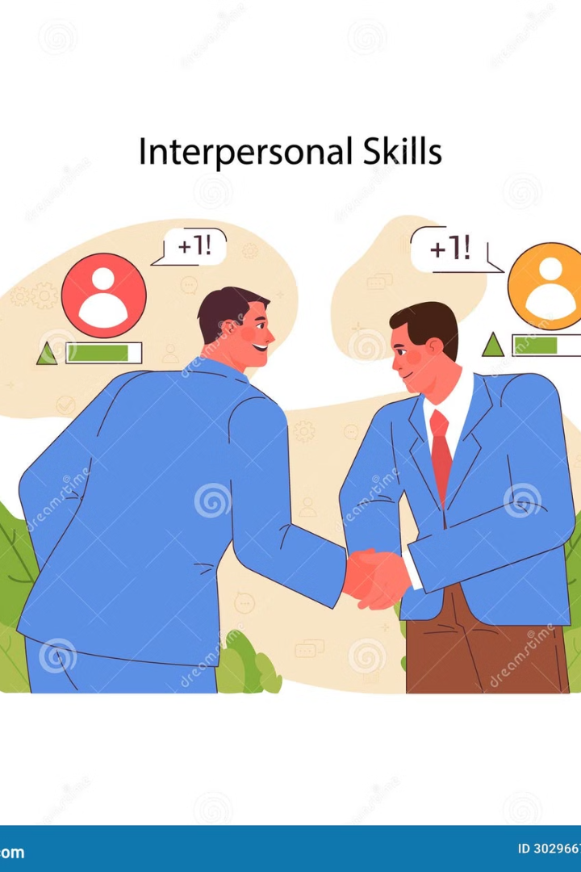
INTERPERSONAL SKILLS
Interpersonal skills refer to an ability to build rapport with the individuals. Nurses need to develop these skills to establish good interpersonal relationships with patients. These are:
Attentive listening
Meaningful talk
Non-judgmental approach
Empathetic understanding
Unconditional positive regard
Genuineness in approach
Accepting constructive criticism
Respecting others
Good communication skills

Slide 16
Some techniques to improve interpersonal skills are:
Interact with patient and health team members more often
Communicate in a clear, complete and concise manner
Be courteous while interacting with others
Learn the art of listening
Develop positive attitude
Seek feedback regarding communication skills being employed
Be empathetic towards the patient

Slide 17
BARRIERS IN INTERPERSONAL RELATIONSHIP AND STRATEGIES TO OVERCOME
Barrier is anything that prevents, restricts, or impedes the conveyance of meaning by words or gestures between two or more persons in a social setting.
Barriers to interpersonal relationship are: Physiological barrier,Environmental barrier,Psychological barrier,Social barrier,Cultural barrier,Semantic barrier,Organizational barrier,Communication process related barrier.

Slide 18
Physiological Barriers
Strategies to overcome
Lack of attention
The nurse should ensure that the patient is paying complete attention during the communication process.
Discomfort due to illness
Hearing problem
Poor listening skills
While initiating communication the nurse should consider retention and recollection abilities of the patient.
Lack of retention due to poor memory
The nurse should avoid information overload while interacting with the patient
While interacting the nurse should ensure intactness of patient's sensory perception
While communicating due regard should be given to the difference in gender

Slide 19
Environmental Barriers
Strategies to overcome
Loud noise
Before establishing communication the nurse should ensure comfortable position, adequate room temperature and lighting for the patient.
Poor lighting
Uncomfortable setting
Unhygienic surroundings and bad odor
Patient environment must be clean and free from bad odors.
High or low room temperature
For communication to be effective both nurse and the patient should maintain optimum distance.
Distance factor
Lack of privacy
Maintain privacy in physical setting when sharing sensitive issues concerning the patient. This may include using a separate room or a screen.

Slide 20
Psychological Barriers
Strategies to overcome
Shyness or embarrassment in sharing information
Nurse should acknowledge patient emotions and use appropriate communication techniques such as clear and simple words.
Distressing emotions
Misperception and misunderstanding
Prejudice
Nurse and the patient should not have preconceived negative ideas or stereotyped views of the other person.
Nurse and the patient should be free from fear, anxiety and confusion.
The nurse should use therapeutic communication techniques to encourage the patient in sharing his views.
Should assess misconceptions of the patient and clarify them with proper facts.

Slide 21
Social Barriers
Strategies to overcome
Differences in social norms and values
Nurse needs to respect social norms and values.
Differences in social strata
Social strata need to be considered while communicating with the patient.

Slide 22
Cultural Barriers
Strategies to overcome
Ethnic, religious and cultural differences
A nurse should duly understand the cultural differences and traditional values of the patient while providing care.
Traditions, customs and cultural beliefs

Slide 23
Semantic Barriers
Strategies to overcome
Language, jargon (terminology)
The nurse should preferably communicate in the same language as used by the patient and avoid needless translation.
Faulty language translations
The nurse should ensure that the patient is attentive while conveying any kind of information.
The language used should be simple and include minimum technical jargon.

Slide 24
Organizational Barriers
Strategies to overcome
Organizational policy, rules and regulations.
Organizational policy, rules and regulations must be pro communication
Complexity in organizational hierarchy
Organizational structure must be simple and non-complex for smooth communication
Size of the organization
Decentralization in an organizational structure promotes effective communication.

Slide 25
Communication Process Related Barriers
Strategies to overcome
The nurse should communicate in clear, simple language with the patient
Unclear and conflicting messages
Use of inappropriate channels
The nurse should select appropriate channel for communication
Lack of or poor feedback
The nurse should ensure proper feedback from the patient

