Slide 1

COGNITIVE PROCESS

Slide 2
ATTENTION
Through the sense organs ,humans are aware of the number of stimuli around them.
According to Dumville , 'attention is the concentration of consciousness upon one object rather than upon another.'
Attention is the focus of consciousness on a particular object or idea at a particular time to the exclusion of other objects or ideas.
According to Sharma RN, 'attention is defined as a process which compels the individual to select some particular stimulus according to his interest and attitude out of the multiplicity of stimuli present in the environment.'

Slide 3

DETERMINANTS OF ATTENTION
EXTERNAL FACTORS
Nature of stimuli
A picture attracts attention more quickly than words.
Among the pictures human figures get more attention than other objects.
Similarly coloured pictures are more powerful than colourless.

Slide 4
Intensity of stimulus
Contrast
Change
The intense nature of a stimulus attracts a person's attention easily than a weaker torn.
Attention is always aroused by familiar objects in an unfamiliar setting or unfamiliar item in familiar surroundings.
If there is sudden change from the usual pattern, then we attend it at.
Example :sudden halting of moving fans or lights comes to our notice.
Bright colour loud noise etc. influence human process of attention.
Example: uniformed policeman in a swimming pool, or a school kid wearing colour dress.

Slide 5
Novelty
Location of stimulus
Repetition
Newness is another factor that attracts attention.
Location of stimulus also affects attention.
Repetition has great importance in drawing attention in a classroom.
New dress code, new paint on a building etc. attracts person.
In case of visual stimuli the most effective location is to be just in front of the eyes.
When teacher repeats a topic several times the students attend to it.
Film makers, manufacturers of all products make use of this factor.
Example: advertisements given on the front page or on the upper half of any page attracts more attention.

Slide 6
Movement of stimulus
Definite form of the object
Isolation of stimulus
Moving objects tend to catch a person's attention more quickly than a static one.
A sharply defined object attracts our attention more than a broad indefinite object.
A student sitting alone in the corner of the class is seen first that it attracts more attention than others.
We tend to look at walking people, flying birds, moving vehicles etc.
A figure attracts more attention than the background ,a very clearly defined object attracts our attention more than a vague object.

Slide 7

INTERNAL FACTORS
Interest
People attend to objects in which they are interested.
A good teacher can secure the attention of the students if the class is interesting.

Slide 8
Motives
Past experience
Emotion
The basic drives and urges of a individual are very important in securing attention.
Previous experience facilitate attention.
The emotional state in which a person determines attention.
If we know by our past experience that a particular person is sincere to us we pay attention to whatever he advices.
Example: a person attends only to bad qualities of his enemy.
Thirst, hunger, sex, curiosity ,fear are some of the important motives that exercise definite influence upon attention.
When hungry we attend to even distasteful food but while our belly is full we may not attend to even the tastiest.

Slide 9
Habit
Aim
Meaning
The habit of attending to necessary and desirable things on the other hand also develops habit of not attending to unnecessary and undesirable things.
Every man has some immediate and ultimate aims.
In comparison to meaningless stimuli, meaning full stimulus attracts more attention.
Student whose aim is to pass the examination will at once attend to the textbooks or notes.

Slide 10

TYPES OF ATTENTION
According to Ross, Attention can be broadly divided into volitional and non- volitional type.

Slide 11
NON-VOLITIONAL ATTENTION
Also called involountary attention.
In this type of attention, person has no intention or desire to attend to a stimulus.
Attention towards a loud noise, a bright light and a member of the opposite sex are examples of involuntary attention.
Involuntary attention is divided into enforced non-volitional attention and spontaneous non-volitional attention.

Slide 12
Enforced non- volitional attention
This enforced attention is aroused from instincts.
Eg:-mothers attention towards her child and a young person’s curiosity to attend sexual advertisements.
Spontaneous non-volitional attention
This spontaneous attention is aroused through sentiments.
Eg:- paying attention to a patriotic song or shifting attention towards a person who is suffering from an illness.

Slide 13
VOLITIONAL ATTENTION
Also knows volountary attention.
Takes place with the conscious effort of the subject .
Volitional attention divided into implicit volitional and explicit volitional.
Implicit volitional attention
In this type single act of volition bring attention.
Eg:-a teacher wants a student to not repeat skipping homework. if the single warning makes the student do homework regularly that is an instance of implicit volitional attention.

Slide 14
Explicit volitional attention
This type of attention involves taking multiple steps and having will and focus to obtain attention.
Eg:-preparation for an examination or planning for a journey to a new place. this one has to act purposefully for keeping oneself attentive.
DURATION OF ATTENTION
Duration of attention is the length of one's ability to pay attention towards a stimulus.

Slide 15

Sustained attention
Sustained attention is the concentration of one’s activity continuously upon some object.
The individual attention always remains on track and activity proceeds systematically without any serious distractions.
Shifting attention
While paying attention towards an object it is not possible to hold attention continuously with the same intensity for a longer duration.
It is constantly shifting from one object to another.

Slide 16
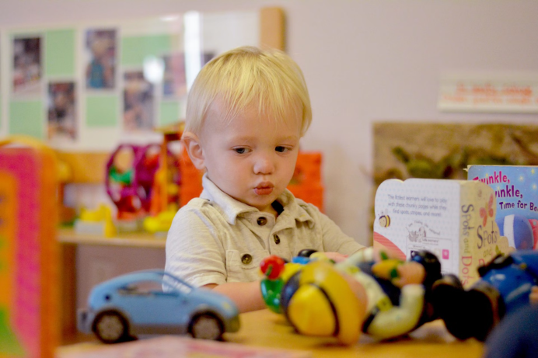
DEGREE OF ATTENTION
There are limitations to the number of objects that can be attended in one period of attention.
The maximum amount of material that can be attended in one period of attention is called span of attention or degree of attention. Span of visual attention- experiments shows that the mind can attend to only four or five separate units if the items are not grouped into familiar units ,but if the items are combined into meaningful whole, many number of items can be perceived at once.
Span of auditory attention- the number of auditory impressions perceived at single instance is called span of auditory attention.

Slide 17
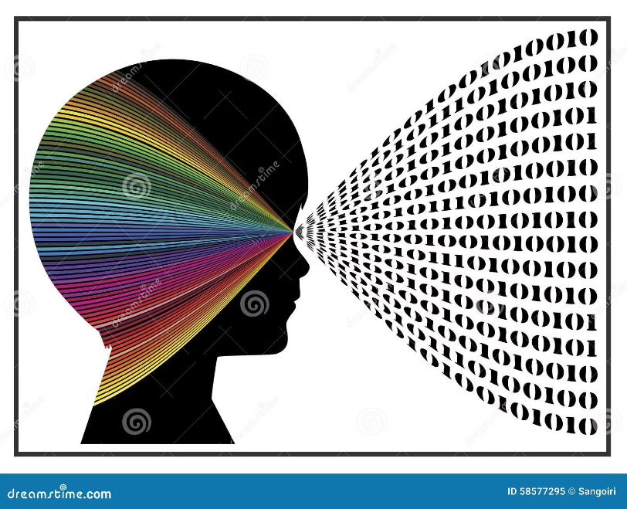
PERCEPTION
Sensation is the initial response of an individual to a stimulus.
Perception is the interpretation of sensory stimuli which reaches the sense organs and the brain.
Interpretation gives meaning to sensation and we become aware of objects.

Slide 18
PRINCIPLES OF PERCEPTION
The principles of perception also known as perceptual organisations.
The phenomena of perceptual organisation were studied by a group of German psychologists known as the Gestalts.
The major principles of perception are:
Figure ground relationship
Principles of grouping
Principles of context
Principles of contrast
Principles of adaptability

Slide 19
The pioneers among them were Max Wertheimer, Kurt Koffka and Wolf Gang Kohler.
The word Gestalt means configuration, totality or whole.
According to Gestalt psychologists, human beings have an inborn tendency to perceive anything as an organised whole that carries a definite form and not as unconnected parts.
Figure and ground principle
According to this principle, a figure is always perceived in relation to its background.

Slide 20

You can see two faces, facing each other. We could perceive the faces due to relative strength of figures when compared to the white background with lesser strength.
If the prominence of the characteristics of the background is higher we tend to see the background.
Figure ground relationship is also dependent on the characteristics of the perceiver.
When the characteristics of both the figure and the ground are equally prominent, we may find two figures with alternating background.

Slide 21
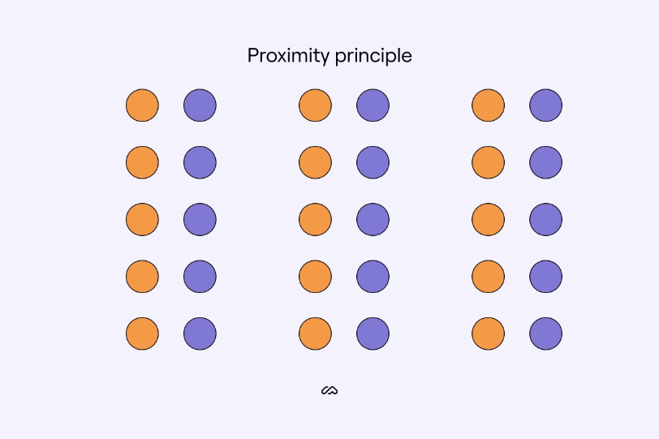
Principle of grouping
According to Gestalt principle ,objects can be perceived meaningfully when they are grouped together.
1)Principle of Proximity
Proximity means nearness.
The object which are nearer to each other can be perceived as a whole.

Slide 22
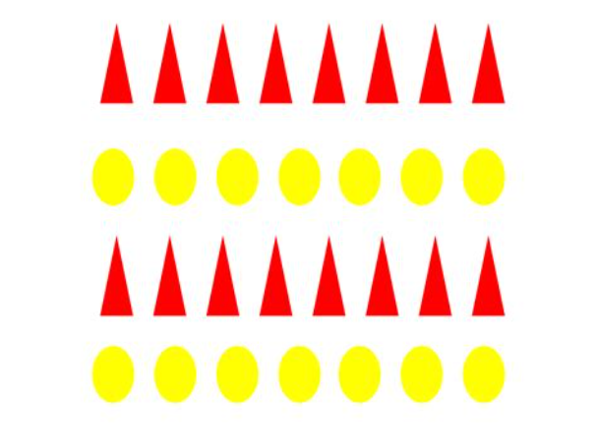
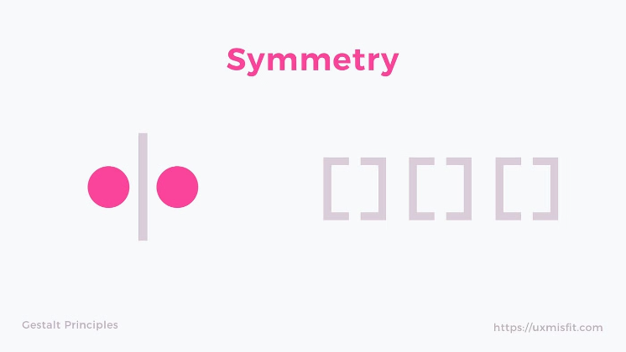
3)Principal of symmetry
2)Principle of Similarity
Objects having symmetrical shape are perceived as groups.
there is a tendency to perceive objects of a similar size , shape or colour as a unit or figure.

Slide 23

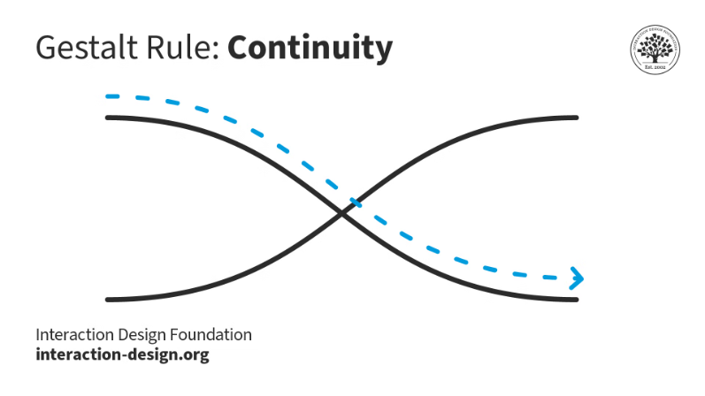
4)Principle of closure
5)Principle of continuity
Items are perceived as complete units even though they may be interrupted by gaps.
Items with the fewest interruptions are perceived as units.

Slide 24
Principle of context
Perceptual organization is also dependent on the context in which we perceive the stimulus.
Principle of adaptability
When perceived in a pleasant context the stimulus will be perceived favourably and when perceived in an unpleasant context, it will tends to be perceived unfavourably.
Adaptability is the tendency of a person to adapt to similar stimuli.
A person who works in a factory subjected to loud noise gets adapted to it and perceive soft noise as negligible.
A patient's behaviour can be perceived both favourably and unfavourably depending on the context in which it occurs.

Slide 25
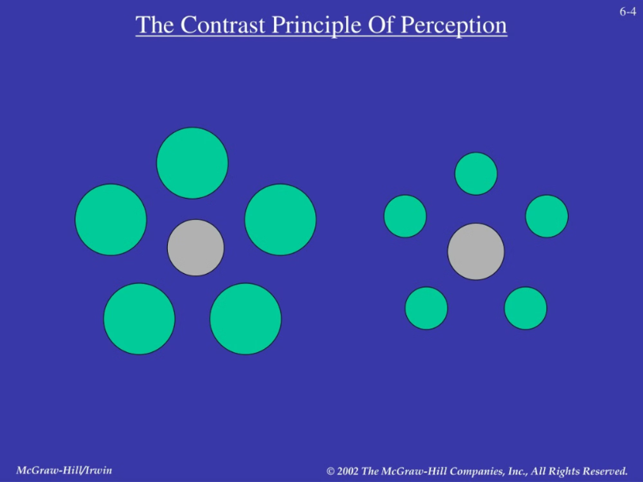
Principle of contrast
When a stimulus is in contrast with a nearby stimulus we tend to perceive it more readily.
That is the reason why dresses with contrast combination appear to be more attractive.
Similarly a patient's behaviour which is contrast to other patients attract our attention and is perceived better.

Slide 26
FACTORS AFFECTING PERCEPTION
1)Internal factors affecting attention also affect perception. Factors are:
Nature of the stimulus
Intensity of the stimulus
Size of the stimulus
Contrast of the stimulus
Reception of the stimulus
Movement of the stimulus

Slide 27
2)External factors affecting attention also affect perception. Factors are:
• Interest of the perceiver
• Motives and drives of the perceiver
• Previous experience of the perceiver
• Mental set of the perceiver
• Desire or need of the perceiver

Slide 28
3)The effective functioning of sense organs affect perception
Sense organs are receptors to receive stimuli and these stimuli are carried to the sensory areas of the brain in the form of nerve impulses.
Any alterations or defects in the normal functioning of sense organs will adversely affect the process of perception.
4)Brain
Different areas of our brain are equipped to receive and process information.
Sensory and association areas of the brain are to function smoothly for the proper processing of information and for proper perception.

