Slide 1
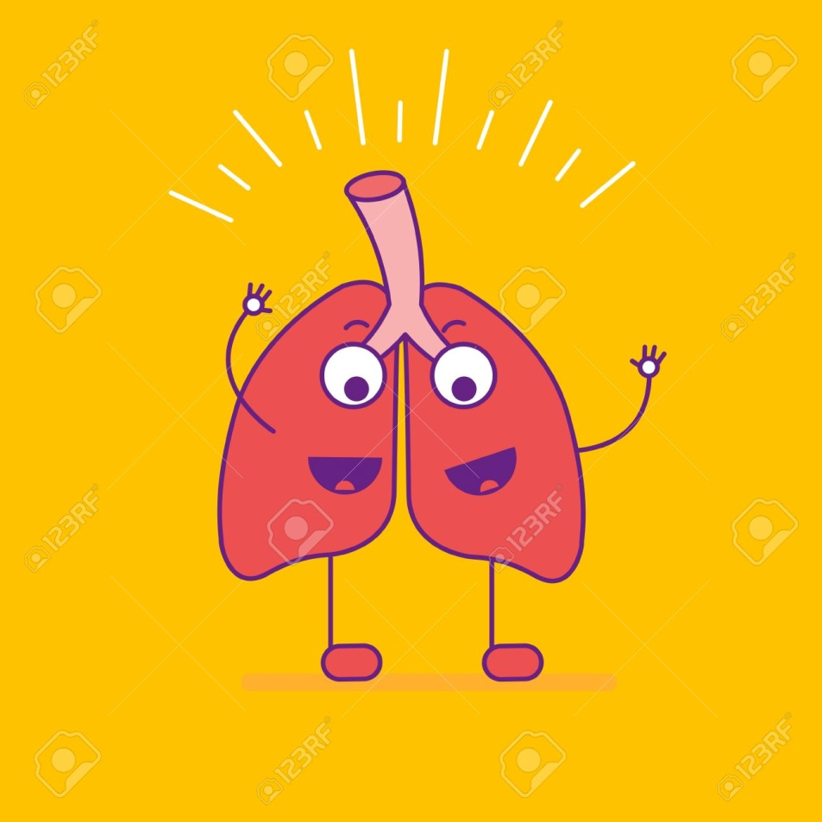
RESPIRATIONS

Slide 2
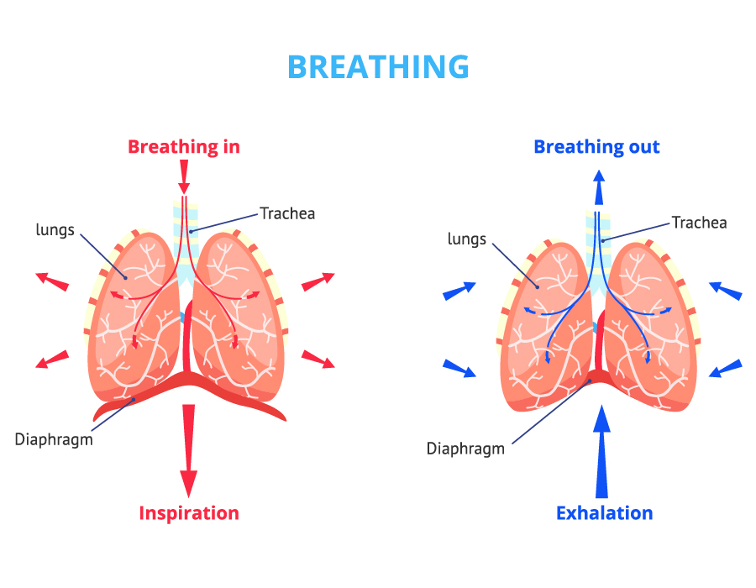

Slide 3
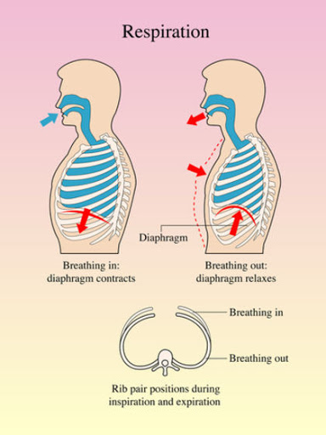

Slide 4


Slide 5
Respiration is the act of breathing.
Inhalation or inspiration refers to the intake of air into the lungs.
Exhalation or expiration refers to breathing out or the movement of gases from the lungs to the atmosphere.
Ventilation is also used to refer to the movement of air in and out of the lungs.

Slide 6
There are basically two types of breathing:
costal (thoracic) breathing and
diaphragmatic (abdominal) breathing.

Slide 7
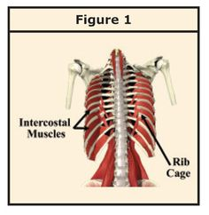
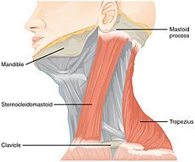
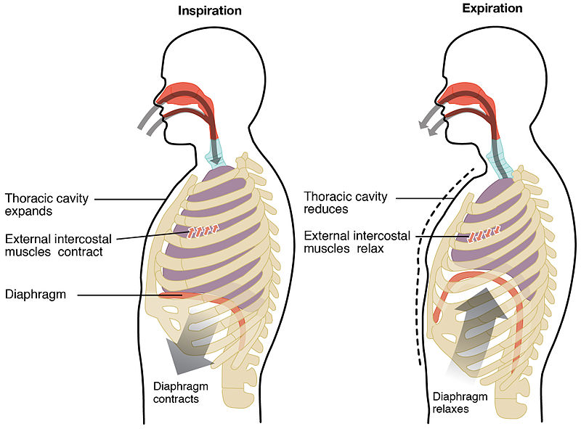
Costal breathing involves the external intercostal muscles and other accessory muscles, such as the sterno-cleidomastoid muscles.
It can be observed by the movement of the chest upward and outward

Slide 8
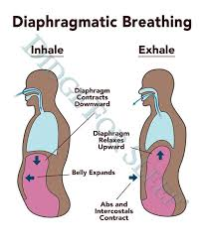
Diaphragmatic breathing involves the contraction and relaxation of the diaphragm, and it is observed by the movement of the abdomen, which occurs as a result of the diaphragm’s contraction and downward movement.

Slide 9
Mechanics and Regulation of Breathing
During inhalation,
The diaphragm contracts (flattens), the ribs move upward and outward, and the sternum moves outward, thus enlarging the thorax and permitting the lungs to expand.

Slide 10
During exhalation
the diaphragm relaxes, the ribs move downward and inward, and the sternum moves inward, thus decreasing the size of the thorax as the lungs are compressed.

Slide 12
Normal breathing is automatic and effortless.
A normal adult inspiration lasts 1 to 1.5 seconds, and an expiration lasts 2 to 3 seconds
.

Slide 13
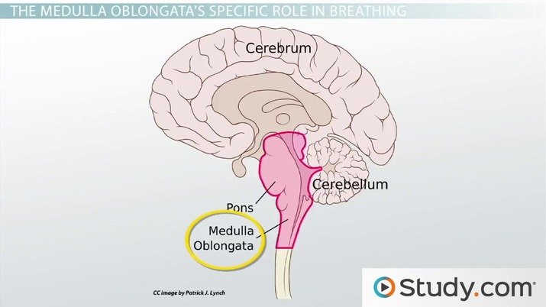

Slide 14
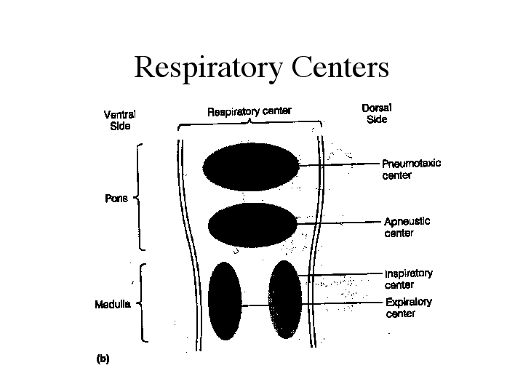
Respiration is controlled by
(a) respiratory centers in the medulla oblongata and the pons of the brain and
(b) chemoreceptors located centrally in the medulla and peripherally in the carotid and aortic bodies.

Slide 15
These centers and receptors respond to changes in the concentrations of oxygen (O2), carbon dioxide (CO2), and hydrogen (H+) in the arterial blood.

Slide 16
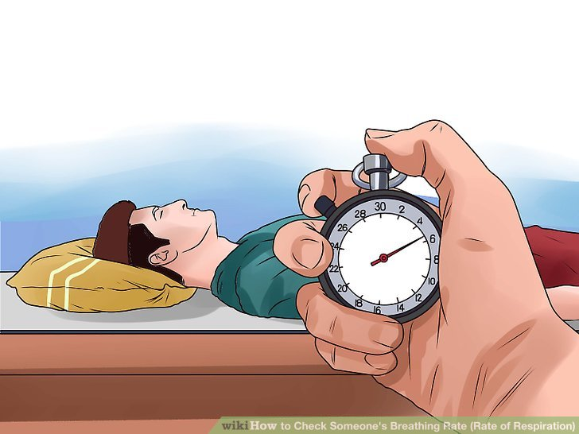
Characteristics of respirations
1) Rate
The number of breaths per minute.
NL-12 to 20 breath per minute

Slide 17
2) Depth / Volume
The depth of a person’s respirations can be established by watching the movement of the chest.
Respiratory depth is generally described as normal, deep, or shallow.

Slide 18
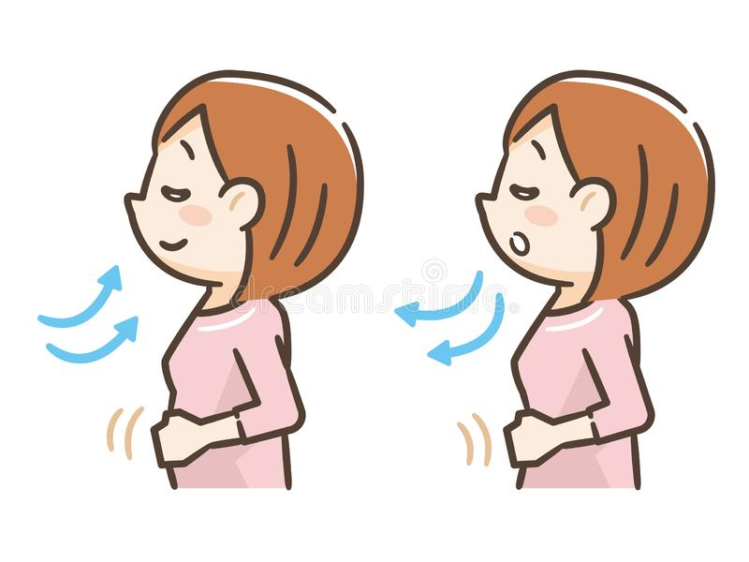
Hyperventilation refers to very deep, rapid respirations;
hypoventilation refers to very shallow respirations.

Slide 19
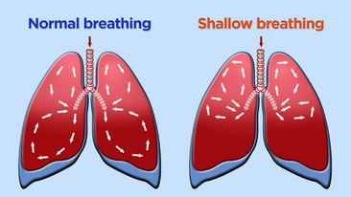
Deep respirations are those in which a large volume of air is inhaled and exhaled, inflating most of the lungs.
Shallow respirations involve the exchange of a small volume of air and often the minimal use of lung tissue.

Slide 20
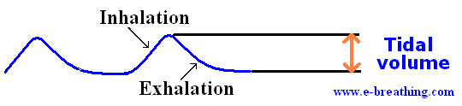
During a normal inspiration and expiration, an adult takes in about 500 mL of air.
This volume is called the tidal volume.

Slide 21
Body Position Also Affects The Amount Of Air That Can Be Inhaled.
People in a supine position experience two physiological processes that suppress respiration:
-an increase in the volume of blood inside the thoracic cavity
-and compression of the chest.

Slide 22
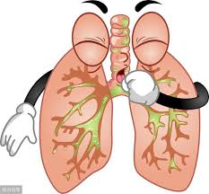
Consequently, clients lying on their back have poorer lung aeration, which predisposes them to the stasis of fluids and subsequent infection.

Slide 23
Certain medications also affect the respiratory depth.
For example, narcotics such as morphine and large doses of barbiturates such as pentobarbital depress the respiratory centers in the brain, thereby depressing the respiratory rate and depth.

Slide 24
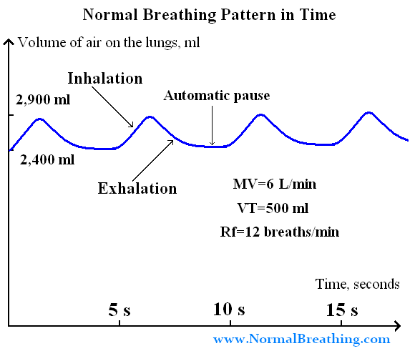
3) Rhythm
Respiratory rhythm refers to the regularity of the expirations and the inspirations. Normally, respirations are evenly spaced.

Slide 25

Respiratory rhythm can be described as regular or irregular.
An infant’s respiratory rhythm may be less regular than an adult’s.

Slide 26
4) Ease or effort
It includes the amount of effort a client must exert to breathe and the sound of breathing.
Usually, breathing does not require noticeable effort.
Sometimes, however, clients can breathe only with substantial effort—this is referred to as labored breathing.

Slide 27

The sound of breathing is also significant.
Normal breathing is silent, but a number of abnormal sounds such as a wheeze are obvious to the nurse’s ear.
Many sounds occur as a result of the presence of fluid in the lungs and are most clearly heard with a stethoscope.

Slide 28
Factors Affecting Respirations

Slide 29
Factors that increase the rate include
exercise (increases metabolism)
stress (readies the body for “fight or flight”)
Increased environmental temperature
lowered oxygen concentration at increased altitudes.
Pain

Slide 30
Factors that may decrease the respiratory rate include
decreased environmental
temperature
certain medications (e.g., narcotics)
increased intracranial pressure.

Slide 31
Normal respiratory rates in different age group
Newborn (30–60)
1 year (20–40)
5–8 years (15–25)
10 years (15–25)
Teen (15–20)
Adult (12–20)
Older adult (15–20)

Slide 32
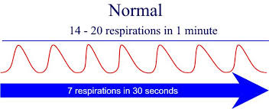

Slide 33
The rate, depth, rhythm, quality, and effectiveness of respirations should be assessed.
The respiratory rate is normally described in breaths per minute.
Breathing that is normal in rate and depth is called eupnea.
Abnormally slow respirations are referred to as bradypnea, and abnormally fast respirations are called tachypnea or polypnea.
Apnea is the absence of breathing.

Slide 34
Altered Breathing Patterns and Sounds

Slide 35
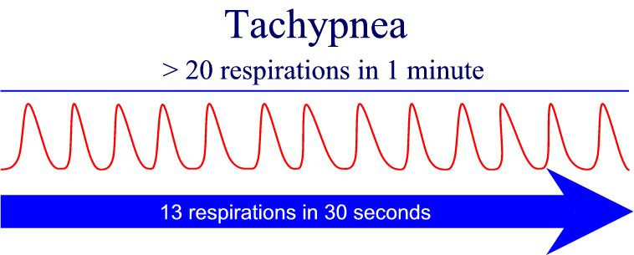
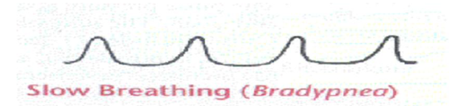
1) Rate
• Tachypnea—quick, shallow breaths
• Bradypnea—abnormally slow breathing
• Apnea—cessation of breathing
Less than 12 breath per min

Slide 36
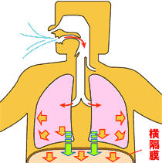
2) Volume
• Hyperventilation—overexpansion of the lungs characterized by rapid and deep breaths
• Hypoventilation—underexpansion of the lungs, characterized by shallow respirations
Hyperventilation hypoventilation

Slide 37
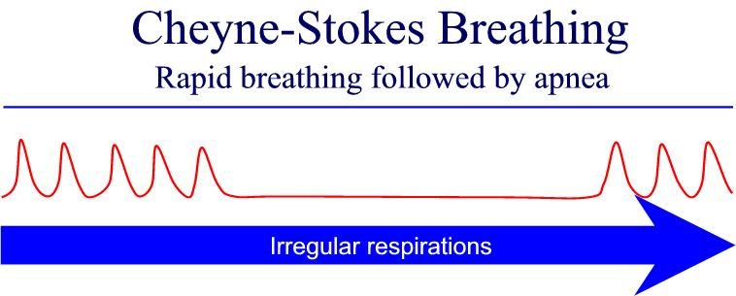
3) Rhythm
• Cheyne-Stokes breathing—rhythmic waxing and waning of respirations, from very deep to very shallow breathing and temporary apnea
Seen in head trauma

Slide 38
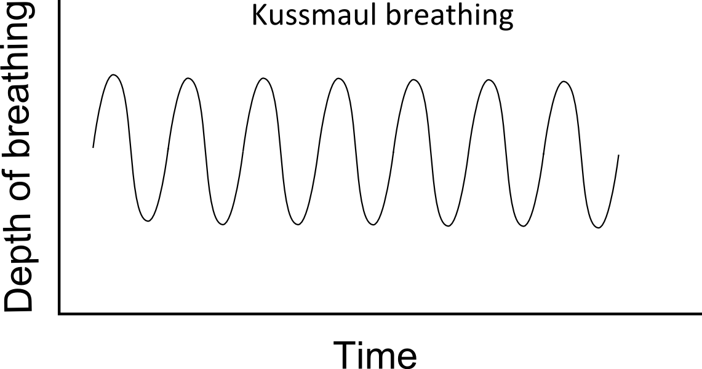
Kussmaul’s respiration
Seen in diabetic patients
Breathing pattern very deep and rapid
Without any pauses

Slide 39
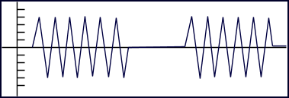
Biot’s respiration
Faster and deeper respirations than normal
With abrupt pauses between them
Breath have equal depth

Slide 40
4) Ease or Effort
• Dyspnea—difficult and labored breathing during which the individual has a persistent, unsatisfied need for air and feels distressed
• Orthopnea—ability to breathe only in upright sitting or standing positions
Apnea :-Absence of respiration

Slide 41
Altered Breathing Sounds
• Stridor—a shrill, harsh sound heard during inspiration with laryngeal obstruction
•Stertor—snoring or sonorous respiration, usually due to a partial obstruction of the upper airway

Slide 42
Wheeze—continuous, high-pitched musical squeak or whistling sound occurring on expiration and sometimes on inspiration when air moves through a narrowed or partially obstructed airway
• Bubbling—gurgling sounds heard as air passes through moist secretions in the respiratory tract

Slide 43
CHEST MOVEMENTS
Intercostal retraction—indrawing between the ribs
Substernal retraction—indrawing beneath the breastbone
Suprasternal retraction—indrawing above the clavicles

Slide 44
SECRETIONS AND COUGHING
• Hemoptysis—the presence of blood in the sputum
• Productive cough—a cough accompanied by expectorated secretions
•Nonproductive cough—a dry, harsh cough without secretions

Slide 45
Assessing Respirations
Resting respirations should be assessed when the client is relaxed because exercise affects respirations, increasing their rate and depth.
Anxiety is likely to affect respiratory rate and depth as well.
Respirations may also need to be assessed after exercise to identify the client’s tolerance to activity.

Slide 46
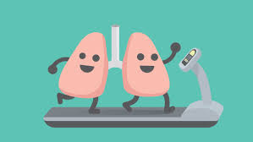
Before assessing a client’s respirations, a nurse should be aware of the following:
The client’s normal breathing pattern
The influence of the client’s health problems on respirations
Any medications or therapies that might affect respirations
The relationship of the client’s respirations to cardiovascular function.

Slide 47
Assessing Respirations
PURPOSES
To acquire baseline data against which future measurements can be compared
To monitor abnormal respirations and respiratory patterns and identify changes
To monitor respirations before or after the administration of a general anesthetic or any medication that influences respirations

Slide 48
To monitor clients at risk for respiratory alterations (e.g., those with fever, pain, acute anxiety, chronic obstructive pulmonary disease, asthma, respiratory infection, pulmonary edema or emboli, chest trauma or constriction, brainstem injury)

Slide 49
ASSESSMENT
Assess
Skin and mucous membrane color (eg:cyanosis)
Position assumed for breathing (eg:use of orthopneic position)
Signs of lack of oxygen to the brain (eg:irritability, restlessness, drowsiness, or loss of consciousness)
Chest movements (e.g., retractions between the ribs or above or below the sternum)
Activity tolerance
Chest pain
Dyspnea
Medications affecting respiratory rate

Slide 50
Equipment
Clock or watch with a sweep second hand or digital seconds indicator
IMPLEMENTATION
Preparation
For a routine assessment of respirations, determine the client’s activity schedule and choose a suitable time to monitor the respirations.
A client who has been exercising will need to rest for a few minutes to permit the accelerated respiratory rate to return to normal.

Slide 51
PROCEDURE
STEPS | RATIONALE
1. Prior to performing the procedure, introduce self and verify the client’s identity using agency protocol | To avoid errors
2. Explain to the client what you are going to do, why it is necessary, and how he or she can participate. Discuss how the results will be used in planning further care or treatments. | To reduce the anxiety of the client
3. Perform hand hygiene and observe appropriate infection prevention procedures. | To prevent cross infection
4. Provide for client privacy | To increase the confidence and reduce anxiety

Slide 52
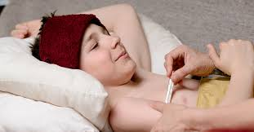
4. Observe or palpate and count the respiratory rate.
The client’s awareness that the nurse is counting the respiratory rate could cause the client to purposefully alter the respiratory pattern.
If you anticipate this, place a hand against the client’s chest to feel the chest movements with breathing, or place the client’s arm across the chest and observe the chest movements while supposedly taking the radial pulse.

Slide 53
Count the respiratory rate for 30 seconds if the respirations are regular. Count for 60 seconds if they are irregular.
An inhalation and an exhalation count as one respiration.
5. Observe the depth, rhythm, and character of respirations.
Observe the respirations for depth by watching the movement of the chest.
6. Document the respiratory rate, depth, rhythm, and character on the appropriate record

Slide 54
EVALUATION
Relate respiratory rate to other vital signs, in particular pulse rate; relate respiratory rhythm and depth to baseline data and health status.
Report to the primary care provider a respiratory rate significantly above or below the normal range and any notable change in respirations from previous assessments; irregular rhythm; inadequate depth; abnormal character of breathing—orthopnea, wheezing, etc and any complaints of dyspnea.

