Slide 1

PERSONALITY
This presentation explores the fascinating world of personality, diving into its origins, classifications, and key types. We'll delve into the nuances of different personality frameworks, uncovering insights into how individuals interact with the world.

Slide 2
The Word's Origin
Definitions of Personality
The word personality is derived from the Latin word Persona which means to speak through.
According to Allport personality is the dynamic organisation within the individual of those psycho physical systems that determine his characteristic behaviour and thought.
Eysenck defines personality is the more or less stable and enduring organisation of a person's character, temperament ,intellect and physic which determines his unique adjustment to the environment.

Slide 3

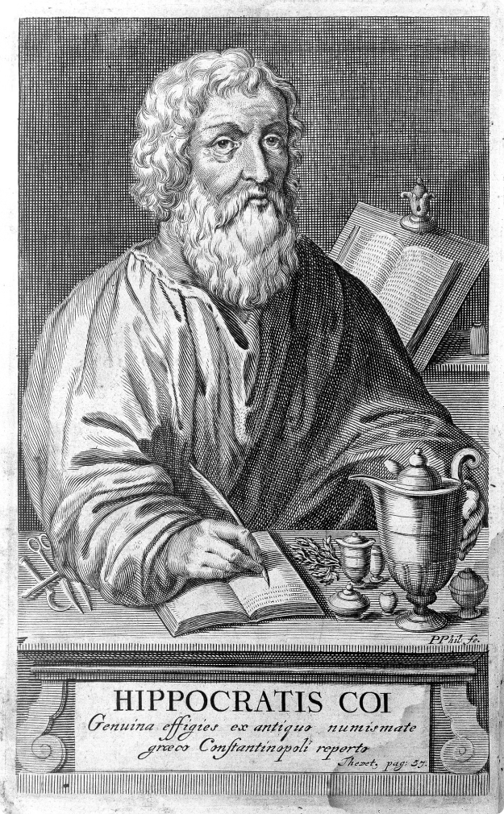
CLASSIFICATION OF PERSONALITY
HIPPOCRATES' TYPES
FLUID
PERSONALITY TYPE
CHARACTERISTICS
Blood
Sanguine
cheerful, optimistic
Yellow bile
Choleric
angry, Irritable
Phlegm
Phlegmatic
cold, calm
Black bile
Melancholic
sad, pessimistic

Slide 4
KRETSCHMER'S TYPE
According to Kretchmer there is a close relationship between one's body structure and personality.
BODY TYPE
PERSONALITY TYPE
Asthenic / Leptosomatic
The individual is generally reserved with drawn sensitive to criticism and makes only very few friends.
Body is tall ,thin narrowly build.
Pyknic
Good natured, sociable, Jolly ,fun loving and hilarious.
Short, round and fat type of body.
Athletic
Energetic, optimistic ,adjustable and generally interested in action rather than ideas and imaginations.
well developed muscular body structure.

Slide 5
CLASSIFICATION BY WILLIAM SHELDON
Sheldon classified personality into three based on body type and temperament.
Endomorphic: The endomorph is short and plum and sociable. He assumed to be relaxed and even tempered. Endomorph is associated with viscerotonic temperament.
Ectomorphic: The ectomorph is tall, lean and thin and said to be restrained and self- conscious. Ectomorph is associated with cerebrotonic temperament.
Mesomorphic: The mesomorph is muscular and heavily set, he likes physical activities. Mesomorph is associated with somatotonic temperament.

Slide 6
TYPE-A AND TYPE -B PERSONALITIES
Proposed by Meyer Friedman and Rosenman.
TYPE-A
TYPE-B
People characterised under type A personality are seen to process high motivation and achievement orientation.
Easy going.
they do not experience the competitive drive and urgency for time.
Time urgency(set time limit)
Work consistently without stress.
Workaholics- tend to perform maximum.
Enjoys achievements.
Ambitious and competitive.

Slide 7
TYPE-A AND TYPE -B PERSONALITIES
Proposed by Meyer Friedman and Rosenman.
TYPE-A
TYPE-B
People characterised under type A personality are seen to process high motivation and achievement orientation.
Easy going.
they do not experience the competitive drive and urgency for time.
Time urgency(set time limit)
Work consistently without stress.
Workaholics- tend to perform maximum.
Enjoys achievements.
Ambitious and competitive.

Slide 8
EYSENCK'S TYPES
Introversion
Extroversion
Neuroticism
A typical introvert is quiet ,retiring sort of a person, introspective, fond of books or computer rather than people .
A typical extrovert is sociable ,likes to party, have many friends.
Neurotic person is anxious, worrying individual , moody and frequently depressed.
They crave for excitement ,takes chances.
They are overtly emotional, reacting strongly to all sorts of stimuli.
They are reserved and distant except to intimate friends .
They are fond of practical jokes, always have a ready answer and generally like changes.
They are at risk of loss of sleep and suffering from psychosomatic disorders.
They keep feelings under close control.

Slide 9
Psychoticism
Lie tendency
A person with strong psychotic tendency may be solitary, not caring for people and troublesome and difficult fitting anywhere.
This dimension of personality has the tendency of dissimilation.
The individual fakes the fact for getting social approval.
They may be cruel and in human ,lacking in feelings and empathy .
To project the good side of a person’s behaviour they may manipulate the real bad habits and tendencies in front of others.
They are aggressive even to loved ones, they may have a liking for odd and unusual things.
They like to make fool of other people and to upset them.

Slide 10


CARL JUNG'S TYPE OF PERSONALITY
Introverts
Extroverts
Generally more imaginative and theoretical type of people.
Extroverts are outgoing, enjoy being in social situations, and thrive on interaction.
They are slightly afraid of external realities. many of them are cool, interested in books, magazines and better in writing than speaking.
Generally realistic and practical and try to verify theoretical knowledge with factual information .
They take calculated risks, like changes and optimistic.
Even though they have strong feelings likes and dislikes, they do not always express their feelings to others.
Extroverts are social, outspoken and they are interested in sports and games and demand constant emotional sensation.

Slide 11
FIVE FACTOR MODEL
Paul Costa and Robert McCrae have introduced 5 factor model of personality ,also called Big five factors.
Openness to experience -people with this factor are imaginative, curious ,open to new ideas and interested in cultural pursuits.
Conscientiousness- this people are achievement oriented ,dependable, responsible, prudent, hard working and self controlled.
Extraversion- extroverts are sociable, active, outgoing and fun loving.
Agreeableness -these people are helpful, cooperative, friendly, caring and nurturing.
Neuroticism -they are emotionally unstable , anxious, worried, irritable and hypertensive.

Slide 12
MEASUREMENT AND EVALUATION OF PERSONALITY
The assessment of personality is broadly classified into two :-
Objective assessment methods and Projective assessment techniques.
OBJECTIVE METHODS
In objective assessment method the standardised measurement devices are used.
The question items are clearly sighted.
While developing objective measures the psychometric properties such as reliability, validity etc. are maintained.

Slide 13
1.Questionnaire
Set of questions used to obtain information about personality from a subject.
It is a popular method as it is fast ,efficient and less expensive means of gathering information about personality characteristics.
It consist of a series of questions for which the subject responds by putting a tick mark on either ‘yes’ or ‘no’ , ‘cannot say’ or ‘undecided’.
The answers are evaluated and used for personality assessment.
2.Personality inventory
A personality inventory is a psychological assessment tool that measures a person's personality traits, strengths, and weakness.
•Eg: Minnesota multiphasic personality inventory (MMPI),California psychological inventory(CPI), 16 PF etc.

Slide 14
Minnesota Multiphasic Personality Inventory (MMPI)
Developed in the late 1930's by psychologist Starke R Hathaway and psychiatrist JC McKinley at the University of Minnesota.
It is used in psychology for counseling and research purpose.
The test is also used to evaluate the effectiveness of treatment programs, including substance abuse programs.
The MMPI contains 567 test items and takes approximately 60-90 minutes to complete.
The 16 personality factor questionnaire(16 PF)
A comprehensive measure of personality found to be effective in a variety of settings where an in depth assessment of the whole person is needed.
Developed by Raymond Cattel.
Focuses on 16 factors that reflect characteristics of the human personality.

Slide 15
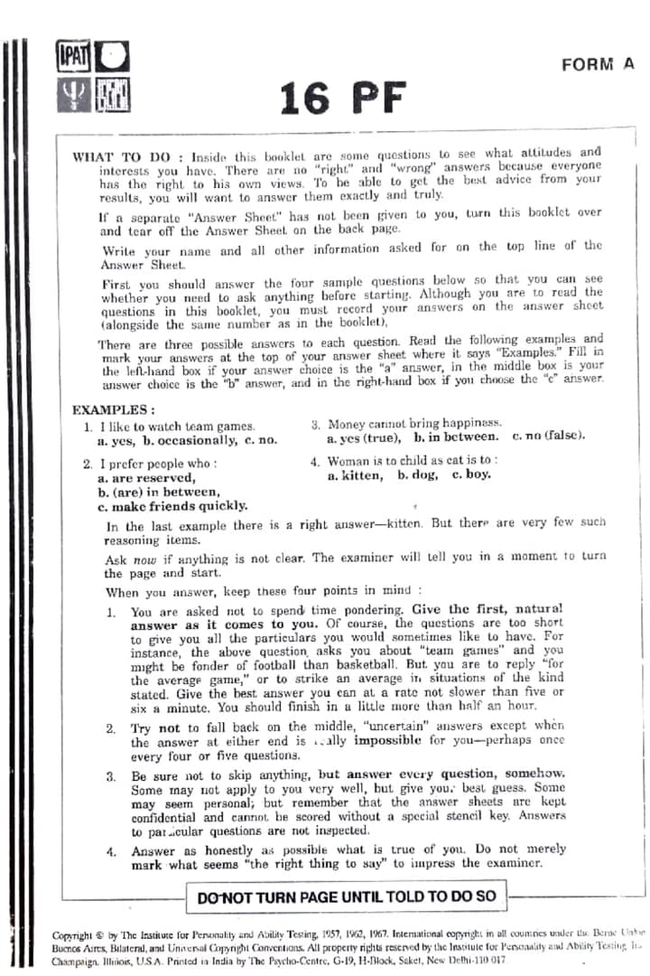

Slide 16
•3.Rating scale
Rating scales are tools which give an opportunity to the subject to rate with regards to their personality traits.
By using a rating scale the examiner can understand where and individual stands in terms of certain personality characteristics.
5 points scale ,7 points scales and 3 point scales are available.
Eg: Hamilton’s depression rating scale.
4.Interview
It is a face to face conversation between the subject and expert to get information from the subject about his personality.

Slide 17
5.Observation
Another popular method to study personality characteristics of an individual in real life situation.
Projective techniques
The main purpose of projective technique is objective assessment of personality.
They are very easy to score and can be evaluated for reliability and validity.
Through the response of the subject unconsciously projects the components of personality.

Slide 18
Rorschach inkblot test
It is one of the most widely used projected techniques.
This technique was developed by Herman Rorschach.
The materials of the test consists of 10 cards on which ink blots are depicted.
Five cards are in black and white, two are in black and red and three are in multicoloured.
This inkblot are completely unstructured and they do not possess any meaning.
The cards are presented to the subject one by one and asked to say whatever comes to mind.

Slide 19
The subject is again told that there is no right answer ,no wrong answer and no good answer and no bad answer.
Their response will be recorded. apart from this, reaction time to give the first response and the total time taken for all the responses in each card and the position of the card are recorded.
The second part of administration is the enquiry phase.
It is intended to get clarification for finding the reason of each response and the location of each percept.
Administration, scoring, analysis and interpretation of the responses can be made as per the direction of the manual.

Slide 20
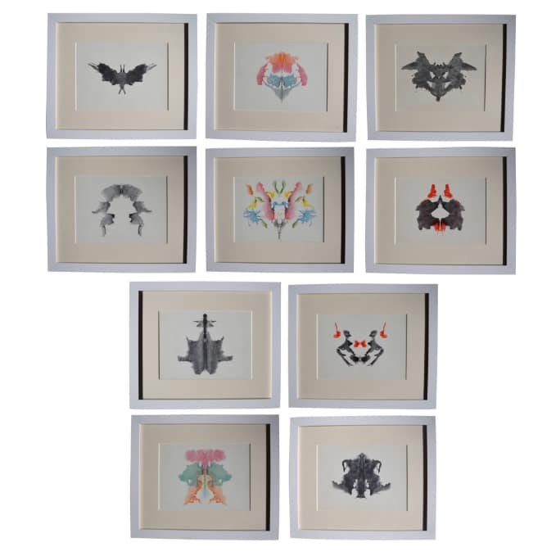

Slide 21
Thematic Apperception test
It is another widely used projective technique developed by Murray and Morgan.
It consist of 30 pictures which portrait human being in a variety of situations .
10 of these are meant for males, 10 for females and 10 for both the sexes .
There is another blank card also.
The cards are presented one at a time.
The subject is asked to write a story describing the situation presented in the picture.
The story should contain three areas ,at first the subject has to write about what is happening at the moment ,then to write what all led up to the situation and finally what will happen in the future.
The theme should contain the present, past and the future of the story.

Slide 22
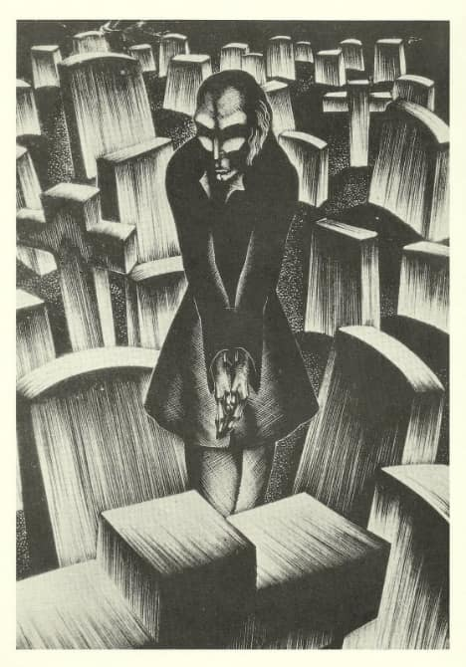
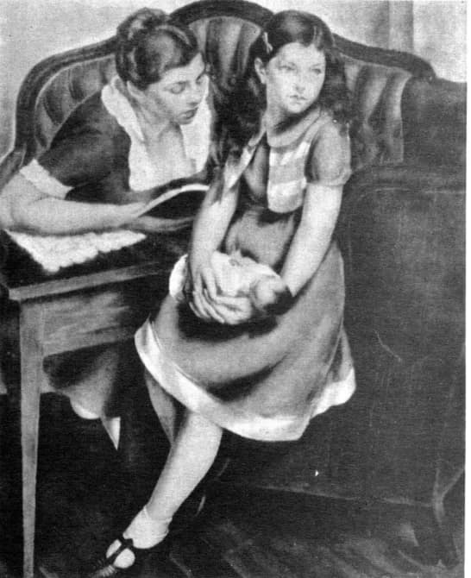

Slide 23
Sentence completion test
In this test a number of incomplete sentences are given to the subject.
The starting part is presented and the subject has to write and make it a complete sentence.
The subject can take freedom to complete it in anyway he wishes.
Eg : my father seldom -------.
To me my future -------.
I would do anything to forget ------.
After completing all the items in a test, the responses are categorised, analysed and interpreted.
Eg: Sack’s sentence completion test.

Slide 24
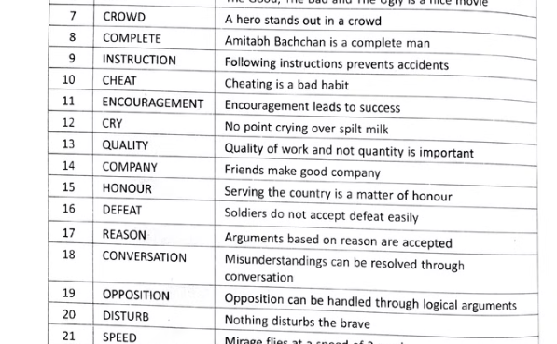
•Word association test
This projective method was introduced by C.G Jung.
In this technique there are a number of selected words. The examiner tells the words one by one and the subject has to reply with the first sentence that comes into his mind.
In giving reply there is no right or wrong answers rather subject can take the freedom.
The examiner records the reply, the reaction time and other unusual behaviour and expressions for personality interpretation.

Slide 25
Draw a person test
In this projective technique, the subject is asked to draw a person.
A sheet of paper, a pencil and an eraser are provided to the subject.
After completion of the human figure the subject is asked to draw the figure of an opposite sex person.
Eg: Machover draw a person test.
Here the beauty or aesthetic aspect is not considered rather the proportion of parts, stress given to each organ, the type of lines etc. important.

Slide 26
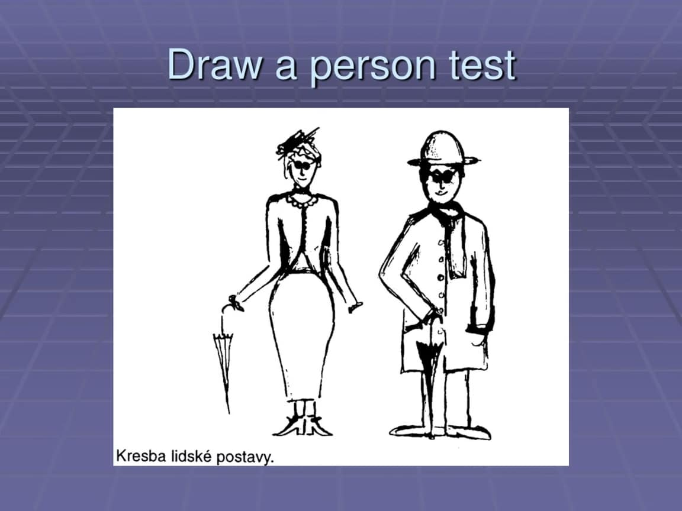

Slide 27
Situational tests
Generally a situation is artificially created in which an individual is given opportunity to perform his or her role.
For example, to test the honesty of an individual without their knowledge some hypothetical situations can be created and asked how they would respond.
Alteration in personality
Alteration in personality can occur due to a number of reasons.
Sudden changes in the environment
Negative life events
Economic and work pressure
Irresponsible child rearing practices
Chronic or acute illnesses
Serious injury, damage of frontal lobe
Personality disorders
Drug abuse

Slide 28
Alteration in personality can lead to:-
Confusion and Delirium
Confusion and delirium refer to a disturbance of consciousness.
People are less aware about their environment and may be excessively agitated and drowsy.
Delirium often results from a serious, newly - developed physical problem or a reaction to a drug, especially in older people.
If the cause of delirium is identified and corrected quickly, delirium often resolves.
Delusions
Delusions are fixed false beliefs that people hold despite evidence to the contrary.
Some delusions are based on a misinterpretation of actual perceptions and experiences.

Slide 29
For example, people may feel persecuted, thinking that a person behind them on the street is following them. Other people think that song lyrics or newspaper articles contain messages that refer specifically to them.
Disorganized Speech
Disorganized speech refers to speech that does not contain the expected logical connections between thoughts or between questions and answers.
For example, people may jump from one topic to another without ever finishing a thought.
Disorganized Behaviour
Disorganized behaviour refers to doing quite unusual things (such as undressing in public or shouting and swearing for no apparent reason) or to being unable to behave normally.

Slide 30
Hallucinations
Hallucinations refer to hearing, seeing, smelling, tasting, or feeling things that are not actually there.
personality disorders
Paranoid personality disorder
Schizoid personality disorder
Antisocial personality disorder
borderline personality disorder
Narcissistic personality disorder

Slide 31
Role of nurse in identification of personality and improving altered personality
• Encourage physical activities.
• Discuss the illness conditions with the patients.
• Enhance interpersonal relationships through listening and responding.
• Use appropriate body language such as smiling, nodding and pleasant facial expressions.
• Teach simple relaxation techniques like deep breathing exercises and meditation.
• Provide reassurance and positive feedback.
• Provide psycho education about illness to the family.
• Refer the patients for psychological support when needed.

