Slide 1

STUDENT PERFORMANCE MONITOR
BY GROUP 01

Slide 2
THE CURRENT
SYSTEM

Slide 3
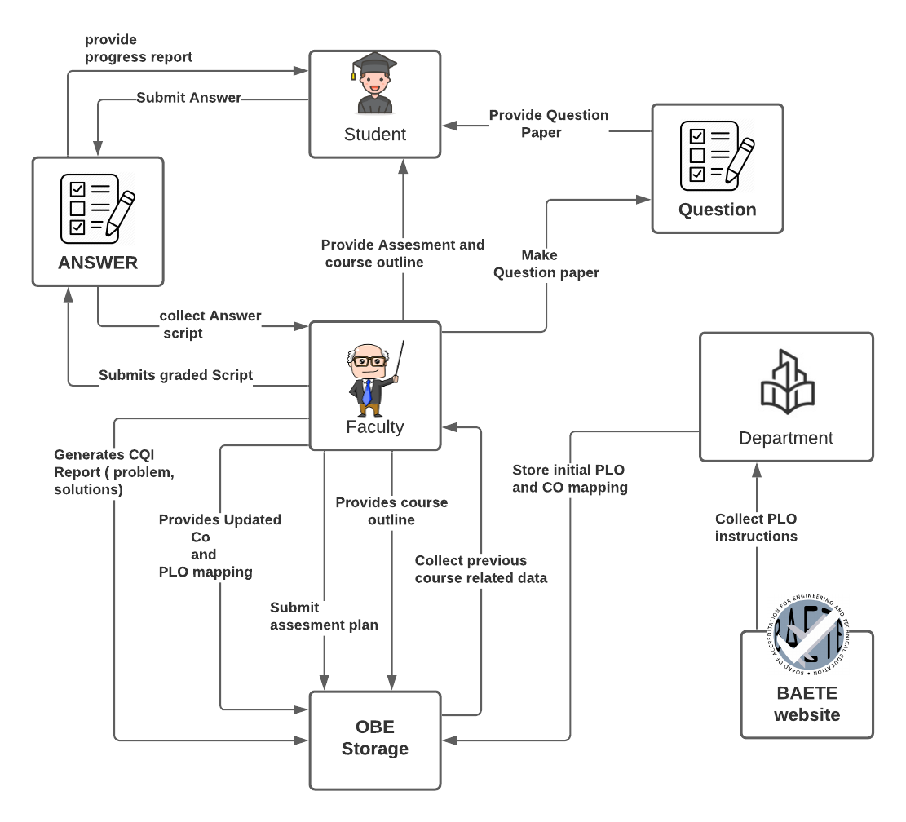

Slide 4
CURRENT PROCESSES
Faculty collect PLO from BEATE website and mapped the CO’s with the PLO.
Mapped CO’s to individual assessment and make question paper.
Students give exam and submit the answer script.
Faculty check script and mark them.
Save the marks in an Excel File.
Those info will be stored in OBE storage.

Slide 5
THE MAIN PROBLEM OF THE CURRENT SYSTEM
Takes too much time, energy and resources
Data is stored, but not utilized in any way.
Data lose probability is high.
Faculty members might enter wrong data.
The faculty members do not have the flexibility to adapt their curriculum and the COs whenever they see fit.
Difficult to make continuous quality improvement .

Slide 6
AN ALTERNATIVE ,
STUDENT PERFORMANCE MONITOR
S P M

Slide 8
SPM PROCESSES
System already contains the PLO, mapping is being automated.
System contains question papers and their sample answer.
Answer scripts will be checked by the system.
System will contain marks of every student.
System will generate various charts and graphs

Slide 9
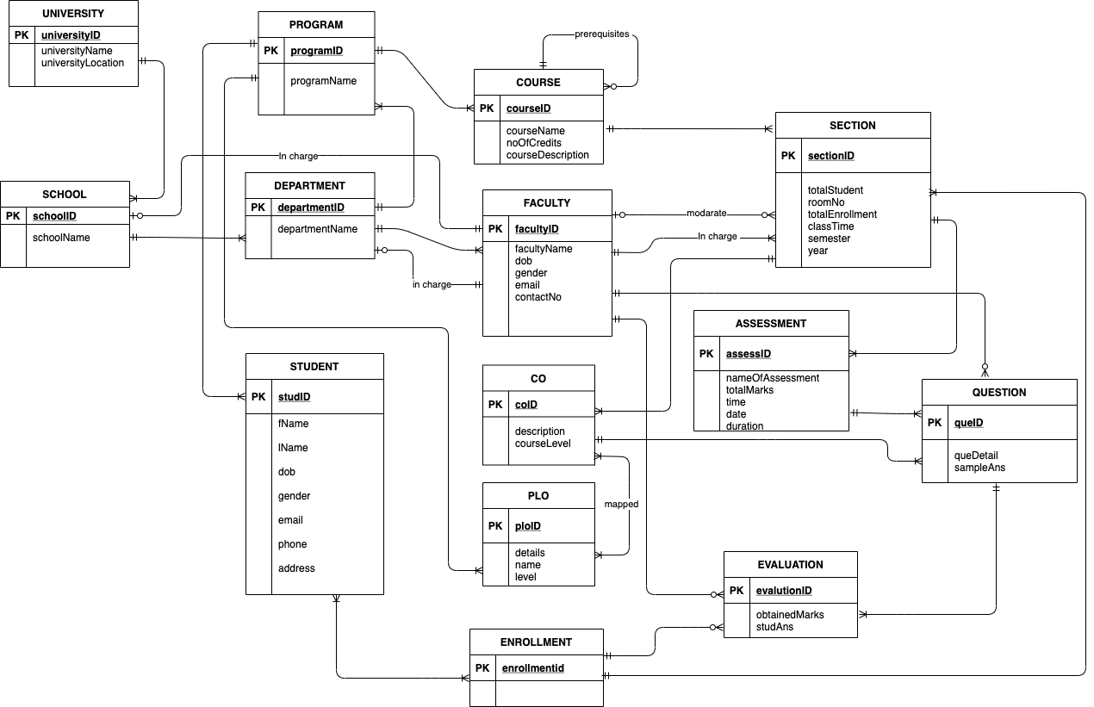
SYSTEM DESIGN

Slide 10
INPUT FORMS
University Account
School Account
Department Account
Faculty Member Account
Student Account
Upload Course Info
Setup Program Info
PLO Info Input
Course Offer Information
Course Registration
PLO Set up for a course (by department Head)
Select PLO of a Course
CO PLO Mapping
Make Question
Question Paper Review
Student Attendance interface
This interface will for Student registration

Slide 11
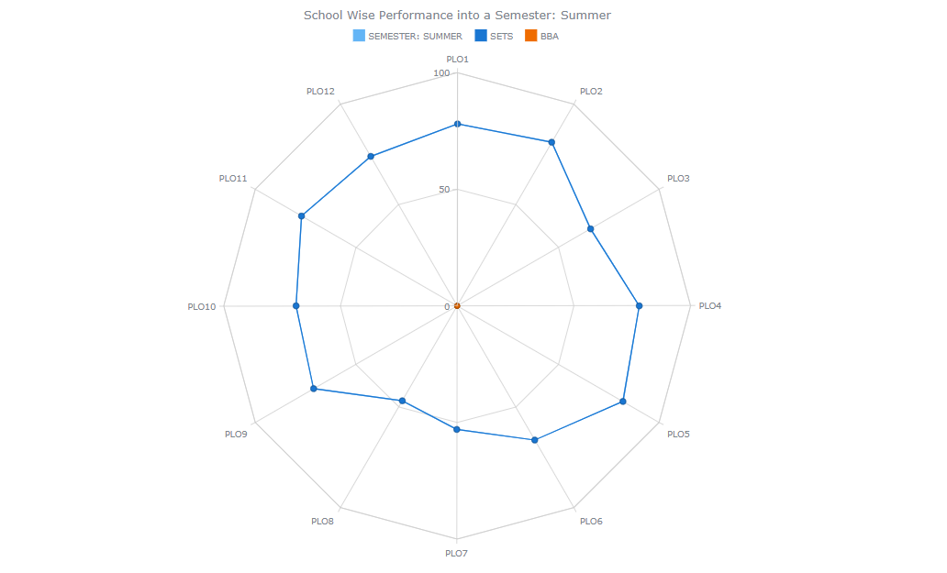
Project Output Graph

Slide 12
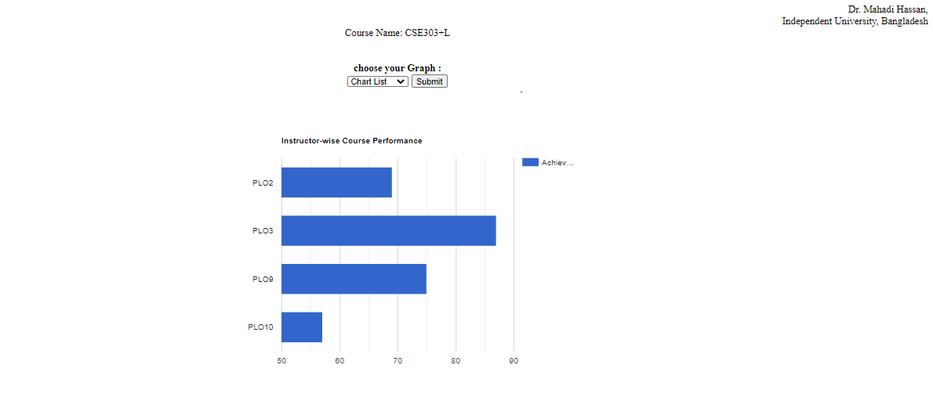

Slide 13
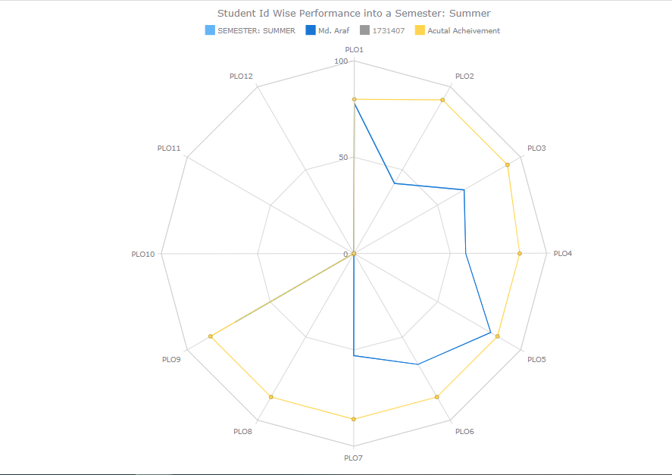

Slide 14
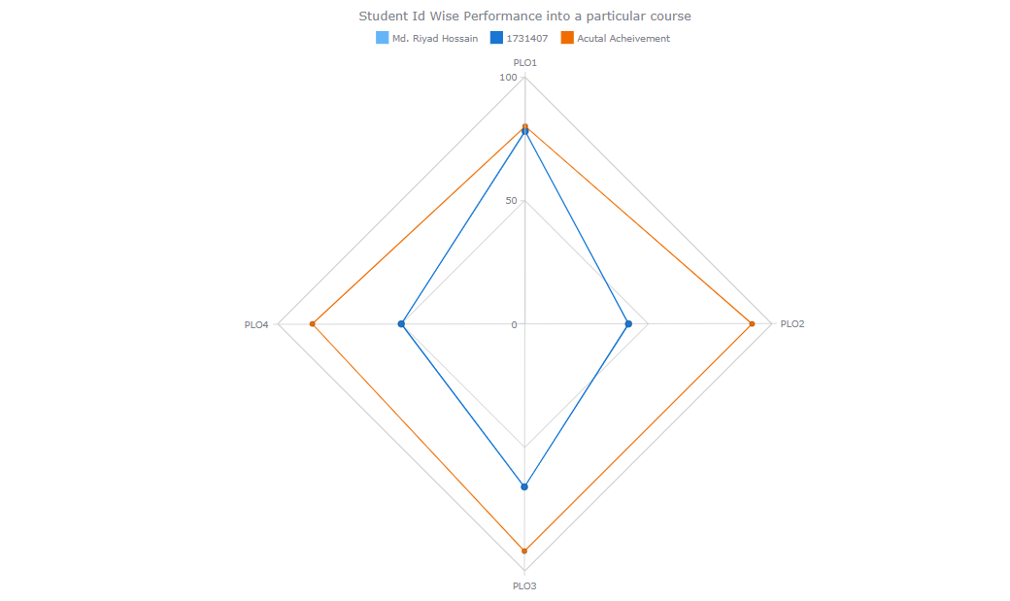

Slide 15
Thank You

