Slide 1




The "Ta'ana" project aims to develop a system for detecting traffic accidents through video analysis to improve road safety.

Slide 2
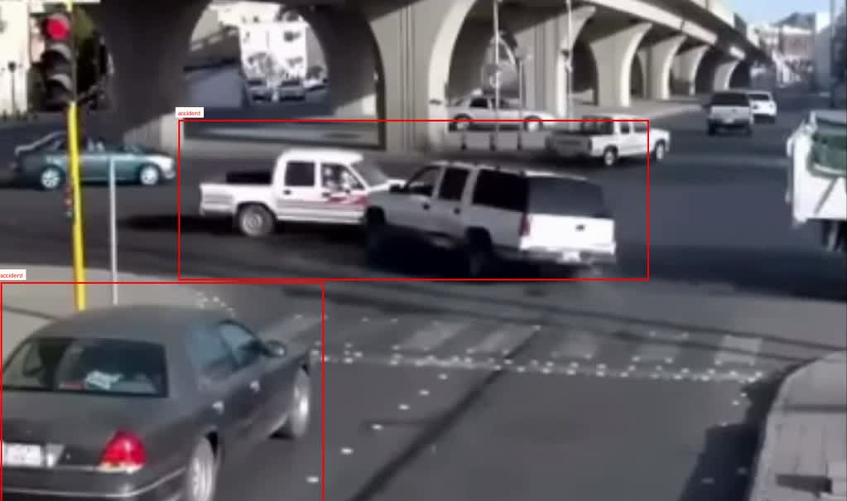

Slide 3
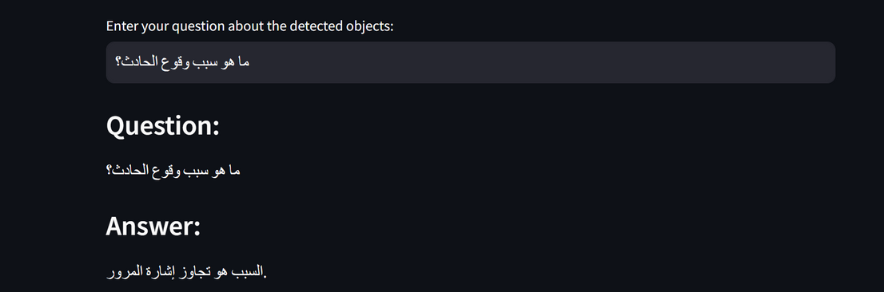

Slide 4
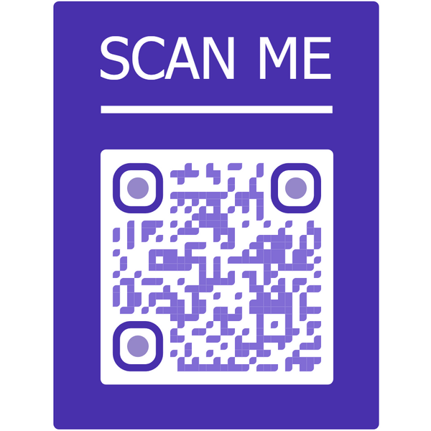
Ta’ana Team
Rahaf Hasan
Hanan Hamdan
Afrah Jaber
Raghad Mohammed

Slide 5

Thank you

