Slide 1

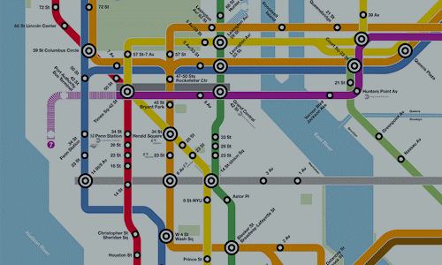
MTA Busiest Station
Afrah Almoutit – Project 1

Slide 2
Introduction:
Ministry of Health in New York planning to providing vaccine center COVID-19. It requested the provision of MTA study to choose right place..

Slide 3
Problem:
Determine what is the busiest station?

Slide 4
Gola:
The goal is limit the spread COVID-19 based on choosing the busiest station to open vaccine center

Slide 5
Data:
MTA Turnstiles
Station Name
C/A
SCP
Date
Unit
Line name
Division
Time
DESC
Entries
Exits
from April to February, 2021

Slide 6
Process:
Data
Cleaning
Reformatting station names
Missing values
Duplication
Aggregation
Sum of entries and exits
Visualization
Using Plotly , matplotlib

Slide 7
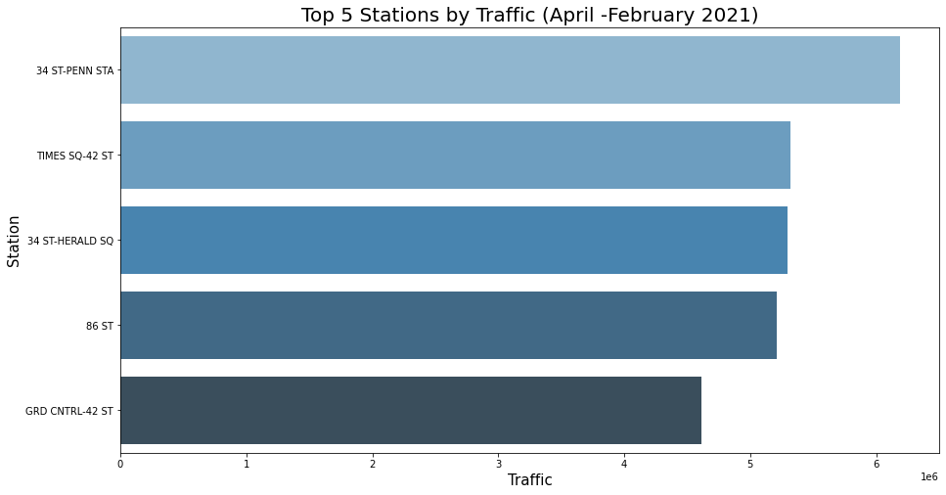
Findings:

Slide 8
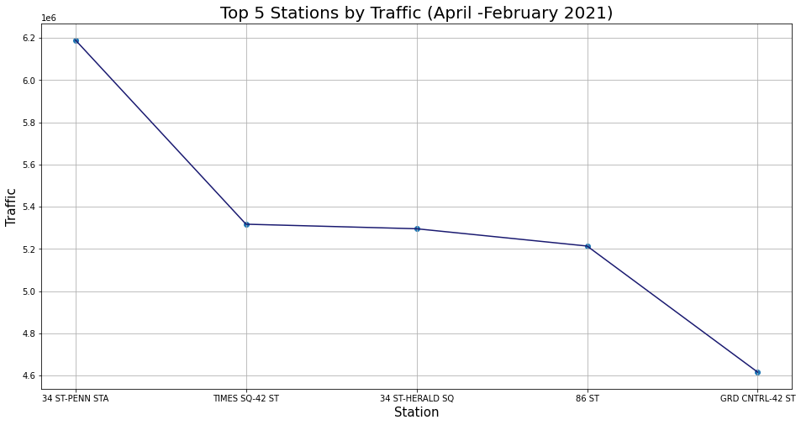
Findings:

Slide 9
Recommendation:
prioritize 34-ST-PENN station to build vaccine center.

