Slide 1
A Career in
Data Science
Using Data to protect and transform Public Health Management
Afraz Arif Khan- Data Scientist II PHSA
24th April 2026

Slide 2


We gratefully acknowledge that we are gathered on the unceded, traditional, and ancestral lands of First Nations in this place currently known as British Columbia where we work, play and live. ​
​
First Nations have been responsible for stewarding ​ this land for all time and we give thanks ​ as uninvited guests on these lands. ​
​
We recognize the historic and ongoing colonial impacts on all​ First Nations, Métis Peoples and Inuit that call this land home. ​
Notes:
Notes from PHSA: As a presenter, we encourage you to put some time and reflection into the land acknowledgment to make it more meaningful and personal.
For example:
I am grateful to speak to you today from the traditional, ancestral and unceded territory of the xʷməθkʷəy̓əm (Musqueam), Sḵwx̱wú7mesh (Squamish), and səlilwətaɬ (Tsleil-Waututh) First Nations.
Here are some guiding questions for people creating a land acknowledgment:
What is your intention or commitment to create a land acknowledgment?
How can you create an acknowledgement that holds up the original people of these lands?
How does the land connect to your work/organization and how does it speak to the importance of ensuring Indigenous Cultural Safety is at the heart of the messaging you convey?
Do you have a personal or professional commitment that builds off the acknowledgement?
How can your acknowledgement share your commitment to truth telling: i.e. reconciliation, addressing racism and long standing inequities?
How have you benefited personally and professionally from living and working on the land you are on? ​
Here are some resources to review in regards to land acknowledgment:
Haden King's Regrets
https://www.cbc.ca/radio/unreserved/redrawing-the-lines-1.4973363/i-regret-it-hayden-king-on-writing-ryerson-university-s-territorial-acknowledgement-1.4973371
Baroness von Sketch Show
https://www.youtube.com/watch?v=xlG17C19nYo
Chelsea Vowel 2016 Beyond Territorial Acknowledgements
https://apihtawikosisan.com/2016/09/beyond-territorial-acknowledgments/
NAHLA 2019 Template for personalizing Land Acknowledgement
https://www.chla-absc.ca/docs/NAHLALandAcnowledgement_4.pdf

Slide 3






Reflection of Journey
High School
Data Scientist II
Discovered love for math, science & technology
EDUCATION
BC Centre for Disease Control
MEng Electrical Engineering
Imperial College London
Using AI & data to protect public health in BC
Imperial College
London
2014 – 2018
MSc Finance
Engineering foundation & discovered ML & AI
University of British Columbia
5+ years in outbreak modelling, hospital burden & risk prediction
2018 – 2021
UBC Sauder
School of Business
Pivoted to finance - noticed data governance gaps
IMPACT
Love math, science & problem solving
Predict disease outbreaks & hospital demand
BC Centre for
Disease Control
Didn’t start here- Engineering to Finance to Data Science
Real-world epidemiological modelling & public health AI tools
Joined during pandemic -applied data science to healthcare
Today
Turning data into decisions that protect communities
Senior Data Scientist predicting outbreaks & saving lives

Slide 4









What is Data Science?
Real-World Use Cases
Netflix
Google Maps
Recommends shows you'll love
Predicts traffic and best routes
UNDERSTAND
ANALYZE
Disease Control
Ask the right questions
and define the problem
Find patterns using
statistics & algorithms
Weather Apps
Forecasts disease outbreaks
DATA SCIENCE
7-day forecasts from sensor data
Banking
IMPACT
Gaming
Detects fraud in real-time
Turn insights into decisions
that create real-world
value
Personalises difficulty & matches
Key Skills for Data Science
Mathematics & Statistics
Computer
Programming
Domain
Knowledge
Curiosity &
Problem Solving
Find patterns and test ideas
Build tools and analyze data
Understand context and ask the right questions
Turn questions into impact

Slide 5
What Skills Do You Need?
Math & Stats
Programming
Critical Thinking
Algebra, probability, statistics - the engine behind every prediction
Python or R - the most used languages.
Asking the right question is half the answer. Curiosity is the most important aspect
Data Storytelling
Domain Knowledge
Communication
Turning numbers into charts and insights that non-experts understand.
Understanding the field (health, finance, etc.) so data has context and can be used.
Working with teams, writing reports, explaining results clearly.

Slide 6
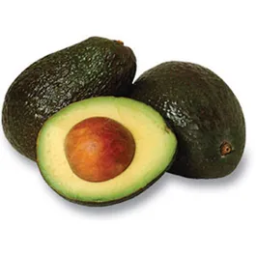
Data Science Starts in a Spreadsheet
Can eating avocados predict your exam grade? Let's find out.
Can we predict whether a student gets an A on their exam based on their habits and grades? Features (inputs):
Hours studied per week
Sleep hours per night
Math grade (0–100)
Eats avocados? (Yes/No)
Target (output):
Gets an A on exam? (Yes/No)
Our Excel Spreadsheet
Student | Hrs/Wk | Sleep | Math % | Avocado? | Got A?
Alice | 15 | 8 | 88 | Yes | ✅ Yes
Bob | 4 | 5 | 61 | No | ❌ No
Carla | 12 | 7 | 79 | Yes | ✅ Yes
David | 8 | 6 | 73 | No | ❌ No
Elena | 18 | 8 | 94 | No | ✅ Yes
Frank | 3 | 5 | 55 | Yes | ❌ No
Grace | 14 | 7 | 85 | Yes | ✅ Yes
Henry | 6 | 6 | 66 | No | ❌ No
The ML model learns: study time & math grade matter most. Avocados?

Slide 7
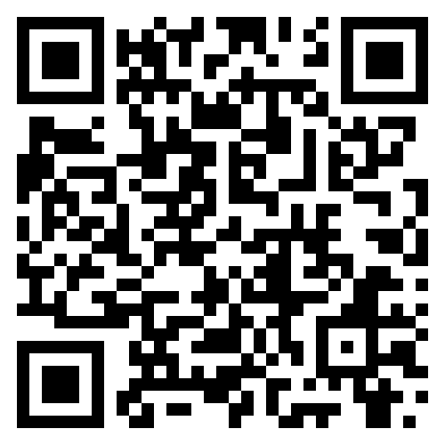
Dashboard Demo
Scan here to begin voting
The dashboard itself is available on https://afrazmathapp.streamlit.app/
Note: The voting page and the dashboard page are different

Slide 8
Data Science & Healthcare- The Future And Present
1
CLINICAL CARE & PATIENT OUTCOMES
2
PUBLIC HEALTH & POPULATION ANALYTICS
3
HEALTHCARE OPERATIONS & SYSTEM EFFICIENCY
Predict risks, complications & readmissions
Support diagnosis & treatment decisions
Medical imaging for faster, more accurate detection
Personalized treatments based on patient data
Predict disease outbreaks & track spread
Monitor population health trends
Identify health risks & target interventions
Detect disparities & improve health equity
Forecast hospital demand (beds, ICU, staff)
Optimize resources & reduce bottlenecks
Improve emergency response & ambulance demand
Automate billing, coding & workflows
Detect fraud in claims
4
CLINICAL DATA & PATIENT RECORDS (NLP)
5
DRUG DISCOVERY & RESEARCH
6
GENOMICS & PRECISION HEALTH
Extract insights from doctor notes & patient charts
Automate documentation & reduce clinician burden
Enable faster, better decisions from unstructured data
Identify new compounds & drug targets
Predict clinical trial success & optimize trial design
Accelerate research & reduce time to treatment
Analyze DNA to predict disease risk
Match patients to targeted therapies
Support early detection of complex conditions
VIRTUAL CARE & REMOTE MONITORING
THE FUTURE
AI triage tools & virtual assistants
Wearables & real-time health monitoring
Early alerts for deterioration
From reactive to predictive & preventative care
Integration of real-time data
Data-driven decisions
More equitable, efficient & resilient healthcare systems

Slide 9
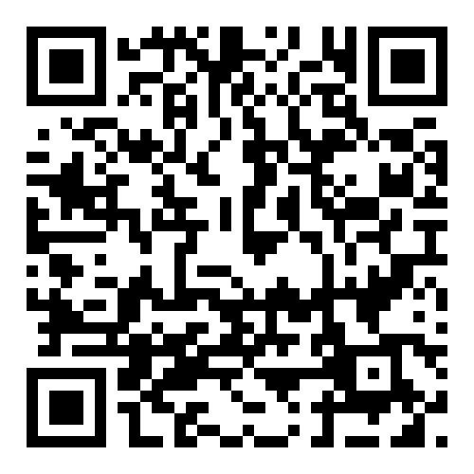
A live COVID outbreak demo
Scan here to begin voting
The dashboard itself is available on https://afrazdiseasedashboard.streamlit.app/
Note: The voting page and the dashboard page are different

Slide 10
A Day in the Life of a Data Scientist
Morning
Average DS salary in Canada
Review incoming data — check quality, flag anomalies, understand what changed overnight
$90,000 – $160,000 / year
Mid-Morning
Explore the data — ask questions, build visualisations, look for patterns
Afternoon
Build or refine models — write Python code, train algorithms, evaluate predictions
Late Afternoon
Present findings — show results to health officers, policymakers and stakeholders

Slide 11
How Can YOU Get Started?
01
Improve Python
02
Play with Data
Khan Academy, Codecademy, YouTube- further help improve- practice!
Kaggle.com has free datasets & beginner competitions. Explore one that interests you.
03
Take a Course
04
Build a Project
Coursera, edX & DataCamp offer intro data science courses - many are free to audit.
Analyse your own data — music taste, sports stats, video games — anything you love.
05
Stay Curious
06
It's OK to Pivot
Follow data scientists on LinkedIn & YouTube. Read about AI in the news every week.
I studied engineering, then finance. Your first step doesn't have to be your last.

Slide 12
Come work with us
We have Co-ops when you go to college!
There are openings on: https://www.phsa.ca/careers

Slide 13
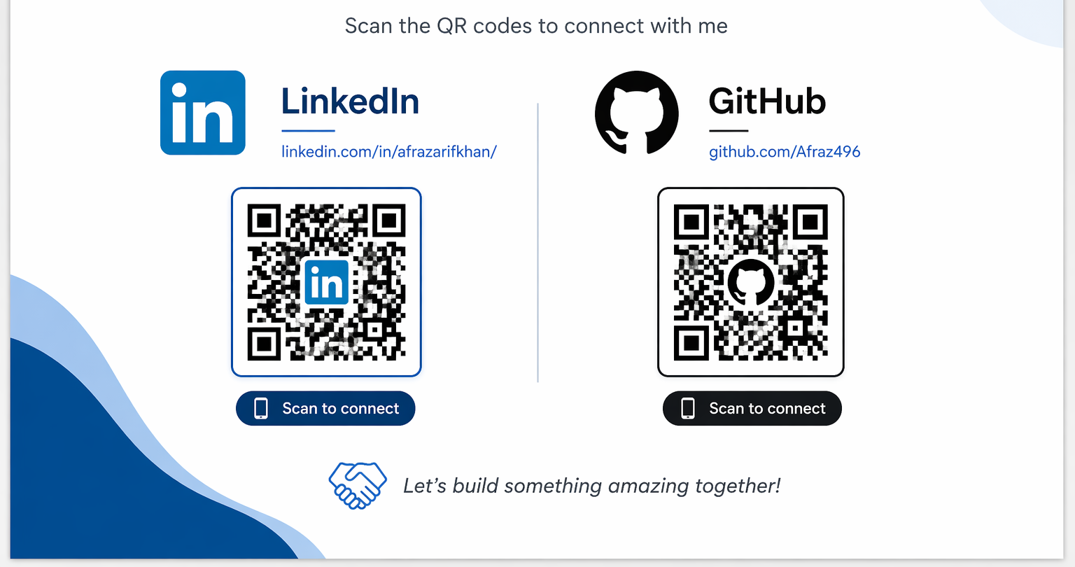
Contact Me

Slide 14
Thank you

