Slide 1
Kubernetes for our modelling team
Why our environments keep breaking, how to stand up a cluster, and whether it is worth it
Afraz Khan · Data Scientist II, BCCDC
Notes:
Roadmap in one sentence: we start with the dependency problem everyone in this room has already lost a day to, then containers as the fix, then a live-ish walkthrough of standing up a cluster, then where it runs and what it costs.

Slide 2
It is almost never the code that breaks
Every one of us has lost a day to something below our own script
Two projects, one machine
The lockfile is not the whole tree
One model was pinned against an older numpy and a newer one needs the current release. On a shared host, one of them loses - and it is usually the one nobody touched recently.
A dozen lines in requirements.txt resolve into hundreds of packages. You pinned the ones you named; the transitive ones move underneath you.
Upgrades happen without you
"It works on my machine"
Someone patches R or a system library on the server. Nothing in your project changed, and last year's script no longer reproduces last year's numbers.
The machine is the environment - and the machine is not in version control, not reviewed, and not recreatable if it is rebuilt.
Notes:
Ask the room for their own example before moving on. Someone will have a good one, and it makes the rest of the talk land as a fix rather than a fashion.

Slide 3
renv and venv only cover the top of the stack
Everything below the line is still whatever the server happens to have installed
Your analysis code
git
Covered by our lockfiles
Reviewed, versioned, reproducible.
R and Python packages
renv / venv / conda
System libraries: GDAL, libxml2, BLAS
whatever apt installed
Not covered by anything
Operating system and glibc
whatever the host runs
This is where the day disappears. Three quarters of the stack our results depend on is undocumented, and it changes without a commit.
GPU drivers and CUDA
whatever the node has
Notes:
The CUDA row is the one that matters for the GPU conversation - driver and toolkit mismatches are the single most common reason a torch script that ran last month stops finding a device.

Slide 4
Your code needs a particular world, not just packages
This is the half of the problem that no lockfile has ever been able to touch
A wheel is built for one world
Distributions disagree with each other
A torch build compiled against CUDA 11.8 will not talk to a node running a 12.x driver. Nothing in requirements.txt records which one you need, so the failure only shows up on the other machine.
The library is libgdal-dev on Debian and gdal-devel on RHEL, at different versions with different build flags. The install steps that worked for a colleague simply fail here.
You cannot upgrade a shared server for one project
Some things only build on one OS release
The box runs everybody's work. Bumping R, glibc or a driver to unblock your model is a change that lands on every other project on that host at the same time.
A package supports Ubuntu 22.04 and nothing else; the server is RHEL. Without a way to bring its world with it, the honest answer is that it cannot run here at all.
Notes:
This is the slide that motivates Docker specifically rather than better package hygiene. The point to land: these are not problems you can solve by being more disciplined with renv - the requirement is below the level renv operates at.

Slide 5
So what is a container, actually?
Not a virtual machine - a process that has been given its own view of the filesystem
Virtual machine
Container
It is a process, not a machine
No second operating system to boot. A container starts in about a second and costs roughly what running the script directly would.
Your code
Your code
Packages
Packages
The image is a filesystem
Built in cached layers and usually a few hundred megabytes - not a multi-gigabyte disk image you copy around.
Guest OS (a full copy)
System libraries
Hypervisor
Container runtime
It shares the host kernel
That is the one thing it does not abstract, and the reason Linux containers need a Linux kernel underneath.
Host OS
Host OS kernel (shared)
Hardware
Hardware
Image vs container
The image is the noun sitting on disk. A container is one running copy of it - you can start twenty from the same image.
The three highlighted rows are what ships inside the image
Notes:
The misconception to kill early is that a container is a small VM. It is not - there is no guest kernel, which is why it is cheap enough to use for a five-minute scoring run. The shared-kernel row is also the honest caveat: this does not let us run a Windows-only tool on a Linux host.

Slide 6
Docker: the smallest useful starting point
Install it, then these three commands cover almost everything before you write a Dockerfile
# Windows, in PowerShell:
winget install Docker.DockerDesktop
# accept the WSL 2 prompt - a Linux kernel
# is the one thing containers cannot fake
docker run hello-world
# a shell inside Ubuntu 22.04, on any host:
docker run -it --rm ubuntu:22.04 bash
# your project, mounted, with a GPU:
docker run --rm --gpus all `
-v ${PWD}:/app -w /app `
pytorch/pytorch:2.3.0-cuda12.1-runtime `
python train.py
Reach for it when
The project needs system libraries or a specific OS
You need a GPU toolchain that matches the driver
A result has to be reproducible a year from now
You are handing the code to someone else, or to a cluster
Skip it when
Pure R or Python with no system dependencies
Quick interactive exploration in your own session
Rebuilding on every edit would slow you down more than it helps
PowerShell continues a line with a backtick, not a backslash, and needs ${PWD} rather than $PWD. On macOS the installer is brew install --cask docker - every docker command below is identical.
Notes:
The third command is the one to demonstrate if you can - dropping into a shell on a different OS in two seconds is what makes the idea click. Also worth saying that the right-hand column is real: not every script needs this, and pretending otherwise is how teams end up resenting the tooling.

Slide 7
A container fixes the stack. Kubernetes fixes the rest.
One image is reproducibility. A cluster is what you need once you have fifty of them
What one container gives you
What it still does not answer
Code, packages, system libraries and drivers in one artefact
A tag that identifies the entire stack, not just your code
Runs identically on a laptop, a server or a cloud VM
Rebuildable from a Dockerfile that lives in the repo
Which machine runs it?
Scheduling
What if it dies at 3am?
Restarts and retries
What about twenty at once?
Queueing and autoscaling
Who gets the GPU?
Resource requests
Notes:
The pivot line: Docker answers what runs, Kubernetes answers where, when and how many. If we only ever ran one job at a time we would not need the second half.

Slide 8
Six words and you can read any manifest
This is genuinely most of the vocabulary you need
Image
Pod
Job
Your environment, frozen and versioned. Everything from CUDA up to your R packages, addressed by a tag.
One running copy of that image, with its own CPU, memory and filesystem.
Run this pod until it finishes, then stop. Retrains, backfills, scoring runs.
CronJob
Deployment
Node pool
A Job on a schedule. Replaces the crontab, with run history and logs attached.
A pod that stays up. A model server, an API, the narration service.
The machines underneath. A GPU pool is a labelled set of nodes that jobs can ask for by name.
Notes:
Do not go near etcd, the control plane or service meshes. These six nouns cover everything in the next three slides.

Slide 9
Step 1 · Package the environment
One file, and the whole stack from the last slide becomes an artefact
The base image
FROM rocker/r-ver:4.4.1
RUN apt-get update && apt-get install -y \
libgdal-dev libxml2-dev libssl-dev
COPY renv.lock .
RUN Rscript -e 'renv::restore()'
COPY . /app
WORKDIR /app
CMD ["Rscript", "run_model.R"]
Pins R itself and the OS underneath it - the two rows our lockfiles never covered.
The apt-get line
System libraries, in the repo, reviewed like code. This is the line that ends the 3am GDAL error.
renv::restore()
Your existing lockfile still does its job. Nothing about how you manage packages has to change.
docker build -t phews:2026.08.1 .
docker push registry.internal/phews:2026.08.1
Notes:
Worth saying out loud that this is useful on its own. Even if we never touch Kubernetes, a Dockerfile per project solves the reproducibility half of the problem.

Slide 10
Step 2 · Get a cluster (start on your laptop)
kind runs a real Kubernetes cluster inside Docker - free, disposable, and fine on Windows
A cluster is a control plane plus nodes
winget install Kubernetes.kind
winget install Kubernetes.kubectl
kind create cluster --name lab
kubectl get nodes
kubectl cluster-info
The control plane accepts your manifests and decides what runs where. Nodes are the machines that do the running. kind fakes both inside Docker.
kubectl is the whole interface
Every environment - laptop, on-prem, Google, AWS - is driven by the same command. Only the line that creates the cluster changes.
Open a new PowerShell window after installing - PATH changes need a fresh shell. Delete the cluster with kind delete cluster: nothing to clean up, nothing to pay for, and the manifests run unchanged in the cloud.
Practise here before spending anything
Write the manifest, break it, fix it locally. Moving to a real cluster is then a credentials change, not a rewrite.
Notes:
If there is a projector and wifi, this is the moment to actually run kind create cluster. It takes about forty seconds and it demystifies the whole thing.

Slide 11
Step 3 · Submit a job and read the logs
Left is the manifest you commit. Right is the entire day-to-day workflow
apiVersion: batch/v1
kind: Job
metadata:
name: phews-retrain
spec:
completions: 3 # one per health authority
parallelism: 3
template:
spec:
containers:
- name: retrain
image: phews:2026.08.1
resources:
requests:
cpu: "4"
memory: 16Gi
restartPolicy: OnFailure
kubectl apply -f job.yaml
kubectl get jobs -w
kubectl logs -l job-name=phews-retrain
kubectl delete job phews-retrain
requests is the contract
Four CPUs and 16 GB are reserved for you. Nobody's notebook can starve the retrain, and the retrain cannot starve anyone else.
parallelism is free speed
Three health authorities fit at the same time instead of queueing behind each other on one host.
Notes:
Four commands is the honest summary of daily use: apply, watch, logs, delete. Everything else is detail you look up when you need it.

Slide 12
Where a cluster actually lives
Three options, and they are not alternatives - most teams use the first and one of the others
Your laptop
Managed cloud
On-premise
kind, minikube, Docker Desktop
GKE, EKS, AKS
Inside our own network
Free, disposable, five minutes
For learning and testing manifests
Not for real data or real workloads
Google, AWS or Azure run the control plane
GPUs available on demand, no purchase
Data has to be allowed to leave our network
Data never moves - the PHI-safe option
Same manifests, same kubectl
Somebody here has to operate it
Notes:
Be explicit that the middle column is where the demo happens and the right column is probably where our real workloads end up, because of the data policy. That is not a contradiction - the manifests are identical.

Slide 13
Google Cloud in practice: GKE
The fastest way to get a real cluster, and a GPU, without buying anything
Autopilot
gcloud container clusters create-auto lab \
--region=northamerica-northeast1
gcloud container clusters get-credentials lab \
--region=northamerica-northeast1
kubectl apply -f job.yaml
You submit pods, Google manages nodes. Billed on what your pods request, so idle capacity is not your problem. Best when nobody wants to tune node sizes.
Standard
You own the node pools. Billed per VM, so you keep the savings if you pack them well - and you get Spot VMs and committed-use discounts.
What it costs
gcloud container node-pools create gpu-pool \
--cluster=lab --machine-type=g2-standard-8 \
--accelerator=type=nvidia-l4,count=1 --spot \
--num-nodes=0 --enable-autoscaling \
--min-nodes=0 --max-nodes=2
A flat 10 cents per cluster-hour for the control plane in either mode, about $72 a month, and the free tier credit covers roughly one cluster. Compute is on top.
A Canadian region keeps data in-country. min-nodes=0 means the GPU pool costs nothing until a job asks for one.
Notes:
Two numbers to have ready if asked: the control plane is a flat ten cents per cluster-hour in both modes, and Spot capacity runs far cheaper than on-demand but can be reclaimed at about thirty seconds notice - fine for a retrain, wrong for a service. Confirm current rates before quoting them in a budget.

Slide 14
The business case
Three arguments, and the costs stated honestly
Reproducibility
Throughput
Capacity without capital
A tagged image reproduces a published result years later without rebuilding a server. That is an audit and peer-review argument, not a convenience one.
Health authorities retrain in parallel instead of in sequence, and a GPU pool that scales to zero costs nothing while it is idle.
We can prove the GPU case on rented hardware for the price of a few evenings, before anyone signs a purchase order.
What it costs us
Containerising each workload - days the first time, hours after that
Cluster fees plus compute; on-prem trades that for hardware and an operator
Data policy decides the venue: cloud is fine for synthetic and dev work, PHI stays inside
Notes:
Do not oversell. The strongest argument in this room is reproducibility, because it is the one that survives a reviewer asking how we produced a 2024 figure. The data-policy line pre-empts the objection somebody is already forming.

Slide 15
What I am proposing
Containerise one workload
Nightly scoring first. It is short, well understood, and the Dockerfile pays for itself whether or not a cluster ever follows.
Run a two-week cloud trial on non-sensitive data
A GKE cluster, a GPU pool that scales to zero, and a written comparison of runtime and effort at the end.
Decide the venue with the platform team
Whether real workloads land on-premise or in a Canadian region is their call, not ours - but the manifests are the same either way.
Notes:
Close on the first bullet if time is short. Containerising one workload is a small, reversible commitment and it is the only thing you actually need agreement on today.

Slide 16
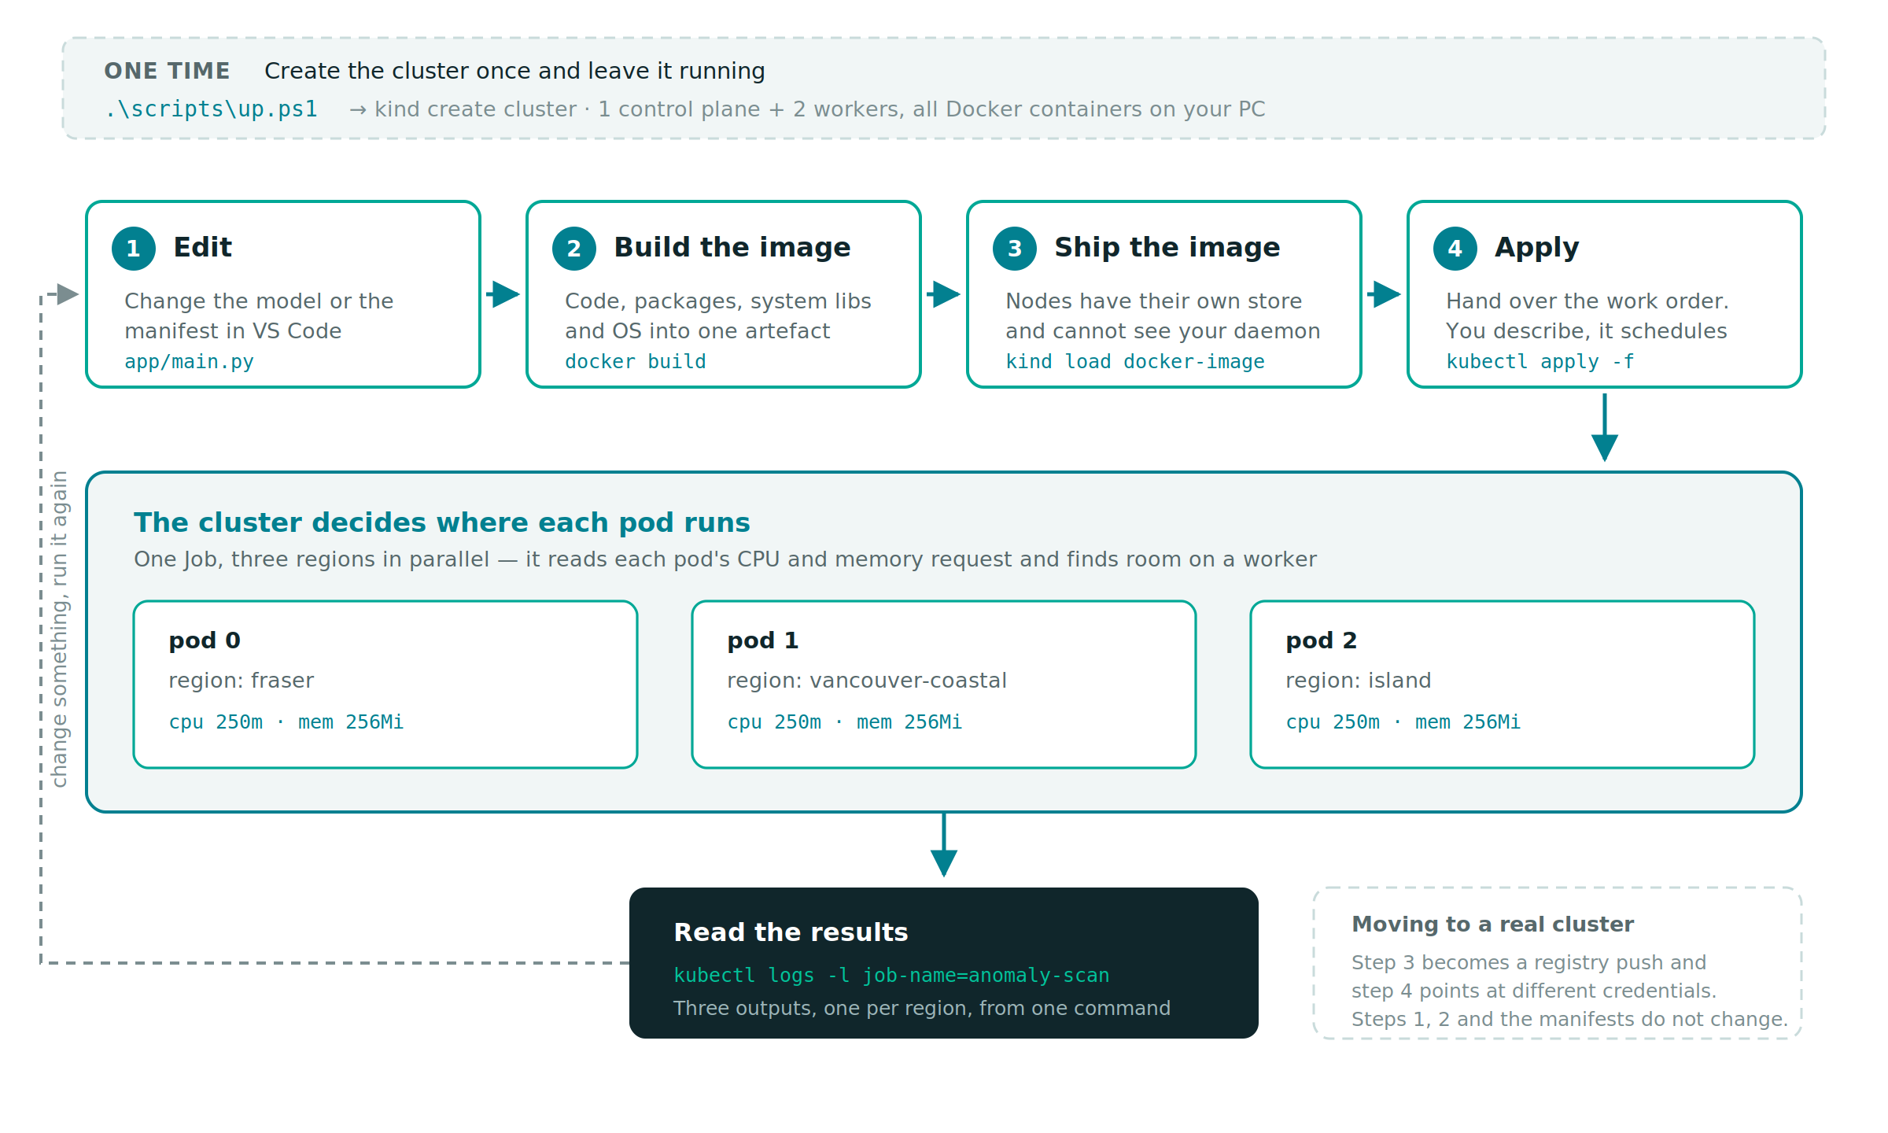
The loop, start to finish
The companion repo runs this end to end on a Windows laptop in about five minutes
github.com/Afraz496/kubernetes-intro
Notes:
Land the talk here. Everything before this was argument; this is the thing they can actually go and do. Point out that steps one and two are useful on their own - a Dockerfile per project solves reproducibility whether or not a cluster ever follows.

