Slide 1
Cloud Computing: A short intro to SLURM and Sockeye
Internal Math Modeling Group

Slide 2
Acknowledgements
I would like to thank Aaron Shapiro, Lisa Tang, Chris Fjell and Hind Sbihi who I have collaborated with on the consult and made it possible to share this presentation on Sockeye cloud computing

Slide 3
Introduction
Part of testing out our hypotheses involves preparing a bulk of simulation data and scripted testing which we often automate but rarely use cloud computing or other scripting tactics to make our work more automated
This presentation serves as an ‘informal’ introduction to UBC’s ARC Sockeye cloud computing platform with an emphasis on how to submit SLURM (Simple Linux Utility for Resource Management) jobs
There will also be some `bash` scripting to help users automate some tests on their modeling work

Slide 4
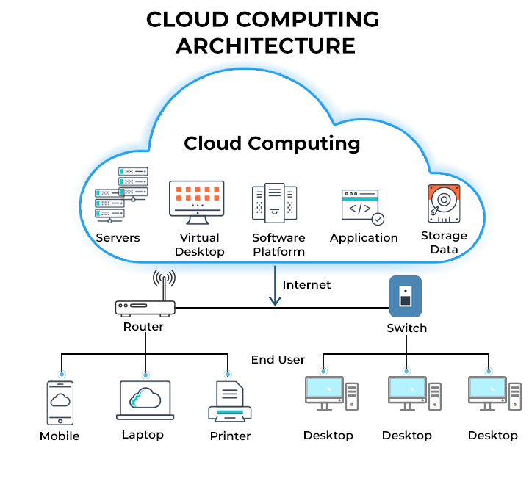
What is cloud computing?
Each machine you use to perform analysis has limited hardware specifications which terribly limit the “time” and the “memory” with which you can perform your modeling work
Imagine a cloud of machines, each with much “more” hardware with much “higher” specifications that you can access and you have direct control over how many resources you use

Slide 5
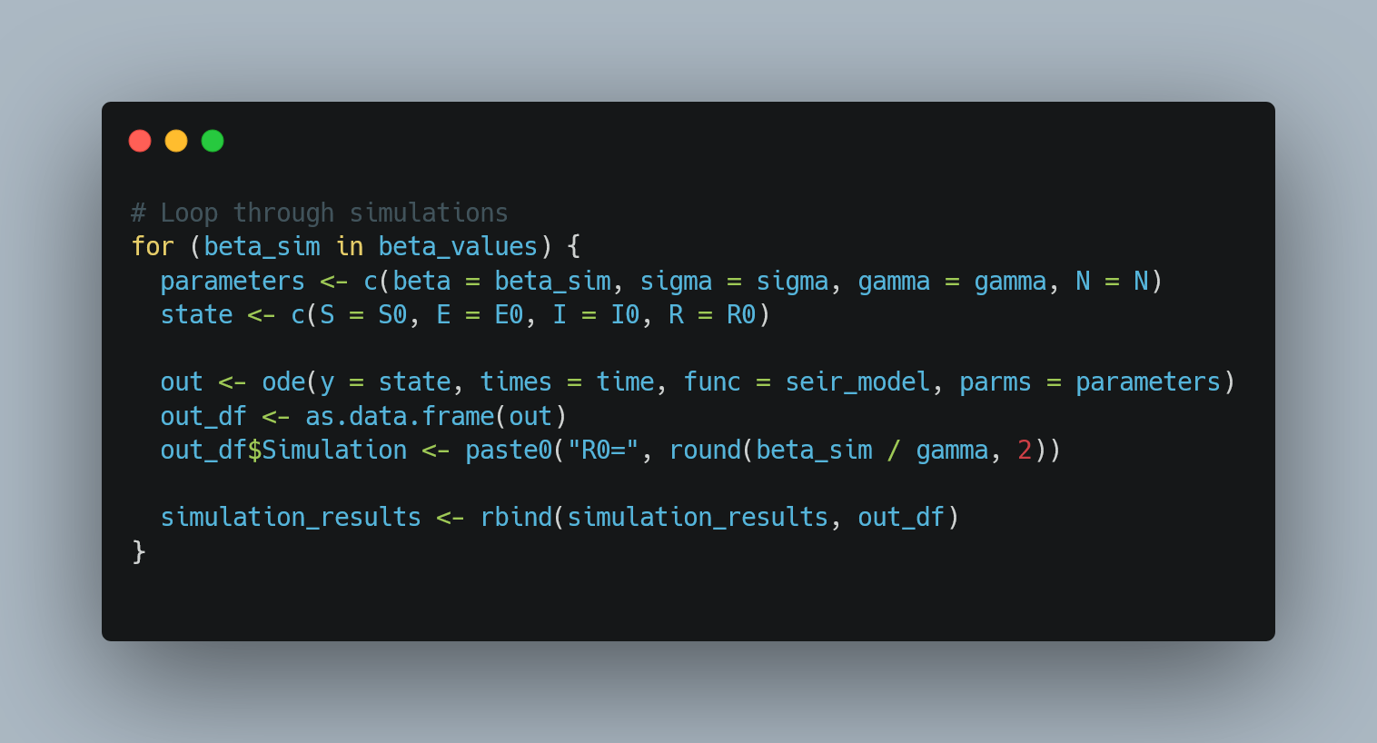
Example of regular scripting use case
Loop over transmission rates
Setup params
Setup ICs (initial conditions)
Solve the SEIR model using ODE solver, using `deSolve`

Slide 6
Example of regular scripting use case
Loop over transmission rates
Setup params
Setup ICs (initial conditions)
Solve the SEIR model using ODE solver, using `deSolve`
Where are the bottlenecks i.e what limits how fast this runs?

Slide 7
Example of regular scripting use case
Loop over transmission rates
Setup params
Setup ICs (initial conditions)
Solve the SEIR model using ODE solver, using `deSolve`
Limited by `N` number of simulations and `T` number of time steps
Note: `rbind` is a pretty inefficient thing too but our major bottlenecks are the simulations themselves

Slide 8
Example of regular scripting use case
Loop over transmission rates
Setup params
Setup ICs (initial conditions)
Solve the SEIR model using ODE solver, using `deSolve`
Complexity: O(NT)
Limited by `N` number of simulations and `T` number of time steps
Note: `rbind` is a pretty inefficient thing too but our major bottlenecks are the simulations themselves

Slide 9
What is bash scripting?
The last slide we saw is technically a script, we wrote some code to automate a process so we don’t have to manually intervene
R and Python are scripting-friendly languages
Rather than deploying scripting within R and Python we can be a bit more meta and run our scripts outside an IDE or a studio
Bash scripting relies on us writing bash code (Linux/Unix) friendly code to automate script running and deployment
What makes this more powerful?

Slide 10
Benefits of bash scripting
We have more control of the params:
No need to individually adjust them in the codebase
It is a lot easier to track changes in the bash script (since it is very modular)
In essence, you can view your codebase as one large function
We can chain scripts (run our simulation work, plotting work and everything we want at the push of a button)
Chaining scripts is heterogenous, you can run R, Python, Go, C++ - pretty much anything that can run on a terminal

Slide 11
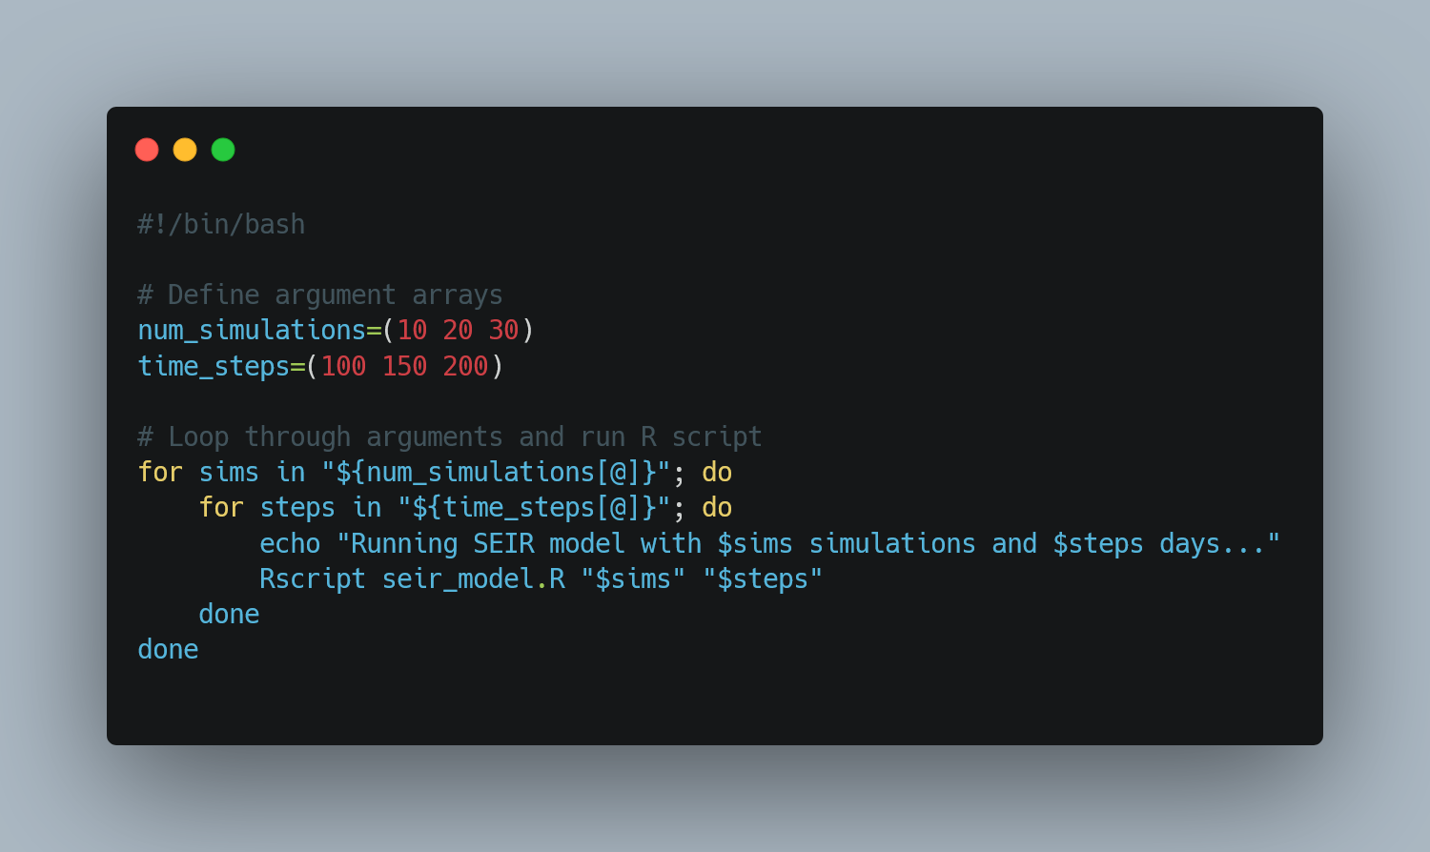

Writing your first bash script
We can specify N simulations and T time steps outside of our R script and have R read them from the bash terminal!
Bash

Slide 12
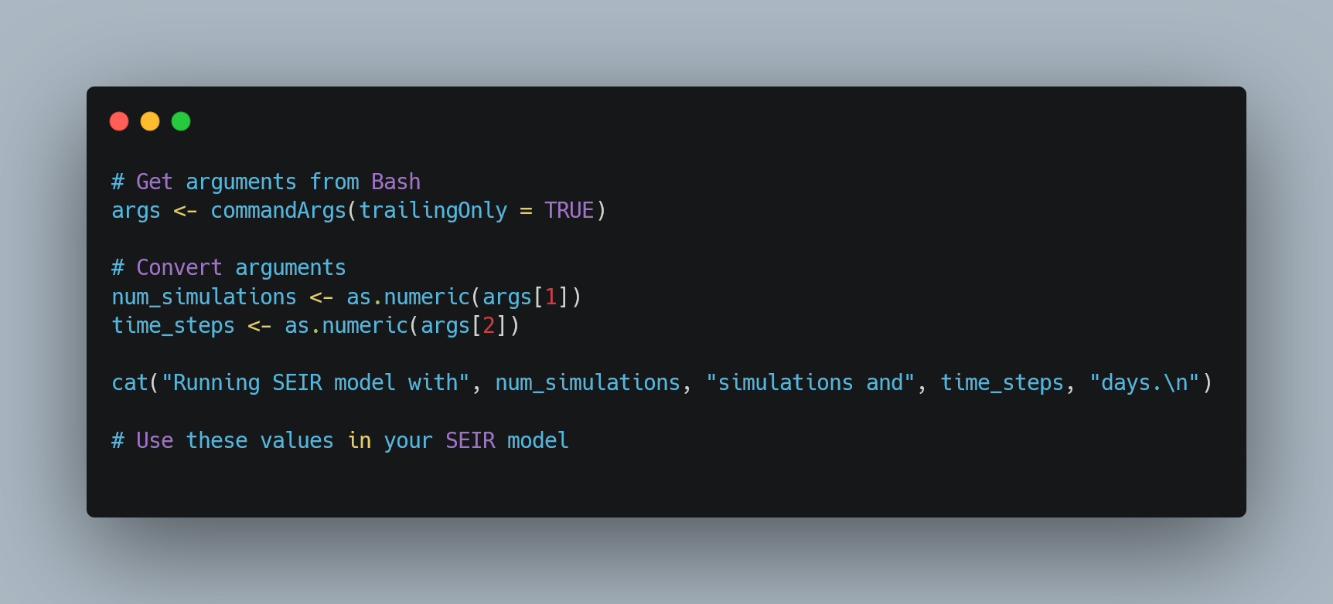

Writing your first bash script
R has a method to read command arguments, we use this in our SEIR model
R script

Slide 13
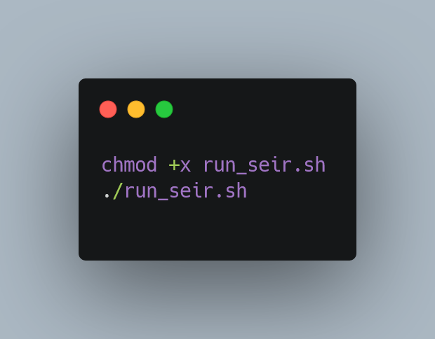
Writing your first bash script
Bash
R script

Slide 14
Sockeye
Logistics: To obtain access you must have a valid CWL username
This will then require Duo registration for 2FA, so make sure you have a device which supports 2FA
Finally, to get started on projects, you will need a sponsor to grant you access to the system and another sponsor (can be the same person) to give you folder allocation since the memory is issued to project leaders

Slide 15
Sockeye: brief note on folder management
UBC ARC Sockeye requires you to SSH into their system and supports a 2 folder system
You write all your code in the `/arc/project` folder under your project allocation, `st-username` (/arc/project/st-username/)`. This is read-only
The output folder is called the `scratch/` folder and is read-write friendly

Slide 16
Setting up Sockeye on VS Code
There is a full guide on the BCCDC Sharepoint to help you develop software on Sockeye by SSH-ing through VS code
A brief note: you will need to do this development on your local machine because Sockeye access requires the Cisco Any Utility VPN from the UBC software mart
If you are still interested in cloud computing and would prefer an alternative path, there is a way to setup Compute Canada but do consult your project manager about access/data governance

Slide 17
SLURM jobs
The UBC Sockeye infrastructure uses SLURM (Simple Linux Utility for Resource Management)
Now this is a standard tool used in most cloud computing systems
Benefits:
You can determine how long to run a script
How much memory the script needs
If you need GPUs or CPUs
You can also spawn job arrays and chain even more scripts! The limits are endless (well not really, they will terminate your jobs if they are over the limit!)

Slide 18
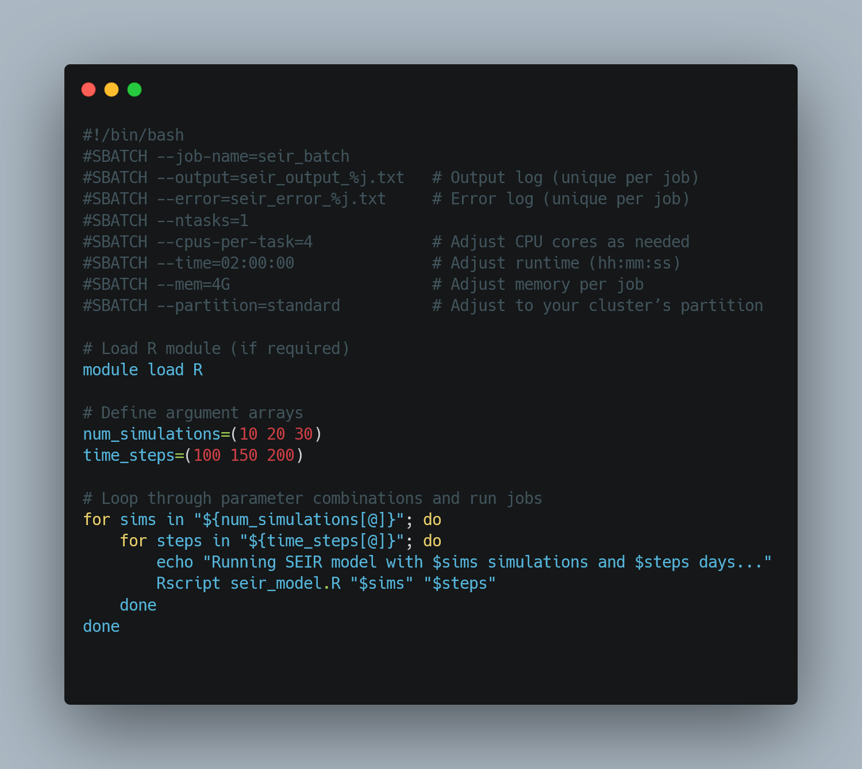
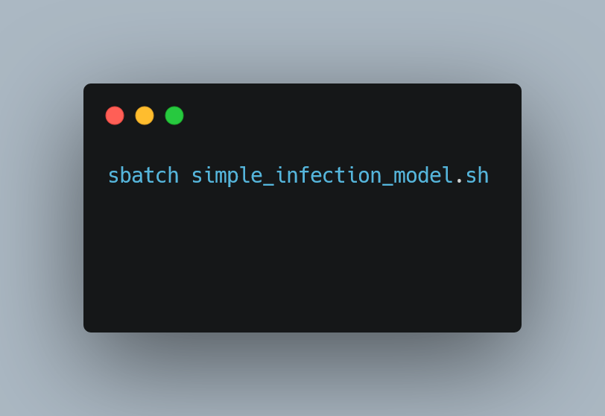
SLURM Job for the simple example
The only changes are the comments
We added in the job name
Where we direct outputs and errors
How many tasks to run! (more on this in the next slide)
How many CPUs to use
How long it runs HH:MM:SS
How much memory per CPU
What cluster partition to use: default – standard

Slide 19
But have we really sped anything up?
Well so far we’ve just refactored everything
Specified memory and resources
But it’s all still too sequential
To utilise cloud computing effectively, we should make use of job arrays to ‘tell’ SLURM to run them in parallel

Slide 20
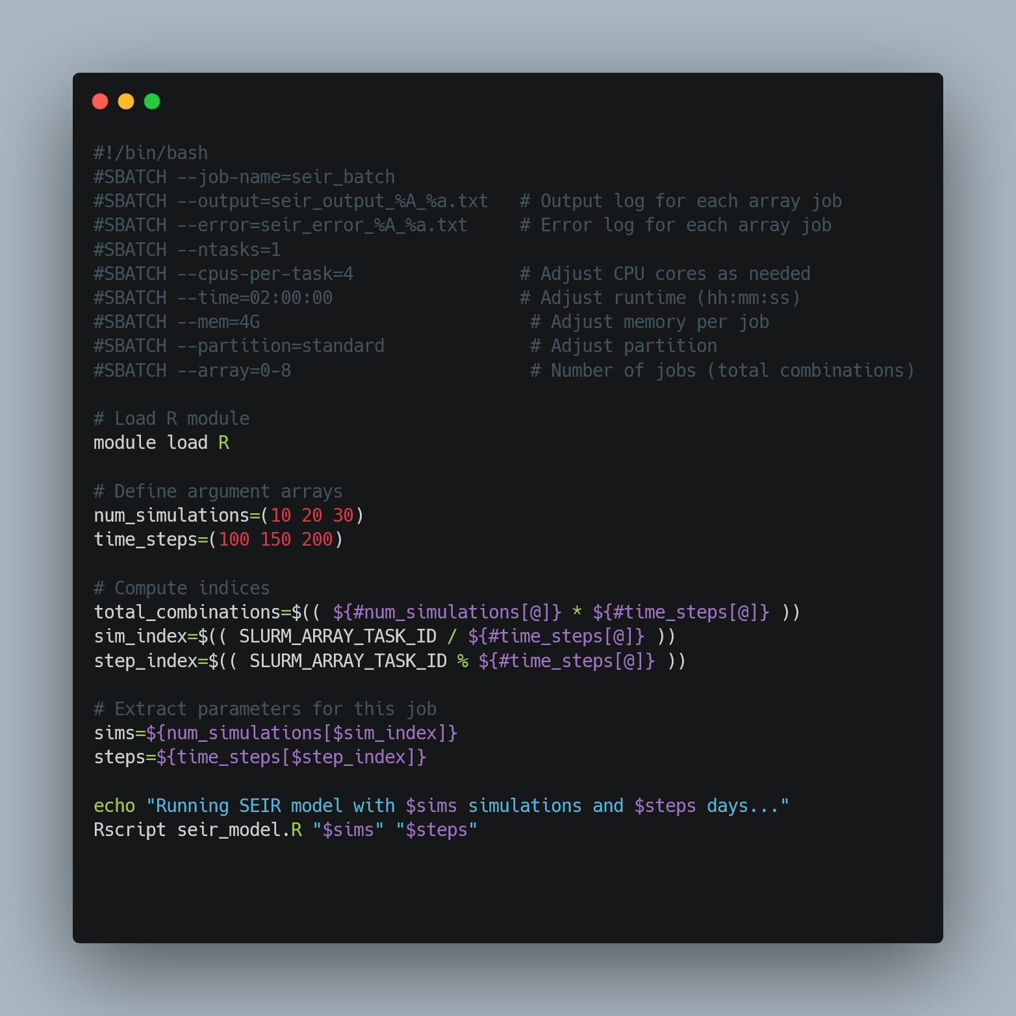
Using SLURM with more than 1 task
We added in job arrays
Since our params are 3x3, we need 9 arrays (always take note of this for your jobs)
SLURM_ARRAY_TASK_ID | sim_index (Row) | step_index (Column) | sims | steps
0 | 0 | 0 | 10 | 100
1 | 0 | 1 | 10 | 150
2 | 0 | 2 | 10 | 200
3 | 1 | 0 | 20 | 100
4 | 1 | 1 | 20 | 150
5 | 1 | 2 | 20 | 200
6 | 2 | 0 | 30 | 100
7 | 2 | 1 | 30 | 150
8 | 2 | 2 | 30 | 200

Slide 21
Live Demo!
Link to GitHub
The full code base and material will be available at the end of the day. There is a README to help you set up R on sockeye
Feel free to reach out to me over email or Teams if you run into any other issues
If it’s more programming related, feel free to create an issue on the Git repo!

Slide 22
Conclusion
SLURM cloud computing is very powerful for automating jobs
To run a simple SLURM solution you really need to understand the basics of:
Bash
The architecture you work on
The scripting language you are using (and its limitations)

Slide 23
Supplementary material
What if you have an uneven grid? The method on slide 20 still works!
SLURM_TASK_ARRAY_ID | Sim_index calculation | Step_index calculation | Sims | steps
0 | 0 / 2 = 0 | 0 % 2 = 0 | 10 | 100
1 | 1 / 2 = 0 | 1 % 2 = 1 | 10 | 150
2 | 2 / 2 = 1 | 2 % 2 = 0 | 20 | 100
3 | 3 / 2 = 1 | 3 % 2 = 1 | 20 | 150
4 | 4 / 2 = 2 | 4 % 2 = 0 | 30 | 100
5 | 5 / 2 = 2 | 5 % 2 = 1 | 30 | 150

Slide 24
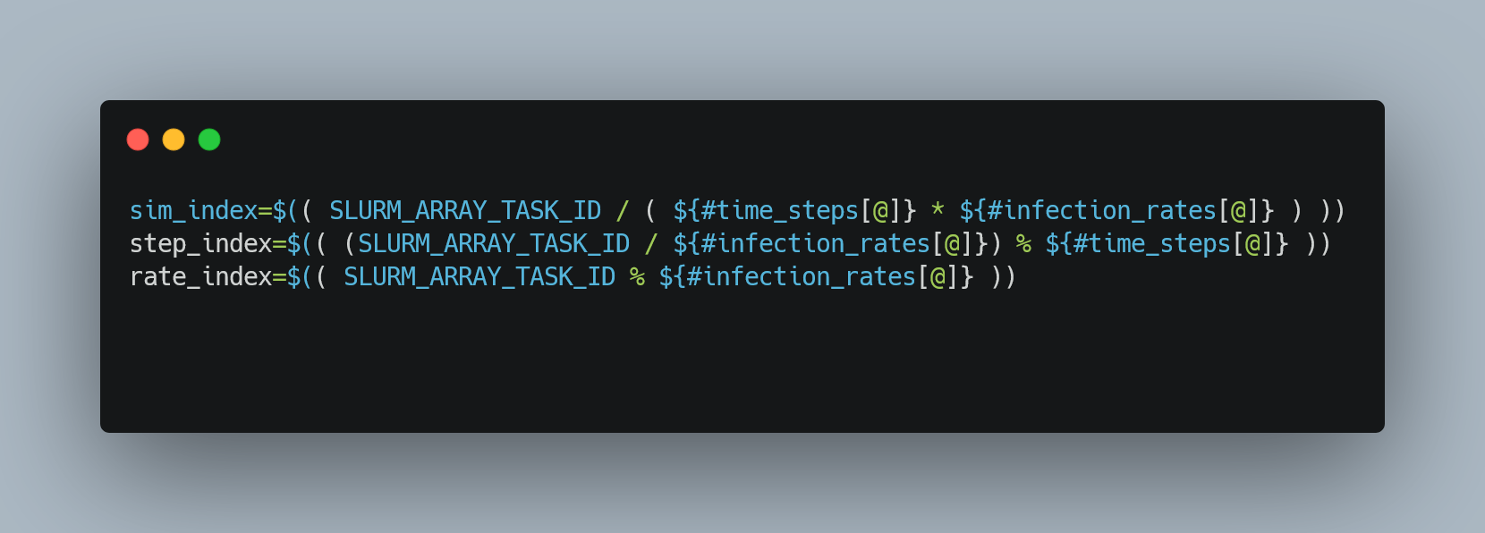
Supplementary material
It gets tricky when it’s 3 or more parameters but doable!

Slide 25
Resources
Linux Cheatsheet
Bash Cheatsheet
Git Cheatsheet
SLURM reading
Sockeye quickstart

