Slide 1





Student Report Card Generator

Slide 2


Introduction
The Student Report Card Generator is a Java-based application developed using Advanced Object-Oriented Programming (AOOP) principles. It helps in managing student data and generating report cards efficiently. The system allows users to add, update, view, and delete student details and marks. It uses core AOOP concepts like inheritance, encapsulation, abstraction, and polymorphism to keep the code modular and reusable. The graphical user interface (GUI) is built using Java Swing, making the application easy to use for teachers and administrators.

Slide 3

Our Team
Santhosh Kumar-2310030108
Afraz-2310030130
Siddarth-2310030123
Sashank-2310030292

Slide 4
Features
🎯 Core Feature: Seamless Database Integration
🧩 Feature Description:
This project features robust integration with a MySQL database to ensure efficient, secure, and persistent management of student academic data.
🔍 How It Works:
Utilizes JDBC (Java Database Connectivity) to bridge the Java Swing application with MySQL.
Stores student data including:
Student Name & Roll Number
Subject-wise Marks
Calculated Grades & Result
Retrieves existing records to auto-fill forms or view report cards.

Slide 5
Key Benefits & Technologies
🌟 Key Advantages:
🔒 Persistent Storage – Data remains safe even after application restarts
🧠 Smart Access – Real-time fetch and display of records
🧹 Clean Data Flow – Centralized and organized data structure
📈 Scalable – Easily expandable for more students or subjects
🛠️ Technologies Used:
💻 Java (Swing for GUI)
🗃️ MySQL (Database)
🔌 JDBC (com.mysql.cj.jdbc.Driver)

Slide 6
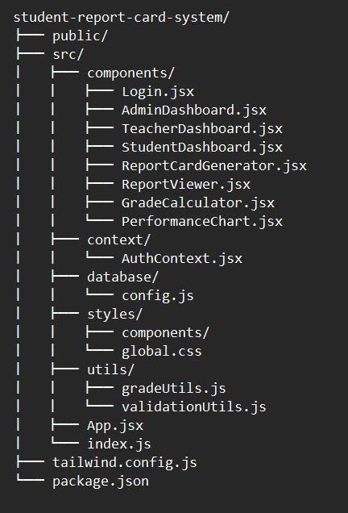
Code Structure
Our project is structured for simplicity and scalability
components/ – UI components like login, dashboards, report generator, and charts.
database/ – Configuration for connecting to the database.
styles/ – Global styling using Tailwind CSS.
App.jsx – Main component for layout and routing
index.js – Entry point of the application.
This structure ensures the code is clean, organized, and easy to manage.

Slide 7
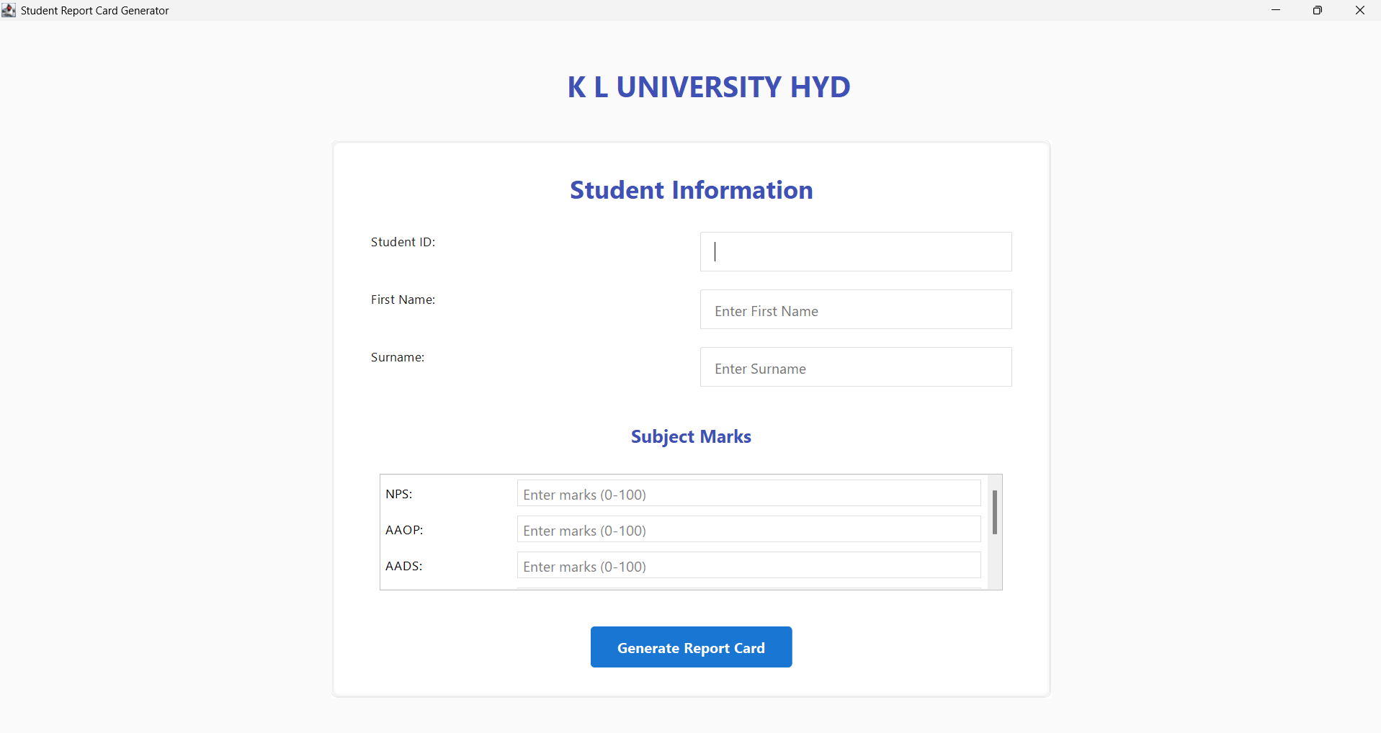
Student Details & Marks Entry Interface
The input interface presents a clean, user-friendly form where faculty can enter student details and subject-wise marks. The form features well-organized input fields with clear labels and placeholders, making data entry efficient and error-free.

Slide 8
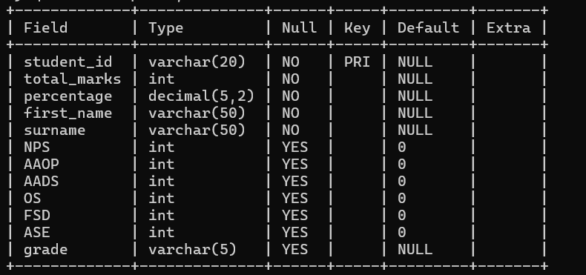
MySQL Backend – Student Report Table
Table Purpose: Stores student academic results for six subjects along with personal details.
Primary Key: student_id uniquely identifies each student.
Student Info:
First_name, surname (both VARCHAR(50))
Student_id (VARCHAR(20))
4. Performance Metrics:
total_marks (sum of subject scores)
Precentage (DECIMAL(5,2))
grade (VARCHAR(5))
5. Subject Marks:
Columns: NPS, AAOP, AADS, OS , FSD, ASE
All of are type INT, nullable with default 0
6. Data Insight:
Each row represents a full report card of a student with subject-wise scores and final evaluation.

Slide 9
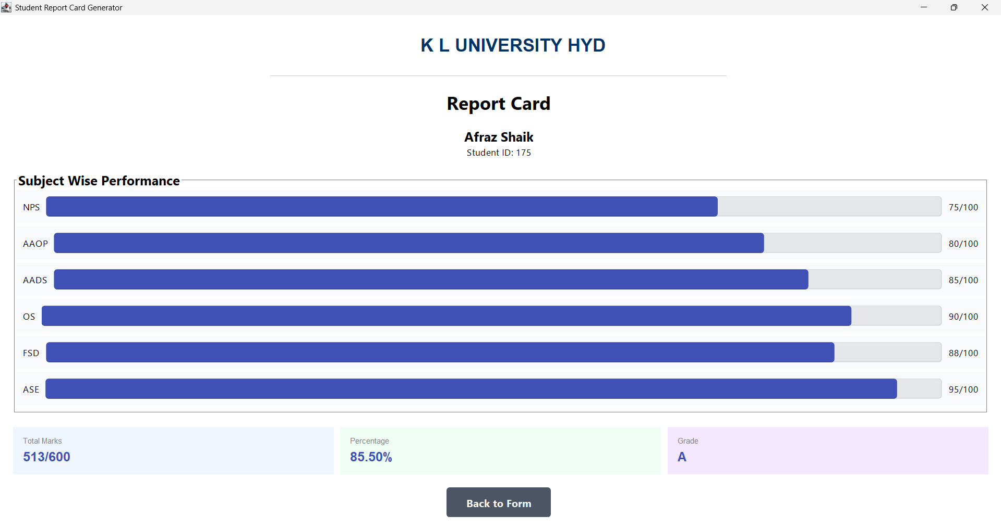
Student Report Card Overview
The generated report card showcases a comprehensive performance visualization with dynamic progress bars for each subject, displaying marks out of 100. The summary section elegantly presents the total marks (513/600), percentage (85.50%), and final grade (A) in color-coded cards for quick assessment.

Slide 10
Sample Code
private void generateReport() {
// Validate Input
String studentId = idField.getText().trim();
int[] marks = new int[SUBJECTS.length];
// Calculate Performance
double percentage = calculateTotalPercentage(marks);
String grade = calculateGrade(percentage);
// Save to Database
saveToDatabase(studentId, marks, percentage, grade);
showReportCard();
}
private String calculateGrade(double percentage) {
if (percentage >= 90)
return "A+";
if (percentage >= 80)
return "A";
// ... more grade ranges
return "F";
}

Slide 11
Conclusion
Project Outcome
Successfully developed a comprehensive student performance tracking system
Integrated UI design with robust data management
Automated grade calculation and reporting
Key Achievements
Real-time data input and validation
Seamless database integration
Dynamic report generation
User-friendly interface with intuitive navigation
Technical Impact
Demonstrates Java Swing application development
Showcases database connectivity
Implements advanced UI/UX design principles
Future Potential
Scalable architecture for educational institutions
Easily extensible for more subjects or metrics
Potential for cloud/web migration
Lessons Learned
Importance of user experience in data entry
Significance of data validation
Power of modular design in software development

Slide 12
Thank You

