Slide 1

CAMBRIDGE COLLEGE, affiliated to Bengaluru north university “BLOCKFERNS REALITY” Real-estate Management System Mohammed Afreed Pasha (U19NQ21S0028) And Syed Ibrahim (U19NQ21S0027)

Slide 2

Synopsis
Introduction
System Analysis
System Requirements
Database Design
Future Enhancement
Conclusion
Bibliography

Slide 3

Synopsis
Real Estate Management System Project focuses mainly on publishing and viewing properties. To be more precise, the system helps to keep track the number of sales and rental properties. Also, the system contains all the buyers, builders, and agent information where builders can sell property, agents can rent used property. Evidently, this project contains an admin panel and a simple client-side. In an overview of this web application, the user can simply register in order to use the features. Here, clients can search for the property details using the state names. As a result, the system filters out all the available properties with detailed information.

Slide 4

Introduction
The BlockFernsReality project aims to revolutionize the real-estate industry. It will provide a cutting-edge online platform for property seekers. The focus is on user experience and functionality to make searching easier and faster. Advanced technology and innovative features will be leveraged. The platform will be comprehensive and intuitive for users to find their dream properties. The goal is to become a leading tool in the real estate market, trusted by users and professionals. BlockFernsReality will transform the way people search for properties online

Slide 5
System Analysis
Existing System:- The current system lacks a centralized platform for property owners, buyers, and renters to interact and conduct transactions. This leads to several problems, including
Inefficient Property Search
Inefficient Property Management
Lack of Transparency
Proposed System:- “BlockFernsReality” Real Estate Management System provides a centralized platform for property owners, buyers, and renters to interact and conduct face-to-face transactions efficiently and securely. The system would enable users to search for properties, submit property listings, manage bookings and maintenance requests, and provide feedback about their experiences.

Slide 6
System requirements
Hardware Configuration
1. 32/64 bit operating system.
2. 4 GB RAM or above.
3. 1024*768 Resolution monitor .
4. 40 GB hard disk or above.
5. Keyboard.
Software Configuration
1. Operating System- Windows 10 .
2. Languages: PHP, HTML, JavaScript, CSS(Bootstrap).
3. Database: MySQL.
4. Browser: Chrome..
5. Xampp server
Documentation Software
1. Word Processor - Microsoft Word.
2. Operating System – Windows 10.

Slide 7
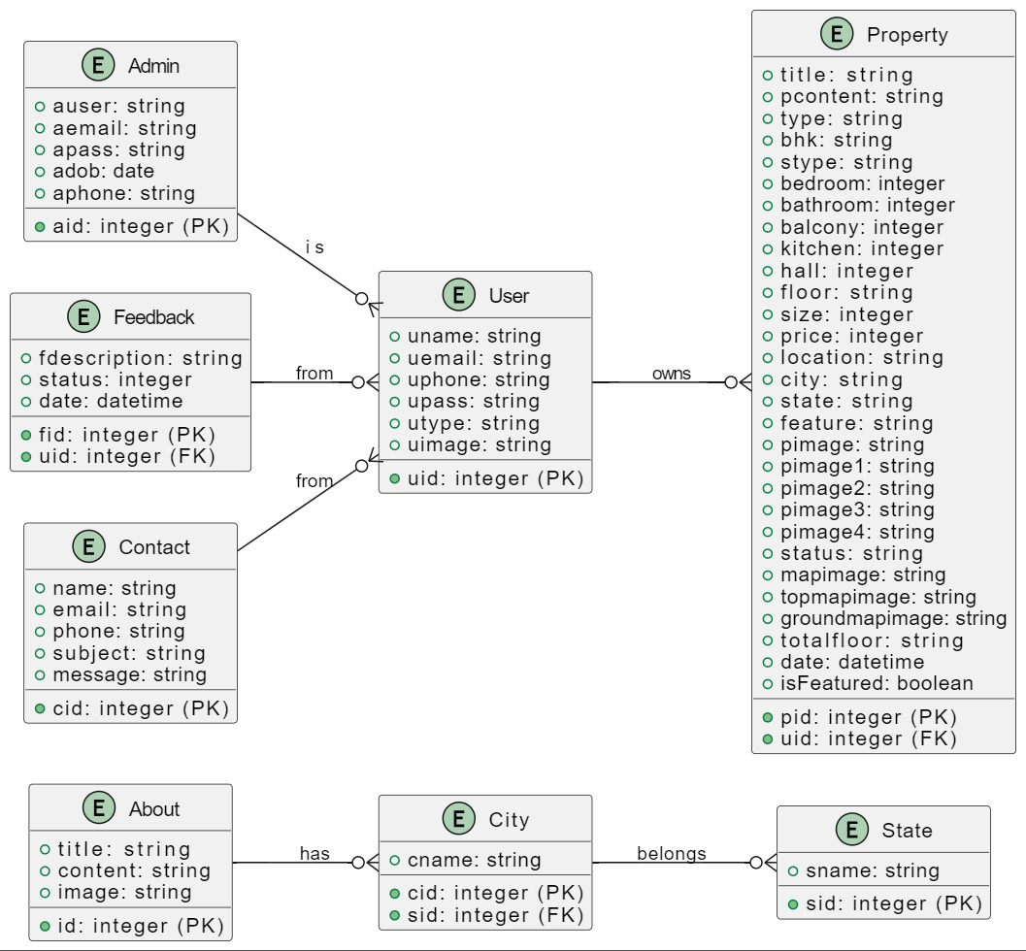
Database Design

Slide 8
Future Enhancement
Advanced search filters and autocomplete search bar will simplify property searches. This will make finding properties easier and more efficient. The enhancements aim to improve functionality, security, and overall user experience. The system will be fully responsive and optimized for mobile devices. This will cater to the growing mobile user base and provide a better experience. Enhancing the feedback feature will allow users to send detailed feedback to the admin. This will help improve service quality and user satisfaction. These enhancements will position the application as a leading tool in the real estate market.

Slide 9

Conclusion
The BlockFernsReality project is a comprehensive Real Estate Management System developed in PHP with a MySQL database. It provides a platform for buyers, sellers, and agents to interact and manage properties efficiently. The system allows users to view and publish properties, search by state,city, and manage their posted properties. It also features an instalment calculator, administrative dashboard, and testimonial system. The goal is to simplify the process of buying, selling, and renting properties with a user-friendly and centralized platform.

Slide 10

Bibliography
https://www.w3schools.com/
https://www.mysql.com/
https://www.php.net/
https://developer.mozilla.org/en-US/docs/Web/JavaScript
https://www.apachefriends.org/
https://getbootstrap.com/
https://www.geeksforgeeks.org/javascript/

Slide 11

THANK YOU

