Slide 1
Automatic Hate Speech Detection Using Deep Neural Networks and Word Embedding
Team no: 03
Name: Sadia Afreen
ID: 19201105
ST: Ehsanur
RA: Sabbir

Slide 2
Introduction
Text from social media sites contain many risks
Developing a model for detecting hate speech in English text on internet
Used deep learning approach
Different classification methods [Naive Bayes Algorithm, Logistic Regression Model]
Feature representations [BoW, TF-IDF, GloVe word embeddings]
Determine best classifier based on accuracy rate

Slide 3
Experimental Analysis
DATA
Individually annotated data
Hate and No-Hate classes
Pre-processed text and embedded terms in text sequence
Experimented with number of representations [BoW and GloVe word embeddings]
Concentrated on machine learning models

Slide 4
Experimental Analysis
Methods of Analysis
Removed unnecessary features to increase efficiency
Train 70% dataset & test 30% dataset
1D-CNN learns to encode input sequence
CNN-based text classifications learn features from words

Slide 5
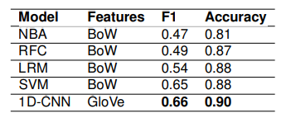
Result
Used the BoW and TF-IDF approaches
Implemented well-established machine learning algorithms
Glove word embeddings
Proposed models were evaluated to identify the best algorithm
Accuracy and F1 values for all classification methods

Slide 6
Conclusion
Hate speech dataset that was manually labeled
Easily detected
Word embeddings, parameters, optimizer have high impact on output achieved
Word embeddings with 1D-CNN is important tool

