Slide 1

A7045- Major Project
Domain: SIP Domain
Cervical Cancer Detection With Cervicography Images Using ResNet50
Team No. – 2021040321
Presented by
21881A0466 - Afreen
21881A04C4 - Umme Sulaim Amara
21881A04C3 - T.Anirudh Reddy
Under the Supervision of
Dr. P. Kalyani
Assistant Professor, Dept. of ECE

Slide 2
Contents
Introduction
Motivation
Objective
Literature Survey
Problem Statement
Advantages
Block Diagram
Methodology
Result
References

Slide 3
Introduction
Cervical cancer is the second most common cancer in women worldwide with a mortality rate of 60%.
Cervical cancer begins with no overt signs and has a long latent period, making early detection through regular checkups vitally important.
Crucial for improving treatment outcomes and reducing mortality rates.
Cervical cancer remains a major concern, especially in regions with limited healthcare access.

Slide 4
Motivation
Cervical cancer requires timely detection for improved patient outcomes.
Currently, about 85% of the women who lose their lives to cervical cancer each year live in developing countries, where medical care is far more limited both in terms of available professionals and access to technology1–3.
Many of these deaths could be prevented with access to regular screening tests, which would enable the effective treatment of pre-cancer stage lesions4,5.
As cervical cancer has no overt signs during the early stages of progression and a long latent period, early detection through regular checkups is vitally important.

Slide 5
Objectives
To extract features from cervicography images using a combination of classical approaches (Histogram of Oriented Gradients (HOG) and Local Binary Patterns (LBP)) and modern deep learning.
To compare the classification ability of machine learning (ML) and deep learning (DL) methods for classifying cervicography images as negative or positive for cervical cancer.
To train an end-to-end ResNet50 model with regularization techniques to increase performance

Slide 6
Literature Survey
Title | Risk factors of cervical cancer among ethnic minorities in Yunnan province, China: A case–control study
Journal Name and Year | European Journal of Cancer Prevention 2022
Authors | M. Zhao, R.-Y. Gu, S.-R. Ding, L. Luo, Y. Jia, C.-X. Gao, B. Chen, X.-B. Xu, and H.-F. Chen,
Contribution | Identifies specific risk factors associated with cervical cancer in diverse ethnic groups..
Parametric Analysis | Using data from 1119 cervical cancer patients and 1119 controls, the study identifies human papilloma virus (HPV) infection, concurrent reproductive tract infections, and basic medical insurance for rural residents as significant risk factors

Slide 7
Title | Artificial intelligence in cervical cancer screening and diagnosis
Journal Name and Year | Frontiers / International Journal of Gynecologic Cancer 2022
Authors | X. Hou, G. Shen, L. Zhou, Y. Li, and T. Wang
Contribution | Aims to reduce the burden on healthcare systems by optimizing screening processes.
Parametric Analysis | AI-based diagnostic tools offer substantial benefits, including faster results, reduced reliance on specialized personnel, and elimination of subjective bias. This research emphasizes the potential of AI to enhance early diagnosis accuracy

Slide 8
Title | Impact of diffusion weighted magnetic resonance imaging in diagnosis of cervical cancer,
Journal Name and Year | Egyptian Journal of Radiology and Nuclear Medicine 2022
Authors | S. M. A. Elsalam, O. Mokhtar, L. Adel, R. Hassan, M. Ibraheim, and A. Kamal
Contribution | Assesses the role of advanced MRI techniques in enhancing diagnostic capabilities for cervical cancer. Supports the integration of innovative imaging technologies in clinical practice.
Parametric Analysis | An ADC cutoff showed 97% sensitivity and 95.5% specificity in distinguishing cancerous from healthy tissue. Their findings suggest DW-MRI's potential as a contrast-free alternative for cervical cancer diagnosis when dynamic imaging is unsuitable.

Slide 9
Title | Performance analysis of machine learning algorithms for cervical cancer detection
Journal Name and Year | International Journal of Healthcare Information Systems and Informatics (IJHISI) 2020
Authors | S. K. Singh and A. Goyal
Contribution | Provides a comparative evaluation of various machine learning algorithms in cervical cancer detection. Aims to identify the most effective models for clinical use.
Parametric Analysis | The research emphasizes the selection of optimal algorithms based on accuracy and cost-effectiveness in terms of computational resources.

Slide 10
Title | Cervical cancer prediction using stacked ensemble algorithm with SMOTE and RFERF.
Journal Name and Year | Cervical cancer prediction using stacked ensemble algorithm with SMOTE and RFERF 2019
Authors | C. Bhavani and A. Govardhan
Contribution | Demonstrates the effectiveness of ensemble learning methods for predicting cervical cancer risk.
Parametric Analysis | The method leverages SMOTE for data balancing and RFE with Random Forest for feature extraction, achieving enhanced accuracy compared to traditional methods.

Slide 11
Problem Statement
Cervical cancer remains a major health challenge due to limitations in current diagnostic methods, affecting early detection and patient outcomes.
Traditional methods like Pap smears are invasive test can sometimes give false-negative or false-positive results, leading to missed diagnoses or unnecessary worry.

Slide 12
Advantages
1.Helps detect cervical cancer in its early stages.
2.Uses cervicography (imaging), reducing the need for biopsies.
3.The collaborative use of multiple machine learning and deep learning algorithms synergizes their strengths, leading to more reliable outcomes.
4.By focusing on early detection through advanced techniques.
5.This improves cancer detection, speeds up diagnosis, and makes screening more accessible.

Slide 13
Block Diagram
Cervicography Images
Image
PreProcessing
Feature Extraction
Output
Classification
Model Training

Slide 14
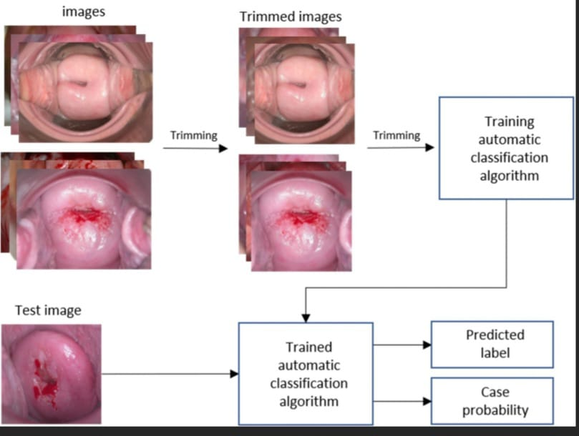
Block Diagram

Slide 15
Methodology
Image Collection: 4,119 cervicography images were collected and labeled as either normal or abnormal.
It consists of 4,119 cervicography images:1,984 negative (normal)2,135 positive (abnormal)
Preprocessing: Images were cropped and resized to focus only on the cervix and remove unwanted parts.
Feature Extraction transforms cervicography images into measurable features.
Feature Selection removes noise, reduces over fitting, and improves learning speed keeps the model focused on the most relevant patterns.

Slide 16
Methodology
Machine Learning (ML):
Models used: XGBoost, SVM, and Random Forest.
Deep Learning (DL):
A ResNet-50 model was used.Used transfer learning and trained on the same images as ML.
Both ML and DL models were evaluated.
DL (ResNet-50) showed the best performance of 0.97.

Slide 17
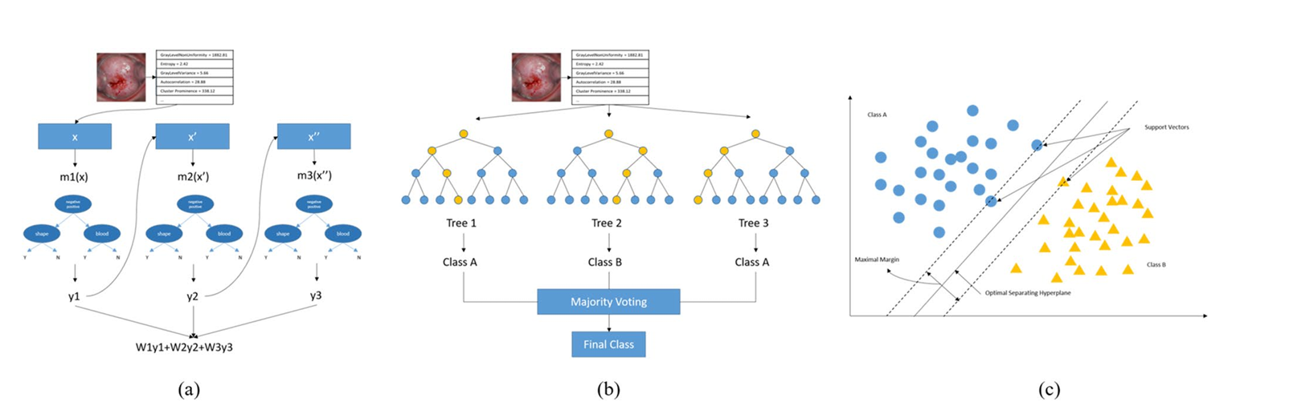
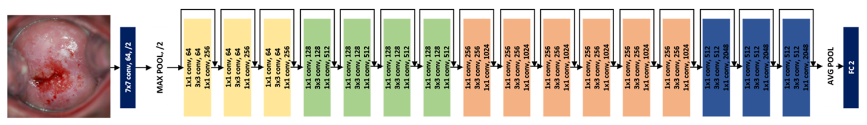

Slide 18
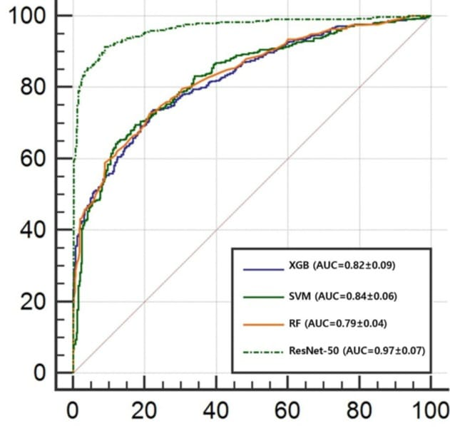
Result
The graph is a ROC (Receiver Operating Characteristic) curve comparing the performance of four classification models:
ResNet-50 (AUC = 0.97) performs best, showing high accuracy.
SVM (AUC = 0.84) and XGBoost (AUC = 0.82) follow closely.
Random Forest (AUC = 0.79) has the lowest performance among the four.
Higher AUC values indicate better model performance in distinguishing between classes.

Slide 19
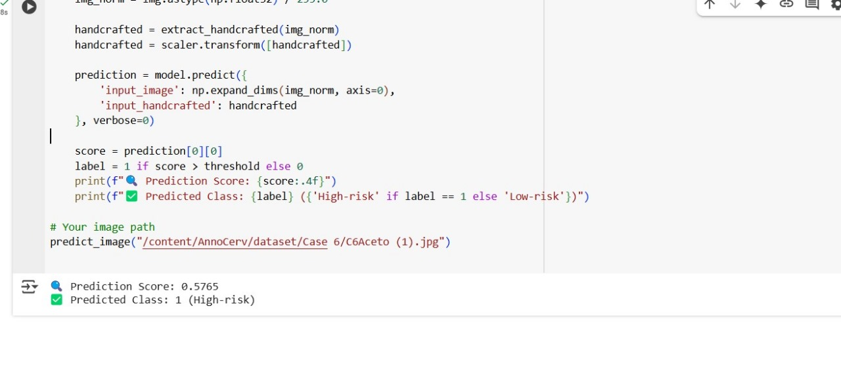
Result

Slide 20
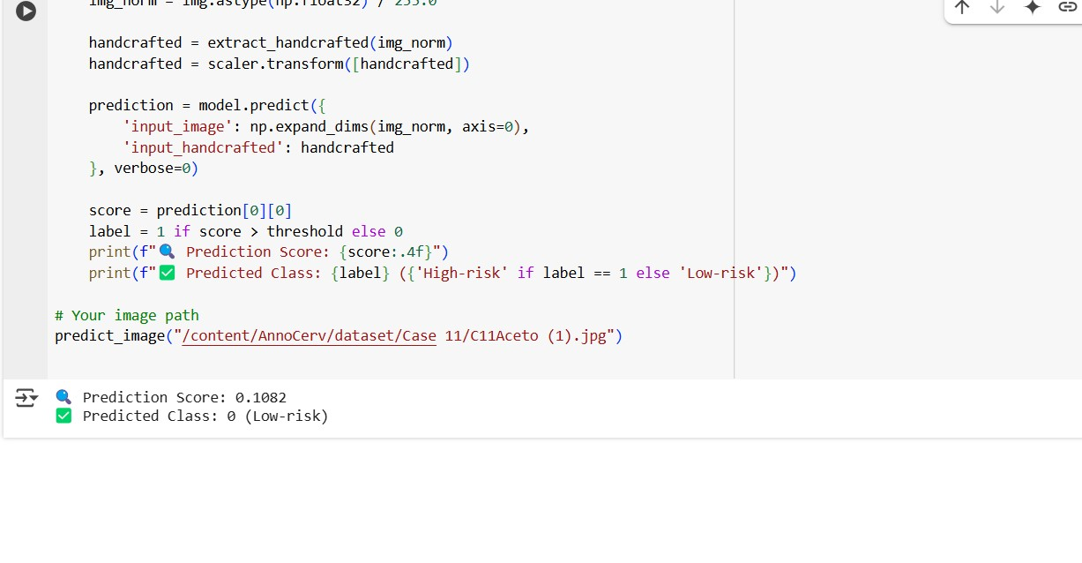
Result

Slide 21
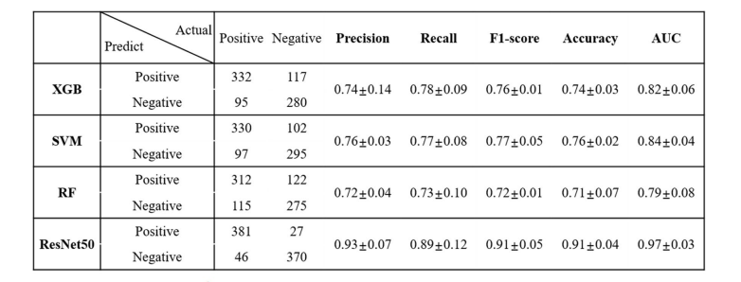
Performance Metrics

Slide 22
Conclusions
we compared the performance of ML and DL models to determine which algorithm would be more suitable to assist clinicians with the accurate diagnosis of cervical cancer.
With both ML and DL techniques, The results for XGB, SVM, and RF were 0.82, 0.84, and 0.79, respectively. Resnet-50 showed 0.97.
ML algorithms did not exceed 0.80 for accuracy, while ResNet-50 showed an accuracy of 0.9065 with a relatively better performance

Slide 23
References[1/2]
[1] T. Šarenac and M. Mikov, ‘‘Cervical cancer, different treatments and importance of bile acids as therapeutic agents in this disease,’’ Frontiers Pharmacol., vol. 10, pp. 484–510, Jun. 2019.
[2] M. Zhao, R.-Y. Gu, S.-R. Ding, L. Luo, Y. Jia, C.-X. Gao, B. Chen, X.-B. Xu, and H.-F. Chen, ‘‘Risk factors of cervical cancer among ethnic minorities in Yunnan province, China: A case–control study,’’ Eur. J. Cancer Prevention, vol. 31, no. 3, pp. 287–292, 2022.
[3] F. Bray, J. Ferlay, I. Soerjomataram, R. L. Siegel, L. A. Torre, and A. Jemal, ‘‘Global cancer statistics 2018: GLOBOCAN estimates of incidence and mortality worldwide for 36 cancers in 185 countries,’’ CA, Cancer J. Clinicians, vol. 68, no. 6, pp. 394–424, Nov. 2018.
[4] X. Hou, G. Shen, L. Zhou, Y. Li, and T. Wang, ‘‘Artificial intelligence in cervical cancer screening and diagnosis,’’ Frontiers Oncol., vol. 12, no. 1, pp. 851367–851380, 2022.
[5] Q. Wen, X. Wang, J. Lv, Y. Guo, P. Pei, L. Yang, Y. Chen, H. Du, S. Burgess, A. Hacker, F. Liu, J. Chen, C. Yu, Z. Chen, and L. Li, ‘‘Association between involuntary smoking and risk of cervical cancer in Chinese female never smokers: A prospective cohort study,’’ Environ. Res., vol. 212, Sep. 2022, Art. no. 113371.

Slide 24
References[2/2]
[6] P. Luhn, J. Walker, M. Schiffman, R. E. Zuna, S. T. Dunn, M. A. Gold, K. Smith, C. Mathews, R. A. Allen, R. Zhang, S. Wang, and N. Wentzensen, ‘‘The role of co-factors in the progression from human papillomavirus infection to cervical cancer,’’ Gynecologic Oncol., vol. 128, no. 2, pp. 265–270, Feb. 2013.
[7] M. Exner, A. Kühn, P. Stumpp, M. Höckel, L.-C. Horn, T. Kahn, and P. Brandmaier, ‘‘Value of diffusion-weighted MRI in diagnosis of uterine cervical cancer: A prospective study evaluating the benefits of DWI compared to conventional MR sequences in a 3T environment,’’ Acta Radiolog., vol. 57, no. 7, pp. 869–877, Jul. 2016.
[8] S. M. A. Elsalam, O. Mokhtar, L. Adel, R. Hassan, M. Ibraheim, and A. Kamal, ‘‘Impact of diffusion weighted magnetic resonance imaging in diagnosis of cervical cancer,’’ Egyptian J. Radiol. Nucl. Med., vol. 51, no. 1, pp. 1–8, Dec. 2020.
[9] S. K. Singh and A. Goyal, ‘‘Performance analysis of machine learning algorithms for cervical cancer detection,’’ Int. J. Healthcare Inf. Syst. Informat., vol. 15, no. 2, pp. 1–21, Apr. 2020.
[10] C. Bhavani and A. Govardhan, ‘‘Cervical cancer prediction using stacked ensemble algorithm with SMOTE and RFERF,’’ Mater. Today, Proc., vol. 80, pp. 3451–3457, Jan. 2023.

