Slide 1

RAILWAY TICKET BOOKING SYSTEM
Final J-Component Review
Name: Afreen Ahmed
Reg: 18BIS0157
Slot: L11 + L12

Slide 2
Abstract
In this emerging world of computers, almost all manual systems are automated but most of them are so complex that a common user is unable to operate that software system. Keeping that in mind, an “Online Railway Reservation System” will be developed to model the present system and to remove the drawbacks.
For journeys of longer distances, most people use the railways which is more convenient and an affordable means of transport in India. Recognizing this, the reservation of railways is a very important task and it must be made faster and more efficient so that it can meet the demand of the people. This requires an efficient program to implement the reservation system. This program will enable us to book and delete a ticket and print the chart for a particular train.

Slide 3
Keywords
Queue Pointers Linked List Malloc Structure Temp

Slide 4
Proposed System
Through this Online Reservation System, customers will not have to wait in line and will able to book their tickets in just a few steps. An online form will be available in which passengers will able to fill their details along with their journey details. To book their seats, users will have to fill in his\her name, age and gender. After submitting these details, it will show its status, whether it has been activated or in process. One can know the waiting list of the train and also know whether the seats of a particular train have been filled or not, by viewing the prepared chart. An online cancellation form will also be available through which reservations can be cancelled by providing their seat number again to carry the next task. After booking, the train ticket the ticket will be displayed on the screen

Slide 5
DS Used
Linked List:
A linked list is a linear data structure where each element is a separate object.
Each element of a list is comprising of two items - the data and a reference to the next node. The last node has a reference to null. The entry point into a linked list is called the head of the list. the list is empty then the head is a null reference.
Queue:
Queue is an abstract data structure, somewhat similar to Stacks. Unlike stacks, a queue is open at both its ends. One end is always used to insert data (enqueue) and the other is used to remove data (dequeue). Queue follows First-In-First-Out methodology, i.e., the data item stored first will be accessed first.

Slide 6
DS Used
Linear Search:
Linear search is a method for finding a target value within a list. It sequentially checks each element of the list for the target value until a match is found or until all the elements have been searched.
Linear search runs in at worst linear time and makes at most n comparisons.
temp:
This type of pointer is used by Window Builder when reference to an object is required after it has been created, but you have not requested an automatic or member pointer to be created. In this case, Window Builder will create a temporary automatic pointer to hold the address of the child object instance.

Slide 7
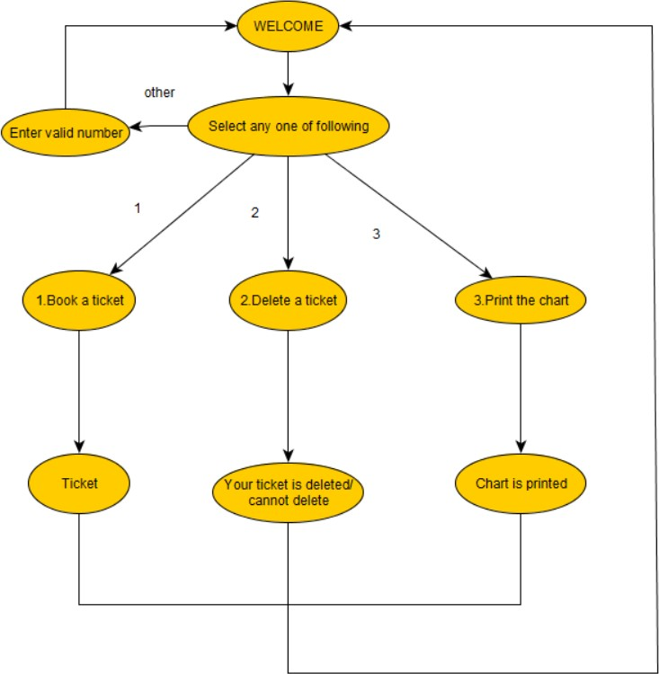

Slide 8
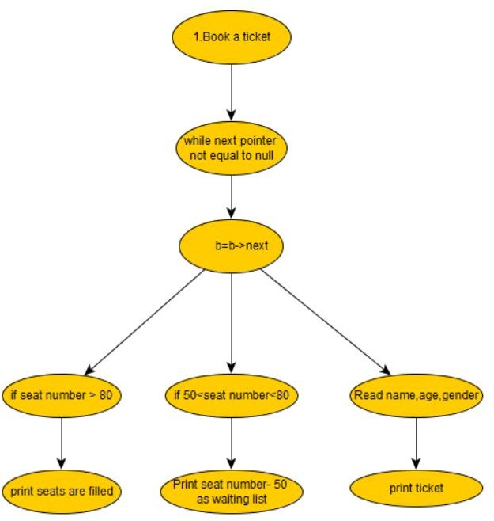
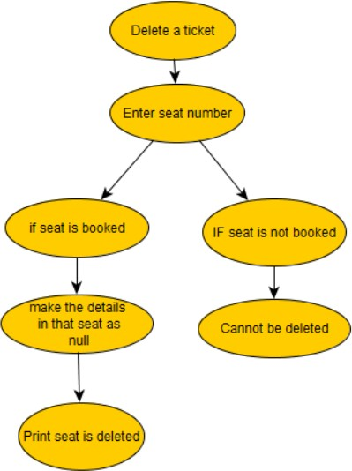
Insert Function
Delete Function

Slide 9
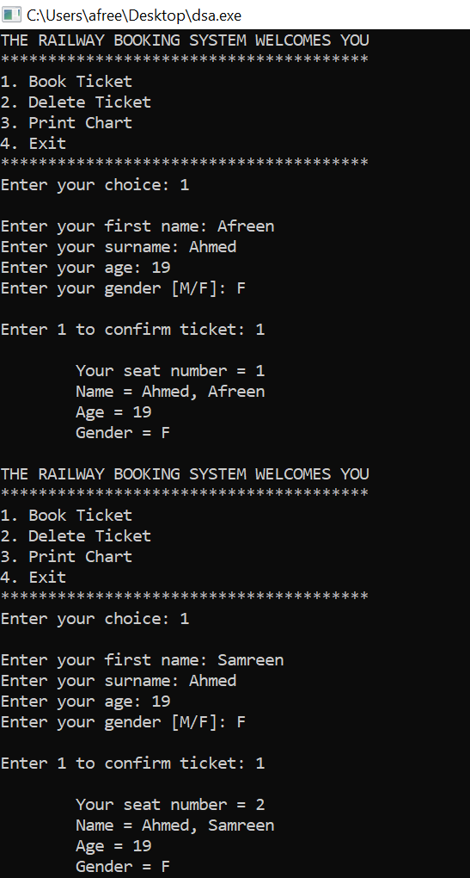
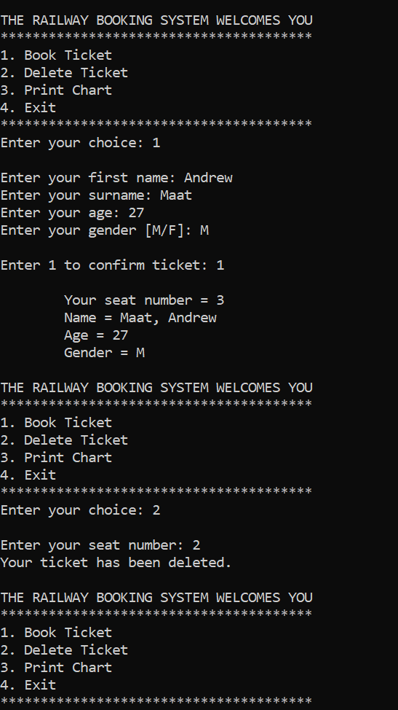

Slide 10
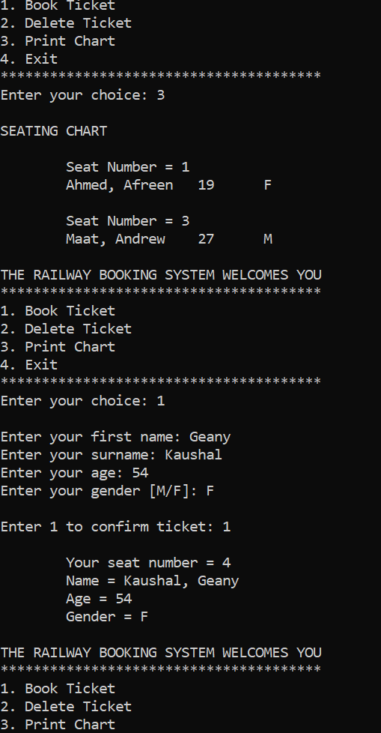
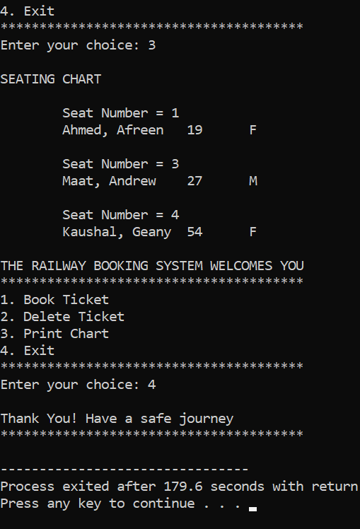

Slide 11
Conclusion
By this project, we are able to book a ticket, know the availability of it, can delete the ticket purchased and also know how many seats are available and also know the waiting list. Here we have used effectively linked list and queues to book a ticket.
Improvements
In this program we can improve it much further by controlling the entire function with time. So in that case we can provide the provision of Thatkal also. We can use much more efficiently defined function in order to reduce the time complexity. It can be further developed by making provision for Online meal order and room service for 1st class travellers.

