Slide 1



Slide 2
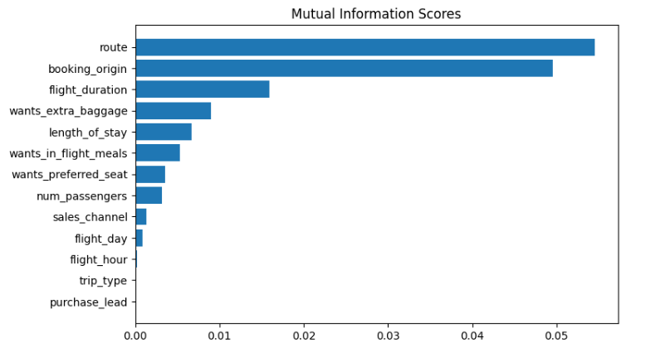
PREDICTIVE MODEL TO GET CUSTOMER BEHAVIOUR INSIGHTS OF FACTORS THAT INFLUENCE THE BUYING
I have trained the data with Random Forest
Classifier model and received the below results
ACCURACY: 84.76
AUC SCORE: 0.5479
We gained the top 5 features insights from
Mutual information scores chart as below
Route
Booking_origin
Flight_duration
Wants_Extra_baggage
Length_of_stay
We need to increase the AUC SCORE

