Slide 1


Slide 2
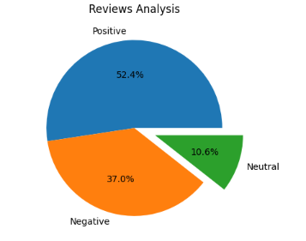
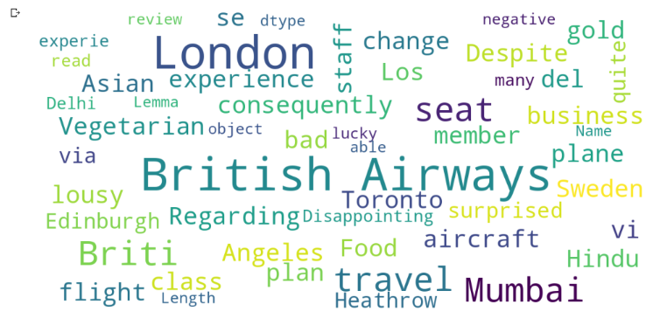

INSIGHTS GAINED FROM VISUALISING CUSTOMER REVIEWS FOR BRITISH AIRWAYS

