Slide 1
GA4GH Beacon
Federated genomic data discovery — a 10-minute introduction
AfriGen-D · Honours student onboarding

Slide 2
What is Beacon API?
Beacon v2 is a set of specifications, developed by GA4GH.
The main purpose of Beacon is to provide a standardized way of sharing genomic/clinical/imaging data to enhance discoverability between researchers.

Slide 3
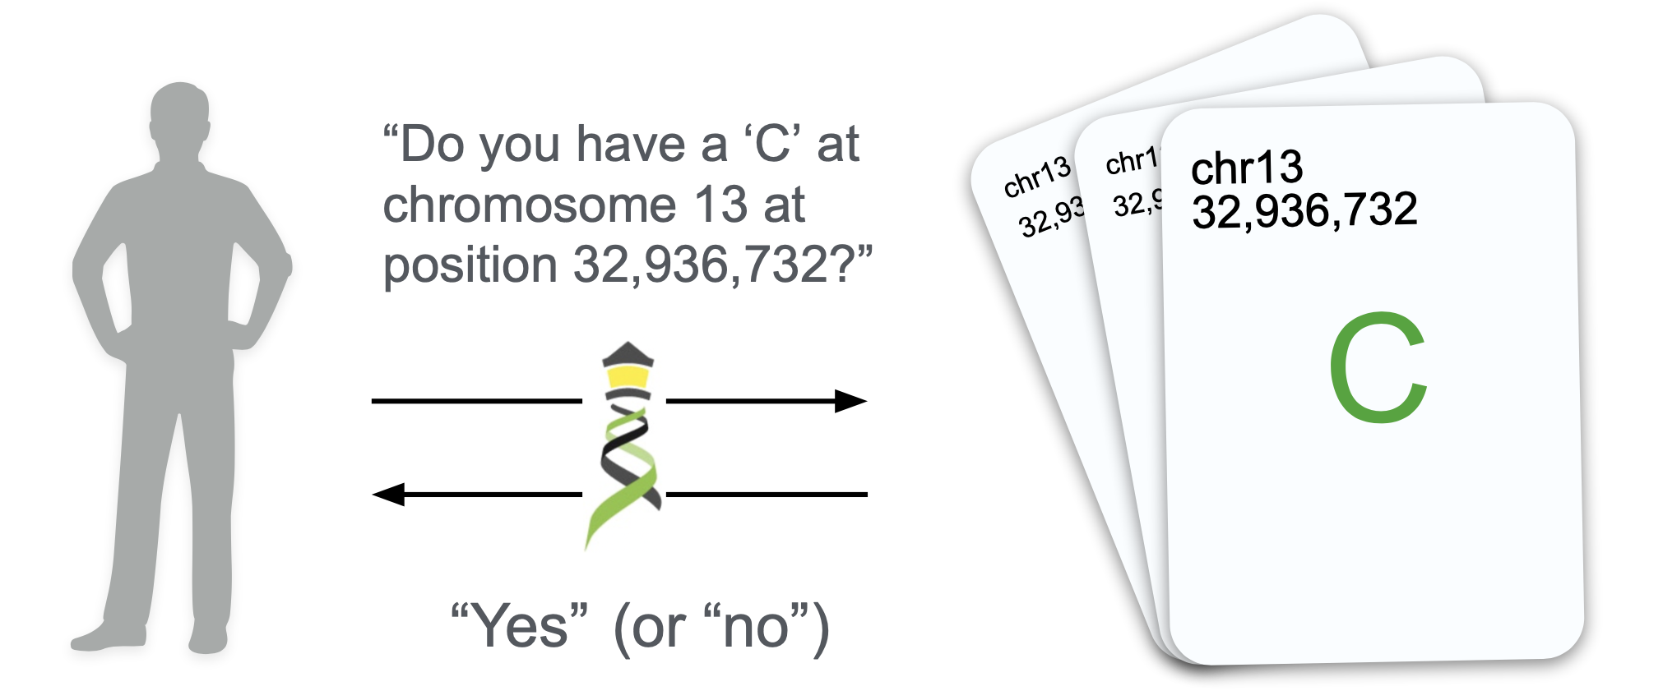
Beacon v1
Beacon v1 only offered boolean or count responses

Slide 4
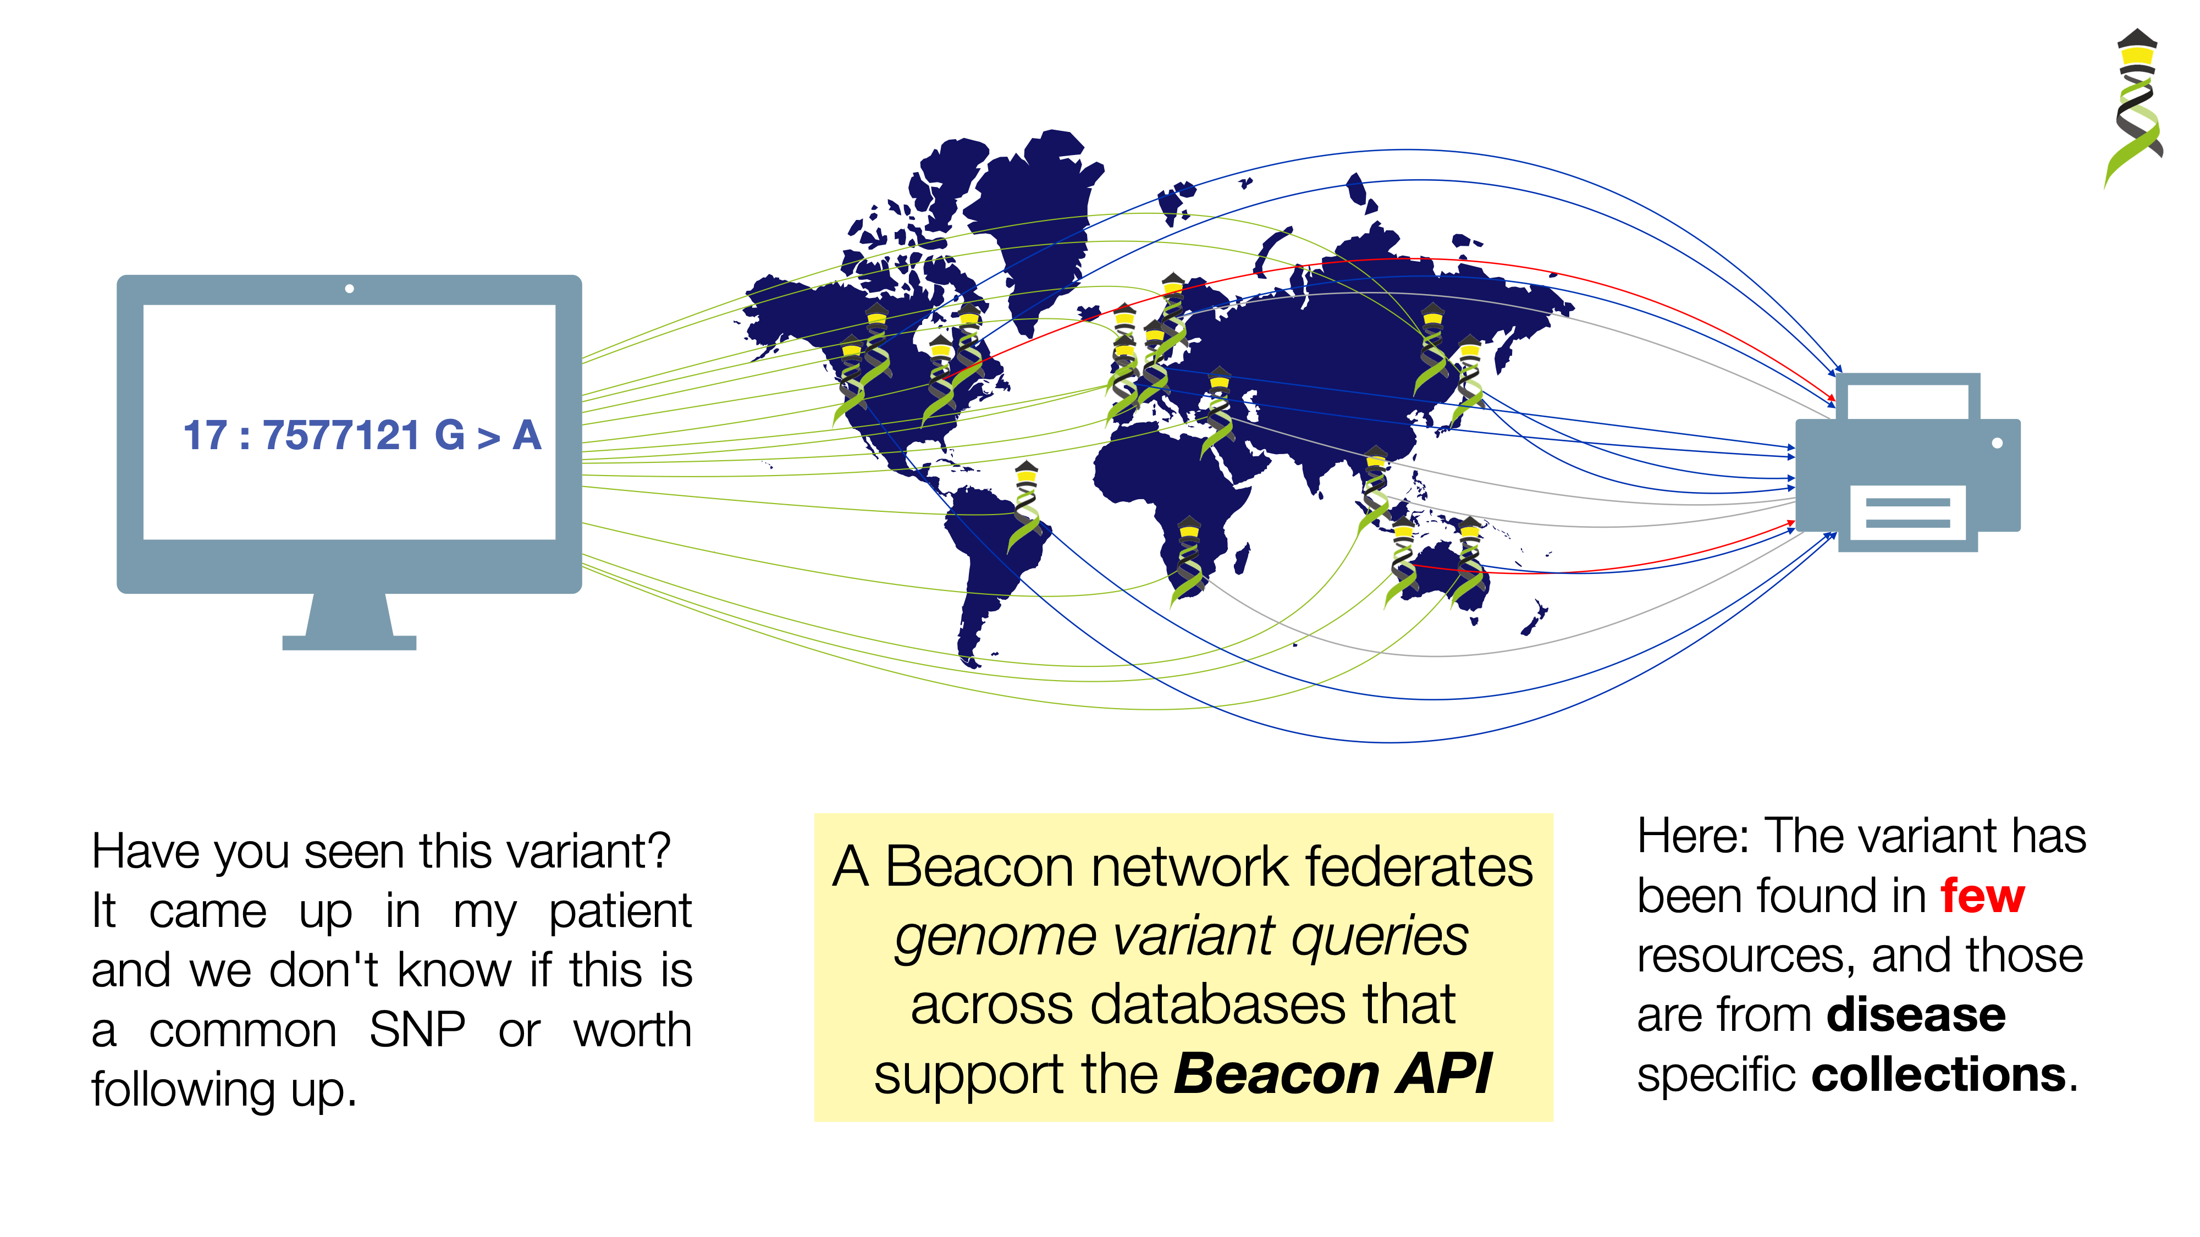
Beacon v1 in a network

Slide 5
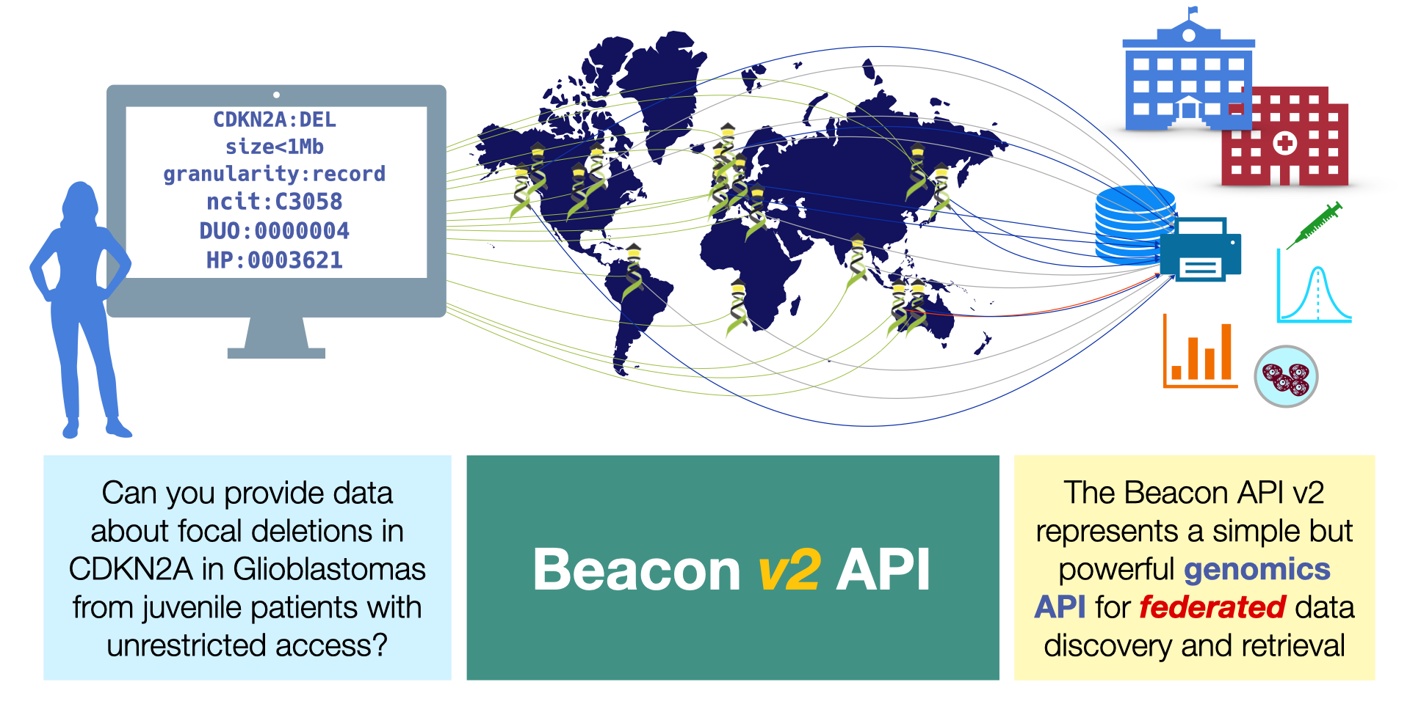
Beacon v2
Beacon v2 offers record responses, displaying data for variations, individuals, biosamples, runs, analyses, datasets and cohorts.

Slide 6
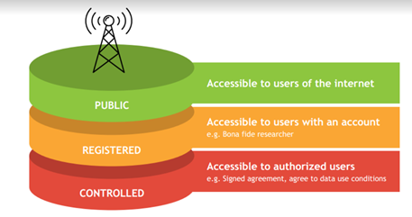
Beacon Security
The beacon API specification does not implement explicit security (e.g. checking user authentication and authorization)
The framework implements different levels of response granularity which can be mapped to authorization levels (boolean / count / record level responses)
Implementations can have beacons running in secure environments with a gatekeeper service managing authentication and autorization levels, and potentially can filter responses for escalated levels
The backend can implement additional access reduction, on a user <-> dataset level if needed

Slide 7
Beacon v2 Implementation
SERVER
Framework
Models
DB
data model · schemas · entities
HTTPS API
Request (GET / POST + JSON)
CLIENT
Response (JSON)
Researcher

Slide 8
Beacon v2 Implementation options
Beacon v2 Reference Implementation
Federated data sources
Independent Beacons exposing local genomic data
API
Genomic Source A
Beacon endpoint
Genomic Source B
Beacon endpoint
Internal DB
Python → Django
(MongoDB)
Genomic Source C
Typical beacon implementation
Beacon endpoint

Slide 9
What you can build · 16 honours-project ideas across 7 themes
A
Privacy & security
B
Federation & networking
C
Standards & conformance
D
Clinical & phenotype
A1 Re-identification attacks on African Beacon A2 Differential-privacy noise layer A3 Reconstruction-attack defense (2025)
B1 Query-log anomaly / abuse classifier B2 Latency benchmarking & SLO design
C1 Property-based fuzzer for Beacon v2
D1 Phenopackets cohort discovery D2 Pharmacogenomics (AGMP / star alleles)
E
UX & visualisation
F
Infrastructure & data eng.
G
Other Beacon types
E1 Privacy-aware result visualisation
F1 V7HC-S bulk-ingest benchmarking
G1 Pathogen (TB / HIV / malaria / mpox) G2 Methylation (MBeacon) G3 Cancer / CNV (Progenetix-style) G4 Crops (cassava / sorghum / teff) G5 Microbiome (gut / oral) G6 Imaging (TB CXR / DR)
Each project pairs an engineering deliverable with a measurable research result · 4–6 months · scoped for honours

Slide 10
Next steps
Pre-watch · Baudis (March 2024) — youtube.com/watch?v=OWF8PC2sX7w (~50 min)
Read · Rambla et al. 2022 — doi.org/10.1002/humu.24369
Browse · docs.genomebeacons.org · genomebeacons.org/FAQ
Try · api-beacon.afrigen-d.dev/api/info (any browser)
Pick a project from the menu. Bring questions to the next session.
Contact: AfriGen-D · UCT CBIO · Mamana Mbiyavanga

