Slide 1


South Africa
liquid fuels
market story
Inland supply, corridor capture and tank turnover
Durban–Lesedi corridor into Gauteng
8 October 2026
Panel layouts aligned; scenario and commercial calibration remain open
Photo source: Royal Vopak | Terminal Durban | vopak.com
Strictly Confidential
Notes:
Speaker note: Walk through four sections: the project question, the analytical
requirements, the model-build problem and the delivery approach. The purpose is to
connect the analyst's tasks to the decisions the engagement needs to support.
Week 1 analytical pack, 6 October 2026. Existing kickoff cover/closing reused at user request.
SCR delivery order: page 1 of 16. Gap IDs and original evidence references retained in notes.
SCR delivery order: page 1 of 16. Gap IDs and original evidence references retained in notes.
SCR delivery order: page 1 of 16. Gap IDs and original evidence references retained in notes.
SCR delivery order: page 1 of 16. Gap IDs and original evidence references retained in notes.
SCR delivery order: page 1 of 16. Gap IDs and original evidence references retained in notes.
SCR delivery order: page 1 of 16. Gap IDs and original evidence references retained in notes.
SCR delivery order: page 1 of 16. Gap IDs and original evidence references retained in notes.
SCR delivery order: page 1 of 16. Gap IDs and original evidence references retained in notes.
SCR delivery order: page 1 of 16. Gap IDs and original evidence references retained in notes.
SCR delivery order: page 1 of 16. Gap IDs and original evidence references retained in notes.
SCR delivery order: page 1 of 16. Gap IDs and original evidence references retained in notes.
SCR delivery order: page 1 of 16. Gap IDs and original evidence references retained in notes.
6 October SCR editorial pass: presentation copy and map hierarchy only. Source observations, example volumes and model inputs unchanged.
SCR delivery order: page 1 of 16. Gap IDs and original evidence references retained in notes.
6 October SCR editorial pass: presentation copy and map hierarchy only. Source observations, example volumes and model inputs unchanged.
SCR delivery order: page 1 of 16. Gap IDs and original evidence references retained in notes.
6 October SCR editorial pass: presentation copy and map hierarchy only. Source observations, example volumes and model inputs unchanged.
SCR delivery order: page 1 of 16. Gap IDs and original evidence references retained in notes.
6 October SCR editorial pass: presentation copy and map hierarchy only. Source observations, example volumes and model inputs unchanged.
SCR delivery order: page 1 of 16. Gap IDs and original evidence references retained in notes.
6 October SCR editorial pass: presentation copy and map hierarchy only. Source observations, example volumes and model inputs unchanged.
SCR delivery order: page 1 of 16. Gap IDs and original evidence references retained in notes.
6 October SCR editorial pass: presentation copy and map hierarchy only. Source observations, example volumes and model inputs unchanged.
SCR delivery order: page 1 of 16. Gap IDs and original evidence references retained in notes.
6 October SCR editorial pass: presentation copy and map hierarchy only. Source observations, example volumes and model inputs unchanged.
Convergence order: national accounting p3; provincial map p4; history/estimates p5. Current page 1.
SCR delivery order: page 1 of 16. Gap IDs and original evidence references retained in notes.
6 October SCR editorial pass: presentation copy and map hierarchy only. Source observations, example volumes and model inputs unchanged.
Convergence order: national accounting p3; provincial map p4; history/estimates p5. Current page 1.
SCR delivery order: page 1 of 16. Gap IDs and original evidence references retained in notes.
6 October SCR editorial pass: presentation copy and map hierarchy only. Source observations, example volumes and model inputs unchanged.
Convergence order: national accounting p3; provincial map p4; history/estimates p5. Current page 1.
Final structure: baseline pp3–6; changes pp7–11 (forecast framework p9); outlook pp12–17 (market choices p16, inventory p17). Current page 1.
SCR delivery order: page 1 of 16. Gap IDs and original evidence references retained in notes.
6 October SCR editorial pass: presentation copy and map hierarchy only. Source observations, example volumes and model inputs unchanged.
Convergence order: national accounting p3; provincial map p4; history/estimates p5. Current page 1.
Final structure: baseline pp3–6; changes pp7–11 (forecast framework p9); outlook pp12–17 (market choices p16, inventory p17). Current page 1.

Slide 2




Slow demand growth and greater import reliance set the baseline; power, refineries and routes could change it
Executive summary
Situation
Complication
Resolution
Baseline / reference | What the evidence establishes | What changes the outlook
Fuel demand and power | 2013–2023 CAGR: petrol −2.08%; diesel +0.82%. Eskom OCGT fuel use fell 40% in FY2025. | Growth, rail, EVs and efficiency alter transport demand; fleet recovery and new generation alter diesel dispatch.
Domestic supply and imports | 2020–2025 imports rose by 5.43bn litres of diesel and 2.73bn of petrol. The sourcing mix has shifted. | SAPREF and PetroSA restart paths, Secunda gas/MRG and Natref output can change domestic supply.
Corridor position and tank turnover | Durban and Lesedi provide coastal and inland assets serving Gauteng. Working capacity and turns are open. | Route costs, access and customer capture determine flow; achievable turnover determines handling headroom.
Medium / Medium reference world | M/M anchors the nine-world matrix. Historical evidence is assembled; numerical calibration remains open. | Vary demand and supply around M/M, then test capture, turnover and returns to identify investment triggers.
Executive summary — baseline and changes. Comparable historical periods differ: Department sales 2013–2023; SARS imports 2020–2025; Eskom FY2025 vs FY2024 (own diesel + kerosene). M/M is a reference framework, not a calibrated forecast.
Strictly Confidential
Notes:
Executive summary — baseline and changes. Comparable historical periods differ: Department sales 2013–2023; SARS imports 2020–2025; Eskom FY2025 vs FY2024 (own diesel + kerosene). M/M is a reference framework, not a calibrated forecast.
Evidence: output/delivered/sa_review_2026_10_07_v3/index.html. Comment dispositions: workstreams/WS0_governance/workplan/sa_review_comment_disposition_2026_10_07.csv. Review draft; scenario and commercial calibration pending.

Slide 3
Vopak can capture inland growth through the Durban–Lesedi corridor, with expansion conditional on turnover and returns
Executive summary
Situation
Complication
Resolution
Investment outlook | Why it matters | What determines the choice
Capture inland supply | Imported and domestic fuel can serve inland demand. Terminal access and customer capture determine volumes. | Size the accessible market by origin, product and destination, then estimate Vopak’s share of the resulting flows.
Use the corridor position | Durban and Lesedi connect coastal handling with inland distribution into the Gauteng catchment. | Compare delivered costs, access and reliability with competing gateways and domestic sources.
Increase asset turnover | Growth can increase throughput through existing tanks. Receipt and dispatch constrain achievable turns. | Use existing assets, debottleneck or add storage according to working capacity, turnover and returns.
Test nine market worlds | Demand and domestic supply each have L/M/H paths. Medium/Medium is the reference to calibrate. | Track captured flow, required turns and capacity headroom in every world; phase investment against clear triggers.
Working thesis for the Durban–Lesedi corridor into Gauteng. Domestic and imported origins require verified access. No measured Vopak share, calibrated nine-world outputs or approved expansion returns are asserted.
Strictly Confidential
Notes:
Working thesis for the Durban–Lesedi corridor into Gauteng. Domestic and imported origins require verified access. No measured Vopak share, calibrated nine-world outputs or approved expansion returns are asserted.
Evidence: output/delivered/sa_review_2026_10_07_v3/index.html. Comment dispositions: workstreams/WS0_governance/workplan/sa_review_comment_disposition_2026_10_07.csv. Review draft; scenario and commercial calibration pending.

Slide 4
Capturable volumes, route competitiveness and tank turnover determine the investment required
Executive summary
Situation
Complication
Resolution
Argument | Situation | Complication | Resolution / decision
Transport demand | Subdued aggregate growth masks different product trends. Road freight supports diesel use. | Sector growth, rail recovery, EVs and efficiency change fuel demand. | D1–D4 define activity, rail, EV and efficiency paths. Translate them into capturable product demand.
Power demand | Power shortages supported diesel use; Eskom consumption has recently fallen. | Recovery may persist or reverse through outages and replacement delays. | D5 adds fleet recovery, replacement timing and diesel dispatch to the same demand paths.
Domestic supply | Reduced local production has increased reliance on imports. | SAPREF, Natref and Secunda can change domestic fuel output materially. | S1–S4 define plant output and sourcing mix. Imports are one consequence of the domestic balance.
Corridor competition | Durban connects imported fuel to inland customers. | Alternative gateways, delivered costs, reliability and access alter flows. | T1–T2 compare delivered economics and capture for domestic and imported fuel serving common destinations.
Vopak investment | Durban and Lesedi provide connected assets whose throughput can rise through higher turnover. | Working tankage, receipt/dispatch, peaks and stock requirements constrain achievable turnover. | T3–T5 compare working capacity, required/achievable turns and dispatch limits. F1 tests incremental returns.
Lever IDs are mapped in the appendix. All nine market worlds use explicit routing, capture and operational assumptions. Tank occupancy, turnover and throughput utilisation are separate measures.
Strictly Confidential
Notes:
Lever IDs are mapped in the appendix. All nine market worlds use explicit routing, capture and operational assumptions. Tank occupancy, turnover and throughput utilisation are separate measures.
Evidence: output/delivered/sa_review_2026_10_07_v3/index.html. Comment dispositions: workstreams/WS0_governance/workplan/sa_review_comment_disposition_2026_10_07.csv. Review draft; scenario and commercial calibration pending.

Slide 5
Nine demand–supply worlds test the investment choice against the Medium / Medium baseline
Executive summary
Situation
Complication
Resolution
Fuel demand / domestic supply | HIGH supply (S1–S4) | MEDIUM supply (S1–S4) | LOW supply (S1–S4)
LOW demand D1–D5 | L / H LOWEST IMPORT PRESSURE Domestic routing and customer capture still determine terminal turns. | L / M Lower imports than baseline. Test utilisation and customer capture. | L / L Demand and supply both fall. Net import effect depends on their relative change.
MEDIUM demand D1–D5 | M / H Lower imports than baseline. Supply recovery reduces import needs. | M / M BASELINE Reference sourcing, captured throughput, required turns and headroom. | M / L Higher imports than baseline. Supply losses increase import needs.
HIGH demand D1–D5 | H / H Demand and supply both rise. Net import effect depends on their relative change. | H / M Higher imports than baseline. Demand growth increases import needs. | H / L HIGHEST IMPORT PRESSURE Test the captured flow against working capacity and achievable turns.
Every cell: sourcing mix → captured Durban / Lesedi flow → required vs achievable turns → headroom → return.
Qualitative matrix, not numerical forecasts. T1–T5 and F1 translate each world into investment outcomes. Imports are an intermediate balance; domestic supply can also generate terminal flows where access is available.
Strictly Confidential
Notes:
Qualitative matrix, not numerical forecasts. T1–T5 and F1 translate each world into investment outcomes. Imports are an intermediate balance; domestic supply can also generate terminal flows where access is available.
Evidence: output/delivered/sa_review_2026_10_07_v3/index.html. Comment dispositions: workstreams/WS0_governance/workplan/sa_review_comment_disposition_2026_10_07.csv. Review draft; scenario and commercial calibration pending.

Slide 6
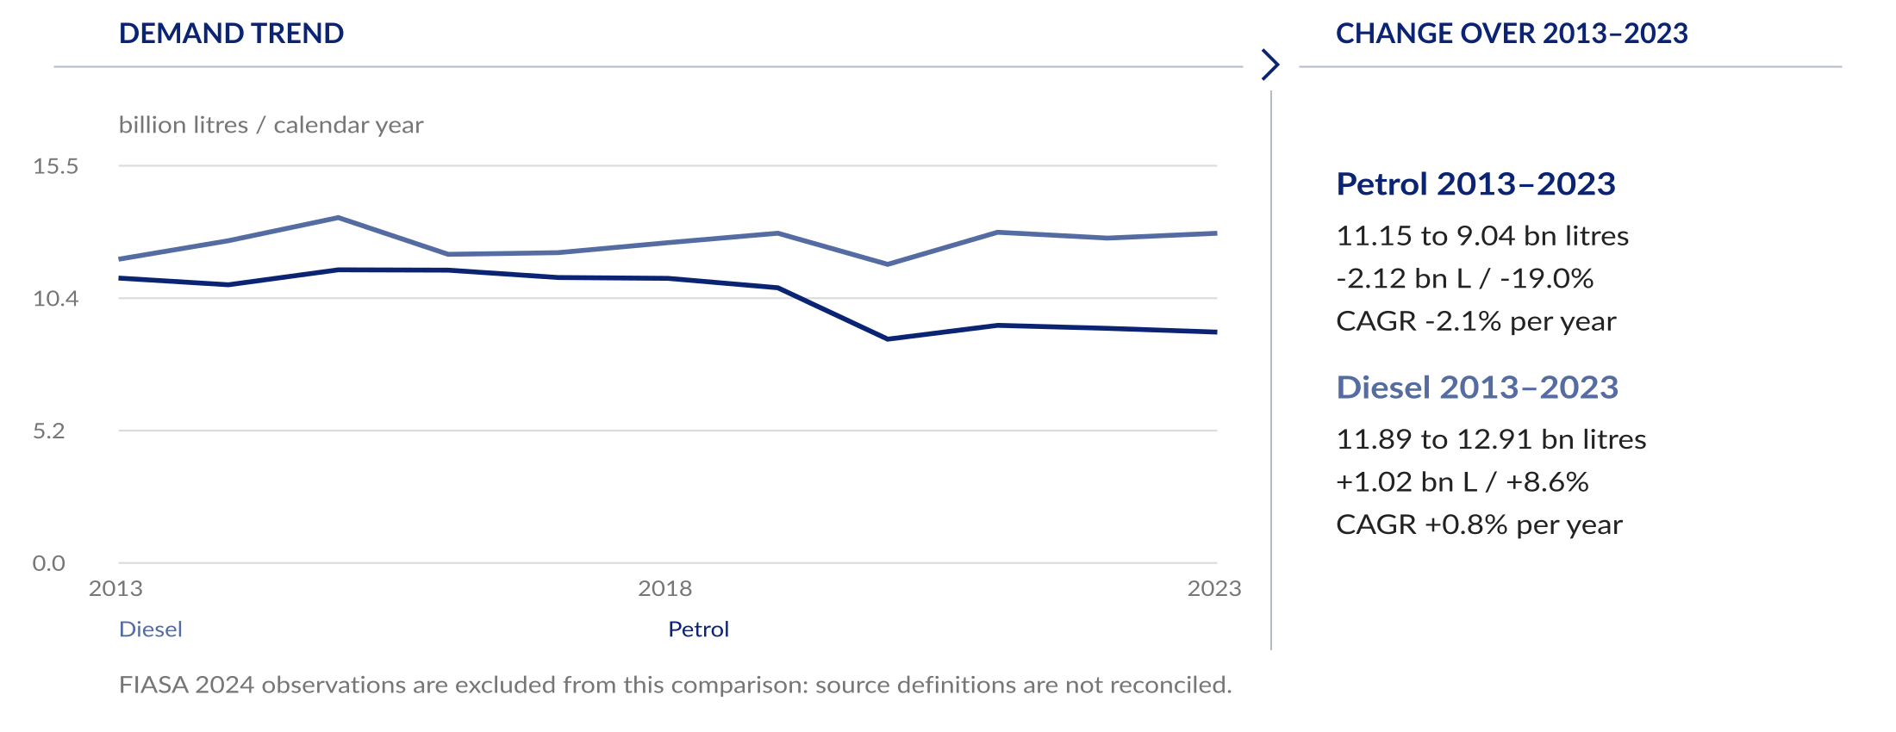
Petrol demand has declined while diesel has grown slowly, limiting the case for demand-led expansion
Executive summary
Situation
Complication
Resolution
The demand history supports a selective investment case: growth must translate into captured corridor throughput and sufficient tank turns.
Department sales 2013–2023. CAGR from comparable endpoints: petrol −2.08%, diesel +0.82%. FIASA 2024 is excluded from the trend calculation; its observations remain in the evidence data.
Strictly Confidential
Notes:
Department sales 2013–2023. CAGR from comparable endpoints: petrol −2.08%, diesel +0.82%. FIASA 2024 is excluded from the trend calculation; its observations remain in the evidence data.
Evidence: output/delivered/sa_review_2026_10_07_v3/index.html. Comment dispositions: workstreams/WS0_governance/workplan/sa_review_comment_disposition_2026_10_07.csv. Review draft; scenario and commercial calibration pending.

Slide 7
Power shortages and road freight have supported diesel consumption, but that support can change
Executive summary
Situation
Complication
Resolution
Demand support | Historical evidence | What this establishes
Power generation | Eskom’s own OCGT fuel use rose to 1,129.5m litres in FY2024, then fell to 679.1m in FY2025 as EAF improved. | D5: availability, retirement and new generation determine dispatch. See the quantitative power exhibit and calibration requirements.
Road freight | The national payload series shows road carrying substantially more tonnage than rail. | D2: transferable tonne-kilometres, rail reliability and fuel intensity determine the net diesel effect.
Demand interpretation | Mining and agriculture add sector-specific diesel exposure; aviation has a separate jet-fuel market. | D1: sector activity drives end-use demand. Histories precede explicit L/M/H assumptions; missing data remain identified.
Eskom 2025 integrated report (own-fleet diesel + kerosene); Stats SA freight payload. No causal diesel attribution from tonnes alone. Details: appendix pp19, 22–23.
Strictly Confidential
Notes:
Eskom 2025 integrated report (own-fleet diesel + kerosene); Stats SA freight payload. No causal diesel attribution from tonnes alone. Details: appendix pp19, 22–23.
Evidence: output/delivered/sa_review_2026_10_07_v3/index.html. Comment dispositions: workstreams/WS0_governance/workplan/sa_review_comment_disposition_2026_10_07.csv. Review draft; scenario and commercial calibration pending.

Slide 8
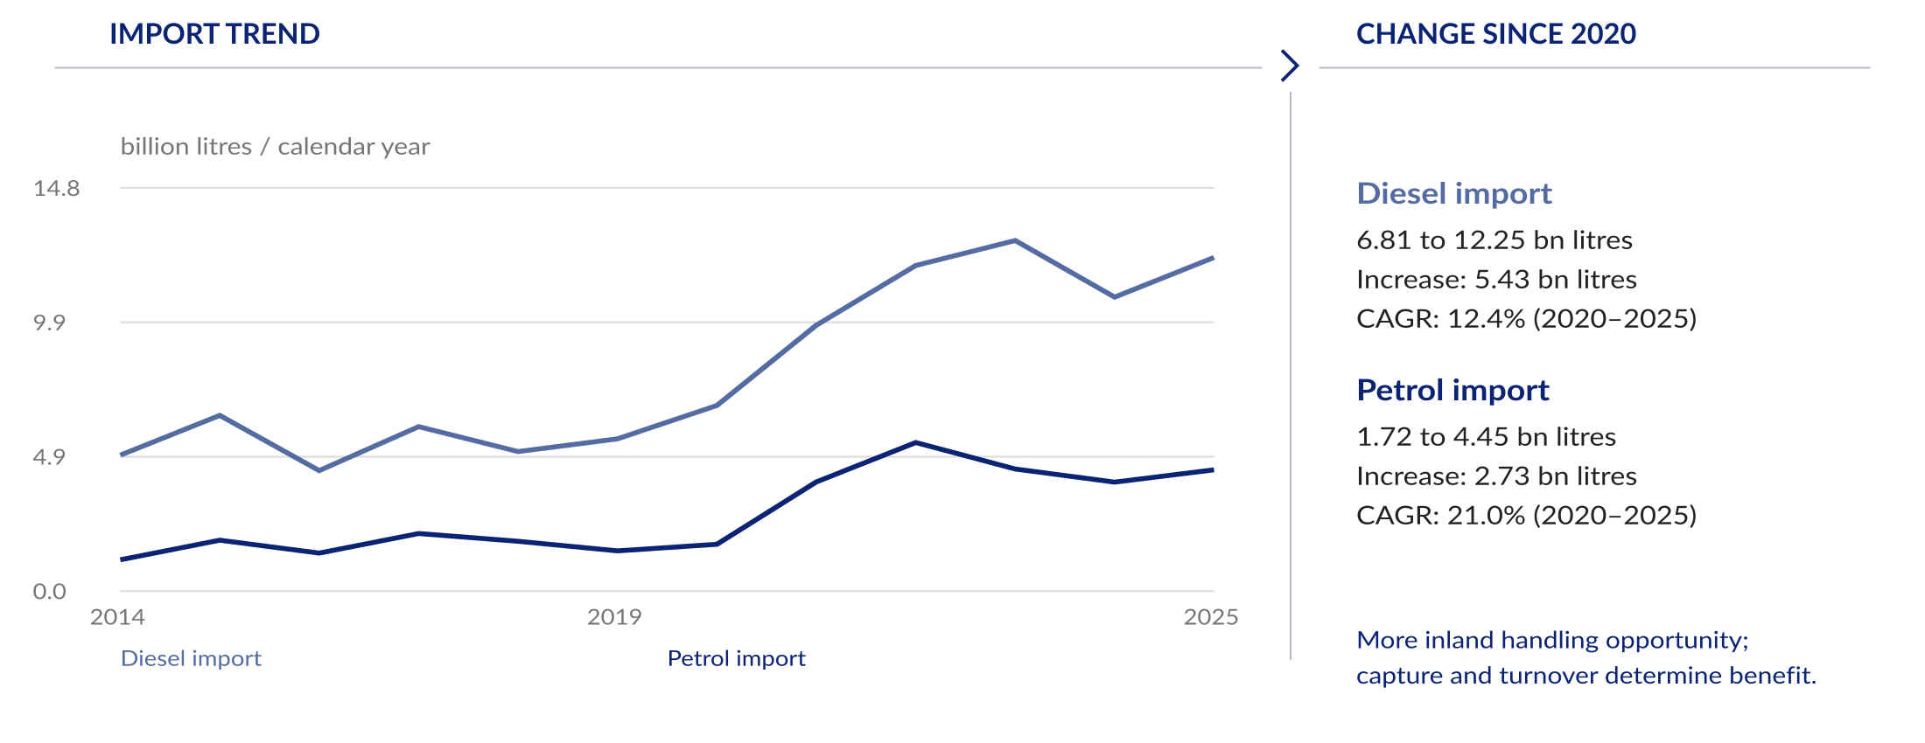
Lower domestic production has increased imports and shifted how inland demand is supplied
Executive summary
Situation
Complication
Resolution
Additional imported litres create handling demand. Vopak benefits where it captures inland flows and can increase turnover or profitably remove a constraint.
SARS litre-reported petrol/diesel codes, complete calendar years. 2020–2025 changes are historical comparisons, not plant-level causal attribution. Export histories retained in the source report; unit/blend exclusions remain.
Strictly Confidential
Notes:
SARS litre-reported petrol/diesel codes, complete calendar years. 2020–2025 changes are historical comparisons, not plant-level causal attribution. Export histories retained in the source report; unit/blend exclusions remain.
Evidence: output/delivered/sa_review_2026_10_07_v3/index.html. Comment dispositions: workstreams/WS0_governance/workplan/sa_review_comment_disposition_2026_10_07.csv. Review draft; scenario and commercial calibration pending.

Slide 9
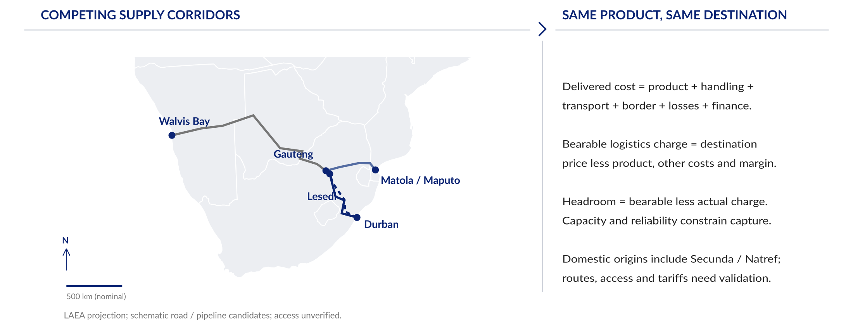
Domestic sources and competing gateways contest the same inland customers
Executive summary
Situation
Complication
Resolution
Compare the same product at the same Gauteng destination. Price headroom only becomes capturable throughput where capacity, rights and reliable access exist.
Natural Earth country geometry; shared LAEA projection with uniform scale. GeoJSON source catalogue: output/delivered/geospatial/2026_10_07. Corridor lines and places remain authored approximations; operating routes, facility positions and access require validation.
Strictly Confidential
Notes:
Natural Earth country geometry; shared LAEA projection with uniform scale. GeoJSON source catalogue: output/delivered/geospatial/2026_10_07. Corridor lines and places remain authored approximations; operating routes, facility positions and access require validation.
Evidence: output/delivered/sa_review_2026_10_07_v3/index.html. Comment dispositions: workstreams/WS0_governance/workplan/sa_review_comment_disposition_2026_10_07.csv. Review draft; scenario and commercial calibration pending.

Slide 10
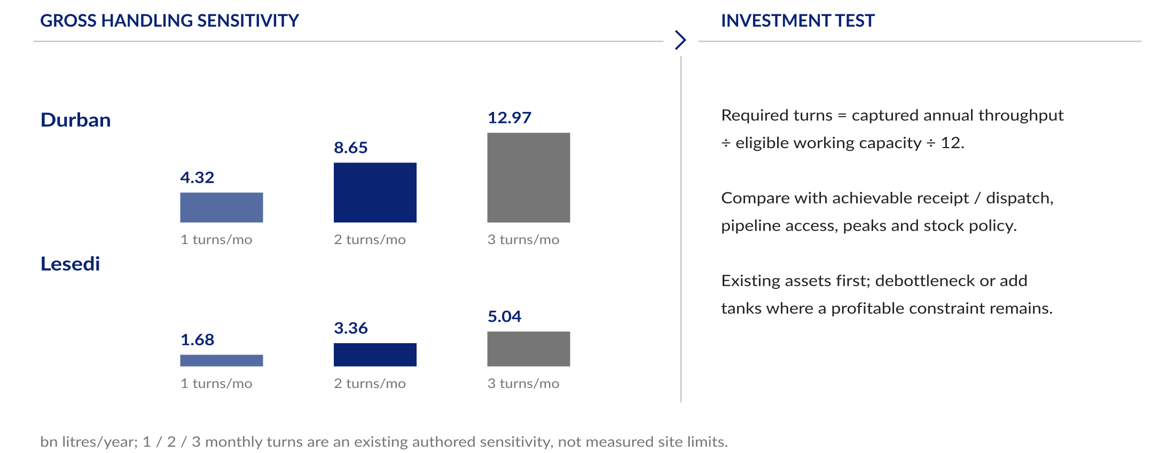
Higher turnover could let Durban and Lesedi serve more demand through existing tanks
Executive summary
Situation
Complication
Resolution
Required working-capacity turns must be compared with achievable turns at each terminal. Gross handling equivalents do not establish spare capacity or actual market share.
Registered REG-TERMINAL-HANDLING-TURNS: 1/2/3 turns per month, authored operational sensitivity, not the demand–supply worlds or measured limits. Gross Durban mixed-product tankage; no assumed eligible fraction. Do not sum inter-terminal transfers as unique demand.
Strictly Confidential
Notes:
Registered REG-TERMINAL-HANDLING-TURNS: 1/2/3 turns per month, authored operational sensitivity, not the demand–supply worlds or measured limits. Gross Durban mixed-product tankage; no assumed eligible fraction. Do not sum inter-terminal transfers as unique demand.
Evidence: output/delivered/sa_review_2026_10_07_v3/index.html. Comment dispositions: workstreams/WS0_governance/workplan/sa_review_comment_disposition_2026_10_07.csv. Review draft; scenario and commercial calibration pending.

Slide 11

Rail recovery, EV adoption and efficiency could reduce transport fuel demand
Executive summary
Situation
Complication
Resolution
The time series establish the starting points. Rail, adoption and efficiency levers must be calibrated into the same three demand paths before the matrix is quantified.
Stats SA freight payload; staged naamsa BEV/PHEV annual sales 2019–2025; existing engine petrol-ICE efficiency diagnostics. Dashed efficiency paths are assumptions, not historical OEM evidence. Medium and causal fuel impacts remain uncalibrated.
Strictly Confidential
Notes:
Stats SA freight payload; staged naamsa BEV/PHEV annual sales 2019–2025; existing engine petrol-ICE efficiency diagnostics. Dashed efficiency paths are assumptions, not historical OEM evidence. Medium and causal fuel impacts remain uncalibrated.
Evidence: output/delivered/sa_review_2026_10_07_v3/index.html. Comment dispositions: workstreams/WS0_governance/workplan/sa_review_comment_disposition_2026_10_07.csv. Review draft; scenario and commercial calibration pending.

Slide 12
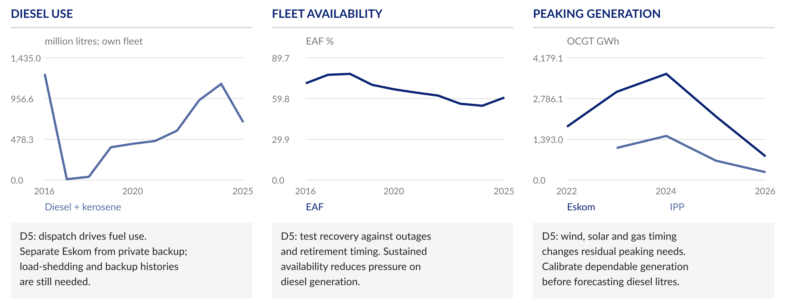
Power recovery could lower diesel use further, while outages and replacement delays could reverse the gains
Executive summary
Situation
Complication
Resolution
Eskom recovery has lowered diesel dispatch. Wind, solar and gas timing must be tested against demand, fleet retirements and dependable output before forecasting residual diesel.
Eskom FY ending March. Fuel/EAF: 2025 report; GWh: staged 2024–2026 reports. Own Eskom and IPP generation separated. Private backup and load-shedding histories are missing; no assumed annual generation gap is assigned entirely to diesel.
Strictly Confidential
Notes:
Eskom FY ending March. Fuel/EAF: 2025 report; GWh: staged 2024–2026 reports. Own Eskom and IPP generation separated. Private backup and load-shedding histories are missing; no assumed annual generation gap is assigned entirely to diesel.
Evidence: output/delivered/sa_review_2026_10_07_v3/index.html. Comment dispositions: workstreams/WS0_governance/workplan/sa_review_comment_disposition_2026_10_07.csv. Review draft; scenario and commercial calibration pending.

Slide 13
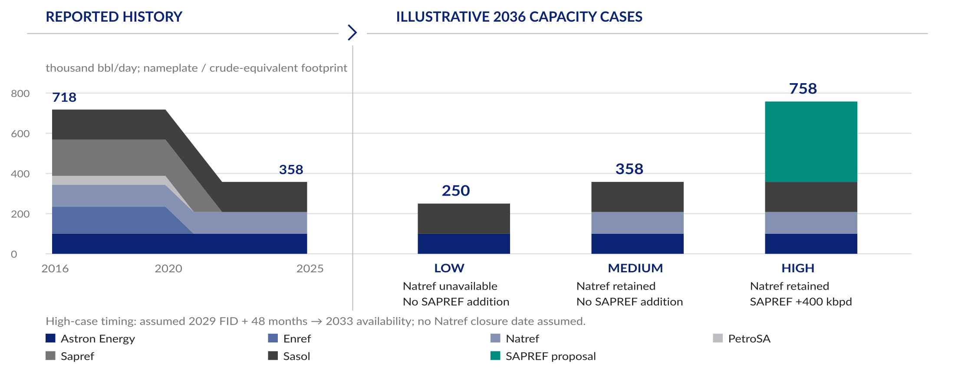
SAPREF could expand the supply footprint, while Natref unavailability would reduce it
Executive summary
Situation
Complication
Resolution
These capacity cases anchor the supply-axis discussion. Translate them into product output, then test imports, corridor capture and required tank turns in each of the nine worlds.
FIASA 2025 p49; registered review_capacity_scenarios.yaml and review_supply_worlds.yaml. Illustrative 2036 sensitivities, not calibrated production forecasts. Other plants held at 2025 reported values; Secunda gas/MRG and PetroSA restart effects remain unquantified. Low is not a Natref closure prediction.
Strictly Confidential
Notes:
FIASA 2025 p49; registered review_capacity_scenarios.yaml and review_supply_worlds.yaml. Illustrative 2036 sensitivities, not calibrated production forecasts. Other plants held at 2025 reported values; Secunda gas/MRG and PetroSA restart effects remain unquantified. Low is not a Natref closure prediction.
Evidence: output/delivered/sa_review_2026_10_07_v3/index.html. Comment dispositions: workstreams/WS0_governance/workplan/sa_review_comment_disposition_2026_10_07.csv. Review draft; scenario and commercial calibration pending.

Slide 14
Changes in delivered cost and reliability could shift inland flows between competing corridors
Executive summary
Situation
Complication
Resolution
Evidence | Interpretation | Implication for Vopak
Durban–Lesedi | Compare road, rail and pipeline to the same receiving point and product specification. | T1–T2: compare access, cost and reliability to the same destination; quantify captured throughput and the resulting tank turns.
Matola / Maputo | Include inland haul and border costs for each reachable destination. | A port-level cost comparison cannot establish Gauteng competitiveness.
Walvis Bay | Test distance, transit time and corridor capacity into each target market. | Do not assume that every inland customer is economically addressable.
Price bearability | Bearable logistics charge = destination selling price less origin product cost, other costs and required margin. | Headroom = bearable charge less actual logistics cost. Capacity and service constrain the share captured through Durban–Lesedi.
Submodel specification adopted from the annotated review. No route winner is asserted without matched costs, access and capacity.
Strictly Confidential
Notes:
Submodel specification adopted from the annotated review. No route winner is asserted without matched costs, access and capacity.
Evidence: output/delivered/sa_review_2026_10_07_v3/index.html. Comment dispositions: workstreams/WS0_governance/workplan/sa_review_comment_disposition_2026_10_07.csv. Review draft; scenario and commercial calibration pending.

Slide 15
Expansion requires capturable throughput beyond achievable capacity at an adequate return
Executive summary
Situation
Complication
Resolution
Investment test | Required measure | Decision consequence
Captured throughput | Domestic + imported unique deliveries by product, customer and terminal. | Establish accessible flows and avoid double-counting Durban–Lesedi transfers.
Required turnover | Annual captured m³ / eligible working m³ / 12 = required monthly turns. | Compare with achievable turns, seasonality, stock policy and receipt/dispatch limits.
Capacity headroom | Achievable annual handling less required throughput; tank occupancy assessed separately. | Use existing capacity where available, then test targeted debottlenecking or additional storage.
Financial return | Storage and handling revenue, operating cost, capex and working capital. | Test incremental cash flow, break-even utilisation, NPV and IRR before committing to expansion.
Public capacity ratios and Gauteng market size are screening evidence only. Working capacity, realised dispatch, routing, tariffs, contracts and capex remain open. No investment return or throughput market share is fabricated.
Strictly Confidential
Notes:
Public capacity ratios and Gauteng market size are screening evidence only. Working capacity, realised dispatch, routing, tariffs, contracts and capex remain open. No investment return or throughput market share is fabricated.
Evidence: output/delivered/sa_review_2026_10_07_v3/index.html. Comment dispositions: workstreams/WS0_governance/workplan/sa_review_comment_disposition_2026_10_07.csv. Review draft; scenario and commercial calibration pending.

Slide 16
The supporting evidence calibrates demand, supply and the terminal investment tests
Appendix
Supporting evidence
Calibration
Reference detail
Evidence group | Detail retained | Connection to the story
Demand | Activity, freight, EVs, efficiency and power | D1–D5 create the three demand paths.
Supply | Plant output, gas availability and restart timing | S1–S4 create the three domestic-supply paths.
Capture and operations | Routes, customer share, working tankage and turnover | T1–T5 translate each world into terminal flows and constraints.
Returns | Rates, costs, capex and funding | F1 translates each investment option into cash flow and returns.
The main story runs from the opening thesis to the investment tests. The added lever register and power/supply calibration pages record what remains to be populated.
Strictly Confidential
Notes:
The main story runs from the opening thesis to the investment tests. The added lever register and power/supply calibration pages record what remains to be populated.
Evidence: output/delivered/sa_review_2026_10_07_v3/index.html. Comment dispositions: workstreams/WS0_governance/workplan/sa_review_comment_disposition_2026_10_07.csv. Review draft; scenario and commercial calibration pending.

Slide 17

Fuel demand has diverged from GDP, so sector activity and fuel intensity need separate treatment
Appendix
Supporting evidence
Calibration
Reference detail
Economic weakness means limited growth in real activity and investment. Structural change means a different mix of output, travel and fuel use; this chart alone cannot attribute causality.
Staged GDP and department fuel sales, indices 2013=100. Sector attribution remains open; COVID distorts short-period comparisons.
Strictly Confidential
Notes:
Staged GDP and department fuel sales, indices 2013=100. Sector attribution remains open; COVID distorts short-period comparisons.
Evidence: output/delivered/sa_review_2026_10_07_v3/index.html. Comment dispositions: workstreams/WS0_governance/workplan/sa_review_comment_disposition_2026_10_07.csv. Review draft; scenario and commercial calibration pending.

Slide 18

Fixed investment has weakened while FDI fluctuates, limiting a simple growth-led fuel argument
Appendix
Supporting evidence
Calibration
Reference detail
Fixed investment helps frame productive capacity. FDI can include large transactions; neither series is a direct investor-confidence measure or an additional fuel-demand multiplier.
World Bank WDI, FDI net inflows and gross fixed capital formation as % of GDP, 2010–2025. Confidence series remains an evidence gap.
Strictly Confidential
Notes:
World Bank WDI, FDI net inflows and gross fixed capital formation as % of GDP, 2010–2025. Confidence series remains an evidence gap.
Evidence: output/delivered/sa_review_2026_10_07_v3/index.html. Comment dispositions: workstreams/WS0_governance/workplan/sa_review_comment_disposition_2026_10_07.csv. Review draft; scenario and commercial calibration pending.

Slide 19
Mining, agriculture and aviation expose fuel demand to different activity drivers
Appendix
Supporting evidence
Calibration
Reference detail
Evidence | Interpretation | Implication for Vopak
Mining | Output, commodity mix and haul distance influence diesel use and freight. | Separate mine activity from the fuel impact of changing freight mode.
Agriculture | Crop cycles, weather, irrigation and logistics can shift seasonal diesel use. | Establish sector activity and fuel exposure before assigning a headwind.
Aviation | Traffic, distance, load factors and aircraft efficiency drive jet-fuel demand. | Keep jet fuel separate from petrol/diesel shares and verify terminal eligibility.
Manufacturing | Real output and industrial composition help explain the economic backdrop. | Test changes using sector data; a national fuel chart does not prove deindustrialisation.
Analytical framework following user comments. Sector-specific exhibits and causal attribution remain to be completed.
Strictly Confidential
Notes:
Analytical framework following user comments. Sector-specific exhibits and causal attribution remain to be completed.
Evidence: output/delivered/sa_review_2026_10_07_v3/index.html. Comment dispositions: workstreams/WS0_governance/workplan/sa_review_comment_disposition_2026_10_07.csv. Review draft; scenario and commercial calibration pending.

Slide 20

Higher fuel prices strengthen EV running-cost incentives, but ownership economics determine uptake
Appendix
Supporting evidence
Calibration
Reference detail
Shipping disruption, crude prices and FX can move fuel costs temporarily. EV adoption depends on sustained total ownership cost, purchase affordability, charging access and fleet replacement.
Department fuel-price history, nominal R/litre. No quantified geopolitical premium or calibrated EV adoption response is asserted.
Strictly Confidential
Notes:
Department fuel-price history, nominal R/litre. No quantified geopolitical premium or calibrated EV adoption response is asserted.
Evidence: output/delivered/sa_review_2026_10_07_v3/index.html. Comment dispositions: workstreams/WS0_governance/workplan/sa_review_comment_disposition_2026_10_07.csv. Review draft; scenario and commercial calibration pending.

Slide 21
New-vehicle efficiency gains affect fuel demand gradually as older vehicles leave the fleet
Appendix
Supporting evidence
Calibration
Reference detail
Evidence | Interpretation | Implication for Vopak
Fleet growth | More vehicles or distance travelled can raise demand. | Measure activity before attributing lower fuel volumes to efficiency.
Efficiency | New-cohort consumption gains enter the fleet over successive replacement cycles. | Obtain OEM and real-world evidence by segment; do not apply new-vehicle gains to every vehicle.
EV substitution | EVs remove some combustion-engine vehicle activity from the fuel calculation. | Count each vehicle transition once, then calculate efficiency on the remaining combustion fleet.
Mechanism supported by existing cohort architecture. OEM historical and future efficiency evidence is still missing; no new forecast shown.
Strictly Confidential
Notes:
Mechanism supported by existing cohort architecture. OEM historical and future efficiency evidence is still missing; no new forecast shown.
Evidence: output/delivered/sa_review_2026_10_07_v3/index.html. Comment dispositions: workstreams/WS0_governance/workplan/sa_review_comment_disposition_2026_10_07.csv. Review draft; scenario and commercial calibration pending.

Slide 22

Eskom’s own OCGT fuel use fell 40% in FY2025 as availability improved
Appendix
Supporting evidence
Calibration
Reference detail
Reported fuel fell from 1,129.5 to 679.1 million litres as EAF improved from 54.56% to 60.60%. This removes part of the recent diesel-demand support.
Eskom integrated report 2025: FY March, own-fleet diesel + kerosene. EAF association is not a dispatch model; private backup use excluded.
Strictly Confidential
Notes:
Eskom integrated report 2025: FY March, own-fleet diesel + kerosene. EAF association is not a dispatch model; private backup use excluded.
Evidence: output/delivered/sa_review_2026_10_07_v3/index.html. Comment dispositions: workstreams/WS0_governance/workplan/sa_review_comment_disposition_2026_10_07.csv. Review draft; scenario and commercial calibration pending.

Slide 23

Road carries most reported freight tonnage, making transferable haul distance a key diesel lever
Appendix
Supporting evidence
Calibration
Reference detail
Payload establishes the historical direction. Diesel displacement requires corridor tonne-kilometres, road fuel intensity, rail traction and last-mile activity.
Stats SA monthly freight payload, complete calendar years. National tonnes are not corridor tonne-kilometres or transferable freight.
Strictly Confidential
Notes:
Stats SA monthly freight payload, complete calendar years. National tonnes are not corridor tonne-kilometres or transferable freight.
Evidence: output/delivered/sa_review_2026_10_07_v3/index.html. Comment dispositions: workstreams/WS0_governance/workplan/sa_review_comment_disposition_2026_10_07.csv. Review draft; scenario and commercial calibration pending.

Slide 24
Rail funding and reliable service determine how much road freight can return to rail
Appendix
Supporting evidence
Calibration
Reference detail
Evidence | Interpretation | Implication for Vopak
Network ambition | The supplied brief reports a 250 Mt target dependent on a funding plan. | Do not treat every additional rail tonne as road displacement. Commodity, corridor and origin matter.
Funding constraint | Brief: R46.34bn approved over five years, including R1.71bn expansion. | Maintenance and sustaining spend dominate. A published plan is insufficient evidence of delivered capacity.
Container corridor | Brief: R2.11bn in 2026/27–2028/29; private funding expected thereafter. | Prioritise Durban–Gauteng road/rail competition and reconcile the corridor to Network Statement v4.
Two fuel effects | Rail can displace truck diesel while improved infrastructure also changes fuel-distribution economics. | Keep freight-demand effects separate from the route delivering fuel to Gauteng.
User-supplied AIA Transnet Funding Brief, Sep 2026, pp1–2; cites FY2026 AFS and Network Statement v4 Annexure 17. Primary figures not independently reconciled.
Strictly Confidential
Notes:
User-supplied AIA Transnet Funding Brief, Sep 2026, pp1–2; cites FY2026 AFS and Network Statement v4 Annexure 17. Primary figures not independently reconciled.
Evidence: output/delivered/sa_review_2026_10_07_v3/index.html. Comment dispositions: workstreams/WS0_governance/workplan/sa_review_comment_disposition_2026_10_07.csv. Review draft; scenario and commercial calibration pending.

Slide 25

Gauteng demand establishes market scale, while Lesedi capture and turnover determine throughput
Appendix
Supporting evidence
Calibration
Reference detail
2022 petrol + diesel sales total 6.81bn litres. Lesedi’s 140,000m³ equals 2.06% of that annual market per effective gross-capacity turn. Actual turns and Gauteng allocation remain unknown.
Department provincial sales, latest complete staged year 2022; Vopak Lesedi current capacity. Cross-vintage scale test only, not current observed market share.
Strictly Confidential
Notes:
Department provincial sales, latest complete staged year 2022; Vopak Lesedi current capacity. Cross-vintage scale test only, not current observed market share.
Evidence: output/delivered/sa_review_2026_10_07_v3/index.html. Comment dispositions: workstreams/WS0_governance/workplan/sa_review_comment_disposition_2026_10_07.csv. Review draft; scenario and commercial calibration pending.

Slide 26
Every market world passes through explicit demand, supply, capture and operating levers
Appendix
Supporting evidence
Calibration
Reference detail
Lever IDs | Inputs to calibrate | Output / remaining evidence
D1–D5 demand | D1 sector growth; D2 rail; D3 EV adoption; D4 efficiency; D5 power. | Historical volumes and time series feed L/M/H demand. OEM, corridor tonne-km and backup evidence remain open.
S1–S4 supply | S1 SAPREF; S2 Secunda gas/MRG; S3 Natref; S4 PetroSA. | Dates, utilisation, availability and yields produce L/M/H domestic output. Medium and plant marginal effects require calibration.
T1–T2 capture | T1 delivered route economics/access; T2 customer/product/destination capture. | Allocate domestic and imported fuel to unique terminal deliveries. Tariffs, rights and commercial allocation remain open.
T3–T5 operations | T3 eligible working tankage; T4 turnover; T5 receipt/dispatch, peaks and stock policy. | Compare required with achievable turns, occupancy and headroom. Existing 1/2/3-turn sensitivity is illustrative only.
F1 finance | Storage/handling terms, costs, capex, tax, working capital and hurdle rate. | Translate constrained throughput into cash flow, NPV, IRR and investment triggers. Commercial inputs remain open.
Medium is the reference market world; operational sensitivities are separate. Owner: Nigel / analyst and commercial teams. Resolve each missing input before numeric adoption or investment reliance.
Strictly Confidential
Notes:
Medium is the reference market world; operational sensitivities are separate. Owner: Nigel / analyst and commercial teams. Resolve each missing input before numeric adoption or investment reliance.
Evidence: output/delivered/sa_review_2026_10_07_v3/index.html. Comment dispositions: workstreams/WS0_governance/workplan/sa_review_comment_disposition_2026_10_07.csv. Review draft; scenario and commercial calibration pending.

Slide 27
Generation timing must close the power balance before residual diesel can be forecast
Appendix
Supporting evidence
Calibration
Reference detail
Time series | Assumption / lever | Evidence status and next use
Recovery history | EAF, unserved energy / load-shedding hours, OCGT GWh and litres. | EAF, Eskom fuel and Eskom/IPP GWh staged. Comparable load-shedding and private backup series still needed.
Generation supply by year | Existing fleet and retirement profile; wind, solar and gas commissioning; availability and utilisation. | Obtain dated Eskom / approved planning schedules. Report annual GWh alongside dependable capacity and dispatch constraints.
Residual dispatch | Electricity demand, hourly/seasonal shape, storage, imports, reserve needs and fuel constraints. | An annual GWh shortfall alone cannot determine diesel use. Calibrate feasible peaking dispatch, then apply consumption rates.
L/M/H demand contribution | Sustained recovery, reference and setback assumptions across the same planning horizon. | Output generation and diesel time series with solid actuals / dashed assumptions. No uncalibrated future values are drawn.
Requested generation-balance exhibit remains quantitatively incomplete. Owner: Nigel / power analyst; trigger: before D5 adoption. Do not convert installed renewable MW directly into dependable diesel displacement.
Strictly Confidential
Notes:
Requested generation-balance exhibit remains quantitatively incomplete. Owner: Nigel / power analyst; trigger: before D5 adoption. Do not convert installed renewable MW directly into dependable diesel displacement.
Evidence: output/delivered/sa_review_2026_10_07_v3/index.html. Comment dispositions: workstreams/WS0_governance/workplan/sa_review_comment_disposition_2026_10_07.csv. Review draft; scenario and commercial calibration pending.

Slide 28
SAPREF and Natref define capacity sensitivities; plant output must complete the supply paths
Appendix
Supporting evidence
Calibration
Reference detail
Plant lever | Required time-series inputs | Scenario treatment
S1 SAPREF | High illustration adds 400 kbpd: assumed 2029 FID plus 48 months gives 2033 availability. Low/Medium add none. | Separate the import phase from refinery commissioning; establish ramp-up, availability and product yields.
S3 Natref | 108 kbpd retained in Medium/High; excluded in the Low stress case at 2036. No closure date assumed. | This is a hypothetical availability test. Confirm operating outlook; do not infer closure from an outage.
S2 Secunda | 150 kbpd reported crude-equivalent footprint held in all three capacity illustrations. | Gas decline and MRG diversion can reduce liquid output without changing nameplate. Quantify the gas balance and liquids penalty.
S4 PetroSA | No restart addition included in these three capacity illustrations. | Test funded restart scope, feedstock, timing and yields separately; zero reported contribution is not proof of dismantled capacity.
Illustrative footprint cases: 250 / 358 / 758 kbpd; not a complete low/base/high production range. Owner: Manish; Nigel review. Resolve dates, operating factors, yields and gas effects before nine-world output adoption or investment use.
Strictly Confidential
Notes:
Illustrative footprint cases: 250 / 358 / 758 kbpd; not a complete low/base/high production range. Owner: Manish; Nigel review. Resolve dates, operating factors, yields and gas effects before nine-world output adoption or investment use.
Evidence: output/delivered/sa_review_2026_10_07_v3/index.html. Comment dispositions: workstreams/WS0_governance/workplan/sa_review_comment_disposition_2026_10_07.csv. Review draft; scenario and commercial calibration pending.

Slide 29
Public capacity ratios establish scale but cannot substitute for realised terminal throughput
Appendix
Supporting evidence
Calibration
Reference detail
Catchment | Initial inference | What the result can support
Durban | 45.1% of the combined published gross capacity of Vopak and Bidvest in Durban. | A two-operator footprint proxy with mixed products and an incomplete market denominator. It does not establish Durban throughput share.
Gauteng / Lesedi | 2022 petrol + diesel sales: 6.81bn litres. Lesedi’s gross capacity equals 2.06% of that market per effective annual turn. | A cross-vintage scale test. Current sales, eligible working capacity, actual turns and Gauteng allocation are needed for a throughput estimate.
Investment implication | Convert eligible tankage and realised turns into unique customer deliveries, then compare with existing capacity. | A large market can coexist with spare terminal capacity. Market scale alone does not establish a need for additional tanks.
Operator capacities: Vopak Durban 360,246m³, Bidvest Durban 439,306m³, Lesedi 140,000m³. Department Gauteng sales 2022; appendix p25. Transfers between terminals must not be double-counted.
Strictly Confidential
Notes:
Operator capacities: Vopak Durban 360,246m³, Bidvest Durban 439,306m³, Lesedi 140,000m³. Department Gauteng sales 2022; appendix p25. Transfers between terminals must not be double-counted.
Evidence: output/delivered/sa_review_2026_10_07_v3/index.html. Comment dispositions: workstreams/WS0_governance/workplan/sa_review_comment_disposition_2026_10_07.csv. Review draft; scenario and commercial calibration pending.

