Slide 1
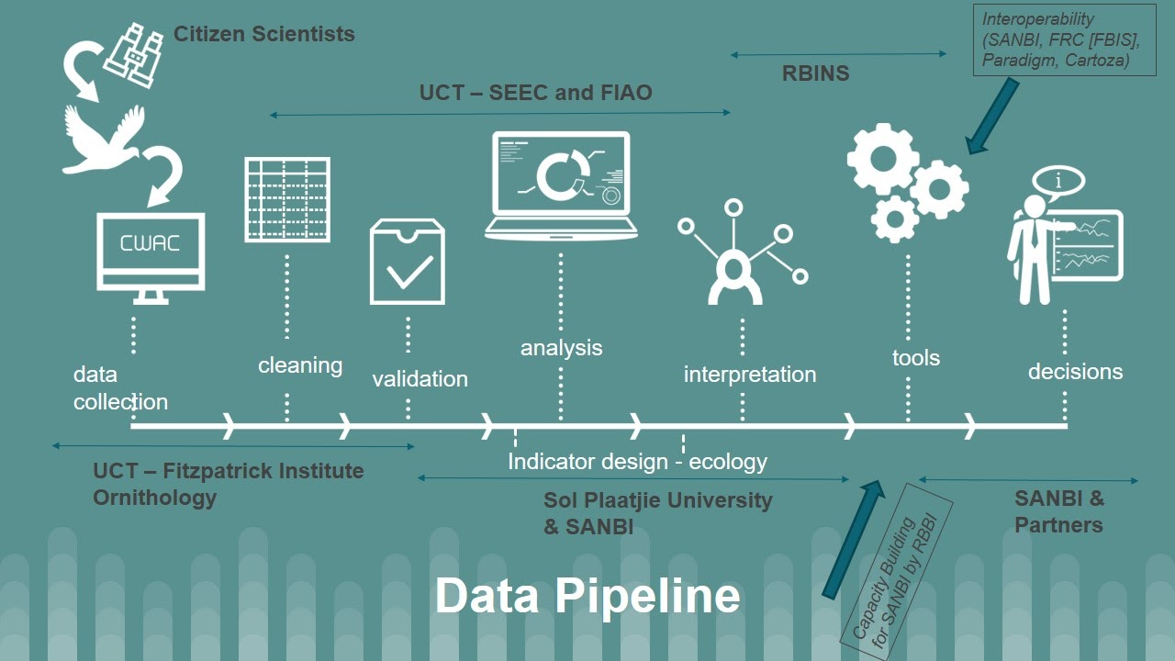
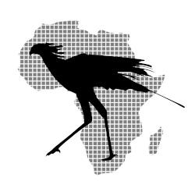

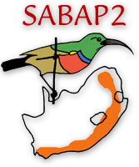
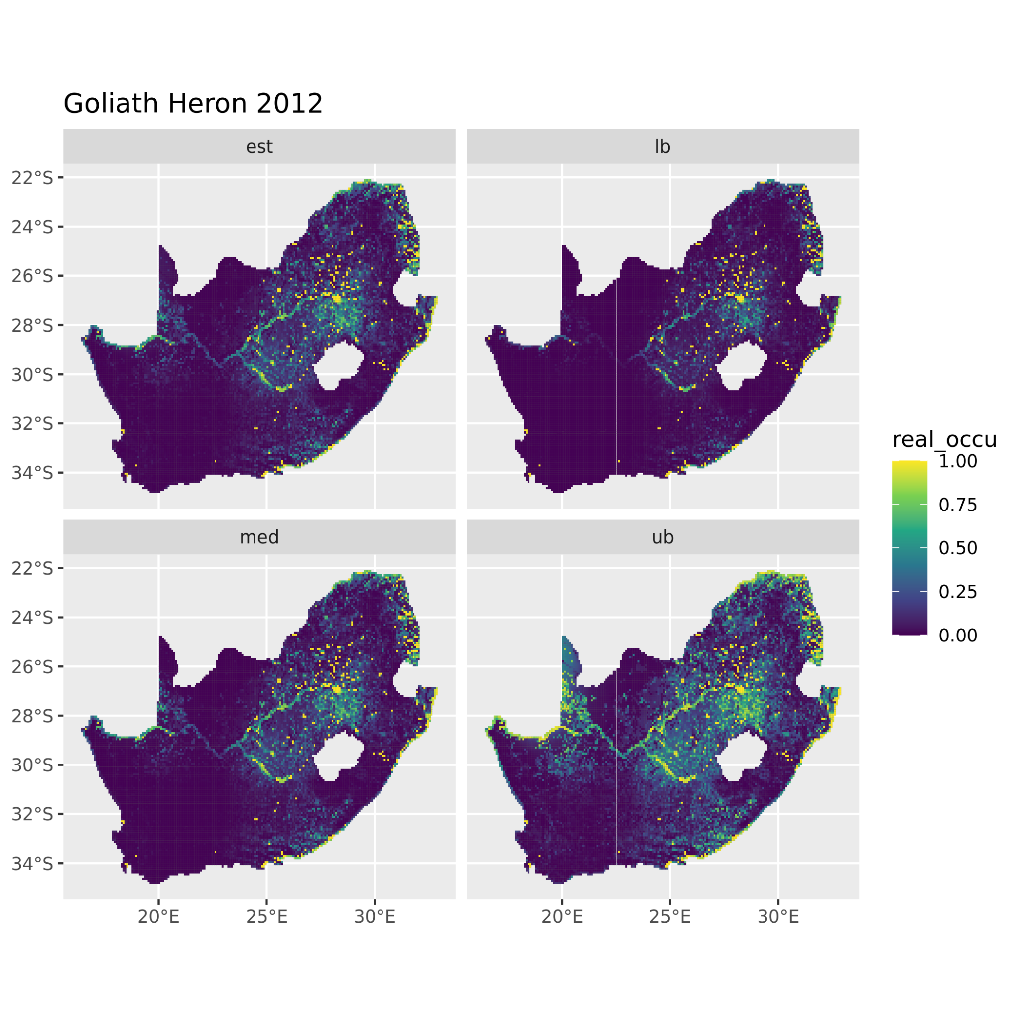
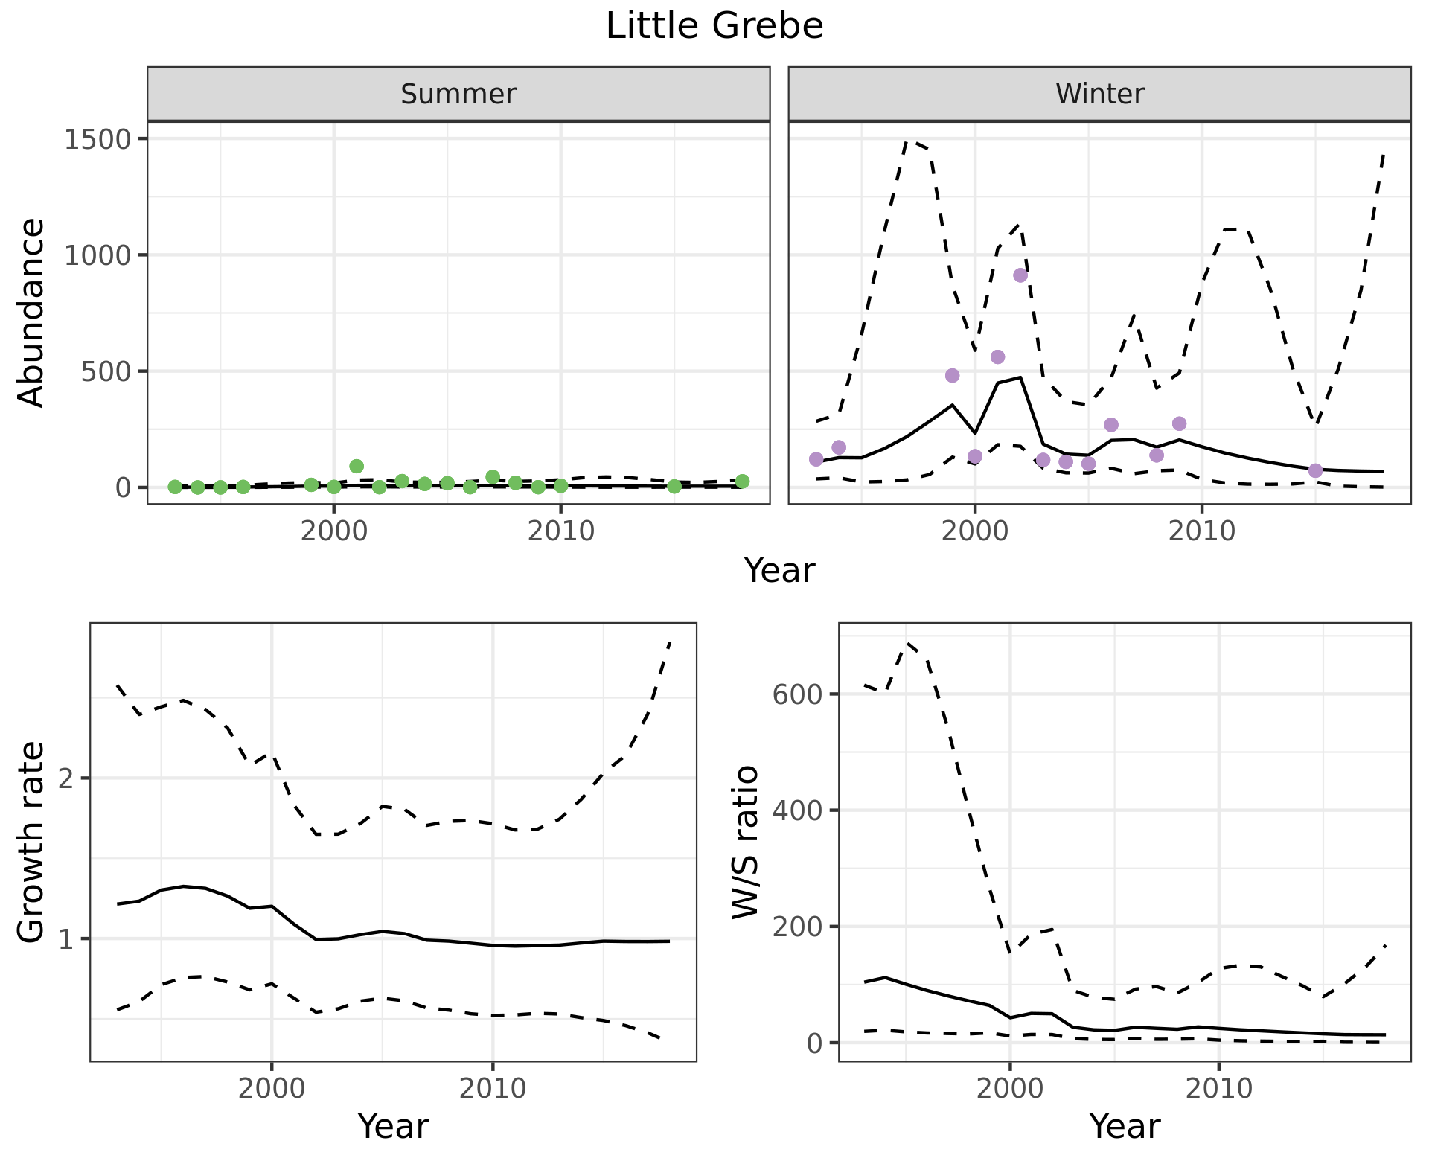

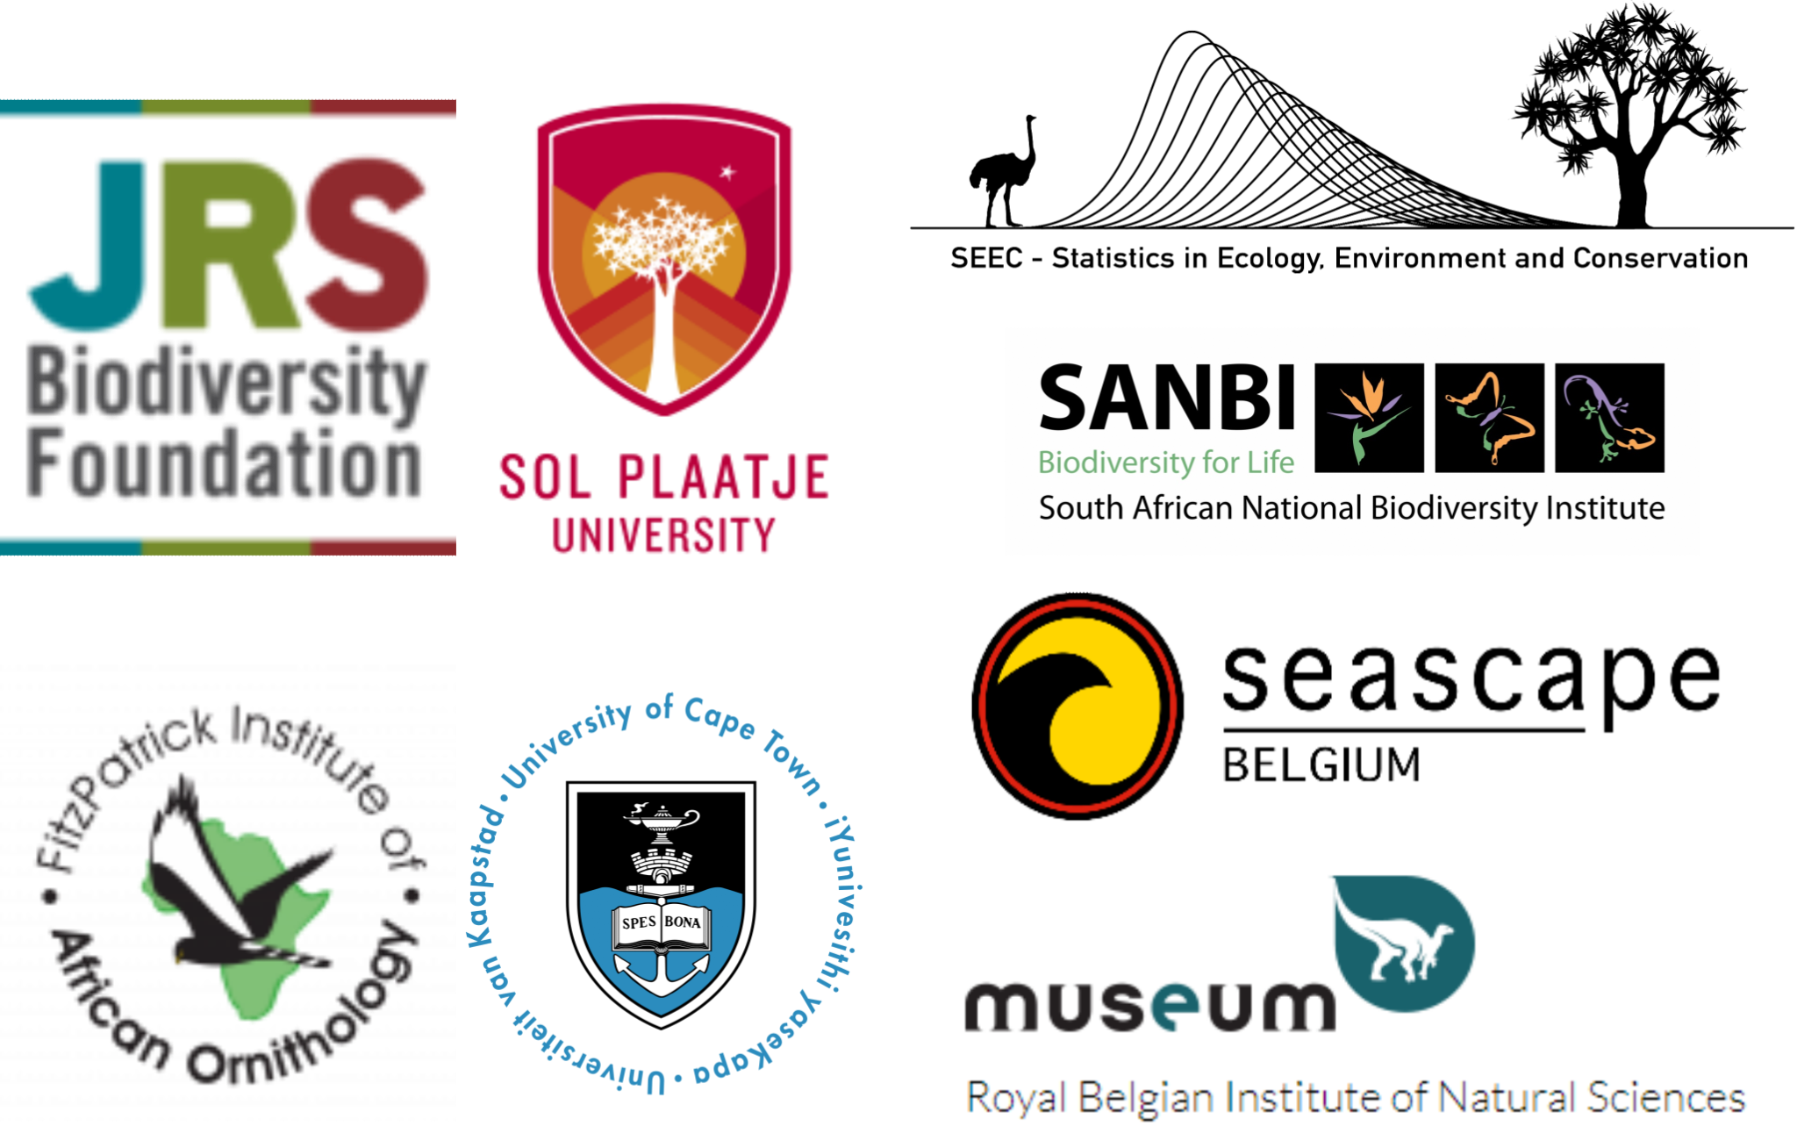
BIRDIE: South Africa’s Biodiversity Data Pipeline for Wetlands and Waterbirds
Francisco Cervantes^{1,2}, Nancy Job², Yvan Stojanov³, Francis Strobbe^{3,4}, Michael Brooks⁵ and Res Altwegg¹
¹Centre for Statistics in Ecology, the Environment and Conservation, University of Cape Town; ²South African National Biodiversity Institute; ³Royal Belgian Institute of Natural Sciences, ⁴Seascape Belgium, ⁵FitzPatrick Institute of African Ornithology, University of Cape Town. *f.cervantesperalta@gmail.com
Wetlands and waterbirds
Who is BIRDIE intended for?
Wetlands are extremely bio-diverse and deliver fundamental ecosystem services. Yet, they are being lost at alarming rates*
Citizen-science is considered a valuable tool for large-scale environmental monitoring
Birds are considered good indicators due to their high accessibility compared to other taxonomic groups
BIRDIE leverages two long-term, citizen-science bird monitoring data sets to produce waterbird conservation indicators
These data are combined with ancillary environmental layers to contextualize changes in bird populations
International agreements: Ramsar, AEWA, etc
National programmes: biodiversity assessments, red listing, etc
Site-specific programmes
Researchers
General public: birders, naturalists, etc
BIRDIE’s indicators will be freely available to everyone on an online dashboard and through a datamart
Currently focused on South Africa, but aiming to cover other African regions
Streamlined species distribution and abundance estimation
Coordinated Waterbird Counts
Occupancy models are fitted to data from SABAP2 to produce distribution-related indicators (e.g., area of occupancy)
State-space models estimate bird abundance at different spatial and temporal scales from CWAC data, accounting for observer errors
www.birdmap.africa
Southern African Bird Atlas Project
Our funders and collaborators:
*Convention on Wetlands. (2021). Global Wetland Outlook: Special Edition 2021. Gland, Switzerland: Secretariat of the Convention on Wetlands.

