Slide 1

Systems summary Coordinated Waterbird Counts (CWAC) & South African Bird Atlas Project (SABAP2)

Slide 2
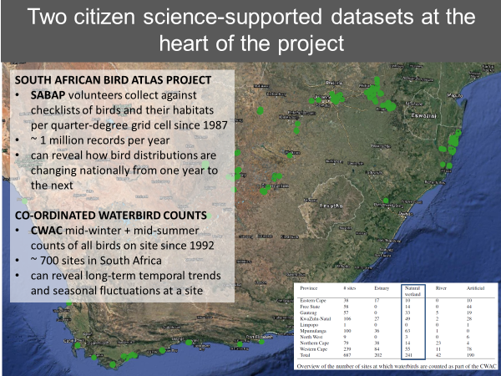

Slide 3
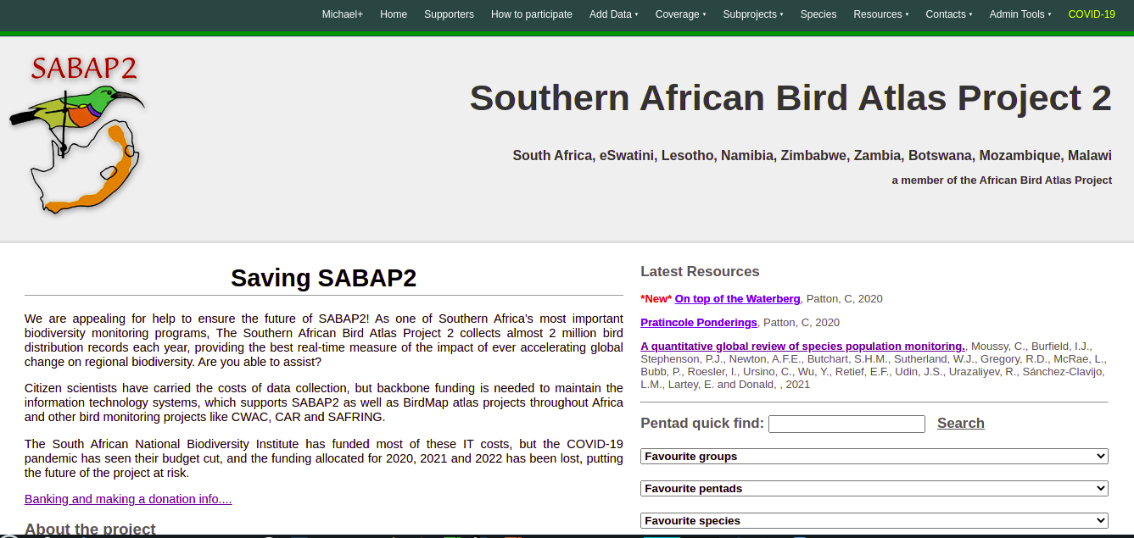
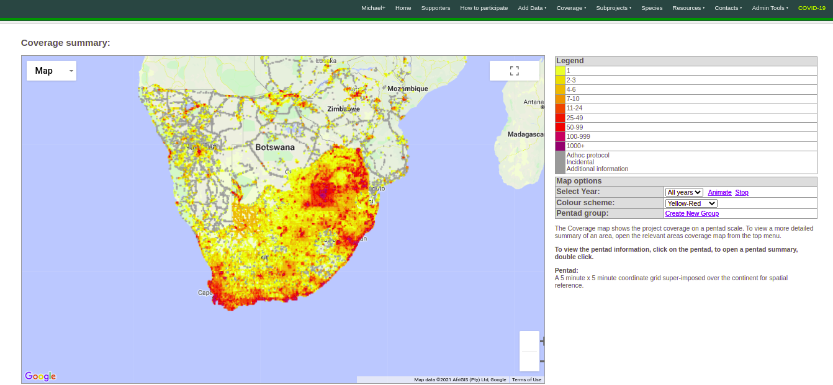
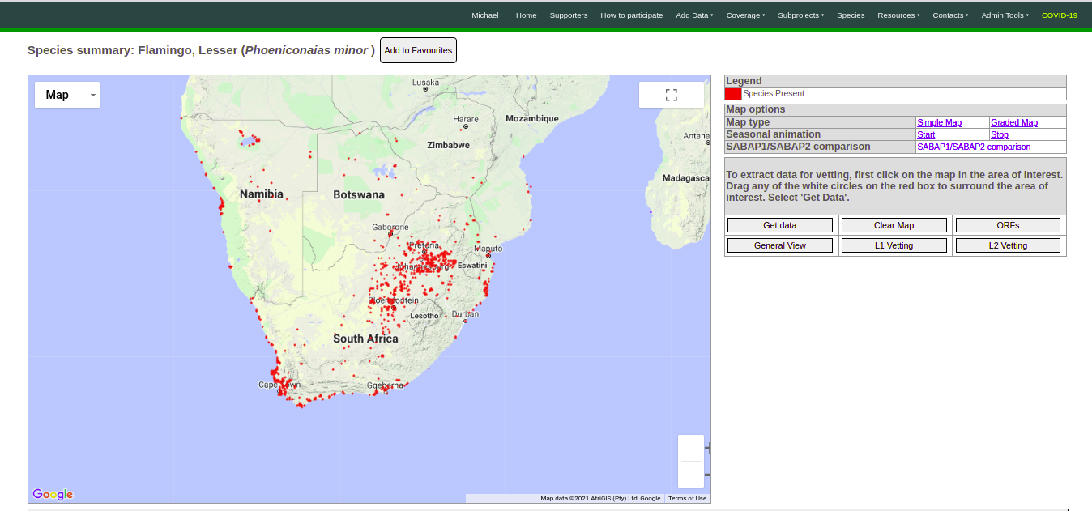
SABAP2: 2007 - ongoing Records: ~17,6 million Pentads: 14061 of 16708

Slide 4
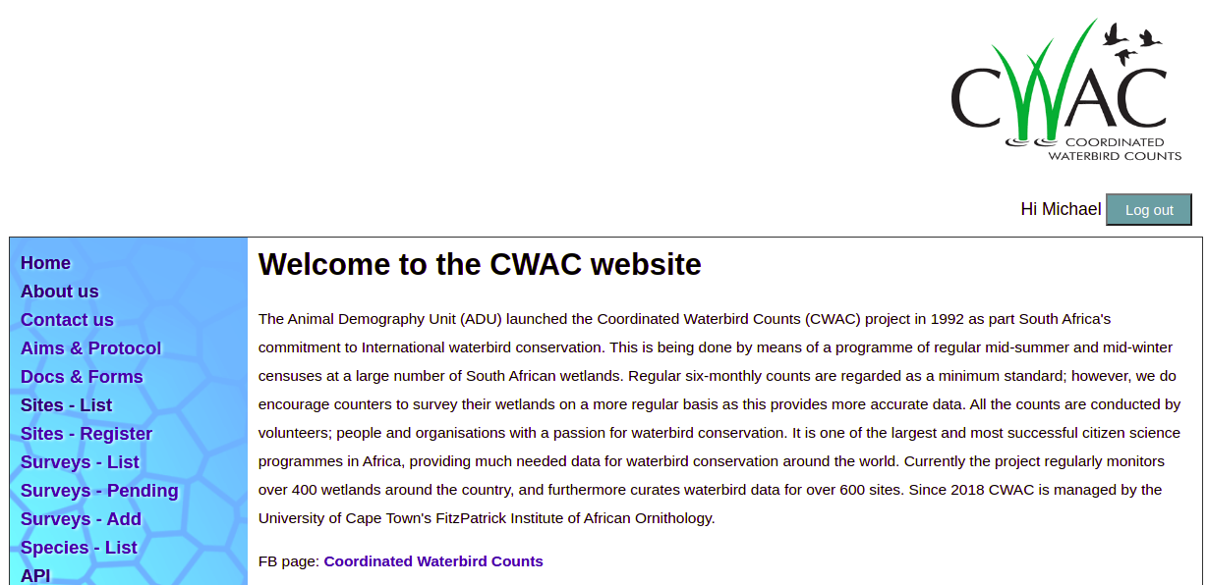
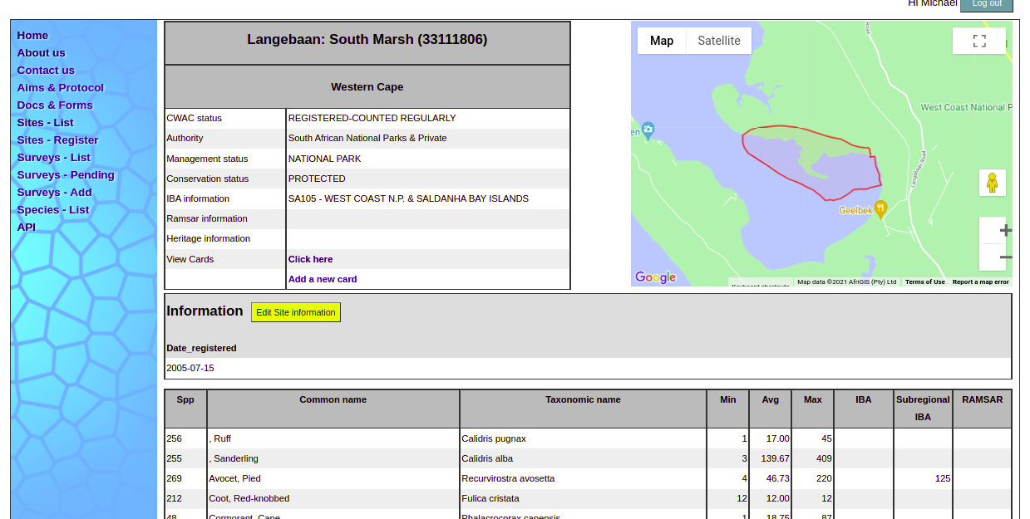
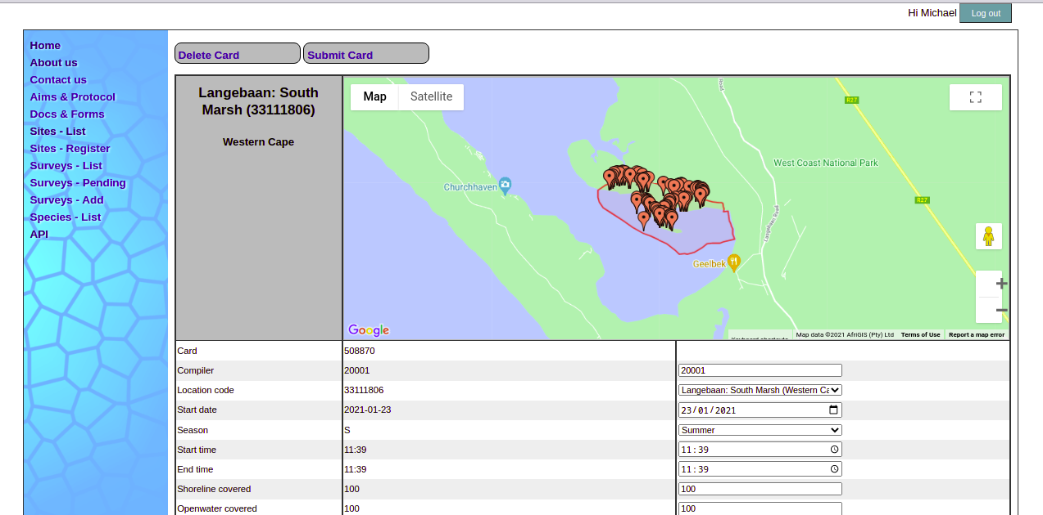
CWAC 1992 - ongoing Records: ~347 000 Sites: 739

Slide 5

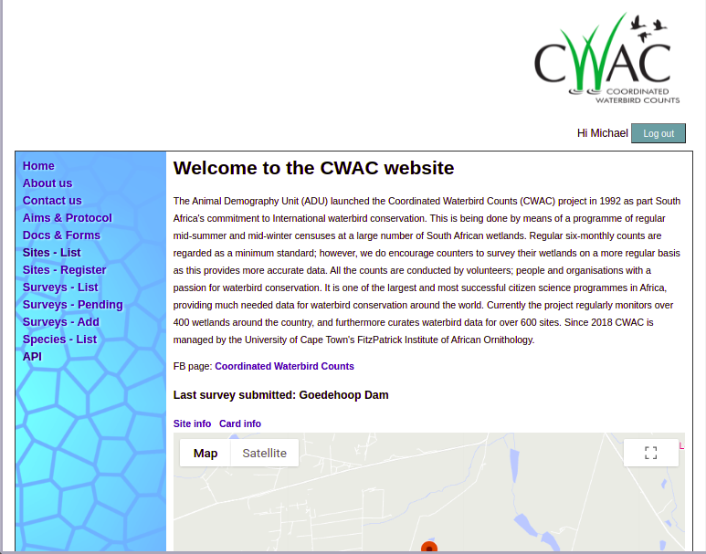

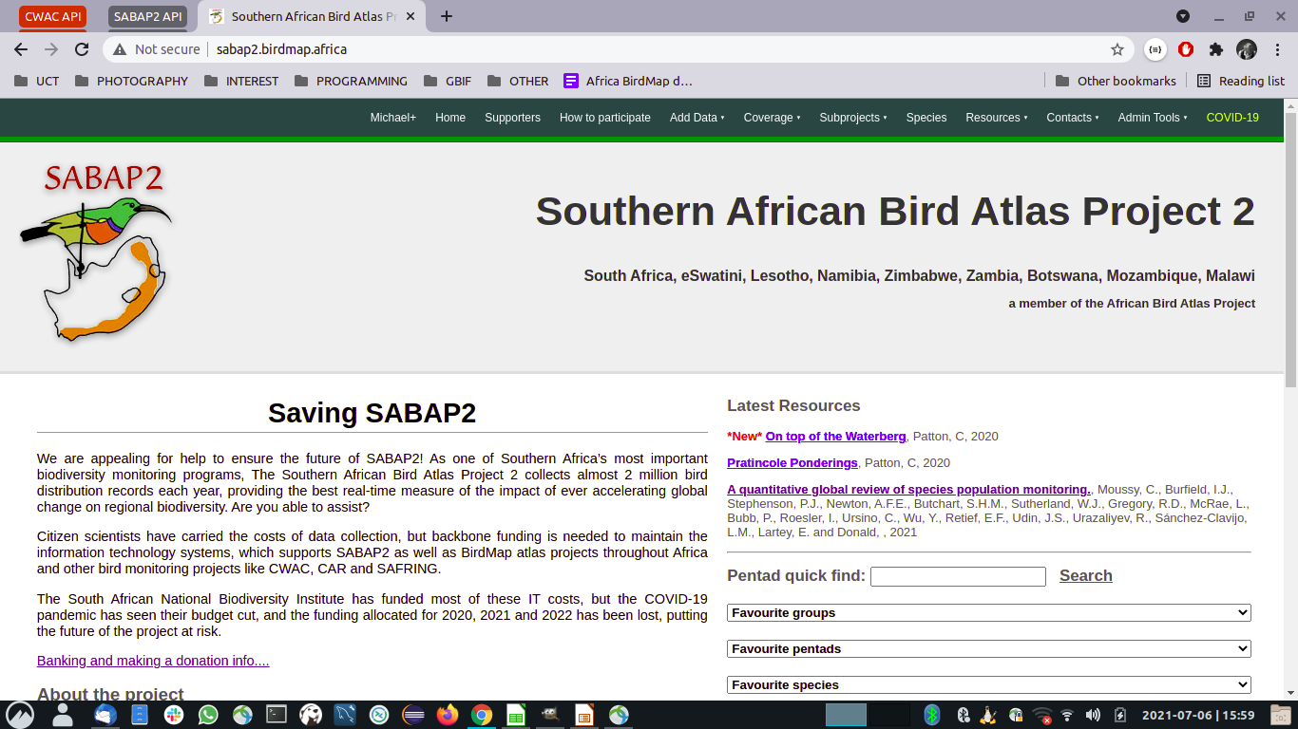
PRIMARY API SERVER
OS: Ubuntu Linux 18.04 LTS
Server edition
Platform:
Apache 2.2 + PHP5.6
Framework:
Slim
WEB SERVER
OS: Ubuntu Linux 18.04 LTS
Server edition
Platform:
Apache 2.2 + PHP5.6
Framework:
Slim
*
FIREWALL
FIREWALL
DATA SERVER
OS: Ubuntu Linux 18.04LTS
Server edition
Platform:
MySQL 5.6
PIPELINE API SERVER
JSON
BIRDIE
Users
CSV
R
FIREWALL
Python
FIREWALL
geoJSON
Other
OS: Ubuntu Linux 18.04 LTS
Server edition
Platform:
nginx + PHP 7.3
Framework:
Flightphp, an extensible
micro-framework for PHP
Auxiliary data
All Hardware:
Intel Xeon Dual 8 core
64GB RAM
8Tb HDD (RAID 0+1)

Slide 6
Data validation process
Data submission
Email, Web
or JSON
Data dictionary
No
User
SABAP2 Pentad
Valid 2-0
Database
Primary API
Raw Data
Product
Valid
Valid
No
PHP + Python based simple AI system
SABAP2 8 cube
Valid 2-0b
No
Analysis
Product
SABAP1 QDGC
Valid 1-0
Valid
Pipeline API
Valid
No
SABAP1 8 cube
Valid 1-0c
No
BIRP verified
Valid 3-0
Human interaction and Validation process
No
CWAC verified
Valid 5-0
Valid
Regional Expert
evaluates submission
Reject
No
ORF system
Info
Record out of Know Range
ORF
ORF
Query record with observer
Delete

Slide 7
Simple data access
CWAC and SABAP2 have a set of data tools that can be implemented fast and extended quickly. This will allow us to map out a framework that can be extended to other datasets for integration into the data pipeline
Data formats to meet most needs are available, making integration fast and easy (CSV, JSON, geoJSON)

Slide 8
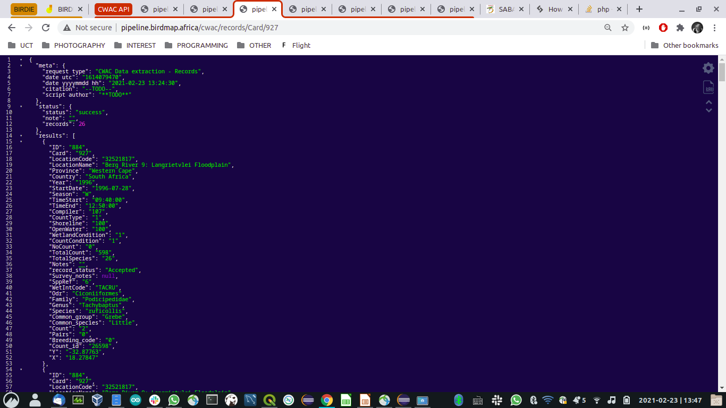
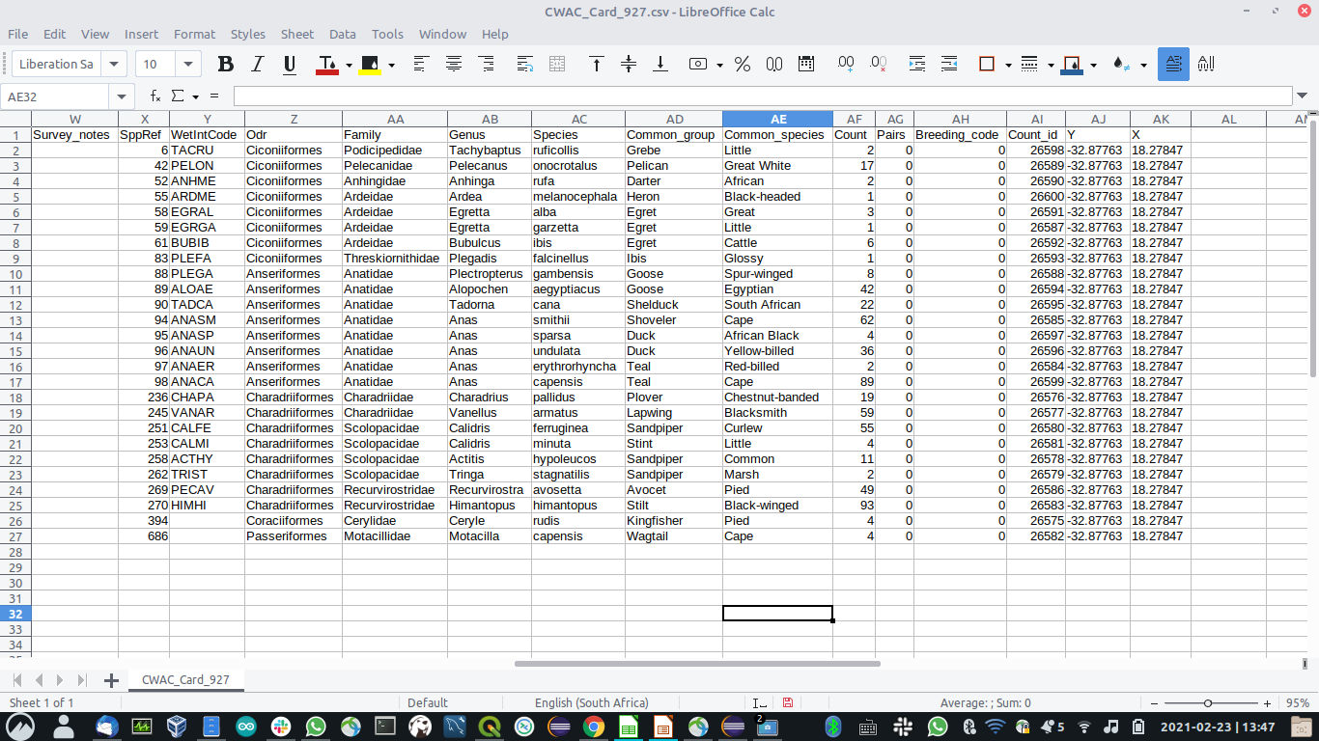
https://pipeline.birdmap.africa/cwac/records/WetIntCode/PODCR?format=csv
https://pipeline.birdmap.africa/cwac/records/WetIntCode/PODCR?format=JSON

Slide 9
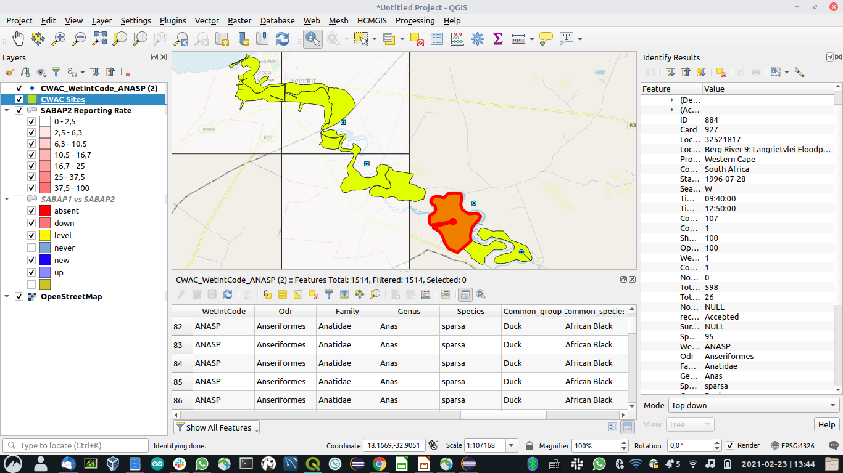
https://pipeline.birdmap.africa/cwac/records/WetIntCode/PODCR?format=geoJSON

Slide 10
API Options
Primary options passed through the url routing using HTTP method GET:
https://pipeline.birdmap.africa/cwac/records/WetIntCode/PODCR
All records with:
WetIntCode - Wetlands International Code
PODCR - Great Crested Grebe (Podiceps cristatus)
https://pipeline.birdmap.africa/cwac/records/LocationCode/25062855
All records with:
LocationCode - CWAC assigned unique code for the site
25062855 - Mkhombo Dam, Mpumalanga, South Africa
Filter variables can be stacked 3 deep:
https://pipeline.birdmap.africa/cwac/records/WetIntCode/PODCR/Season/S/LocationCode/25062855
Data request
Filter 1
Filter 2
Filter 3

Slide 11
API Options
Advanced options passed through the url routing using HTTP methods GET & POST:
https://pipeline.birdmap.africa/cwac/records/WetIntCode/PODCR?format=csv
Routing as per the primary option
GET variable appended to stipulate the format of the output : format=csv
POST variable option to restrict the request fields to a subset of those available
variable name= “data”
variable content=”{"columns":"LocationCode as Loc_Code, LocationName as Name, Province, Y as Latitude, X as Longitude, Surveys as Counts, FirstSurvey as FirstCount, LastSurvey as LatestCount, CoordinateList as boundary_polygon "}”
The “columns” designated in the content allow for field aliases to be assigned. If no “columns”
Security: All passed variables are validated against a data dictionary to prior to processing the request. To prevent SQL injection attempts, SQL keywords are banned (SELECT;DELETE;TRUNCATE;UPDATE;DROP; SLEEP).

Slide 12
Example calls CWAC:
https://pipeline.birdmap.africa/cwac/dictionary
https://pipeline.birdmap.africa/cwac/metadata
https://pipeline.birdmap.africa/cwac/species/
https://pipeline.birdmap.africa/cwac/location?format=geojson
https://pipeline.birdmap.africa/cwac/location/IBACode/SA104?short=1
https://pipeline.birdmap.africa/cwac/records/LocationCode/25062855/SppRef/158
Example calls SABAP2:
http://api.adu.org.za/sabap2/v2/coverage
http://api.adu.org.za/sabap2/v2/coverage/country/southafrica
http://api.adu.org.za/sabap2/v2/coverage/pentad/3355_1825?format=csv
http://api.adu.org.za/sabap2/v2/summary/species/360/country/southafrica
http://api.adu.org.za/sabap2/v2/species/comparison/360/country/southafrica?format=geoJSON

