Slide 1
SESSION 6 · 90 MIN · TA ANITA
Preprocessing I
Filtering and Re-referencing
0 Hz
100 Hz
Why we filter · Highpass, lowpass, bandpass & notch · Reference schemes · Live coding in MNE

Slide 2
From last session:
We learned about how to identify bad EEG signals
Now:
How can we remove unwanted signals based on frequency while preserving the brain activity we care about?
Session 6 · Filtering & Re-referencing

Slide 3



LEARNING GOALS
What you should walk away with
Explain filter, purpose & types
Describe why EEG is filtered and the highpass, lowpass, bandpass, and notch options available.
Apply filters in MNE
Run bandpass, highpass, lowpass, and notch filtering on real data using MNE-Python.
Reason about referencing
Compare referencing schemes and the trade-offs each one introduces.
Part of the EEG Preprocessing Lab Series
Session 6 · Filtering & Re-referencing

Slide 4


TODAY’S ROADMAP
Part A
Part B
Part C
Part D
What and Why Filter?
Filter Types
Re-referencing
Practical Considerations
Frequency ranges of interest and filter parameters.
Highpass, lowpass, bandpass, notch — with live coding.
Linked mastoids, average, and common reference schemes.
Ordering, pitfalls, and an activity comparing cutoffs.
Roadmap
Session 6 · Filtering & Re-referencing

Slide 5
EEG
TYPICAL EEG PREPROCESSING PIPELINE
Raw EEG
Get Data
Filtering
Re-referencing
Artifact Removal
Epoching
Baseline Correction
Analysis
Part A · What Filter?
Session 6 · Filtering & Re-referencing

Slide 6
PART A · 20 MIN
What is Filtering?
Filtering is the process of removing unwanted frequency components from an EEG signal

Slide 7
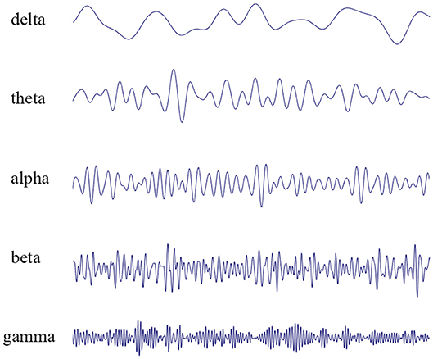
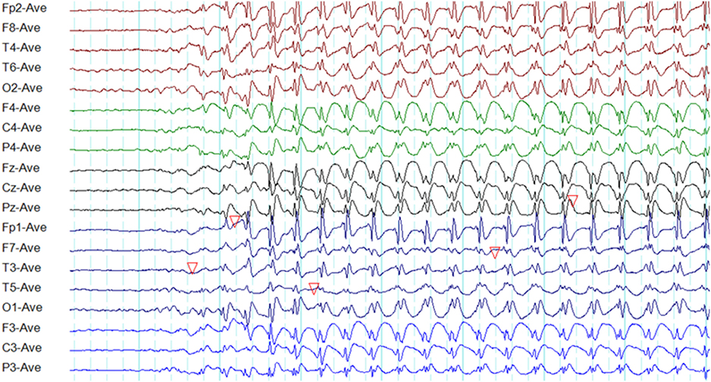
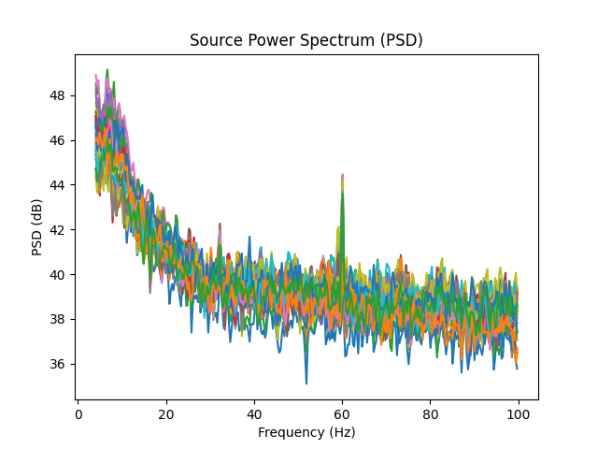
FILTERING
WHAT IS FILTERING
0.5 – 4.0 Hz
4.0 – 8.0 Hz
8.0 – 13.0 Hz
13.0 – 30.0 Hz
Above 30.0 Hz
Part A · What Filter?
Session 6 · Filtering & Re-referencing
This Photo by Unknown Author is licensed under CC BY

Slide 8
PART A · 20 MIN
Why Filter?
EEG carries a wide range of frequencies — not all of it is signal.

Slide 9

THE FREQUENCY LANDSCAPE
Most of What We Want Lives in 0.1–100 Hz
The idea
Typical raw EEG power spectrum
EEG recordings contain everything from slow drifts near 0 Hz to high-frequency noise well above 100 Hz. Filters remove the frequencies we don’t want while preserving the ones we do.
Why it matters
Slow drifts can hide true baseline shifts; high-frequency noise can obscure genuine neural rhythms and cause aliasing. Filtering trades some information for a cleaner, more analyzable signal.
0 Hz
100 Hz
Sharp peak near the middle = line noise (50/60 Hz)
Part A · Why Filter?
Session 6 · Filtering & Re-referencing

Slide 10
FILTER PARAMETERS
Three Knobs That Define a Filter
01
Cutoff frequency
The frequency at which the filter begins attenuating the signal — the boundary between "kept" and "removed."
02
Filter order
How many stages the filter uses. Higher order means a steeper, more precise cutoff, but can introduce more delay or ringing.
03
Roll-off
How gradually the filter transitions from passing to blocking a frequency — a sharper roll-off cuts more cleanly at the cutoff.
Part A · Why Filter?
Session 6 · Filtering & Re-referencing

Slide 11
PART B
Filter Types
Highpass, lowpass, bandpass, and notch — each targets a different range.

Slide 12
HIGHPASS FILTER
Highpass Filter – Removes low frequency signals
Removes
Slow drift
Sweat artifacts
Electrode drift
Typical cutoff
0.1 Hz or 1 Hz are common starting points.
Part B · Filter Types
Session 6 · Filtering & Re-referencing

Slide 13
LOWPASS FILTER
Lowpass Filter – Removes high frequency noise
Removes
Frequency response
Muscle activities
Electronic noise
Typical cutoff
40 Hz are common starting points.
Part B · Filter Types
Session 6 · Filtering & Re-referencing

Slide 14
BANDPASS FILTER
Bandpass Filter
What it does
Combines a highpass and lowpass filter to keep only a specific window of frequencies.
Frequency response
Typical cutoff
1–40 Hz is a very common band for general ERP analysis.
Use it for
General-purpose cleanup that removes both slow drift and high-frequency noise at once.
Part B · Filter Types
Session 6 · Filtering & Re-referencing

Slide 15

NOTCH FILTER
Notch Filter
What it does
Removes a narrow band around one specific frequency, leaving everything else untouched.
Frequency response
Typical cutoff
50 Hz (Europe/Africa) or 60 Hz (Americas).
Use it for
Targeting power-line interference specifically, without discarding nearby frequencies.
Part B · Filter Types
Session 6 · Filtering & Re-referencing

Slide 16
LIVE CODING
Choosing Filter cutoffs
Application | Highpass | Lowpass
ERP | 0.1 Hz | 30 Hz
Cognitive | 1 Hz | 40 Hz
Resting state | 1 Hz | 45 Hz
Sleep | 0.1 Hz | 35 Hz
Gamma Analysis | 1 Hz | 100 Hz
Part B · Filter Types
Session 6 · Filtering & Re-referencing

Slide 17
PART B RECAP
Filter types at a glance
Filter | Typical cutoff | Removes
Highpass | 0.1 Hz or 1 Hz | Slow drift, DC offset
Lowpass | 40 Hz or 100 Hz | High-frequency noise; anti-aliasing
Bandpass | 1–40 Hz (common for ERPs) | Slow drift and high-frequency noise together
Notch | 50 Hz or 60 Hz | Power-line interference specifically
Part B Recap
Session 6 · Filtering & Re-referencing

Slide 18
PART C · 20 MIN
Re-referencing
Every EEG measurement is relative — the reference choice shapes what you see.

Slide 19
THE CORE IDEA
EEG Is Always a Difference
Every EEG channel is measured relative to a reference electrode. The voltage you see is never absolute — it’s always "this electrode minus the reference."
Why the choice matters
A noisy or biased reference electrode contaminates every single channel in the recording.
Different reference schemes can change apparent amplitude, topography, and even which effects look significant.
There is no universally "correct" reference — only trade-offs suited to different montages and questions.
Part C · Re-referencing
Session 6 · Filtering & Re-referencing

Slide 20
REFERENCING SCHEMES
Three common approaches
Scheme | How it works | Trade-off
Linked mastoids (A1 + A2) | References to the average of both mastoid electrodes | Classic and widely comparable, but can be affected by muscle activity nearby
Average reference | Subtracts the mean of all channels from every channel | Works well for dense arrays (64+ channels); poor coverage biases the average
Common reference (e.g., Cz) | References every channel to one single electrode | Simple to set up, but that electrode’s own activity biases the whole recording
Part C · Re-referencing
Session 6 · Filtering & Re-referencing

Slide 21
PART D · 15 MIN
Practical Considerations
A few rules of thumb — and pitfalls — for real preprocessing pipelines.

Slide 22

PIPELINE ORDER
Filter Before You Epoch
In most workflows, filtering happens on the continuous recording — before it is cut into epochs.
1
2
3
4
Raw continuous data
→
Filter (highpass / lowpass / notch)
→
Re-reference
→
Epoch
Why order matters
Filtering short, isolated epochs directly can create edge artifacts at the boundaries of each segment. Filtering the continuous signal first, then epoching, avoids distorting the data right at the start and end of each trial.
Part D · Practical Considerations
Session 6 · Filtering & Re-referencing

Slide 23

TWO RULES OF THUMB
Pitfalls Worth Remembering
Aggressive highpass distorts slow ERPs
Always inspect visually, before and after
Pushing the highpass cutoff above roughly 2 Hz can distort or even eliminate slow ERP components. Choose the cutoff based on what the analysis actually needs, not just what looks clean.
Every preprocessing step — filtering, referencing, anything else — should be checked by eye. Compare the raw trace and power spectrum before and after to confirm the step did what you intended.
Part D · Practical Considerations
Session 6 · Filtering & Re-referencing

