Slide 1

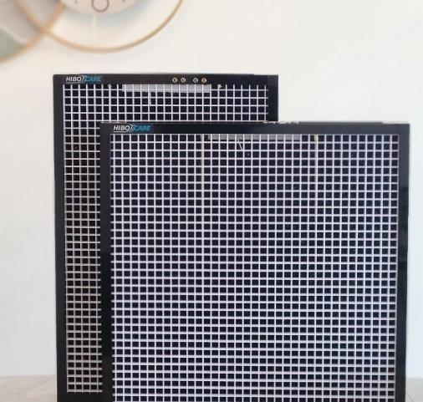
INSTALLATION at Emergency Room of a Hospital in the us
Long Term FINDINGS
Revolutionising the air we breathe

Slide 2

Background
The hospital was looking for a solution to improve the IAQ in its Emergency Room.
The HVAC system is not new and the solution needed to be easily retrofittable.
There were complaints of musty smell in the ER.

Slide 3





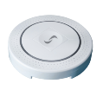



HVAC Setup and Details of the Installation
AHU1
AHU2
The Emergency Room at the hospital is served by two identical HVAC systems, AHU1 was retrofitted with HiboScreens and an IAQ monitor was included before the filters to measure particulates in Outside Air + Return Air mix.
A second IAQ monitor measured IAQ inside the Emergency Room which registers average of reduction from HiboScreen fitted AHU1 and as-is AHU2.
A third IAQ monitor was included in the AHU after the filters but could not perform reliably due to high airflow in the AHU.

Slide 4
Installation and Data Capture Timelines
Date Time | Status
15-Aug 2024 to 26-Aug 2024 | Air quality monitors installed and data captured to assess pre-installation state
26-Aug 2024 to 6-Sep 2024 | HiboScreen Installation Period
6-Sep 2024 to date | Post HiboScreen Installation

Slide 5
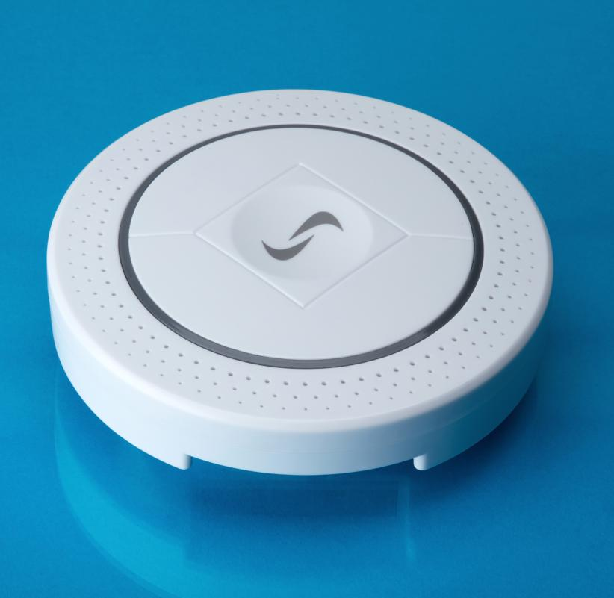


IAQ Monitors Used
Well tested and calibrated IAQ monitors from Synetica are installed.
These monitors meet all of the requirements for WELL® and RESET® air quality monitoring.

Slide 6
Data from the Pre-filtration Air Quality Monitor correlates well with the local AQI Station’s Data
Strong correlation, 73%
Statistical correlation = 73% (strong)
Data for local AQI monitoring station, as extracted from aqicn.org vs. Synetica sensor installed in AHU1 before the filters (outside + recirculating air)

Slide 7
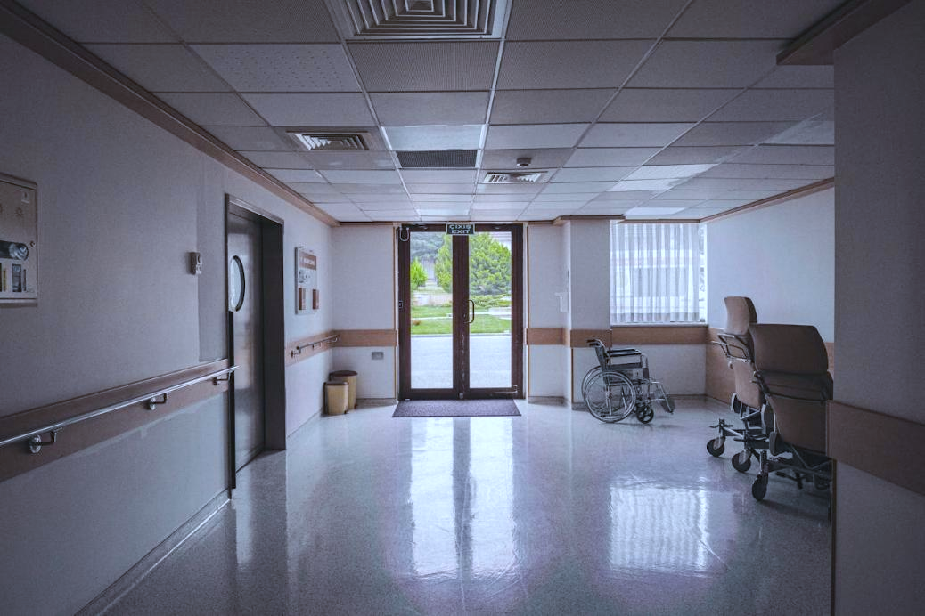
Post-installation Feedback
Statistical correlation = 73% (strong)
There was an immediate perceived improvement in the air quality of the Emergency Room after installation of HiboScreen.
The complaints of musty smell in the ER were gone.
Strong correlation, 73%

Slide 8
Data analysis: Coarse Particulate Matter - PM10
3x improvement in the average PM10 inside the ER when only half the air was treated by HiboScreen
4.9x extrapolated improvement if both the AHUs had HS
Severe AQI events
3.0x observed improvement
PM in the supply air (RA+OA*) as a % of PM in the ER air (does not reflect single pass performance)
HiboScreen Installation
*RA+OA = mixture of Return air + Outside air
Data with very low particulate count was excluded due to sensor accuracy limitations and 2 day moving average was used for even graph profile

Slide 9
Data analysis: Fine Particulate Matter – PM2.5
3.1x improvement in the average PM2.5 inside the ER when only half the air was treated by HiboScreen
5.3x extrapolated improvement if both the AHUs had HS
Severe AQI events
3.1x observed improvement
PM in the supply air (RA+OA*) as a % of PM in the ER air (does not reflect single pass performance)
HiboScreen Installation
*RA+OA = mixture of Return air + Outside air
Data with very low particulate count was excluded due to sensor accuracy limitations and 2 day moving average was used for even graph profile

Slide 10
Data analysis: Very Fine Particulate Matter - PM1
3x improvement in the average PM1.0 inside the ER when only half the air was treated by HiboScreen
5.0x extrapolated improvement if both the AHUs had HS
Severe AQI events
3.0x observed improvement
PM in the supply air (RA+OA*) as a % of PM in the ER air (does not reflect single pass performance)
HiboScreen Installation
*RA+OA = mixture of Return air + Outside air
Data with very low particulate count was excluded due to sensor accuracy limitations and 2 day moving average was used for even graph profile

Slide 11
Data analysis: >90% improvement in IAQ on Days with High Pollution Level
Coarse Particles
PM10 (µg/m3) | Pre-HiboScreen filtration | Filtration with 1 AHU incl. HiboScreen | No. of Days | Extrapolated for both the AHUs
13-25 | 12% | 35% | 61 | 58%
25-70 | 16% | 43% | 79 | 70%
>70 | 12% | 52% | 14 | 91% (7.6x)
It is possible to achieve a
sustained particulate reduction of >90% (6-8x improvement)
in a busy environment,
even with very old, end-of-life HVAC systems,
even for very fine particulates,
even during critical AQI events (wildfires etc.)
Fine Particles
PM2.5 (µg/m3)
13-25 | 12% | 34% | 61 | 56%
25-70 | 16% | 45% | 78 | 74%
>70 | 12% | 54% | 14 | 96% (8.3x)
Very Fine Particles
PM1.0 (µg/m3)
1.7-3 | 12% | 34% | 54 | 57%
3-9 | 17% | 44% | 84 | 70%
>9 | 15% | 54% | 13 | 94% (6.3x)
PM in the supply air (Return + Outside*) as a % of PM in the ER air (does not reflect single pass performance)
Better performance on the days with higher particulates can be due to multiple factors such as better sensor efficiency at that AIQ, relatively lower impact of human activity, lower impact of air circulation in-efficiency, lower error due to comparison with outside + return air.

Slide 12
Conclusions
The installation has clearly demonstrated a reduction in particulates leading to an improvement in air quality, particularly during severe AQI events, also noticeable perceptually through elimination of the musty smell.
Average 5x boost in air filtration performance across particles of all sizes (PM10, 2.5, 1.0)
>90% air filtration performance against all particle sizes (PM10, 2.5, 1.0) can be achieved in existing HVAC systems on days with poor AQI outside due to wildfire events, high pollution etc.
Existing HVAC systems can be effectively boosted to IAQ improvement performance that beats the design performance.
High footfall locations can also benefit from a very high filtration boost using HiboScreen.

Slide 13



www.hibocare.com
Clean Air, Green Buildings, Healthy Spaces

