Slide 1
Lab 1 - Backpropagation
Department of Computer Science, NCTU
TA Yu-Chuan Chuang

Slide 2
Important Rules
Important Date :
Report Submission Deadline: 3/28 (Thu) 12:00 p.m.(中午12點)
Demo date: 3/28 (Thu)
Turn in :
Experiment Report (.pdf)
Source code (.py)
Notice: zip all files in one file and name it like「DLP_LAB1_your studentID_name.zip」, ex: 「DLP_LAB1_0656608_莊祐銓.zip」

Slide 3
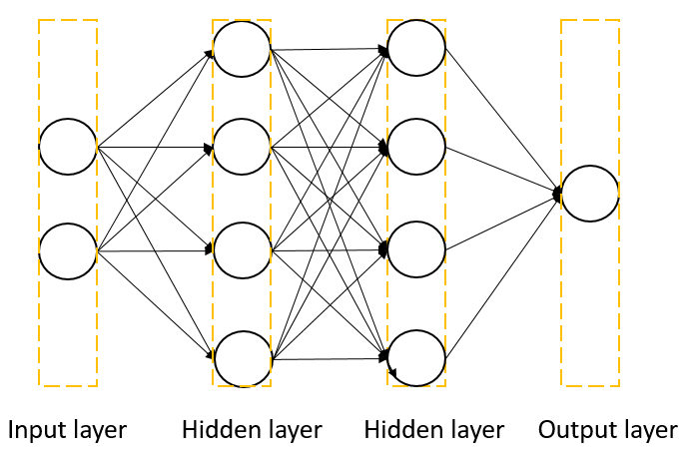
Lab Objective
In this lab, you will need to understand and write a simple neural networks with forward pass and backpropagation using two hidden layers.

Slide 4
Requirements
Implement a simple neural networks with two hidden layers
You must use backpropagation in this neural network and only can use Numpy and other python standard library to implement
Plot your comparison figure showing the predictions and ground truth

Slide 5


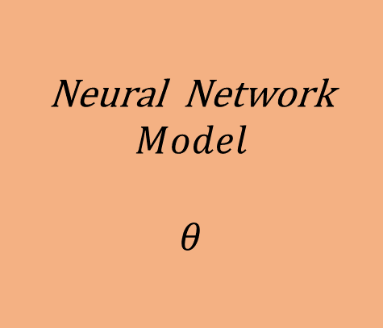









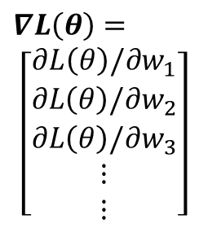

Gradient Descent
$${ x}^{n}$$
Neural Network
$$Model$$
$$θ$$
$${ y}^{n}$$
$${ \hat{y}}^{n}$$
Loss Function
$$L(θ)$$
Input
Model
Output
Ground
truth
$$∇L\left(θ\right)=$$
$$\left[\begin{aligned}∂L\left(θ\right)/∂w_{1} \\ ∂L\left(θ\right)/∂w_{2} \\ ∂L\left(θ\right)/∂w_{3} \\ ⋮ \\ ⋮\end{aligned}\right]$$
$${Compute ∇L(θ}^{0})$$
$$θ^{1}={θ^{0} − ρ ∇L(θ}^{0})$$
Network Parameters
$$θ=\{w_{1},w_{2},w_{3},w_{4},⋯\}$$
$$θ^{2}={θ^{0} − ρ ∇L(θ}^{1})$$
$${Compute ∇L(θ}^{1})$$
$${Compute ∇L(θ}^{2})$$
$$θ^{3}={θ^{0} − ρ ∇L(θ}^{2})$$
$$ρ :Learning rate$$

Slide 6
Flow Chart
Prepare data
Create model
Forward pass
Repeat n times or until convergence
Training
Backward pass
Update weights
Notes:
這邊則是大家實作時可以參考的流程 我們等等就會按照這個流程來一步一步觀察
首先是準備你的資料
在來是設計你的模型
之後就可以決定你的訓練方法
那訓練方法又可在拆分為三個階段
Forward backward以及update weights
一直重複training這個步驟 直到網路收斂或是你認為ok就可以停下來

Slide 7
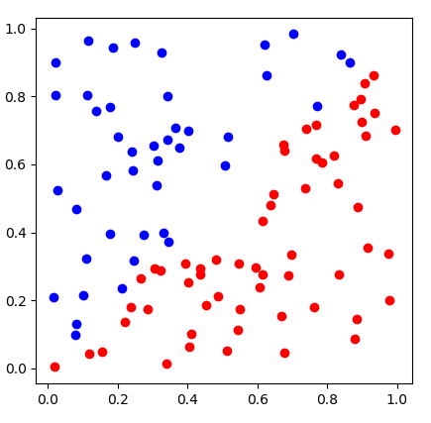
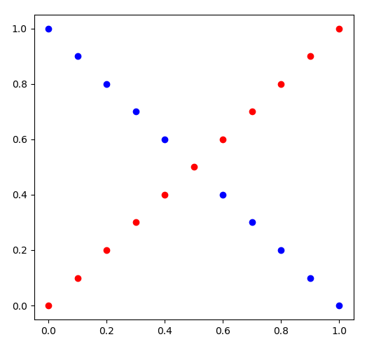
Prepare Data
generate_linear()
generate_XOR_easy()

Slide 8
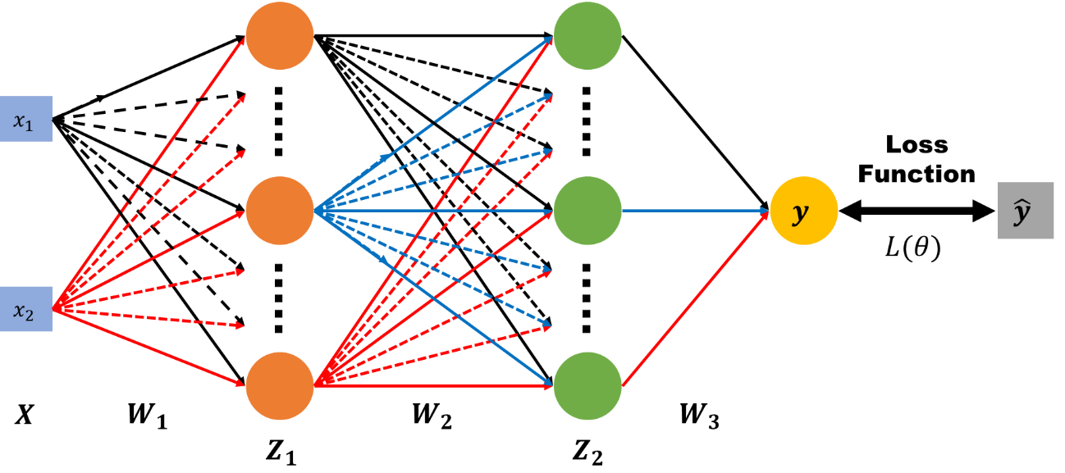
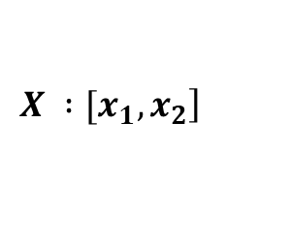


Create Model
$$\left.X :[x_{1}, x_{2}\right]$$
$$y : outputs$$
$$\hat{y} : ground truth$$
$W_{1}, W_{2}, W_{3}$ $: weight matrix of network layers$

Slide 9
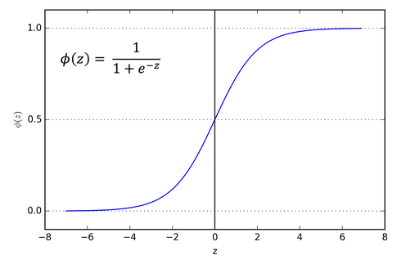
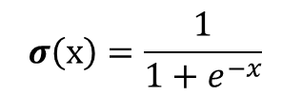
Forward
$Z_{1}=σ(XW_{1})$ $Z_{2}=σ(Z_{1}W_{2})$ $y=σ(Z_{2}W_{3})$
$$σ\left(x\right)=\frac{1}{1+e^{−x}}$$

Slide 10



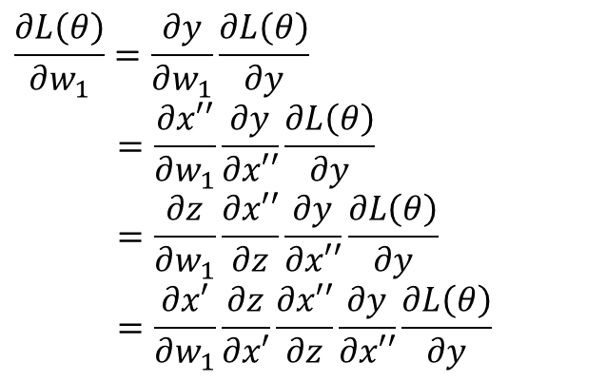




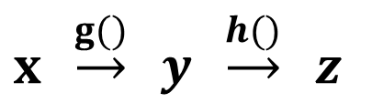




Backward
$$x′$$
$$z$$
$$x′′$$
$$x$$
$$y$$
$$\hat{y}$$
$$w_{1}$$
$${w′}_{1}$$
$$L(θ)$$
$x′=xw_{1}$ $z=σ(x′)$ $x′′=z{w′}_{1}$ $y=σ(x′′)$
$$\frac{∂L\left(θ\right)}{∂w_{1}}=\frac{∂y}{∂w_{1}}\frac{∂L\left(θ\right)}{∂y}$$
$$=\frac{∂x′′}{∂w_{1}}\frac{∂y}{∂x′′}\frac{∂L\left(θ\right)}{∂y}$$
$$=\frac{∂z}{∂w_{1}}\frac{∂x′′}{∂z}\frac{∂y}{∂x′′}\frac{∂L\left(θ\right)}{∂y}$$
$$=\frac{∂x′}{∂w_{1}}\frac{∂z}{∂x′}\frac{∂x′′}{∂z}\frac{∂y}{∂x′′}\frac{∂L\left(θ\right)}{∂y}$$
Chain rule
$y=g\left(x\right) z=h(y)$
$x \underset{→}{g()} y \underset{→}{h()} z$
$$\frac{dz}{dx}=\frac{dz}{dy} \frac{dy}{dx}$$

Slide 11
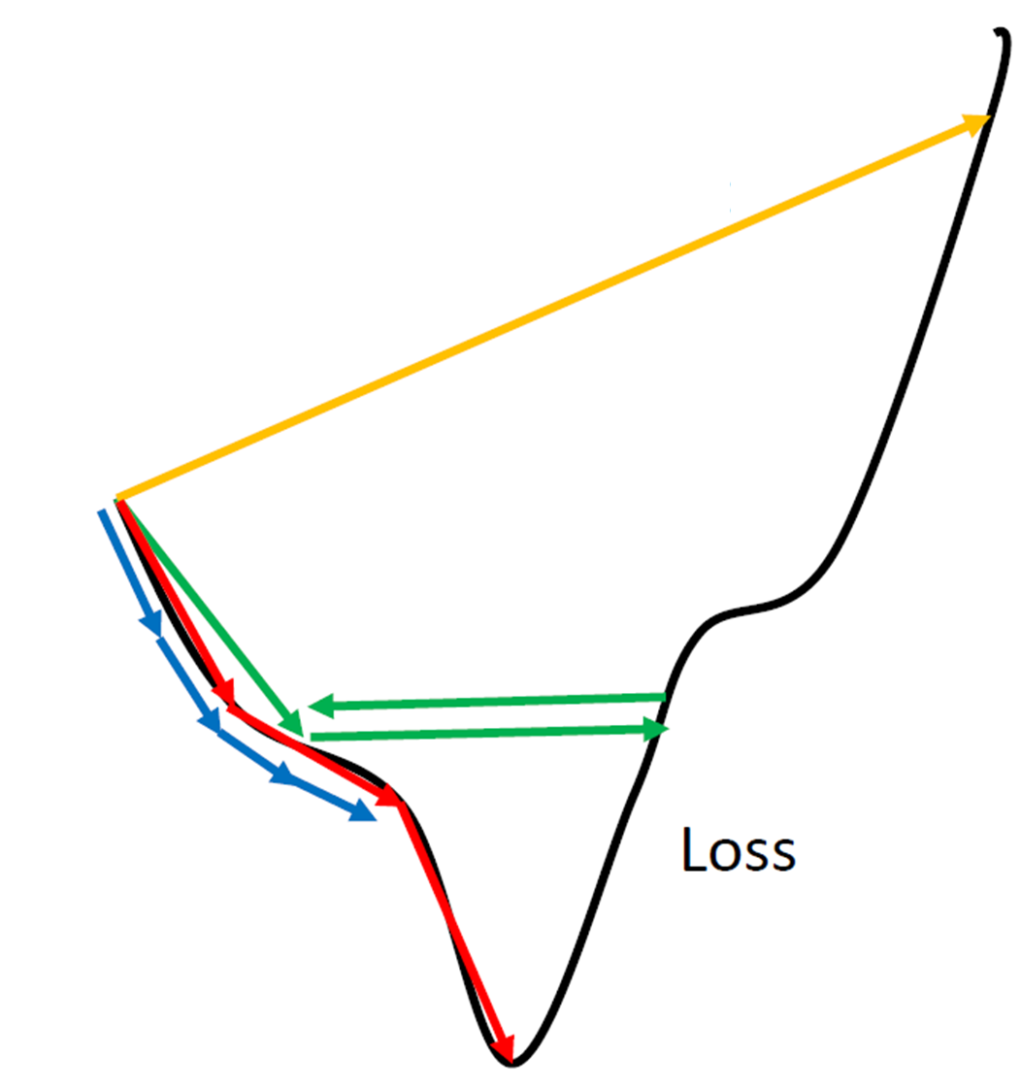










Update Weight
Network Parameters
$$θ=\{w_{1},w_{2},w_{3},w_{4},⋯\}$$
$$∇L\left(θ\right)=$$
$$\left[\begin{aligned}∂L\left(θ\right)/∂w_{1} \\ ∂L\left(θ\right)/∂w_{2} \\ ∂L\left(θ\right)/∂w_{3} \\ ⋮ \\ ⋮\end{aligned}\right]$$
$${Compute ∇L(θ}^{0})$$
$$θ^{1}={θ^{0} − ρ ∇L(θ}^{0})$$
$$ρ :Learning rate$$
$${Compute ∇L(θ}^{1})$$
$$θ^{2}={θ^{0} − ρ ∇L(θ}^{1})$$
$${Compute ∇L(θ}^{2})$$
$$θ^{3}={θ^{0} − ρ ∇L(θ}^{2})$$
$$⋮$$
http://www.denizyuret.com/2015/03/alec-radfords-animations-for.html

Slide 12
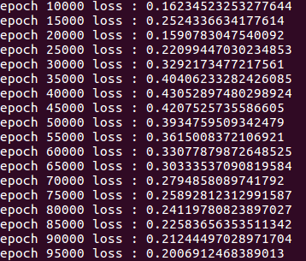
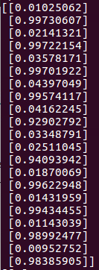
In the training, you need to print loss
In the testing, you need to show your predictions

Slide 13
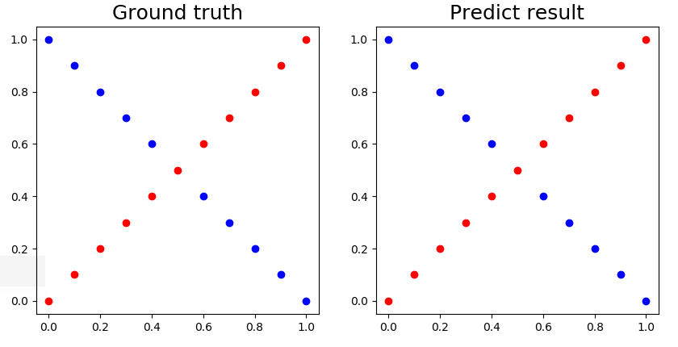
Visualize the predictions and ground truth at the end of the training process

Slide 14
Reference
http://www.denizyuret.com/2015/03/alec-radfords-animations-for.html
http://speech.ee.ntu.edu.tw/~tlkagk/courses_ML17_2.html

