Slide 1
Georgia State University Data Mining – CSC 6740
Final Project Presentation
Risk of Developing Coronary Heart Disease prediction
Abdul Afrid Mohammed

Slide 2

Introduction
The problem statement of this project is to build a machine learning model that can predict whether a person is at risk of developing heart disease based on their medical history and demographics.
The goal is to provide a tool that can help healthcare professionals identify patients who may need further testing or treatment to prevent or manage heart disease. Additionally, the project aims to raise awareness about the risk factors for heart disease and encourage individuals to make lifestyle changes to reduce their risk.

Slide 3
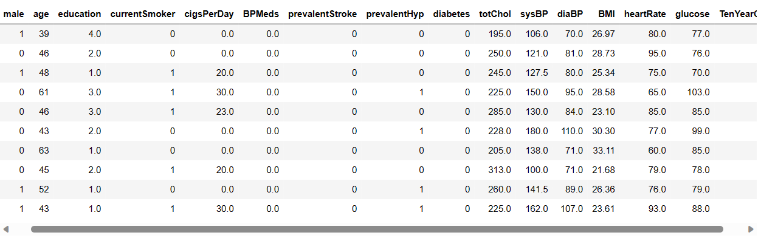
Data Source
The heart disease dataset includes over 4,240 records,16 columns, and 15 attributes. The goal of the dataset is to predict whether the patient has a 10-year risk of future (CHD) coronary heart disease.
The Dataset is obtained from the Kaggle.
It consists of 8 Continuous features and 7 Categorical features.

Slide 4
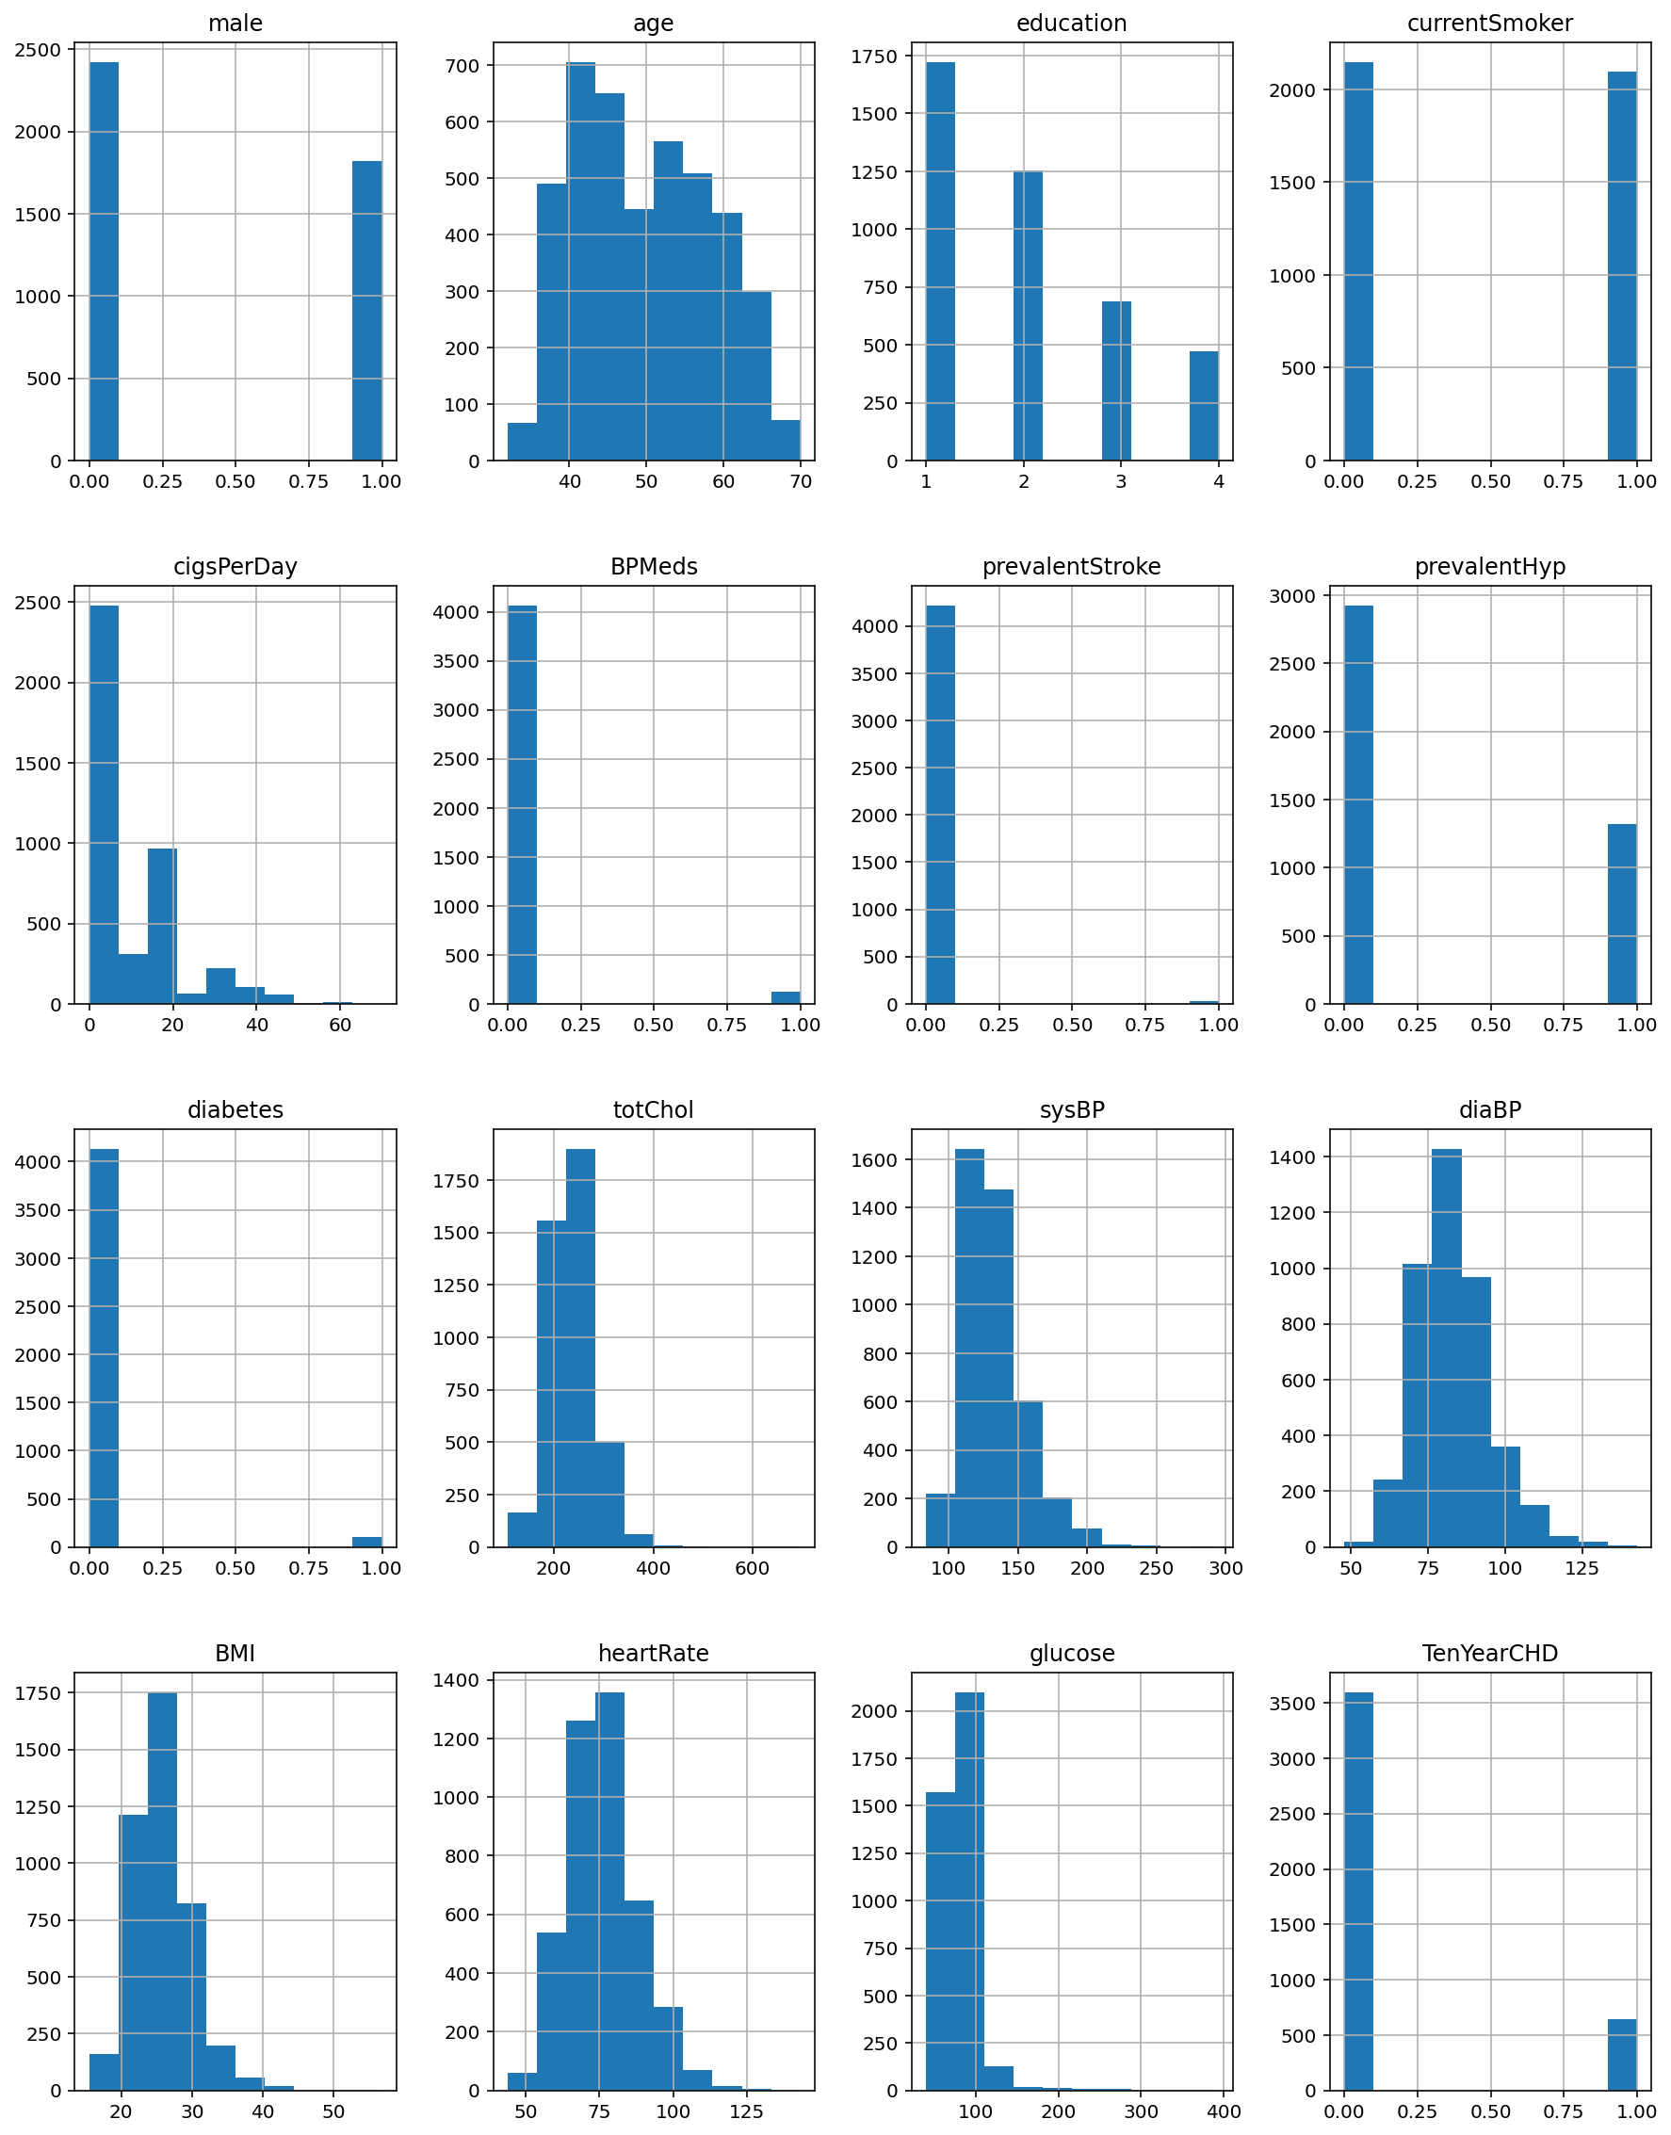
Plots
Observing the distribution of each feature using the histograms.

Slide 5
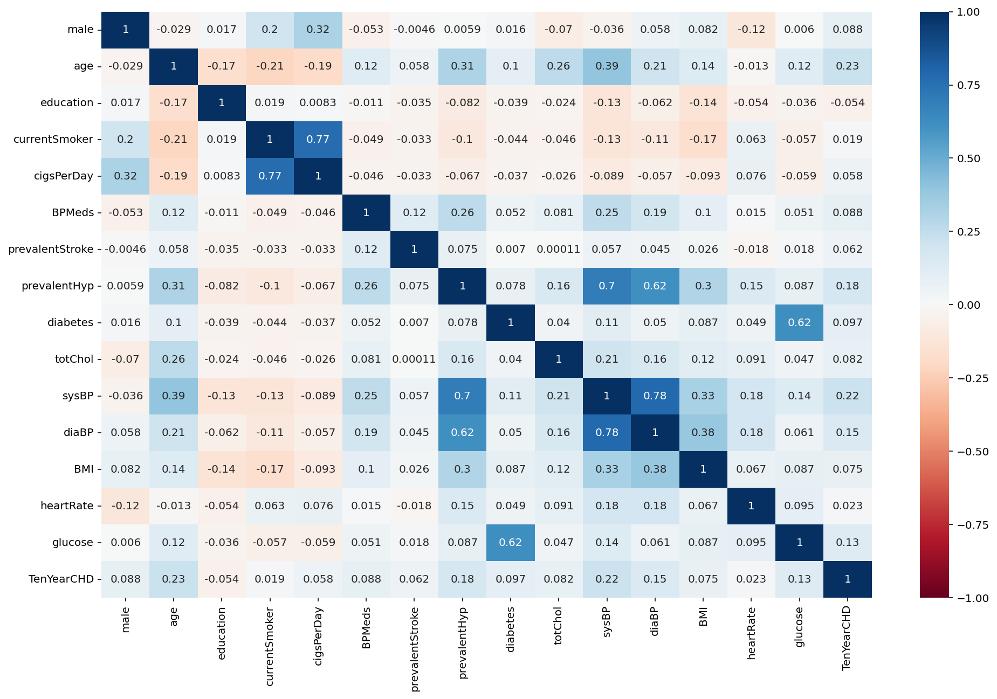
Correlation
Observing the Correlation between the features and the output variable.
We can observe Age and Blood Pressure are the ones with high correlation among the set of features.

Slide 6
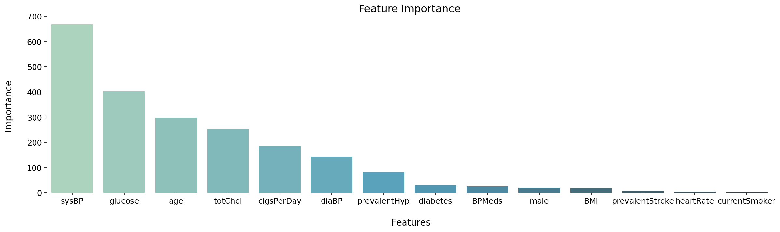
Feature Selection
Visualizing the Importance of the features and selecting the 10 best features using the chi-square test.

Slide 7
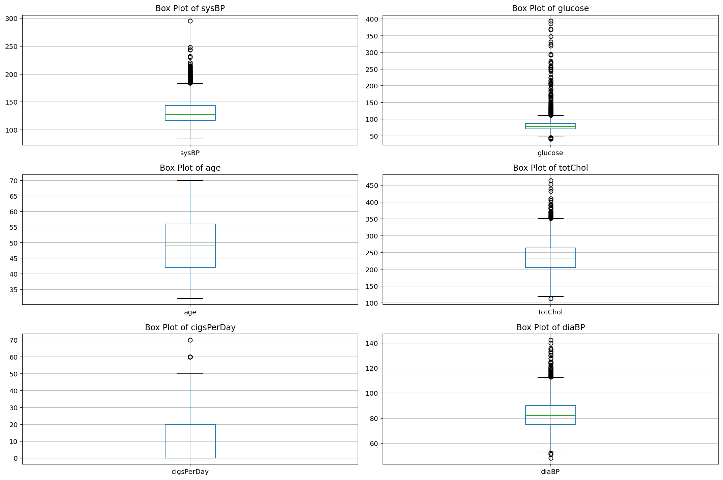
Outliers
Boxplots of the features.
Outliers can be clearly visualized.
I have used IQR method to determine the outliers in each feature and clamped them to the upper and lower bound values.

Slide 8
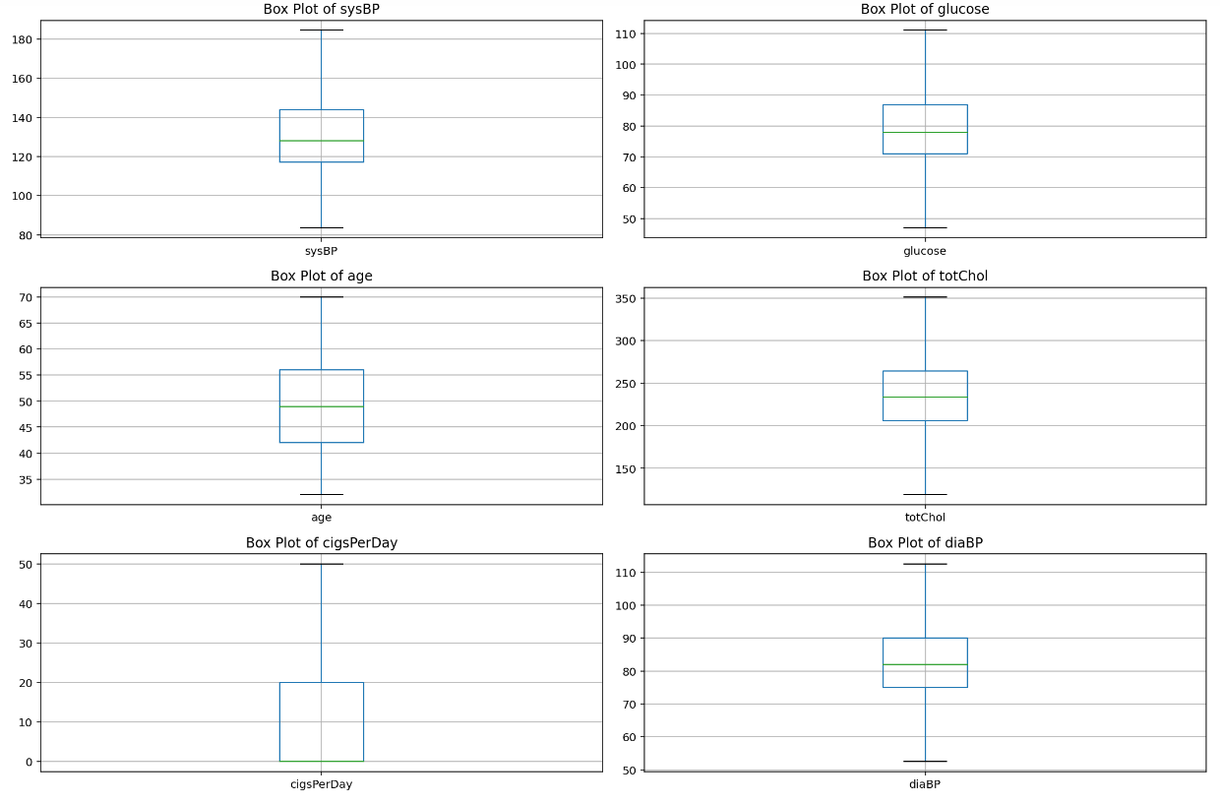
Outliers
Box plot visualization after handling the outliers using the clamping method.

Slide 9
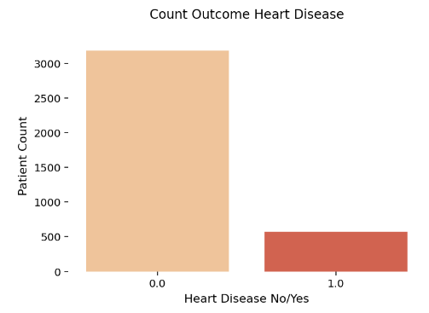
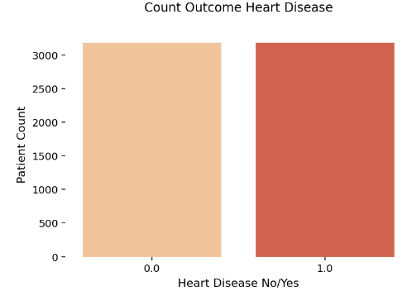
Normalization & Sampling
Normalization: As the outliers are already handled, Minmax normalization technique has been used.
Sampling: Up-Sampling has been used on the imbalanced dataset.

Slide 10

Models
As this is a classification problem, following algorithms are used to predict the outcome.
Logistic Regression
Support Vector Classifier
Decision Tree Classifier
K-Nearest Neighbours(KNN)

Slide 11

Evaluation and Data Sampling
Accuracy, Precision, Recall and F1-Score are used as the Evaluation Metrics.
K-Fold cross validation is used to sample the data into k-folds and train the model.

Slide 12
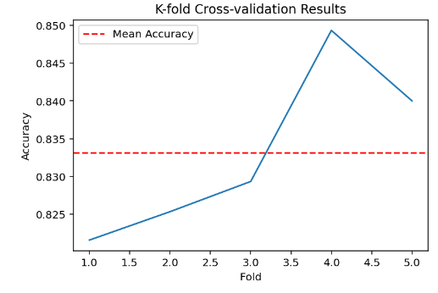
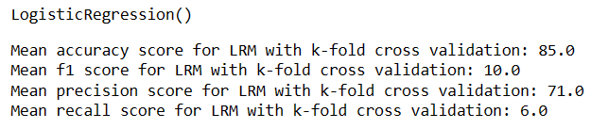
Model Building
Logistic Regression:

Slide 13
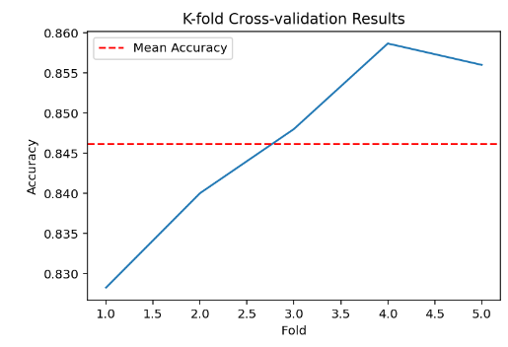
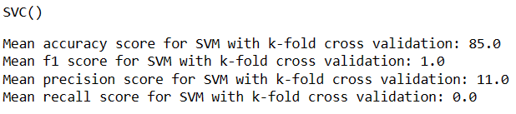
Model Building
Support Vector Classifier:

Slide 14
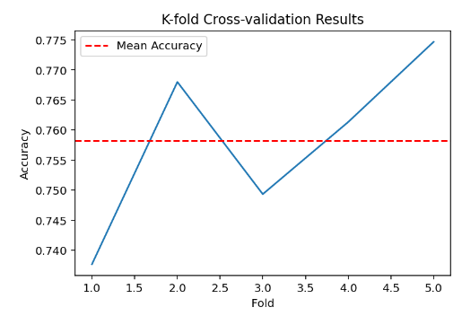
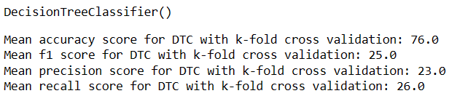
Model Building
Decision Tree Classifier:

Slide 15
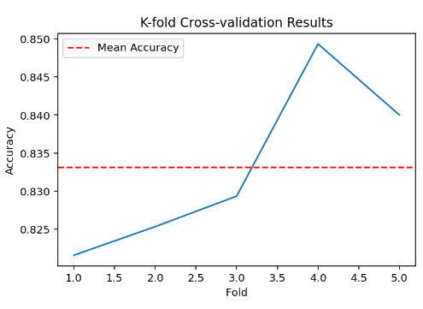
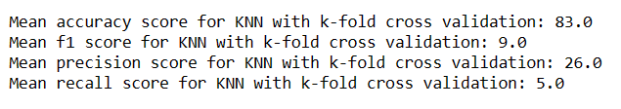
Model Building
K-Nearest Neighbours(KNN):

Slide 16
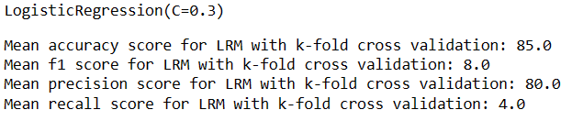
Hyperparameter Optimization
GridCV has been used to go through all the parameters and give us optimal features depending upon the data.
After Hyperparameter Tuning, Evaluation of the Logistic Regression:

Slide 17
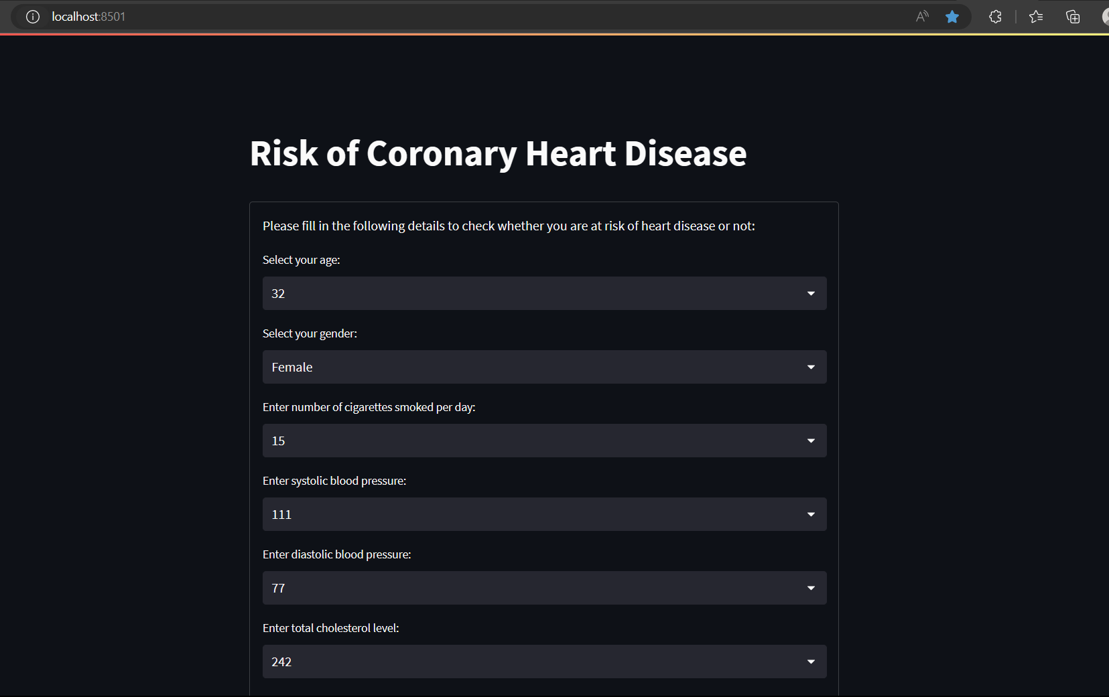
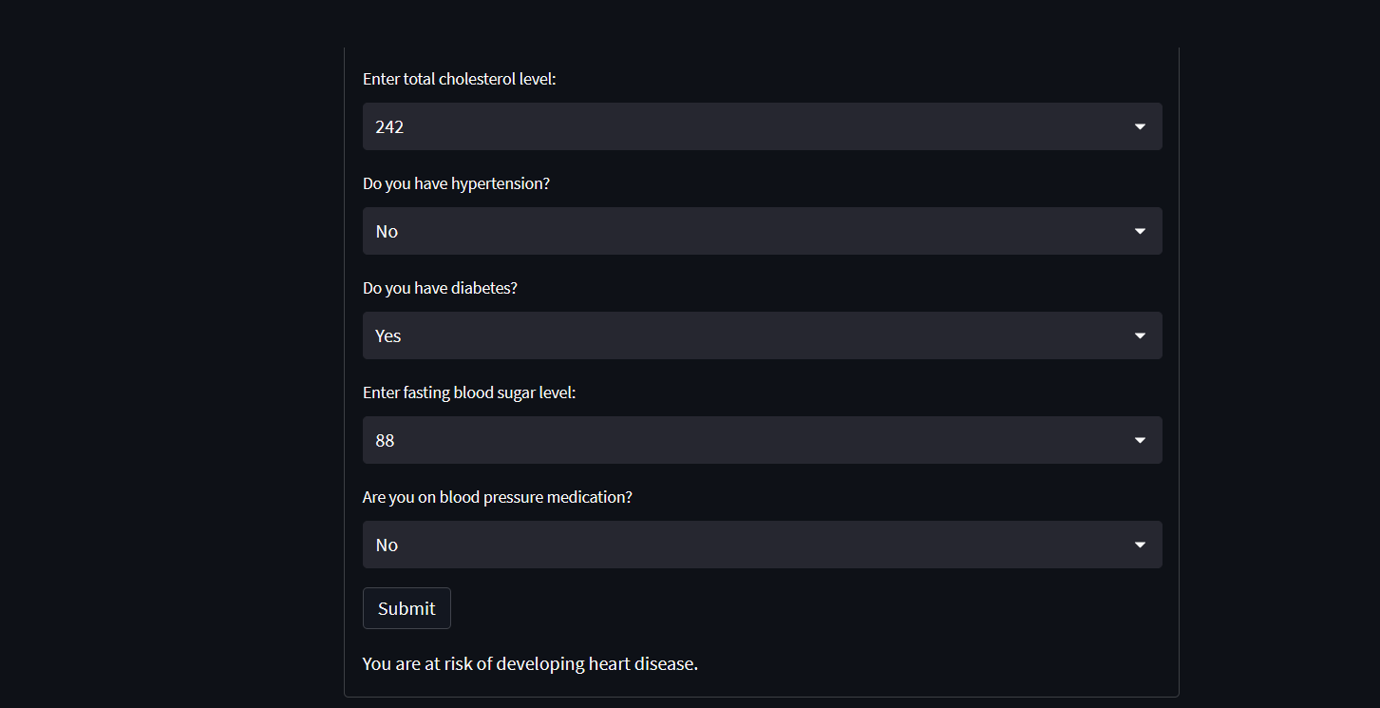
Web Interface
We can input the feature values from the drop down menu. It will tell whether or not the person is at the risk of developing a heart disease

Slide 18

THANK
YOU!

