Slide 1
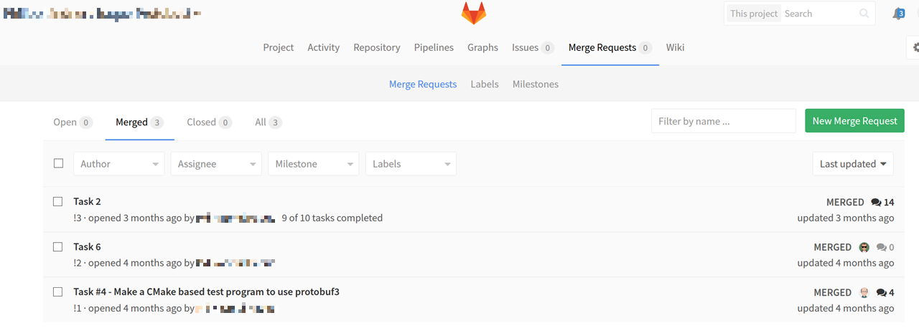
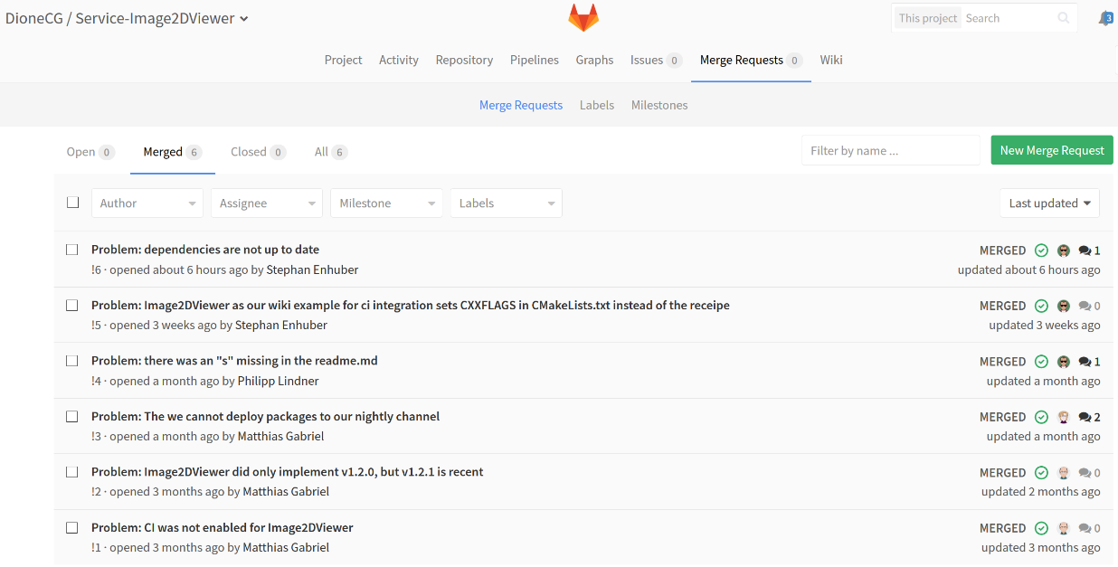
wrong or no problem description
(What are these 3 MRs about?)
Nobody knows what is „Task 2“ or „Task 6“
X
not good
correct problem description
P
good

Slide 2
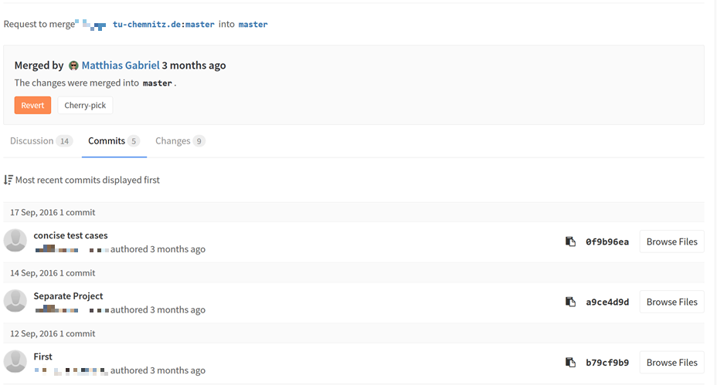
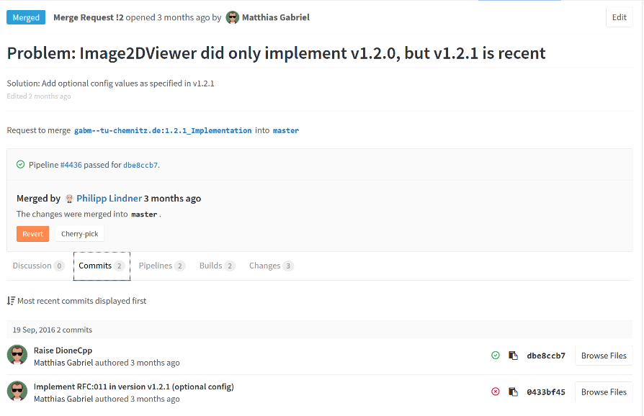
Wrong:
The description of the commits is not useful. What is inside the commit? What does „First“ mean, for example?
X
not good
Merge Request:
Correct problem description
Correct solution description
P
2 commits inside the MR
precise content description
(see also next image)
good

Slide 3
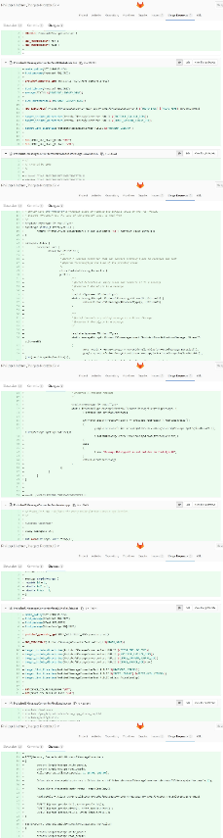
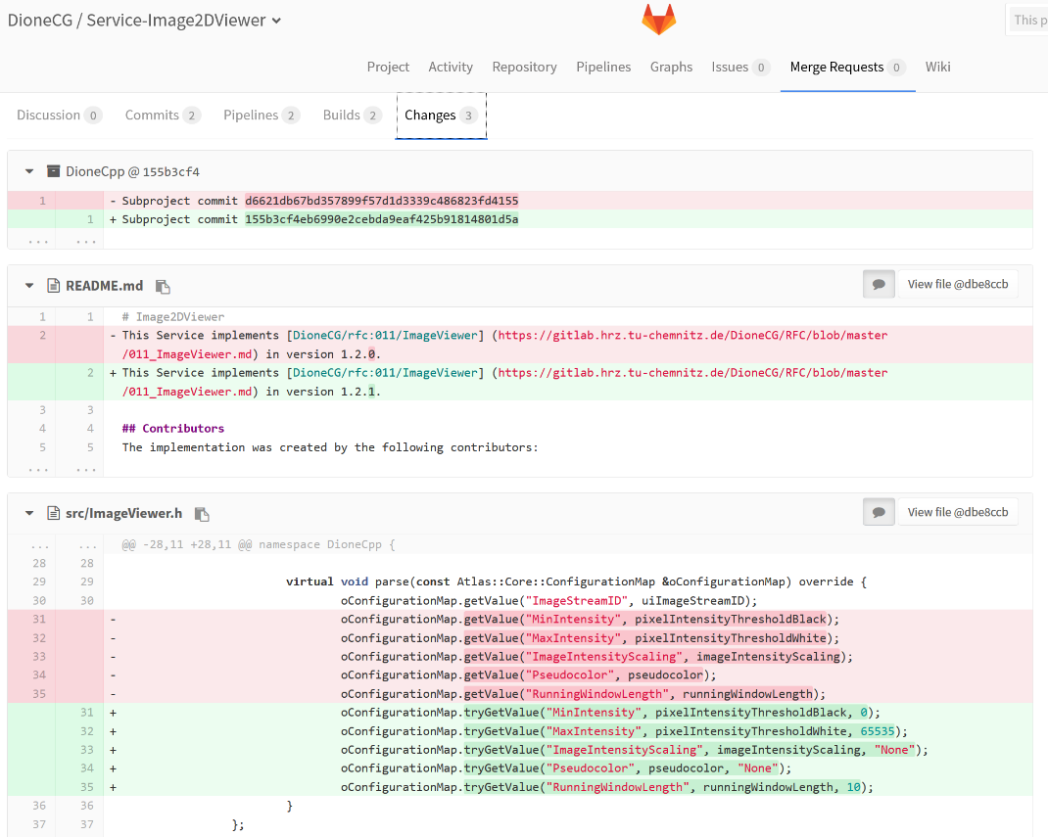
Wrong:
The MR solves multiple problems at once.
There are 5 commits with 100s of lines of code in this MR.
It is impossible to understand what this MR is doing and what the code is used for.
Good: These 2 commits inside the Merge Request contain just few lines of code (the green coloured ones) to solve one small particular problem
These few lines of code are easy to understand.
So the MR is easy to understand
X
P
not good
good

Slide 5

correct problem description

Slide 6
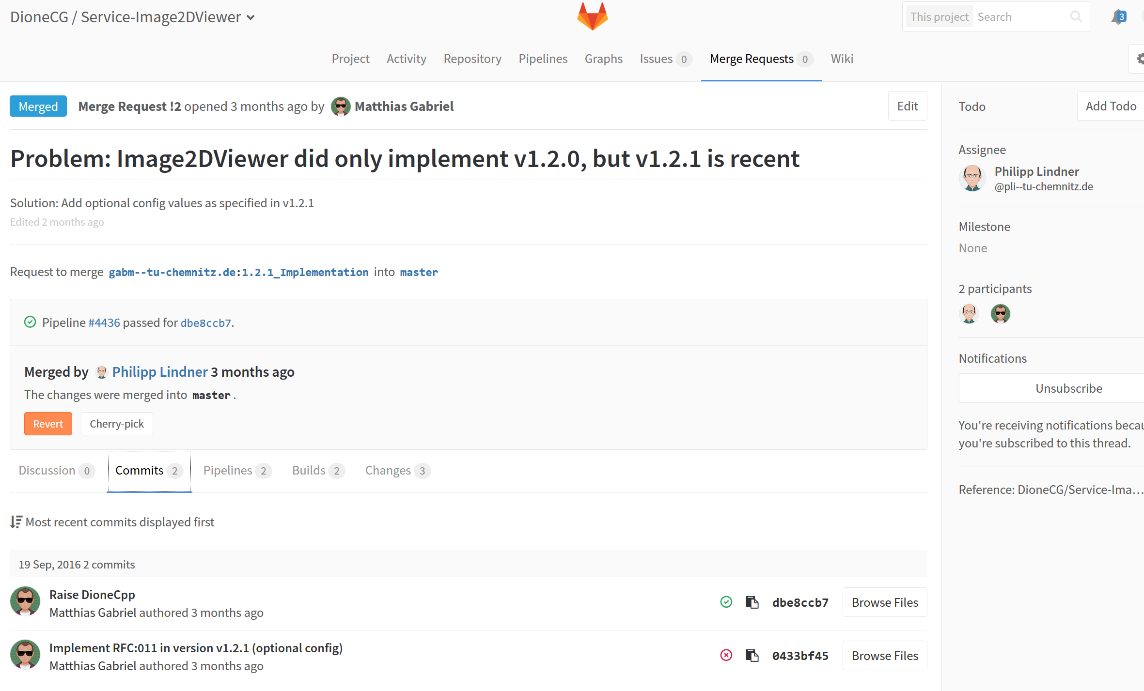
Merge Request:
Correct problem description
Correct solution description
2 commits inside the MR
precise content description
(see also next image)

Slide 7
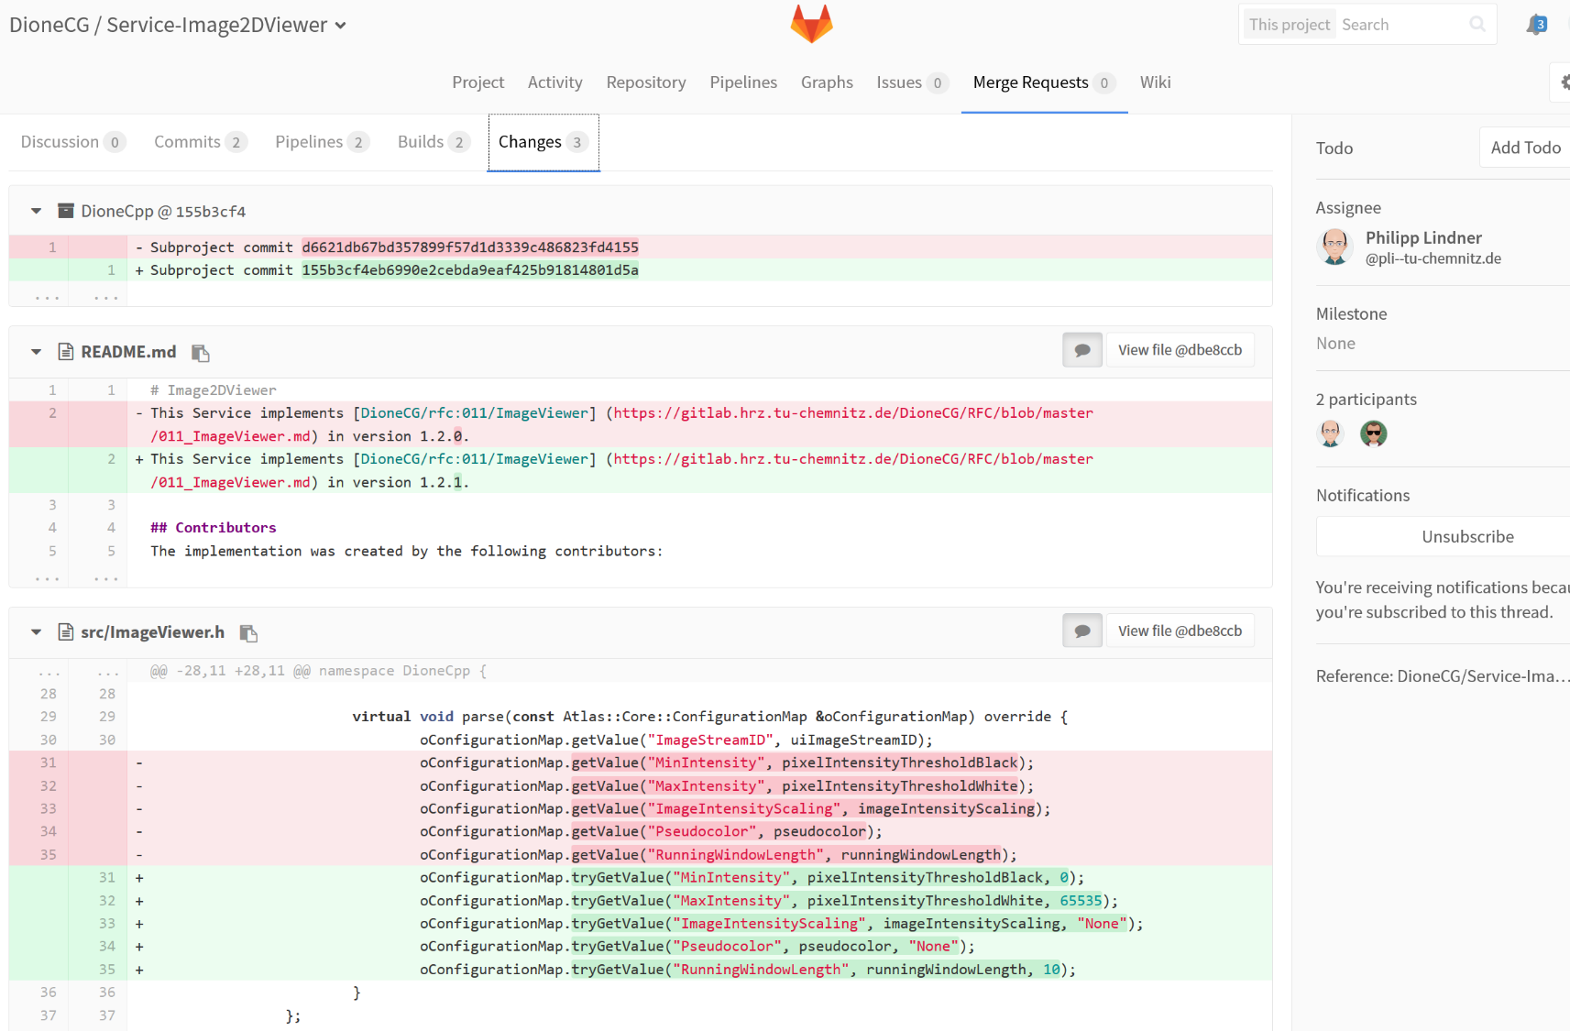
Good: The 2 commits contain just few lines of code (the green coloured ones)
to solve one small particular problem
These few lines of code are easy to understand. So the MR is easy to understand

Slide 9
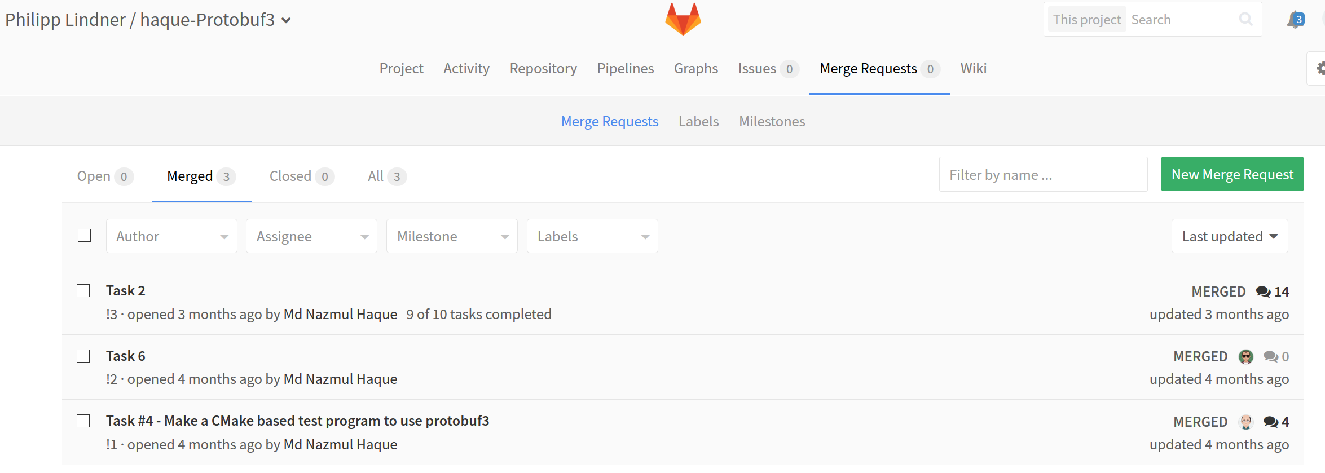

Slide 10
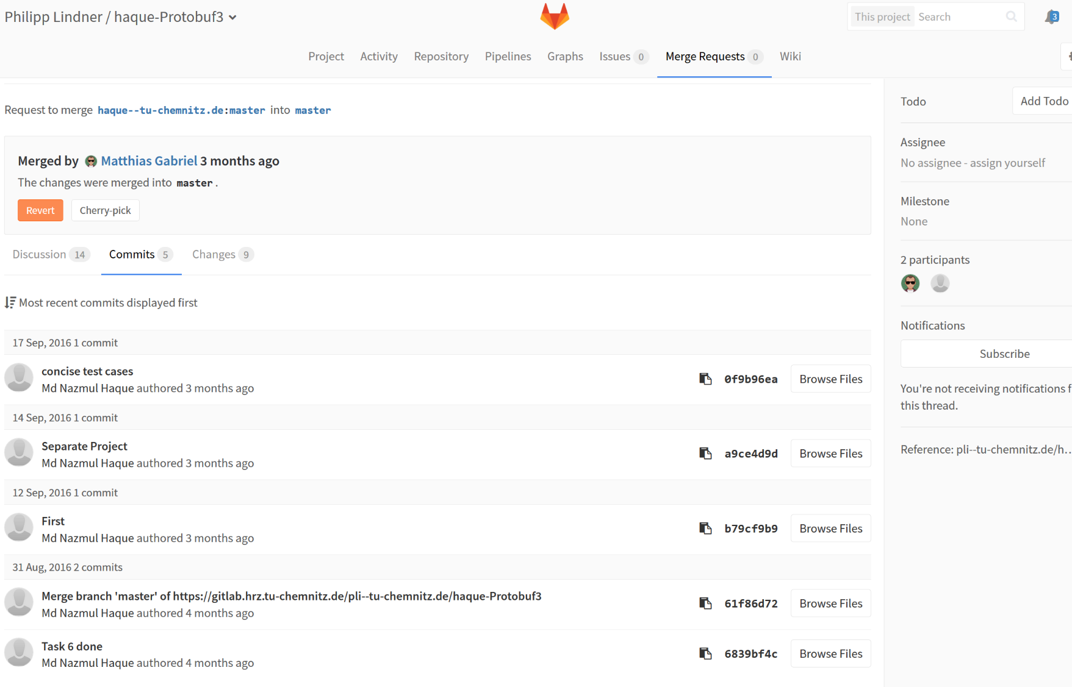

Slide 11
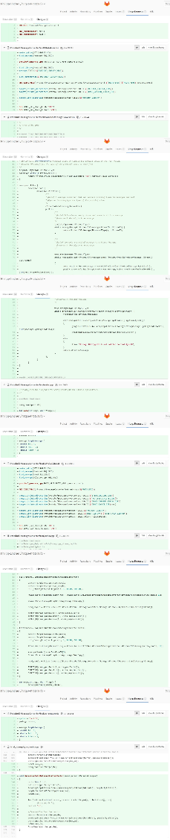

Slide 13
wrong or no problem description
(What are these 3 MRs about?)
Nobody knows what is „Task 2“ or „Task 6“

Slide 14
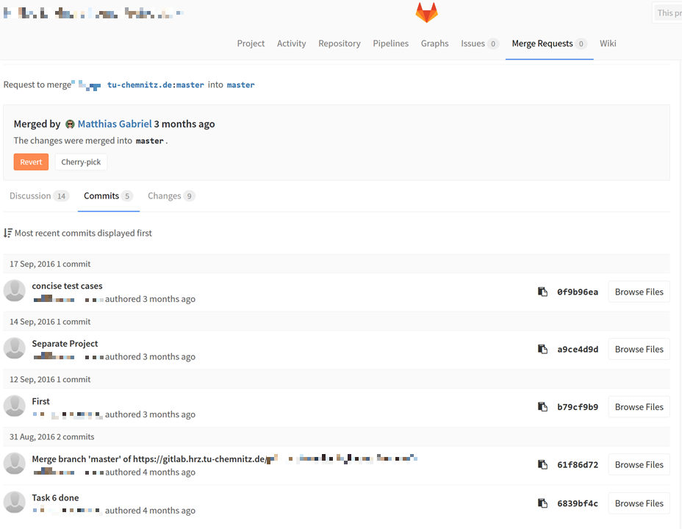
Wrong:
The description of the commits is not useful. What is inside the commit? What does „First“ mean, for example?

Slide 15
Wrong:
The MR solves multiple problems at once.
The are 100s of lines of code in the MR.
It is impossible to understand what this MR is doing and what the code is used for.

Slide 16
-SNIP-
More code follows… 100s lines of code
-SNIP-

Slide 17
