Slide 1
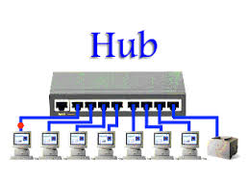
HUB?
In networking, a hub is a device that links multiple computers and devices together. Hubs can also be referred to as repeaters, and they serve as the center of a local area network (LAN). In a hub, each connected device is on the same subnet and receives all data sent to the hub.

Slide 2
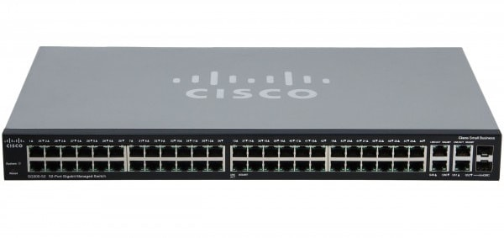
Switch?
Switches are key building blocks for any network. They connect multiple devices, such as computers, wireless access points, printers, and servers; on the same network within a building or campus. A switch enables connected devices to share information and talk to each other.

Slide 3
Switch
A switch is a multiport bridge with a buffer and a design that can boost its efficiency(a large number of ports imply less traffic) and performance. A switch is a data link layer device. The switch can perform error checking before forwarding data, which makes it very efficient as it does not forward packets that have errors and forward good packets selectively to the correct port only

Slide 4
Types of Switch
Unmanaged switches: These switches have a simple plug-and-play design and do not offer advanced configuration options. They are suitable for small networks or for use as an expansion to a larger network.
Managed switches: These switches offer advanced configuration options such as VLANs, QoS, and link aggregation. They are suitable for larger, more complex networks and allow for centralized management.

Slide 5
Types of switch
Smart switches: These switches have features similar to managed switches but are typically easier to set up and manage. They are suitable for small- to medium-sized networks.
Layer 2 switches: These switches operate at the Data Link layer of the OSI model and are responsible for forwarding data between devices on the same network segment.
Layer 3 switches: These switches operate at the Network layer of the OSI model and can route data between different network segments. They are more advanced than Layer 2 switches and are often used in larger, more complex networks.

Slide 6
Difference Between Layer-2 and Layer-3 Switches
Layer 2 Switch | Layer 3 Switch
Operate on layer 2 (Data link) of OSI model. | Operate on layer 3 (Network Layer) of OSI model.
Send “frames” to destination on the basis of MAC address. | Route Packet with help of IP address
Work with MAC address only | Can perform functioning of both 2 layer and 3 layer switch
Used to reduce traffic on local network. | Mostly Used to implement VLAN (Virtual Local area network)
Quite fast as they do not look at the Layer 3 portion of the data packets. | Takes time to examine data packets before sending them to their destination
It has single broadcast domain | It has multiple broadcast domain.
Can communicate within a network only. | Can communicate within or outside network.

Slide 7
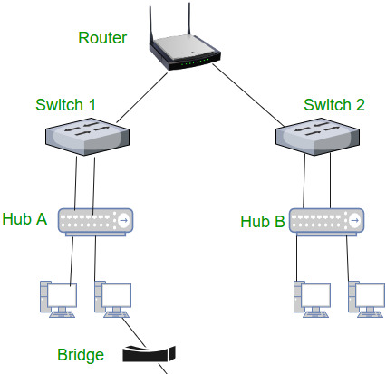
Routers
A router is a device like a switch that routes data packets based on their IP addresses. The router is mainly a Network Layer device. Routers normally connect LANs and WANs and have a dynamically updating routing table based on which they make decisions on routing the data packets. The router divides the broadcast domains of hosts connected through it.

Slide 8
Difference Between Router and Switch
Router | Switch
The main objective of router is to connect various networks simultaneously. | While the main objective of switch is to connect various devices simultaneously.
It works in network layer. | While it works in data link layer.
Router is used by LAN as well as MAN. | While switch is used by only LAN.
Through the router, data is sent in the form of packets. | While through switch data is sent in the form of frame.
There is less collision taking place in the router. | While there is no collision taking place in full duplex switch.
Router is compatible with NAT. | While it is not compatible with NAT.
Router is a relatively much more expensive device than switch. | Switch is an expensive device than hub. but cheaper than router.

