Slide 1
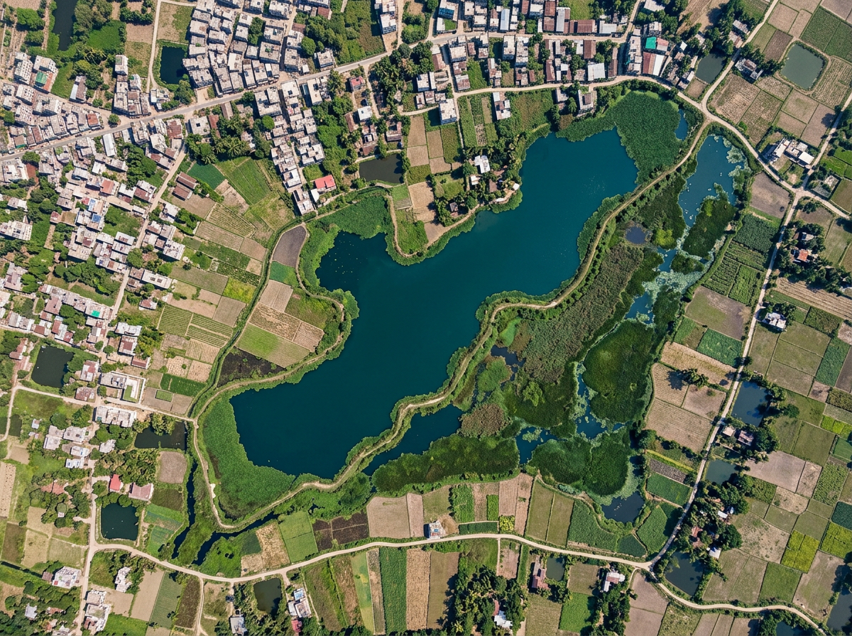
CLIMATE RESILIENCE & ENVIRONMENTAL SUSTAINABILITY
TerraLink
Smarter Wetland Monitoring & Project Management
From a satellite signal to a recorded field response, all in one place.
Afrin Jahan Era
Islamic University of Technology (IUT)
terralink-probah.vercel.app
Notes:
TerraLink is a web app for NGOs that protect ponds and wetlands in Bangladesh. It helps teams spot possible changes, check them on the ground, assign work, track costs, and make clear reports.

Slide 2
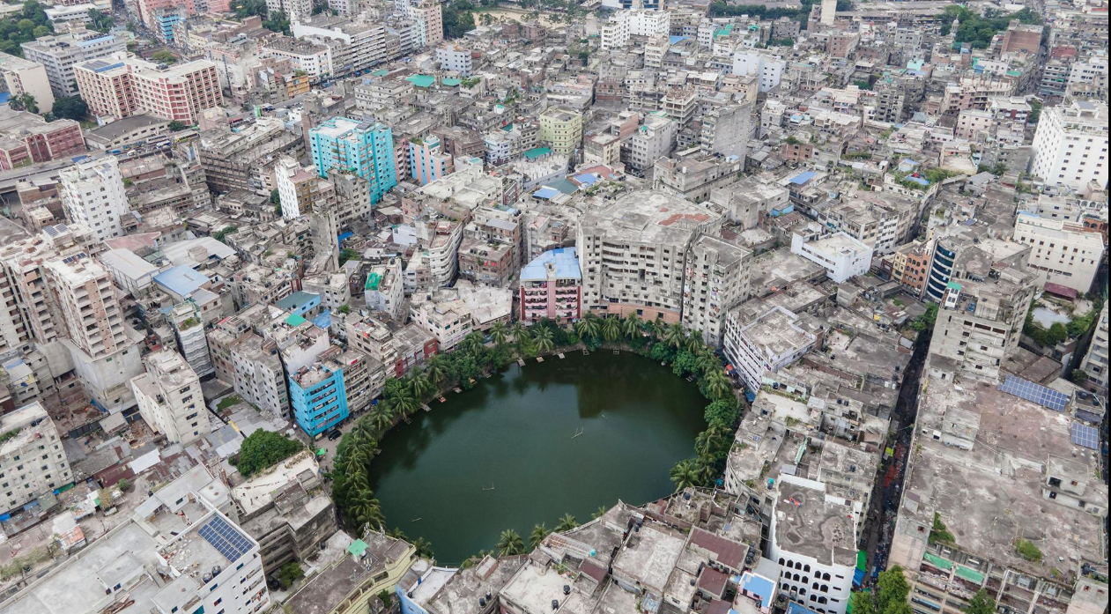
The Problem
Wetland protection requires more than identifying environmental changes.
Ponds, beels and wetlands store rainwater, reduce urban flooding and support fisheries and livelihoods. Around Dhaka, many canals and water bodies have disappeared or become blocked as the city grows.
Environmental project managers and field coordinators face three key challenges:
Difficult monitoring: Comparing satellite images takes time and skill. Clouds or seasonal drying can make a pond look smaller than it is.
Scattered records: Findings, photos, tasks and costs sit in separate files, phones and chat groups.
Limited follow-up: It is unclear who should check a site, by when, and at what cost, so reports take long to prepare.
Urban growth puts steady pressure on ponds and wetlands in and around Dhaka.
The gap A simple workflow that connects environmental observations to the checks, work and costs that follow.
Notes:
Ponds, beels and wetlands store rainwater, reduce urban flooding and support fisheries and livelihoods. Around Dhaka many canals and water bodies have disappeared or become blocked. NGO teams face three challenges: monitoring is difficult because comparing satellite images takes skill and clouds or seasonal drying can mislead; records are scattered across files, phones and chat groups; and follow-up is limited because it is unclear who checks a site, by when and at what cost. The gap is a simple workflow that connects observations to the work and costs that follow.

Slide 3
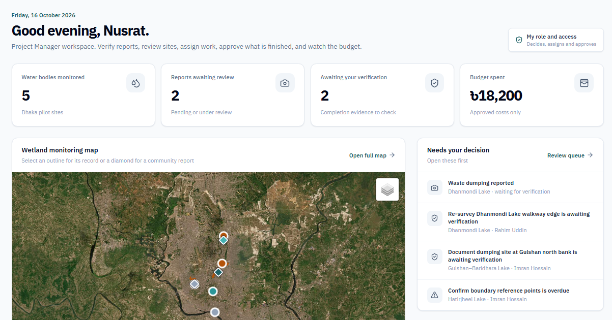
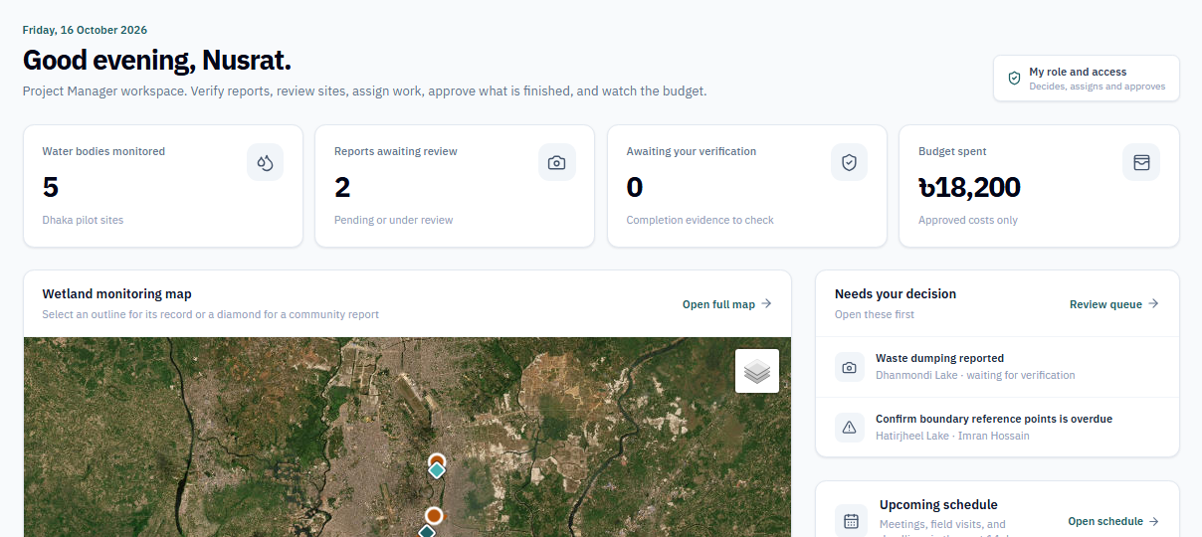
Our Solution
One platform to monitor, review and manage wetland protection projects.
TerraLink keeps one shared record for each site, linking satellite evidence, decisions, tasks and costs.
Compare satellite images to spot possible changes in visible water area
Review satellite findings and photo reports, checked by AI for waste
Assign tasks; each person gets an email and a calendar invite
Track budgets; spending more needs the manager’s approval
Email reports, plan Google Meet calls and post updates to Discord
Built to be trusted
Uses free Sentinel-2 imagery and measures the water area in the browser (NDWI). When clouds hide a site, it shows "Insufficient data" instead of guessing, and a drop in water is treated as a reason to check, not as proof.
Live prototype: the manager dashboard
Who uses it
Project Manager reviews findings, approves work, controls budget
Our approach Turn a possible environmental change into a documented, trackable action.
Field Coordinator updates assigned tasks and records costs
User explores water bodies and reports problems with photos
Notes:
TerraLink keeps one record for each lake. It links satellite evidence, decisions, tasks and costs. AI checks report photos and cleanup photos for waste. When a task is assigned, the field coordinator gets an email and a calendar invite. Spending within a task budget is accepted at once; more money needs the manager’s approval. Reports go out by email as a PDF. Meetings are created in Google Meet and saved in each guest’s calendar, and a Discord bot posts every lake update. Who uses it: the project manager reviews, approves and controls the budget; the field coordinator does the work and records costs; a user reports problems with photos.

Slide 4
How It Works
From a resident’s report or a satellite signal to a closed task and a shared report.
1 REPORT
2 REVIEW
3 DECIDE
4 ASSIGN
5 WORK
6 VERIFY
7 CLOSE & SHARE
Community member
Report a problem
photos + map pin
CNN photo check
marks the waste
Not taken forward
reason recorded
Sees the result
report shows Resolved
Project manager
No
Review evidence
report or satellite
Confirmed?
verified or measured
Yes
Create task
coordinator + deadline
No
Approve work?
and expenses
Yes
Task completed
outcome recorded
Field coordinator
Do the work
start, record costs
Submit for review
photos + summary
TerraLink (automatic)
Satellite comparison
Sentinel-2, NDWI
Schedule + email
calendar, assignee
AI check + email
CNN checks photos
Report + email
PDF, download or send
Main step
Decision
Automatic (TerraLink)
Side path or return
Notes:
The flow, in four lanes. A resident reports a problem with photos and a map pin. In the review step, a CNN model checks the photos and marks the waste. The satellite comparison can also measure the water area from two Sentinel-2 images. The project manager reviews the evidence and decides: a report is verified or rejected with a reason. If it is confirmed, the manager creates a task for a field coordinator with a deadline and a budget. TerraLink emails the coordinator with a calendar invite. The coordinator does the work, records costs and submits after-photos. The CNN model checks those photos for waste, then TerraLink emails the manager. The manager approves the work, or sends it back. When the task is completed, the resident sees the result, and the report can be downloaded as a PDF or sent by email.

Slide 5
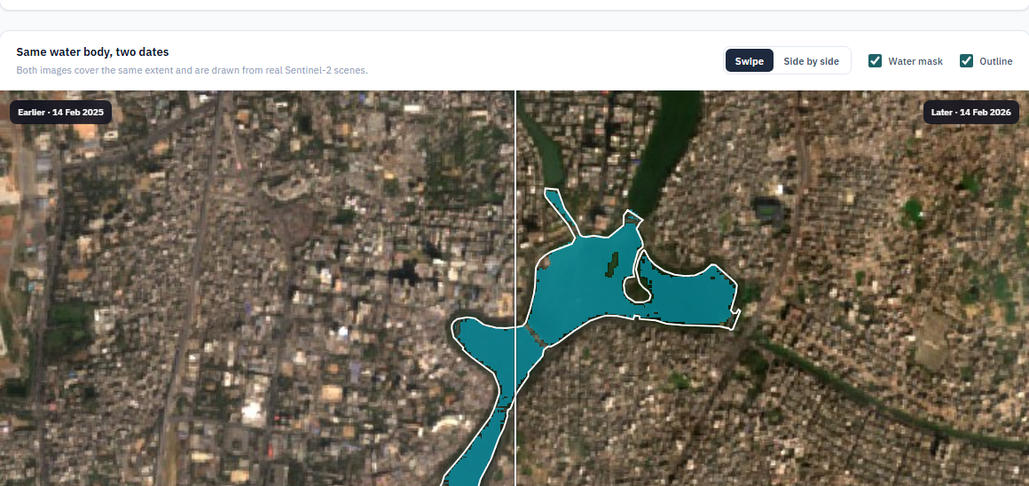
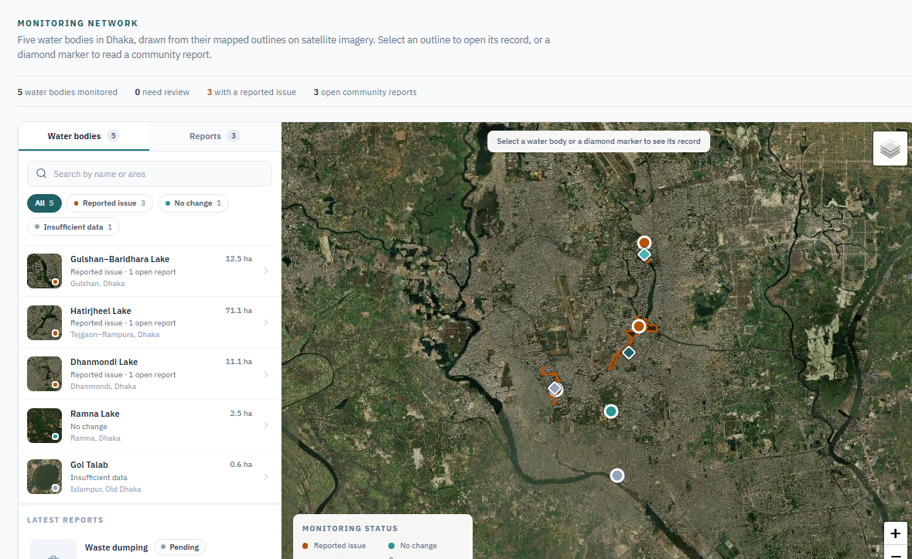
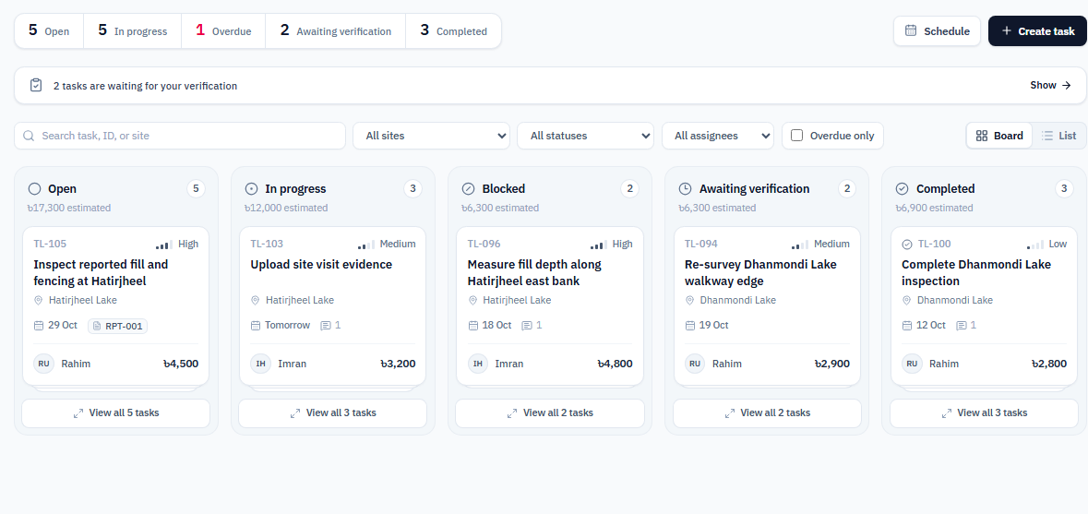
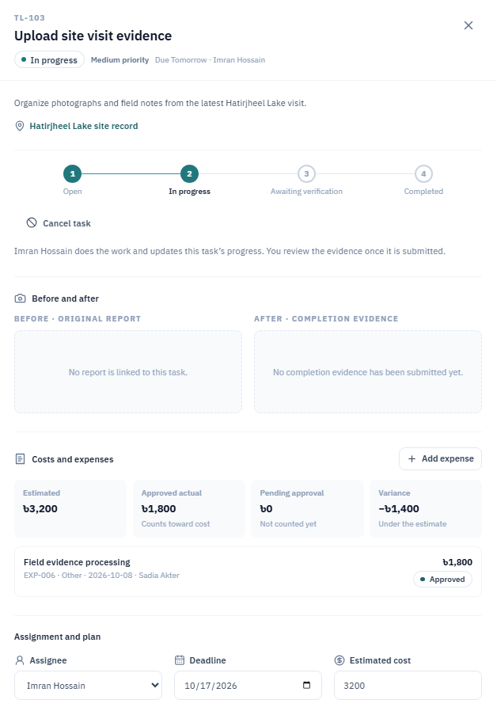
Key Features: Map, Review & Tasks
See the change on real imagery, then turn it into accountable work.
FEATURE 1
Map & Change Analysis
See every site on one map and measure the change between two real images.
Real Sentinel-2 scenes, a water mask and the uncertainty stated
Insufficient data when clouds block the view
A drop in water is a signal to check, not proof
FEATURE 2
Review & Tasks
Turn a verified finding into accountable field work.
Verify photo reports and satellite findings; AI marks the waste
Assign a field coordinator, deadline and budget
AI checks the after-photos before the manager approves
Notes:
Feature 1, Map and Change Analysis, shows the Dhaka water bodies on one map. The manager picks two dates and TerraLink measures the water area on real Sentinel-2 images. When clouds block the view, it shows Insufficient data instead of guessing. Feature 2, Review and Tasks, turns a verified finding into field work. AI marks the waste on report photos. The manager assigns a field coordinator with a deadline and a budget. The coordinator sends after-photos, AI checks them for waste, and then the manager approves or returns the work.

Slide 6
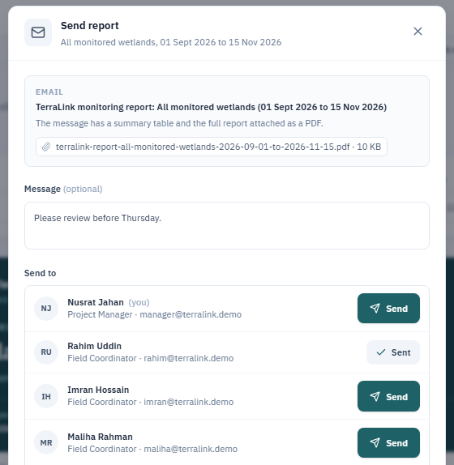
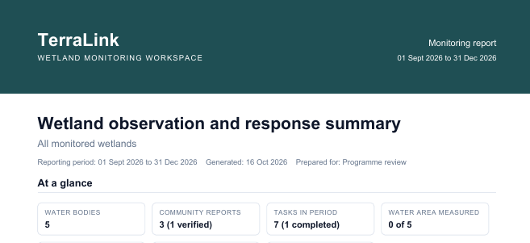
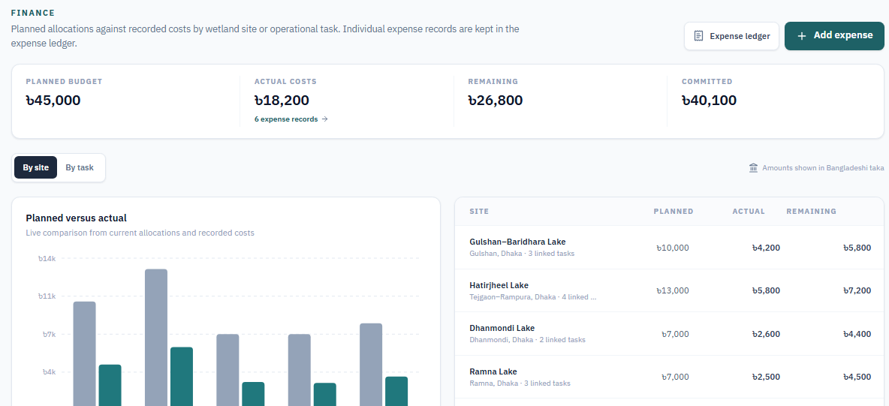
Key Features: Reports, Meetings & Costs
Reports and events reach the right people without leaving the page where the work happens.
FEATURE 3
FEATURE 4
FEATURE 5
Reports
Meetings & Updates
Budgets & Costs
Download a PDF, or Send: each person gets a subject, a summary table and the PDF attached.
Create a Google Meet for any task or lake. It goes into every guest’s calendar.
Each task has a budget. Spending within it is accepted; more needs approval.
Images, decisions and costs
Sources and limits included
PDF download or email
Meet link from your account
Saved in each guest’s calendar
Discord thread for each lake
Budget, spent and variance
Extra budget needs approval
Over-budget email warning
One Send button per person. A tick shows who already has the report.
The PDF the person downloads
Budgets: planned against actual cost
Notes:
Features 3, 4 and 5. Reports: download a PDF, or send it by email; each person gets a summary and the PDF attached. Meetings and updates: the manager creates a Google Meet from a task or a lake; it is saved in Google Calendar and every guest gets the link by email. A Discord bot keeps one thread for each lake and posts every change; anyone can type /status for the latest. Budgets and costs: each task has a budget. Spending within it is accepted at once. Going over needs a request and the manager’s approval, and the manager is emailed when a site goes over budget.

Slide 7
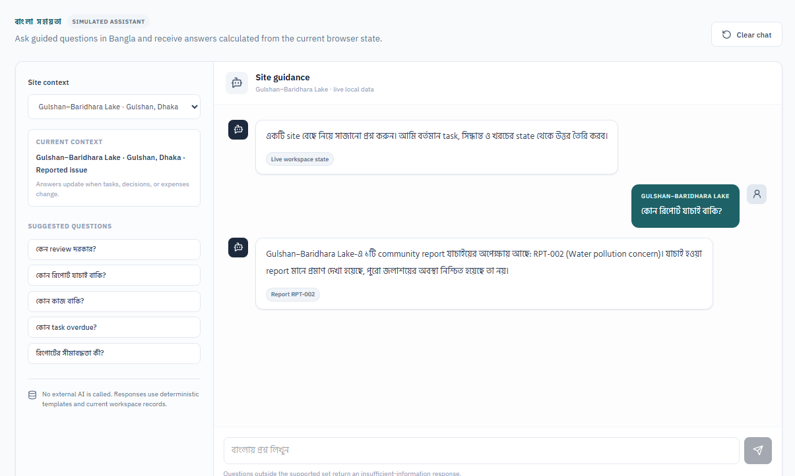
Key Features: AI Copilot & Discord
Ask a question and get an answer from live data. A Discord bot shares every lake update.
FEATURES 6 & 7
A team member asks a question
Site and satellite records
Community reports
TerraLink Copilot
with role-based access
Answer with photos
with its source record
Tasks and costs
Field notes and photos
Copilot keeps data private
Discord bot
Ask in English, Bangla or Banglish
The manager sees everything
Coordinators see only their own work
One thread for each lake
Posts every status change
Type /status to see the latest
Live prototype: Copilot answers from current records and names its source.
The goal: quick answers for everyone, and private data only for the manager.
Notes:
Features 6 and 7. TerraLink Copilot answers questions about lakes, tasks and budgets from live records, with photos and the source of each answer. People can ask in English, Bangla or Banglish. Access follows the role: the manager sees everything, including budgets and reporter contacts; a field coordinator sees only their own work and public lake facts. The Discord bot keeps one thread for each lake. It posts every status change, new report, measurement and task update, and anyone can type /status to see the latest.

Slide 8
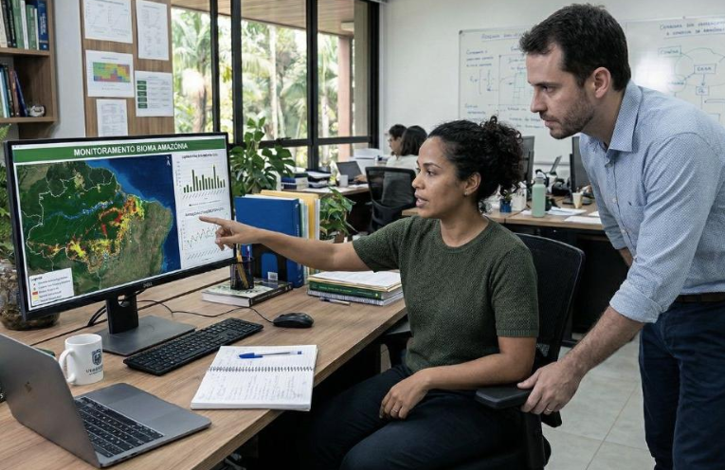
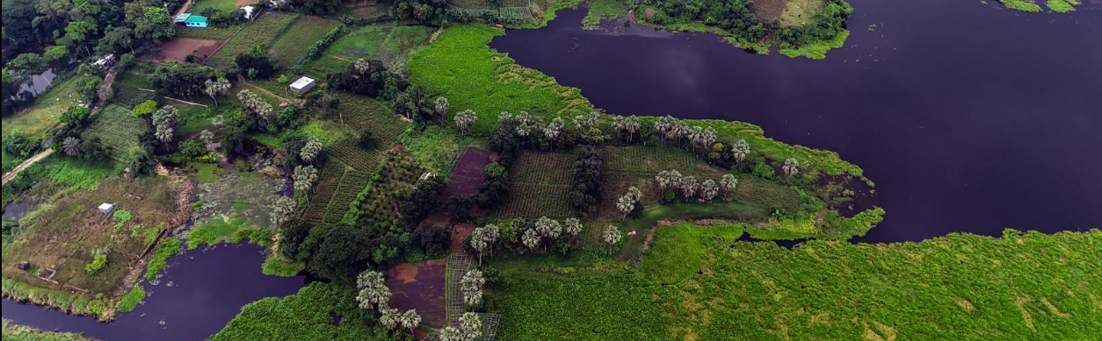
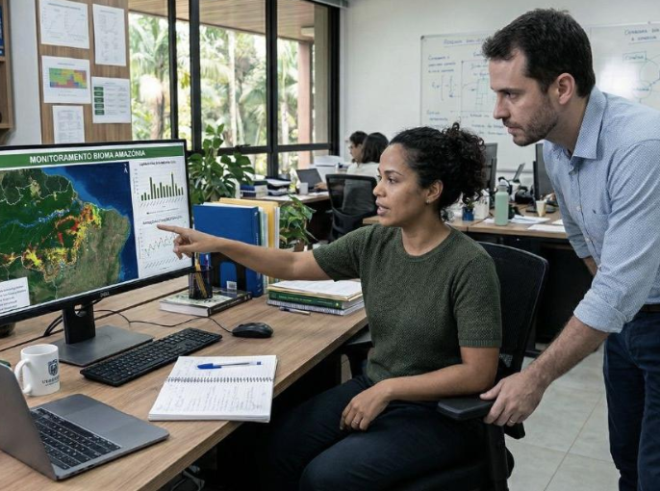
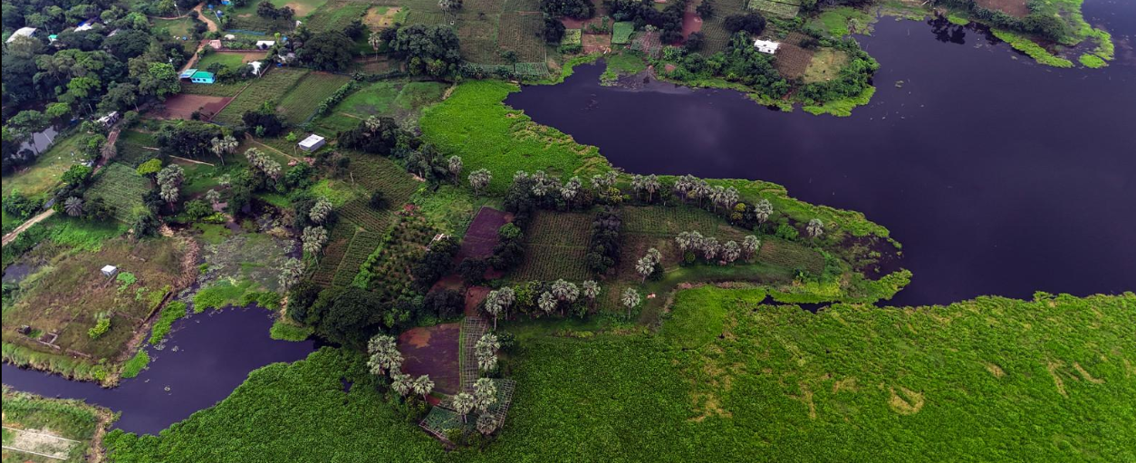
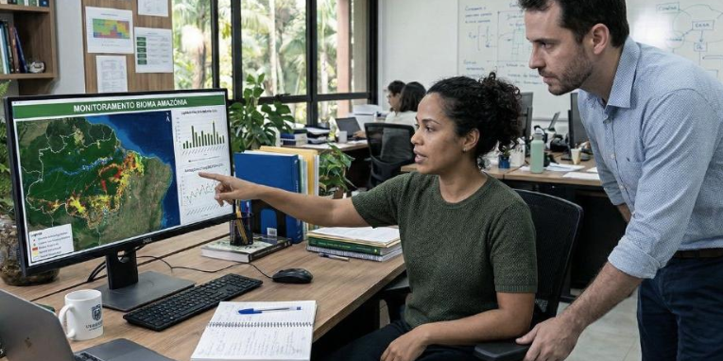
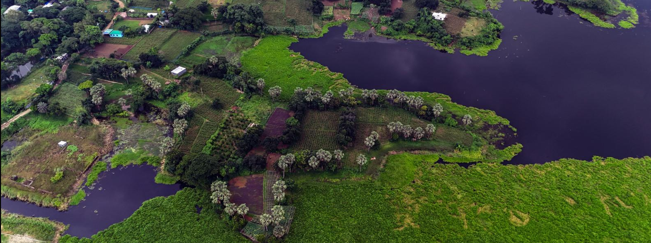
Expected Impact & Vision
Built for small NGO teams that protect wetlands. Local communities are the ones who benefit.
EXPECTED IMPACT
How will TerraLink help?
One shared record connects residents’ reports, satellite evidence, field work and expenses.
Managers see findings and pending work in one place.
Report and upload problems with a photo, and follow the result.
Responsibilities, deadlines and expenses are easy to track.
Reports go out by email as a PDF.
Actual impact will be evaluated through user feedback and project results.
A focused first step
Our vision
Five selected Dhaka ponds and wetlands, built on existing satellite data and free tools, with sample records where real data is not available.
A practical tool that turns satellite observations into organised, accountable wetland protection work.
Notes:
How TerraLink helps: managers get a clearer view of findings and pending work; residents can report and upload problems with a photo and follow the result; responsibilities, deadlines and expenses are easier to track; and reports are shared by email as a PDF. Actual impact will be evaluated through user feedback and project results. The first prototype is a focused first step: five selected Dhaka ponds and wetlands, built on existing satellite data and free tools, with clearly labelled sample records where real project data is not available. Our vision is a practical tool that turns satellite observations into organised, accountable wetland protection work.

Slide 9
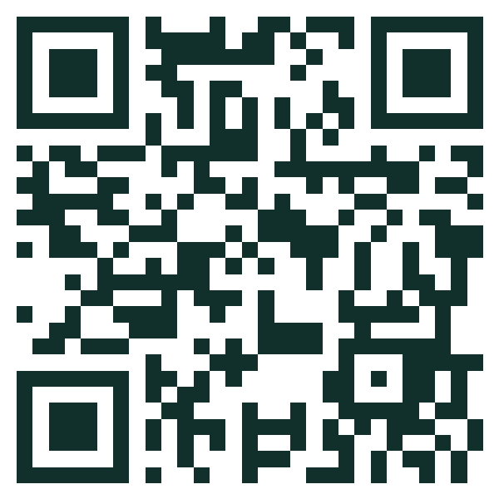
Thank You
Questions are welcome.
TerraLink helps NGOs protect wetlands with clear evidence, clear responsibility and clear records.
Live demo
terralink-probah.vercel.app
Afrin Jahan Era · IUT
Notes:
Thank you. Questions are welcome. The live demo is at terralink-probah.vercel.app, or scan the QR code.

