Slide 1
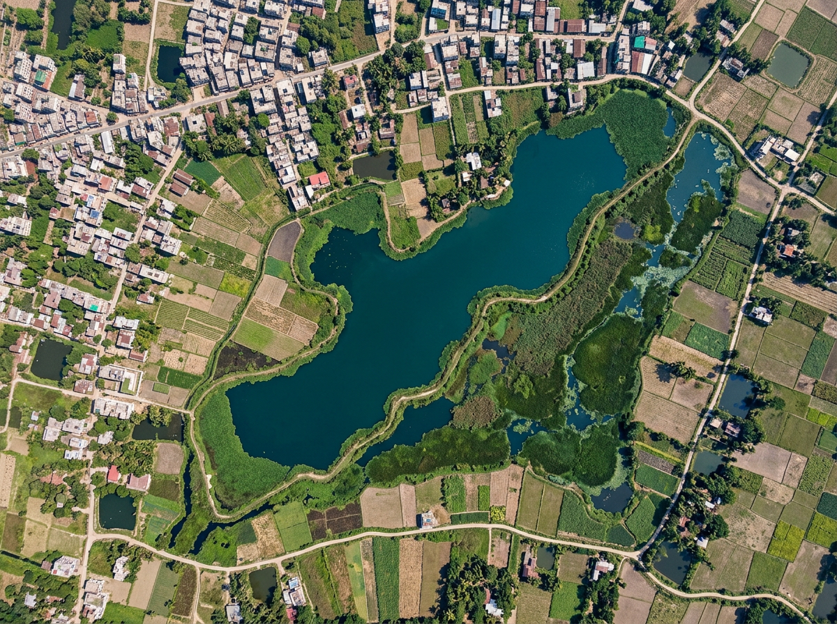
CLIMATE RESILIENCE & ENVIRONMENTAL SUSTAINABILITY
TerraLink
Smarter Wetland Monitoring & Project Management
From a satellite signal to a recorded field response, all in one place.
Afrin Jahan Era
Islamic University of Technology (IUT)
terralink-probah.vercel.app
Notes:
TerraLink is a web app for NGOs that protect ponds and wetlands in Bangladesh. It helps teams spot possible changes, check them on the ground, assign work, track costs, and make clear reports.

Slide 2
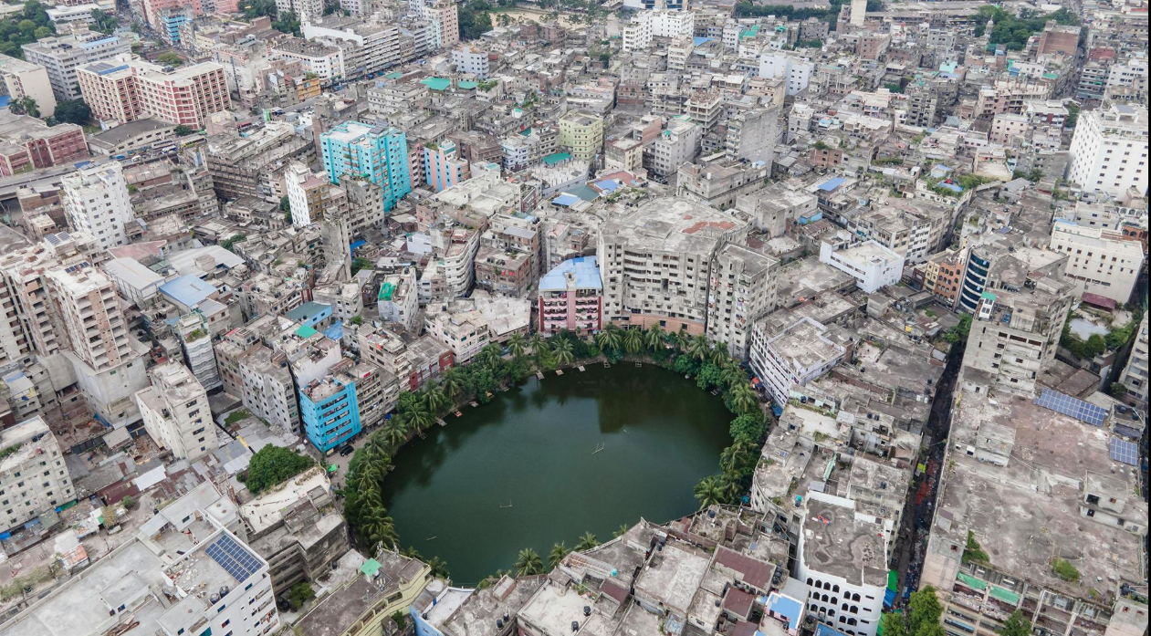
The Problem
Wetland protection requires more than identifying environmental changes.
Ponds, beels and wetlands store rainwater, reduce urban flooding and support fisheries and livelihoods. Around Dhaka, many canals and water bodies have disappeared or become blocked as the city grows.
Environmental project managers and field coordinators face three key challenges:
Difficult monitoring: Comparing satellite images takes time and skill. Clouds or seasonal drying can make a pond look smaller than it is.
Scattered records: Findings, photos, tasks and costs sit in separate files, phones and chat groups.
Limited follow-up: It is unclear who should check a site, by when, and at what cost, so reports take long to prepare.
Urban growth puts steady pressure on ponds and wetlands in and around Dhaka.
The gap A simple workflow that connects environmental observations to the checks, work and costs that follow.
Notes:
Ponds, beels and wetlands store rainwater, reduce urban flooding and support fisheries and livelihoods. Around Dhaka many canals and water bodies have disappeared or become blocked. NGO teams face three challenges: monitoring is difficult because comparing satellite images takes skill and clouds or seasonal drying can mislead; records are scattered across files, phones and chat groups; and follow-up is limited because it is unclear who checks a site, by when and at what cost. The gap is a simple workflow that connects observations to the work and costs that follow.

Slide 3
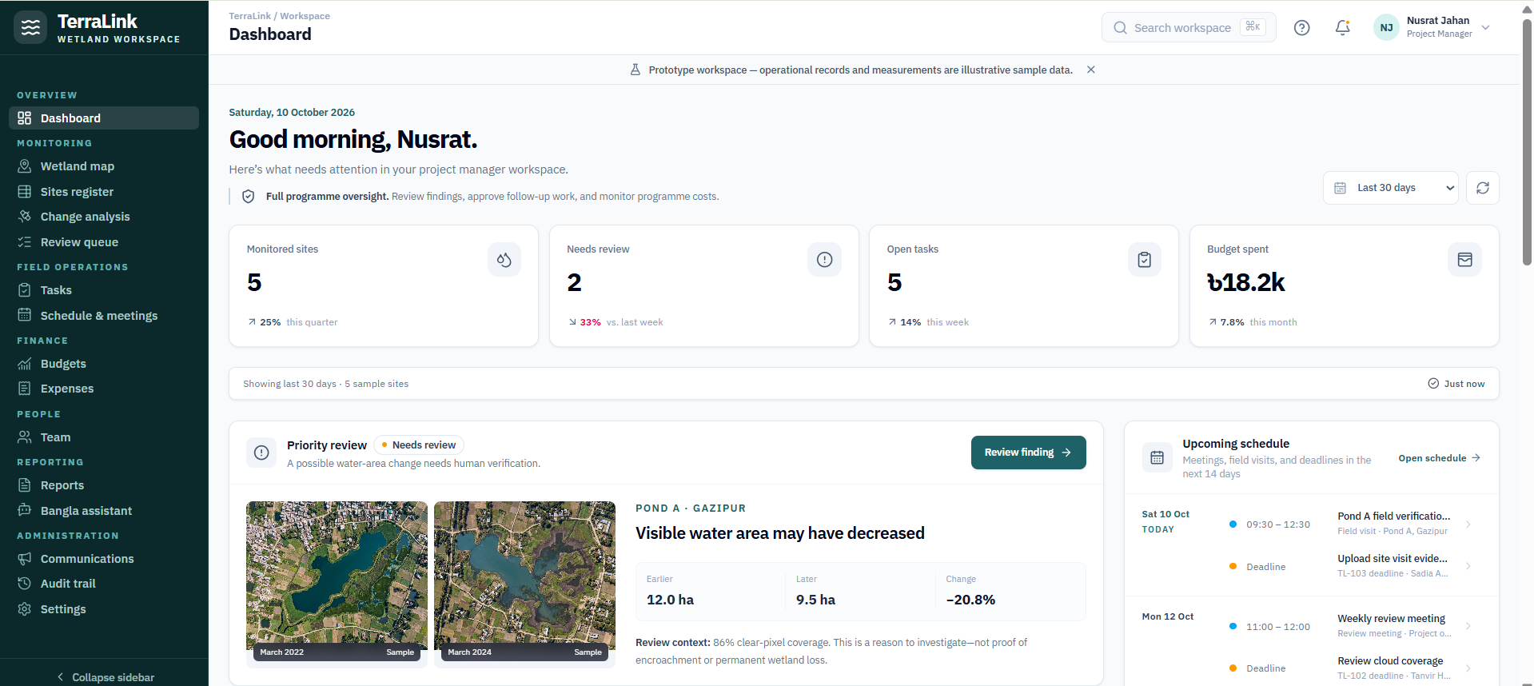
Our Solution
One platform to monitor, review and manage wetland protection projects.
TerraLink keeps one shared record for each site, linking satellite evidence, decisions, tasks and costs.
Compare satellite images to spot possible changes in visible water area
Review findings before deciding on follow-up action
Assign tasks, deadlines and responsibilities
Track planned and actual project costs
Prepare reports with evidence, decisions and progress
Built to be trusted
Uses free Sentinel-2 imagery and Dynamic World water data. When clouds hide a site, it shows "Insufficient data" instead of guessing, and a drop in water is treated as a reason to check, not as proof.
Live prototype: the manager dashboard
Who uses it
Project Manager reviews findings, approves work, controls budget
Field Coordinator updates assigned tasks and records costs
Our approach Turn a possible environmental change into a documented, trackable action.
Office Operator keeps records, so workers need no smartphone
Notes:
TerraLink keeps one shared record for each site, linking satellite evidence, decisions, tasks and costs. Teams compare images, review findings, assign tasks, track costs and prepare reports. It is built to be trusted: it uses free Sentinel-2 imagery and Dynamic World, shows Insufficient data when clouds hide a site, and treats a drop in water as a reason to check, not proof. Three roles use it: the project manager, the field coordinator and an office operator who keeps records so field workers do not need smartphones.

Slide 4
How It Works
A satellite change becomes work only after a person reviews it.
1
SATELLITE MONITORING
2
MANAGER REVIEW
3
FIELD WORK
4
REPORTING
Sentinel-2 images
same season, 2–3 years
Review evidence
images, dates, coverage
Assign task
owner, deadline, estimate
Report
images, decisions, tasks, costs
Mask clouds
and shadows
Check limits
clouds, season, resolution
Field check and cost
notes, evidence, actual cost
Bangla assistant
answers with sources
Clear enough?
Decision
Within budget?
Audit trail
who did what, and when
Yes
Measure water-area change
Confirmed
Approve with a reason
Yes
Reported complete
KEY
Step
No
Insufficient data
Unclear
Recheck next clear image
No
Warning to the manager
Decision
Main path
No change
Close, keep monitoring
Side path or alert
Task status Review pending → Approved → In progress → Reported complete
Notes:
Example: Pond A shows about 20% less visible water; the manager reviews it, Rahim checks the site, the 4,200 taka visit cost is recorded and the report is printed. A wetland change moves through clear steps. The satellite shows a possible change, such as Pond A having about 20% less visible water. The manager compares old and new images and decides whether follow-up is needed. If the image is unclear or there is no real change, the site is rechecked when the next clear image arrives, which loops back to observation. If follow-up is approved, a task is assigned with an owner, deadline and estimated cost; the field coordinator checks the site; the actual cost is recorded against the budget; and the manager prepares a report. Tasks move from Review pending to Approved, In progress and Reported complete.

Slide 5
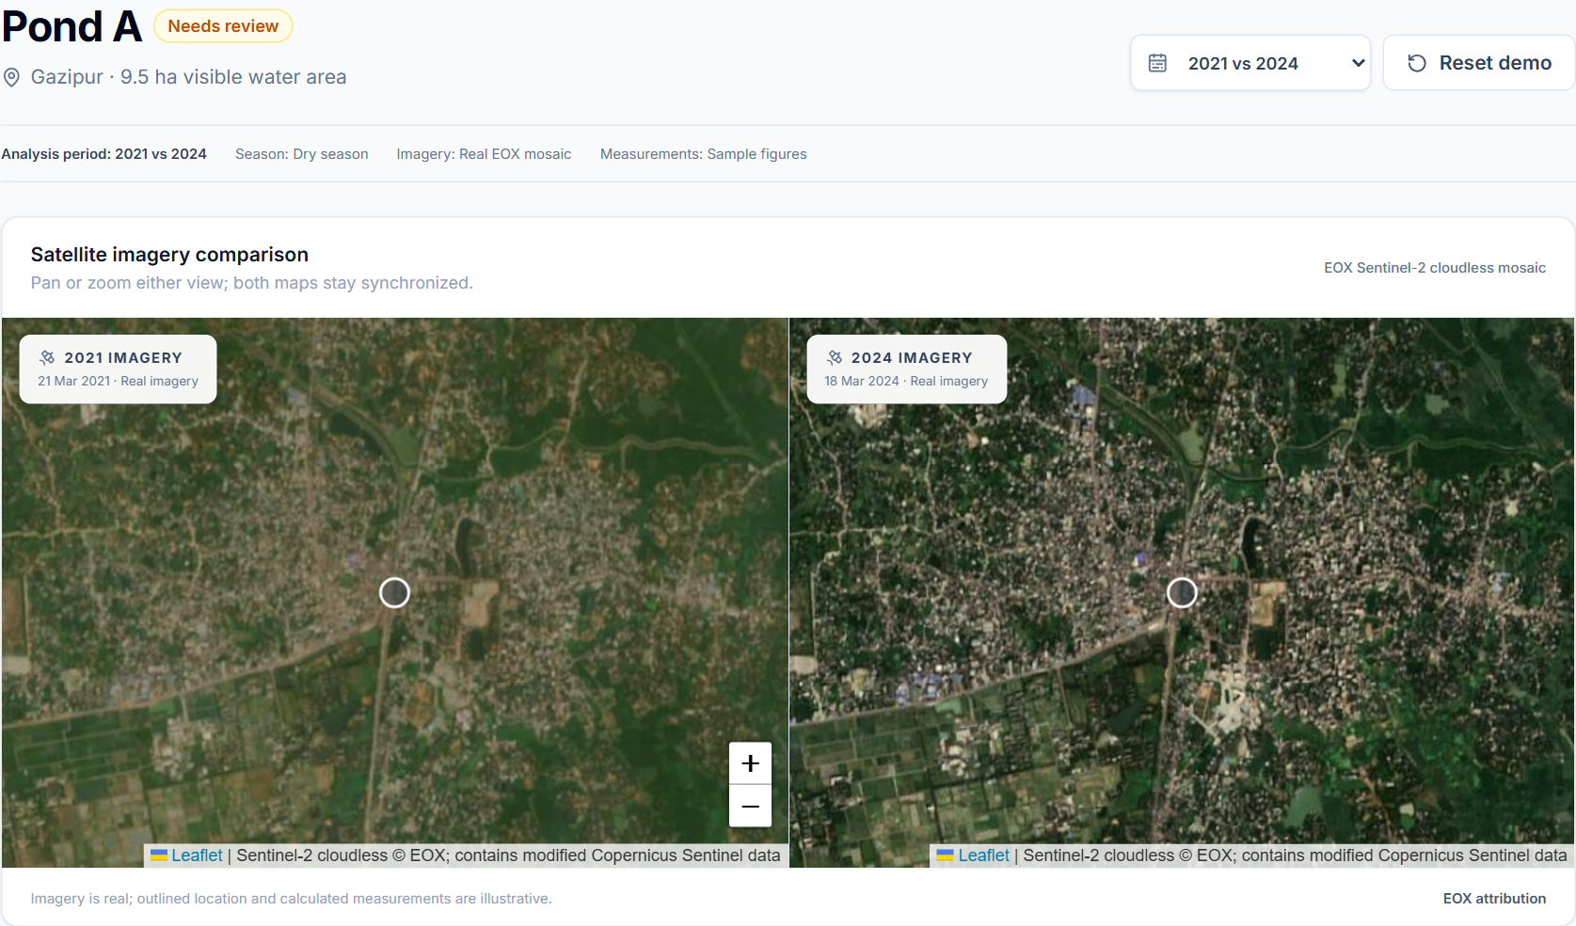
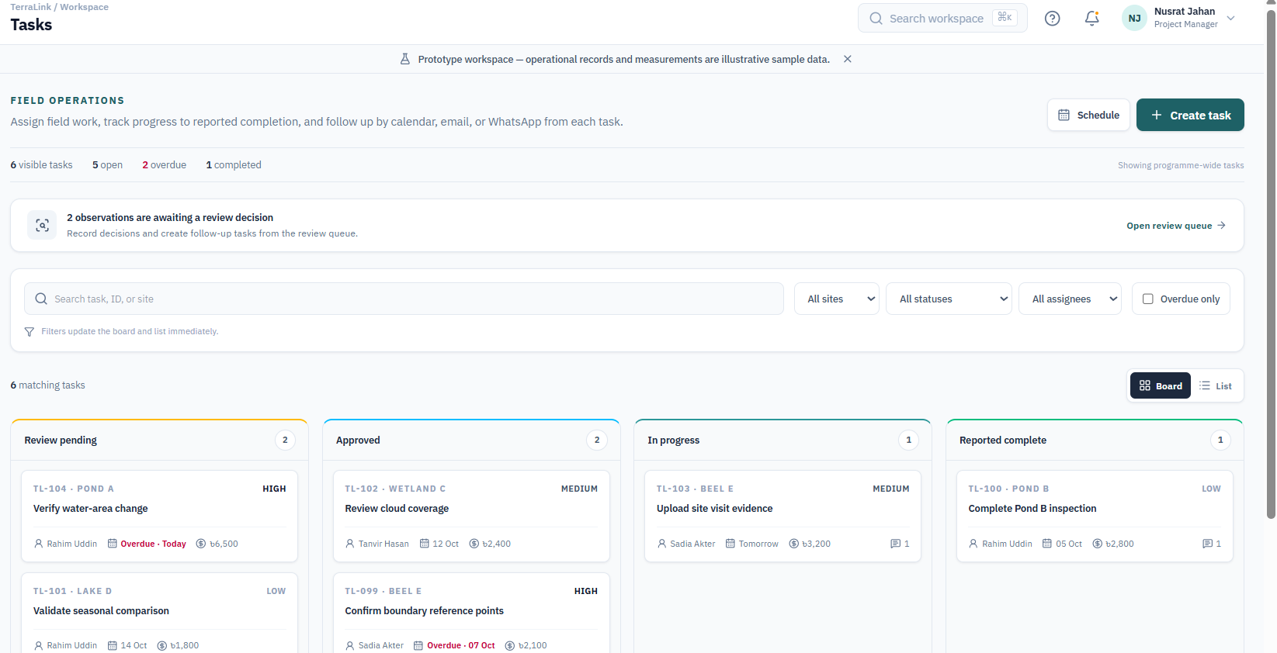
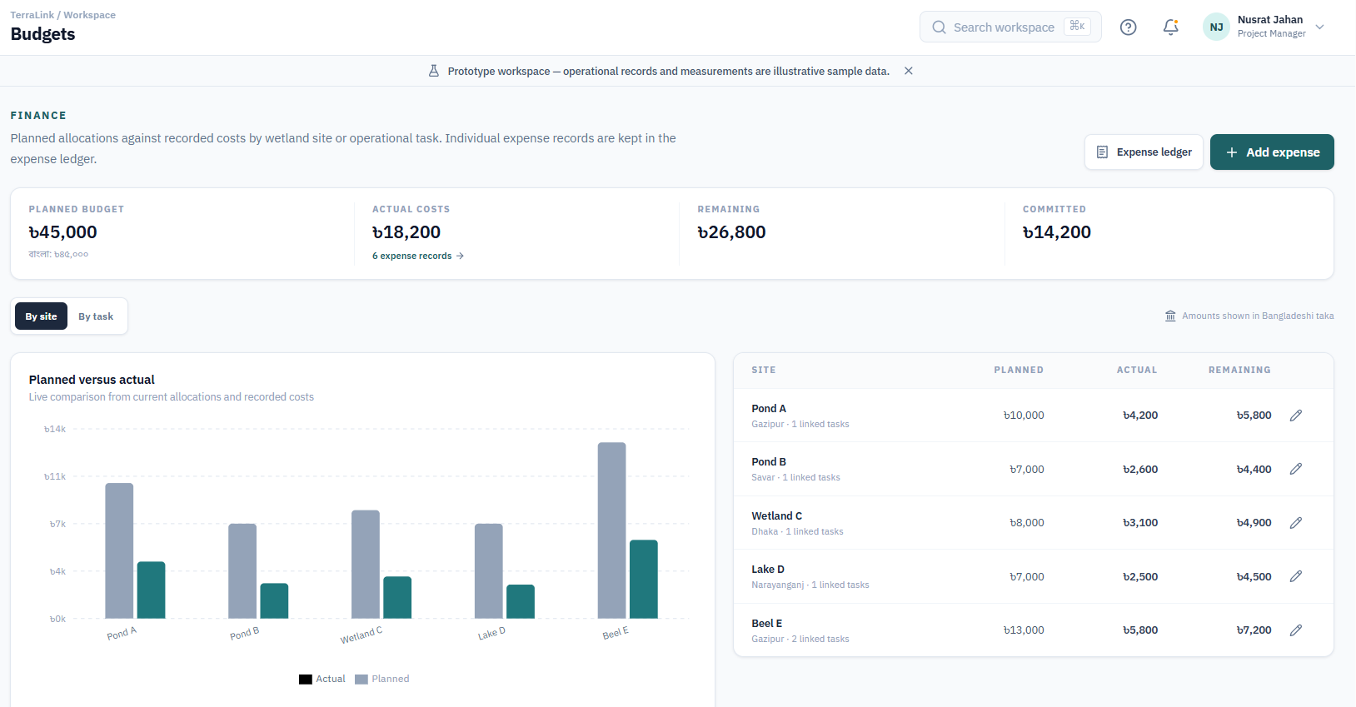
Key Features: Monitoring & Operations
The core tools a team uses every week to watch sites, act on findings and control costs.
Map & Change Analysis
Review & Tasks
Team & Costs
See every site on one map and compare old and new satellite images side by side.
Turn a reviewed finding into accountable field work.
Keep team records and compare planned spending with actual expenses.
Filter sites by review status
Estimated change in visible water area
Shows "Insufficient data" when clouds block the view
Record each decision with a written reason
Assign an owner, deadline and estimated cost
Track status from review to completion
Every expense linked to a task and a site
Remaining budget calculated automatically
Clear warning when a site goes over budget
Notes:
The core features. Map and Change Analysis shows every site and compares old and new satellite images, with an estimated change in visible water and an Insufficient data label when clouds block the view. Review and Tasks turns a reviewed finding into accountable work with an owner, deadline and cost. Team and Costs links every expense to a task and site and warns when a site goes over budget.

Slide 6
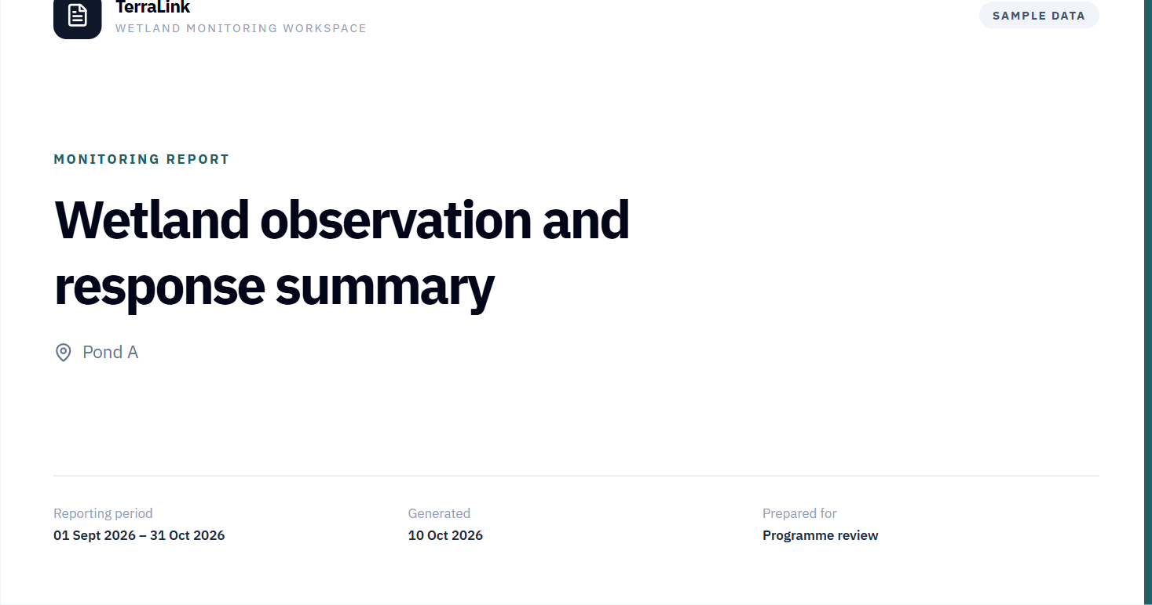
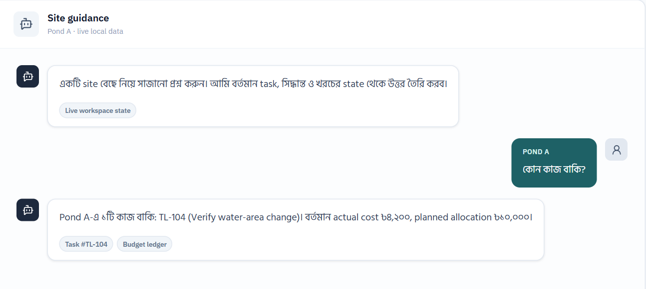
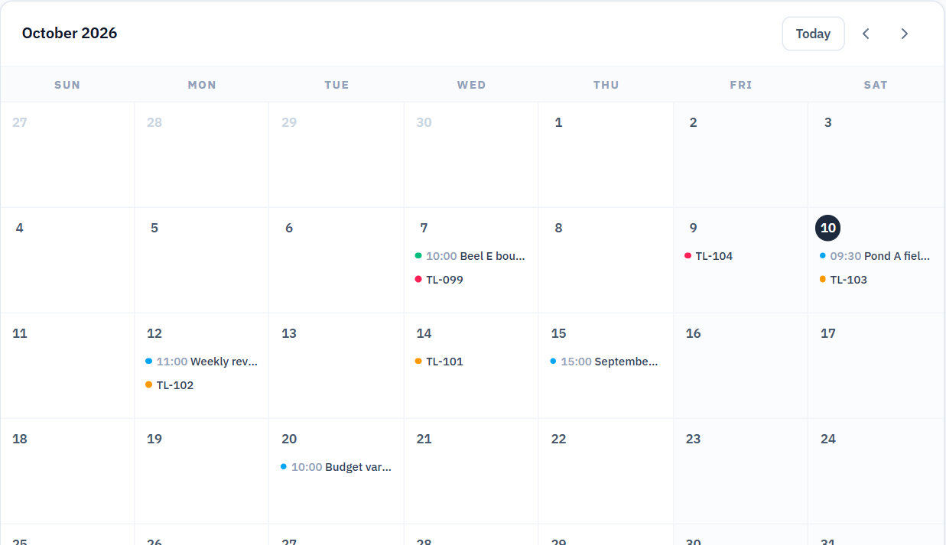
Key Features: Reporting & Coordination
Tools that explain the work, share it with others and keep everyone on schedule.
Reports
Bangla Assistant
Schedule & Notifications
Create a printable report from current records in one click.
Ask questions in Bangla and get answers from saved project records.
Plan field visits and meetings alongside task deadlines.
Images, decisions, tasks and costs
Limitations and data sources included
Print or save as PDF
Questions such as which work is pending
Every answer shows its source records
Says clearly when data is missing
Add events to Google Calendar
Email and WhatsApp reminders
Audit trail of every action
Notes:
Supporting features. Reports are generated in one click with images, decisions, tasks, costs, limitations and sources, and can be printed or saved as PDF. The Bangla assistant answers questions such as which work is pending, using only saved records, and shows its sources. Schedule and notifications let the team plan field visits and meetings, add them to Google Calendar, send reminders, and keep an audit trail of every action.

Slide 7
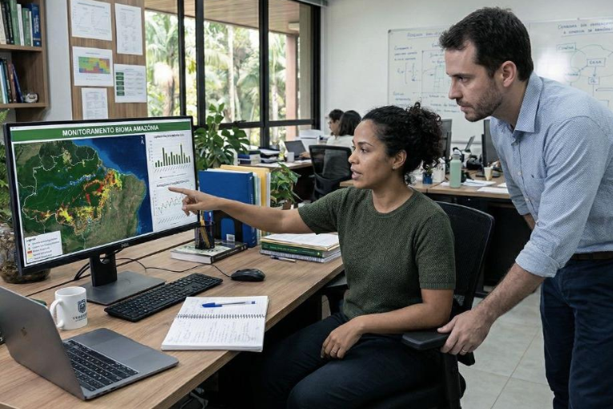
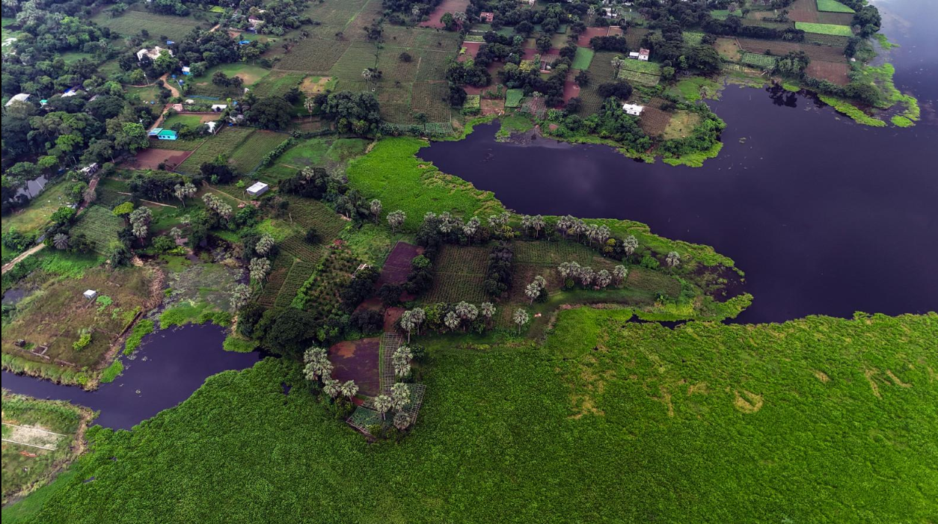
Target Users & Expected Impact
Built for small NGO teams that protect wetlands. Local communities are the ones who benefit.
Who will benefit?
Environmental NGOs and teams responsible for protecting ponds and wetlands in Bangladesh.
How will TerraLink help?
Give managers a clearer view of findings and pending work
Reduce the effort needed to combine project information
Make responsibilities, deadlines and expenses easier to track
Support decisions with documented evidence
Local communities are the intended beneficiaries of better-managed wetland protection. Actual impact will be evaluated through user feedback and project results.
Notes:
The main users are environmental NGOs and teams that protect ponds and wetlands in Bangladesh. TerraLink gives managers a clearer view of findings and pending work, reduces the effort of combining project information, makes responsibilities, deadlines and expenses easier to track, and supports decisions with documented evidence. Local communities are the intended beneficiaries; the actual impact will be evaluated through user feedback and project results.

Slide 8
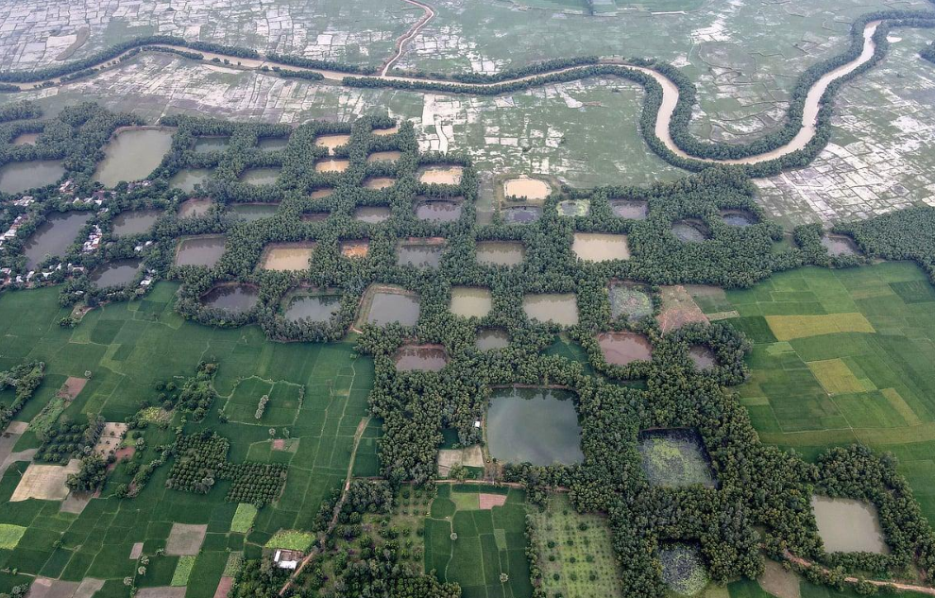
Feasibility & Vision
A focused first step, built on existing data and free tools.
A focused first step
The first prototype covers five selected ponds or wetlands around Dhaka, chosen by site size and the availability of clear satellite imagery.
Why start small?
Focus on a manageable number of locations
Use existing satellite data instead of training a new AI model
Show the complete workflow from observation to report
Use sample records where real project data is not available
Our vision A practical tool that helps environmental teams turn satellite observations into organised, accountable wetland protection work.
Notes:
The first prototype covers five selected ponds or wetlands around Dhaka, chosen by size and the availability of clear satellite imagery. We start small to focus on a manageable number of sites, use existing satellite data instead of training a new AI model, show the complete workflow from observation to report, and use clearly labelled sample records where real data is not available. Our vision is a practical tool that turns satellite observations into organised, accountable wetland protection work.

Slide 9
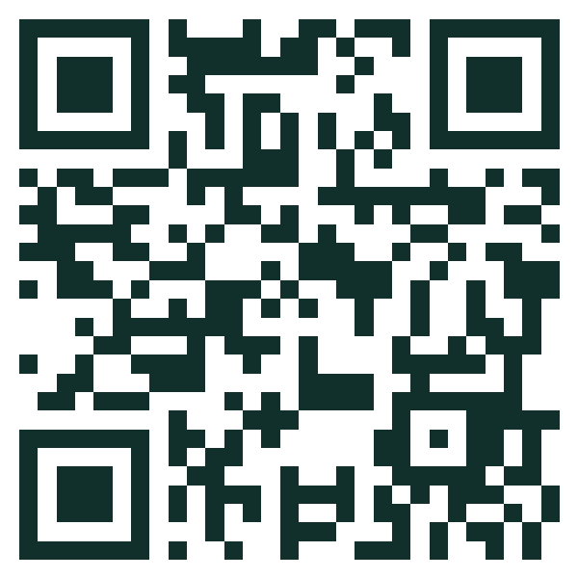
Thank You
Demo path · about 5 minutes
01
Dashboard see sites that need attention
Questions are welcome.
02
Map open Pond A
TerraLink helps NGOs protect wetlands with clear evidence, clear responsibility and clear records.
03
Change analysis compare images, record a decision
04
Create a task assign the field coordinator
05
Switch role update progress, add a cost
Live demo
terralink-probah.vercel.app
Afrin Jahan Era · IUT
06
Bangla assistant ask “কোন কাজ বাকি?”
07
Report print or save as PDF
Notes:
Thank you. In the live demo we follow one full journey: dashboard, map, change analysis and decision, create a task, switch to the field coordinator to update progress and add a cost, ask the Bangla assistant what is pending, and print the report. Questions are welcome.

