Slide 1
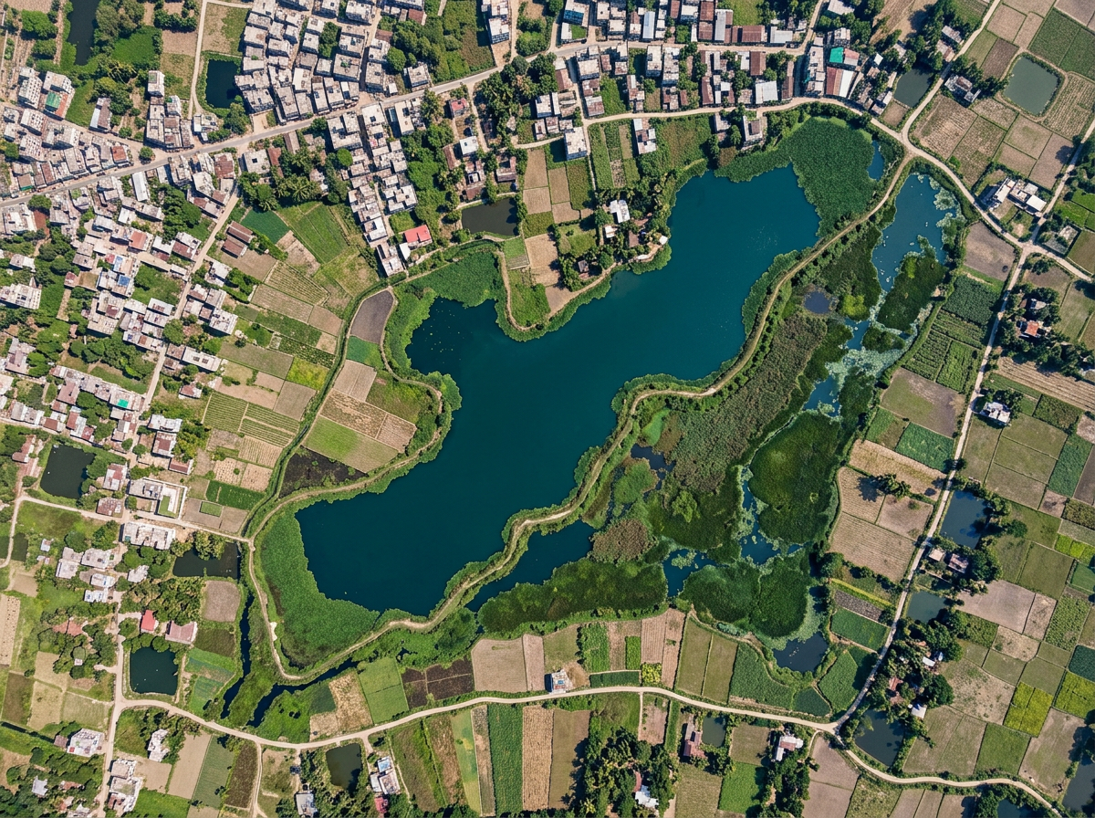
CLIMATE RESILIENCE & ENVIRONMENTAL SUSTAINABILITY
TerraLink
Smarter Wetland Monitoring & Project Management
From a satellite signal to a recorded field response, all in one place.
Afrin Jahan Era
Islamic University of Technology (IUT)
terralink-probah.vercel.app
Notes:
TerraLink is a web app for NGOs that protect ponds and wetlands in Bangladesh. It helps teams spot possible changes, check them on the ground, assign work, track costs, and make clear reports.

Slide 2
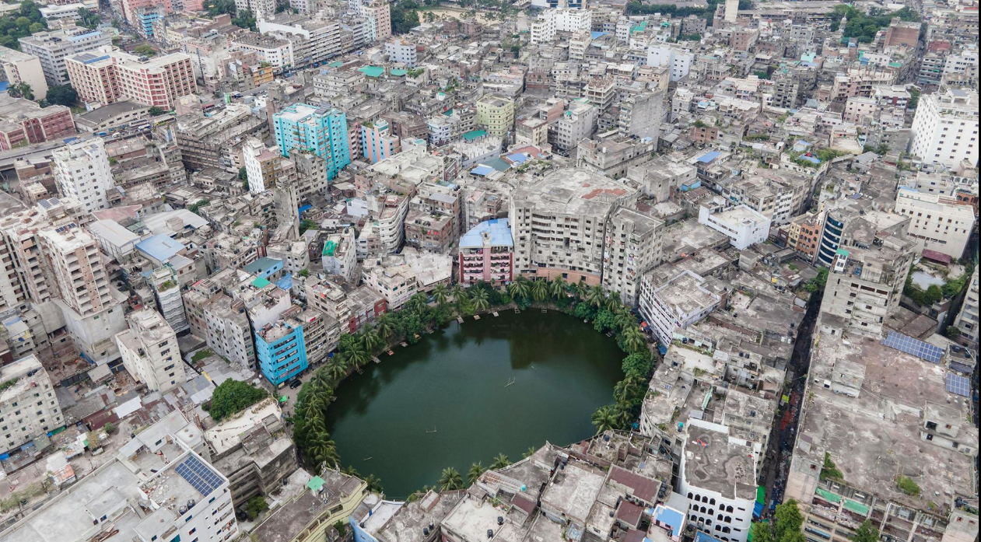
The Problem
Wetland protection requires more than identifying environmental changes.
Ponds, beels and wetlands store rainwater, reduce urban flooding and support fisheries and livelihoods. Around Dhaka, many canals and water bodies have disappeared or become blocked as the city grows.
Environmental project managers and field coordinators face three key challenges:
Difficult monitoring: Comparing satellite images takes time and skill. Clouds or seasonal drying can make a pond look smaller than it is.
Scattered records: Findings, photos, tasks and costs sit in separate files, phones and chat groups.
Limited follow-up: It is unclear who should check a site, by when, and at what cost, so reports take long to prepare.
Urban growth puts steady pressure on ponds and wetlands in and around Dhaka.
The gap A simple workflow that connects environmental observations to the checks, work and costs that follow.
Notes:
Ponds, beels and wetlands store rainwater, reduce urban flooding and support fisheries and livelihoods. Around Dhaka many canals and water bodies have disappeared or become blocked. NGO teams face three challenges: monitoring is difficult because comparing satellite images takes skill and clouds or seasonal drying can mislead; records are scattered across files, phones and chat groups; and follow-up is limited because it is unclear who checks a site, by when and at what cost. The gap is a simple workflow that connects observations to the work and costs that follow.

Slide 3
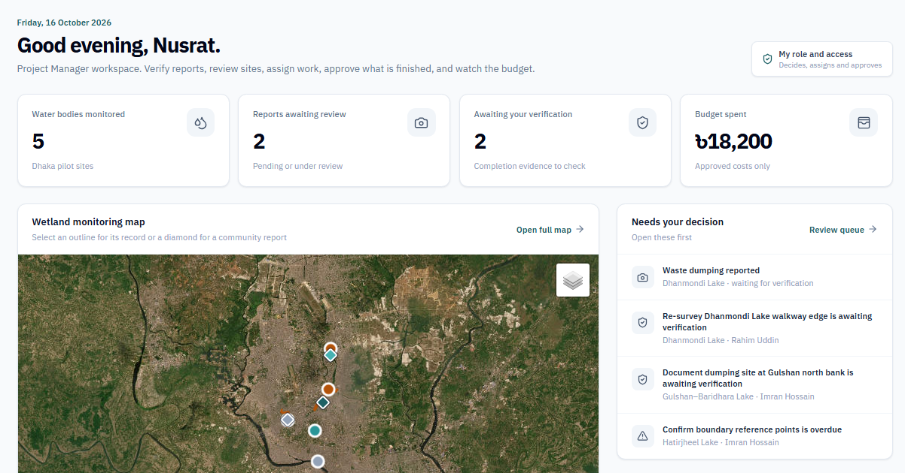
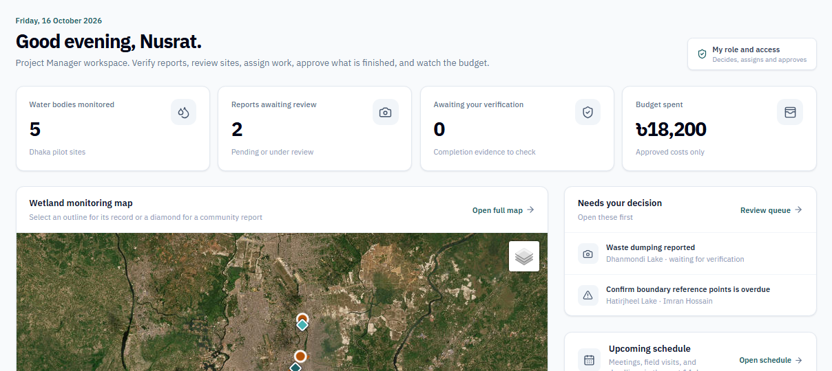
Our Solution
One platform to monitor, review and manage wetland protection projects.
TerraLink keeps one shared record for each site, linking satellite evidence, decisions, tasks and costs.
Compare satellite images to spot possible changes in visible water area
Review satellite findings and resident photo reports before deciding
Assign tasks, deadlines and responsibilities to field coordinators
Track planned and actual project costs
Share reports as a PDF by email, with deadlines on the calendar
Built to be trusted
Uses free Sentinel-2 imagery and measures the water area in the browser (NDWI). When clouds hide a site, it shows "Insufficient data" instead of guessing, and a drop in water is treated as a reason to check, not as proof.
Live prototype: the manager dashboard
Who uses it
Project Manager reviews findings, approves work, controls budget
Our approach Turn a possible environmental change into a documented, trackable action.
Field Coordinator updates assigned tasks and records costs
User explores water bodies and reports problems with photos
Notes:
TerraLink keeps one shared record for each site, linking satellite evidence, decisions, tasks and costs. Teams compare images, review findings and resident photo reports, assign tasks, track costs and share reports. Residents can also upload photos to report a problem. It is built to be trusted: it uses free Sentinel-2 imagery, measures water area in the browser, shows Insufficient data when clouds hide a site, and treats a drop in water as a reason to check, not proof. The screenshot is the project manager’s dashboard. Who uses it: the Project Manager reviews findings, approves work and controls the budget; the Field Coordinator updates assigned tasks and records costs; a User explores the water bodies and reports problems with photos.

Slide 4
How It Works
From a resident’s report or a satellite signal to a closed task and a shared report.
1 REPORT
2 REVIEW
3 DECIDE
4 ASSIGN
5 WORK
6 VERIFY
7 CLOSE & SHARE
Community member
Report a problem
photos + map pin
Not taken forward
reason recorded
Sees the result
report shows Resolved
Project manager
No
Review evidence
report or satellite
Confirmed?
verified or measured
Yes
Create task
coordinator + deadline
No
Approve work?
and expenses
Yes
Task completed
outcome recorded
Field coordinator
Do the work
start, record costs
Submit for review
photos + summary
TerraLink (automatic)
Satellite comparison
Sentinel-2, NDWI
Schedule + email
calendar, assignee
Email manager
ready for review
Report + email
PDF, download or send
Main step
Decision
Automatic (TerraLink)
Side path or return
Notes:
The exact flow, in four lanes. A resident reports a problem with photos and a map pin; or the satellite comparison measures the water area from two Sentinel-2 images. Both go to the project manager, who reviews the evidence and decides: a report is verified or rejected with a reason, and a site is Confirmed for follow-up, Inconclusive, or No change; if clouds block the view the site shows Insufficient data. If confirmed, the manager creates a task for a field coordinator with a deadline and cost. TerraLink puts the task on the schedule, can add it to Google Calendar, and emails the assignee. The coordinator starts the work, records costs, and submits completion photos with a summary. TerraLink emails the manager. The manager approves the work and the expenses, or returns it for more work, which sends it back to the coordinator. When the task is completed with an outcome, the resident sees the result on their report, and the report can be downloaded as a PDF or sent by email.

Slide 5
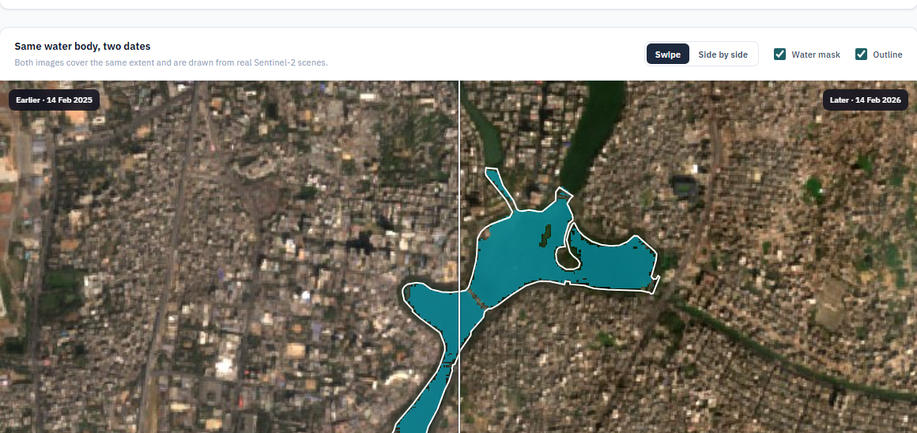
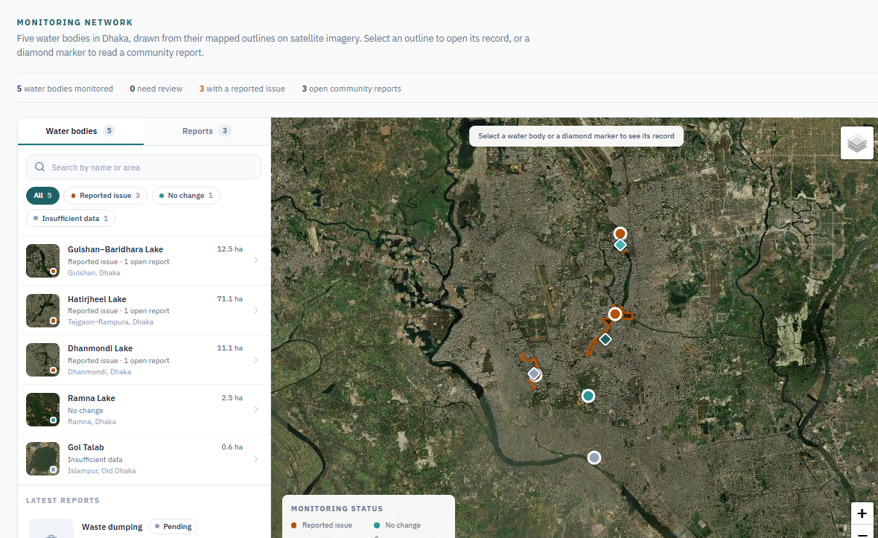
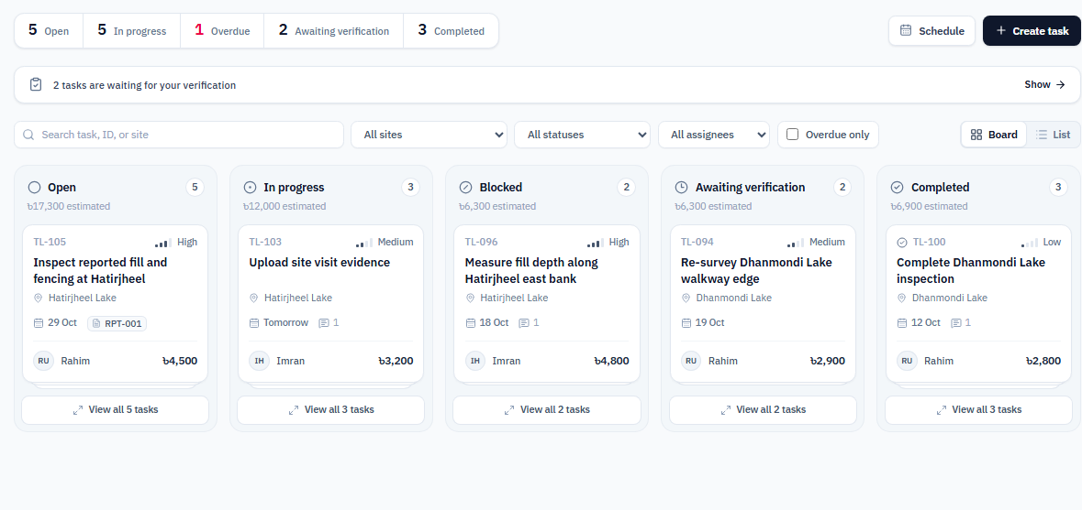
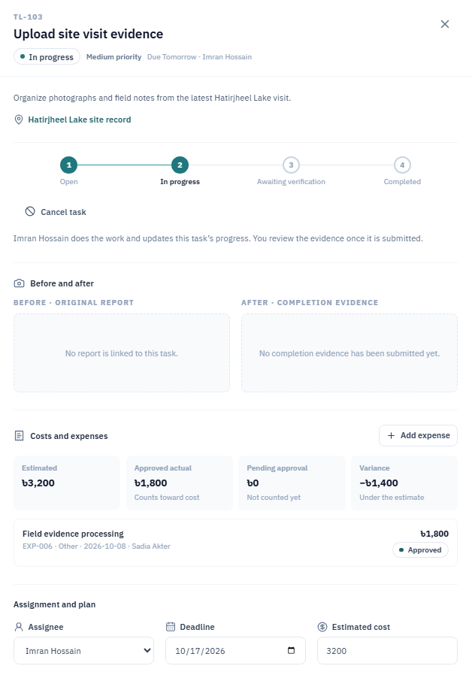
Key Features: Map, Review & Tasks
See the change on real imagery, then turn it into accountable work.
FEATURE 1
Map & Change Analysis
See every site on one map and measure the change between two real images.
Real Sentinel-2 scenes, a water mask and the uncertainty stated
Insufficient data when clouds block the view
A drop in water is a signal to check, not proof
FEATURE 2
Review & Tasks
Turn a verified finding into accountable field work.
Verify resident photo reports and satellite findings
Assign a field coordinator, deadline and estimated cost
The coordinator works and submits photos; the manager approves
Notes:
The first two of the six features. Feature 1, Map and Change Analysis, shows the five Dhaka water bodies on a map with their real mapped outlines. The manager picks two dates and TerraLink finds the clearest Sentinel-2 scene near each, draws both, and measures the water area with a water mask (NDWI), stating the uncertainty. When clouds block the view, or a water body is under one hectare, it shows Insufficient data instead of a guess. Feature 2, Review and Tasks, turns a verified finding, from the satellite or from a resident’s photo report, into field work: the manager records a decision with a reason, assigns a field coordinator with a deadline and cost, the coordinator works and submits photos, and the manager approves or returns the work. The small images laid over the corners show the wetland map and a task’s stages.

Slide 6
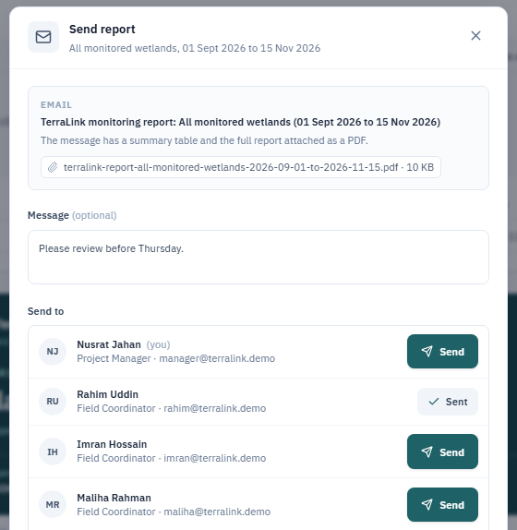
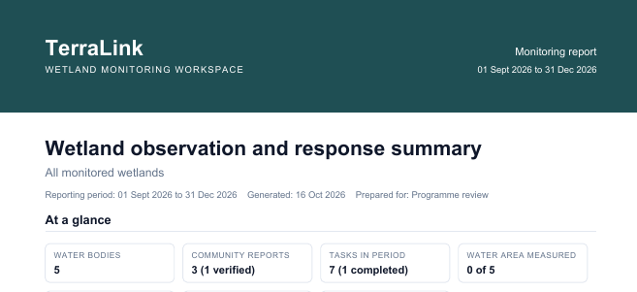
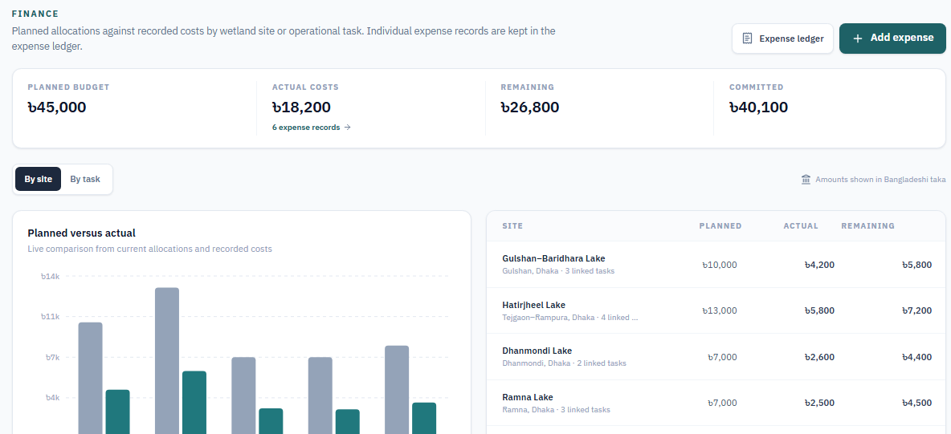
Key Features: Reports, Calendar & Costs
Reports and events reach the right people without leaving the page where the work happens.
FEATURE 3
FEATURE 4
FEATURE 5
Reports
Schedule & Notifications
Team & Costs
Download a PDF, or Send: each person gets a subject, a summary table and the PDF attached.
Tasks and events go on the schedule and Google Calendar, with email invitations and alerts.
Planned against actual cost per site; an expense counts once approved, with a budget warning.
Images, decisions and costs
Sources and limits included
PDF download or email
Events on Google Calendar
Email invitations, alerts
Visits next to deadlines
Planned vs actual per site
Approved expenses only
Over-budget email warning
One Send button per person. A tick shows who already has the report.
The PDF the person downloads
Budgets: planned against actual cost
Notes:
Features 3, 4 and 5. Reports: Download PDF saves the report; Send opens a list of the team plus any extra email address, and each person has their own Send button; the email arrives with a subject, a short message, a summary table and the PDF attached. Schedule and Notifications: tasks and events go on the TerraLink schedule, can be added to Google Calendar, and come with email invitations and alerts. Team and Costs: the budget page compares planned and actual cost for each water body, an expense counts only after the manager approves it, and the manager is emailed when a site goes over budget. The images show the Send dialog, the PDF a person downloads, and the Budgets page. Email uses EmailJS and the calendar uses the Google Calendar API.

Slide 7
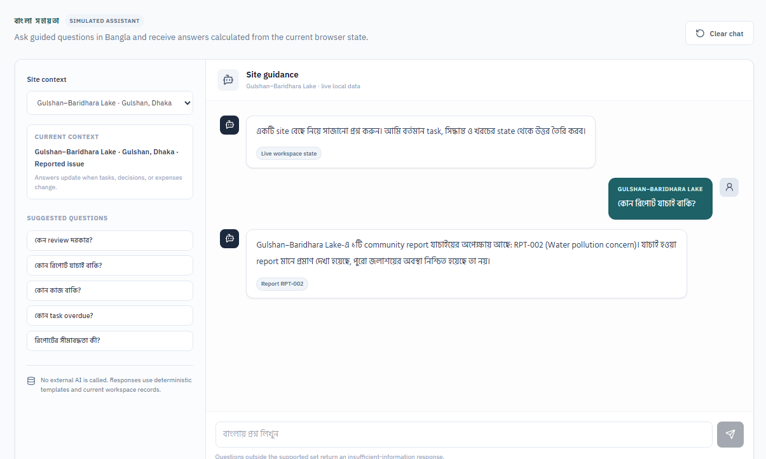
Key Features: Bangla AI Assistant
Ask in Bangla and get answers from the organisation’s own data, so no one has to dig through the database.
FEATURE 6
A team member asks in Bangla
Site and satellite records
Community reports
Bangla AI assistant
trained on company data
Answer in Bangla
with its source record
Tasks and costs
Field notes and photos
Today: guided answers
Next step: train it on our data
Answers a set list of questions from live project records
Shows the source record for each answer
Says clearly when data is missing
Train it on the organisation’s own data: past reports, site records, costs and field notes
Anyone can ask in Bangla, without asking colleagues or searching the database
Answers stay within what each role may see
Live prototype: a guided assistant that answers from the current records and names its source.
The goal: less time spent searching for information, and fewer people needed to find it.
Notes:
The Bangla assistant is meant to replace the usual question to a colleague: where is that information? Today it is a guided assistant: it answers a set list of questions in Bangla from the live project records and always names the source record, and it says clearly when data is missing. It does not call an external AI model yet. The next step is to train it on the organisation’s own data, such as past reports, site records, costs and field notes, so any team member can ask a question in Bangla and get an answer without asking colleagues or searching the database. Answers will stay within what each role is allowed to see, and will keep showing their sources. The goal is less time spent searching for information, and fewer people needed to find it.

Slide 8
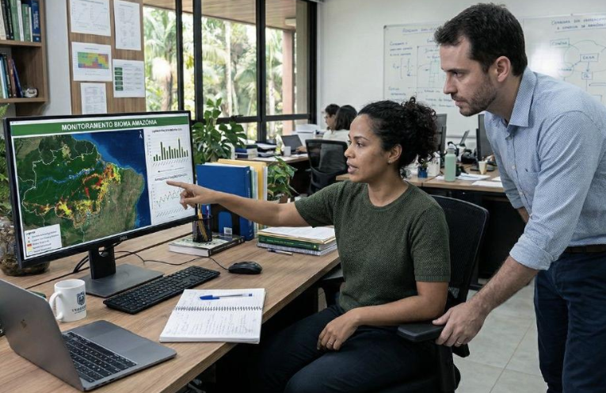
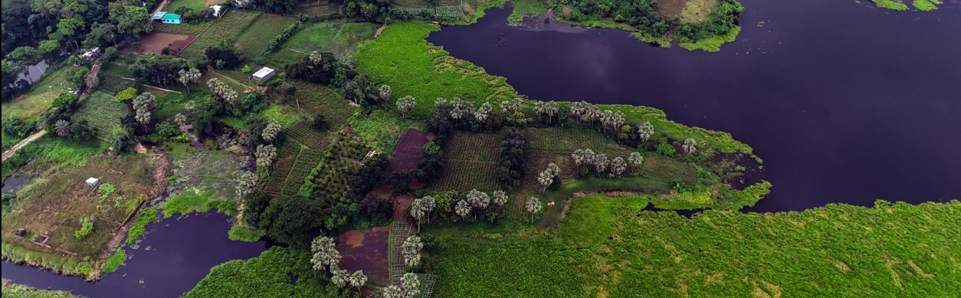
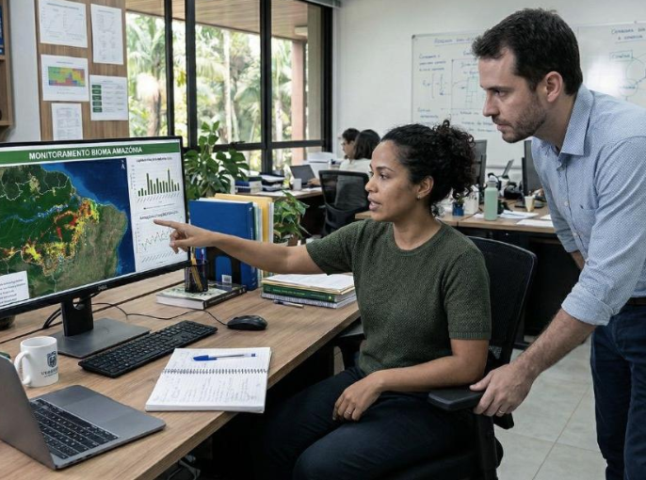
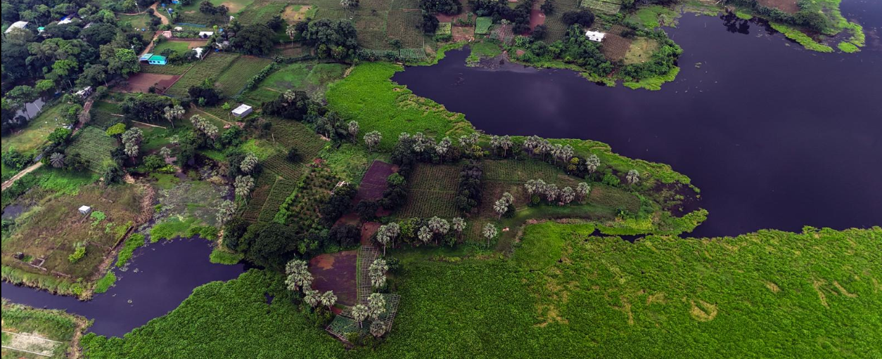
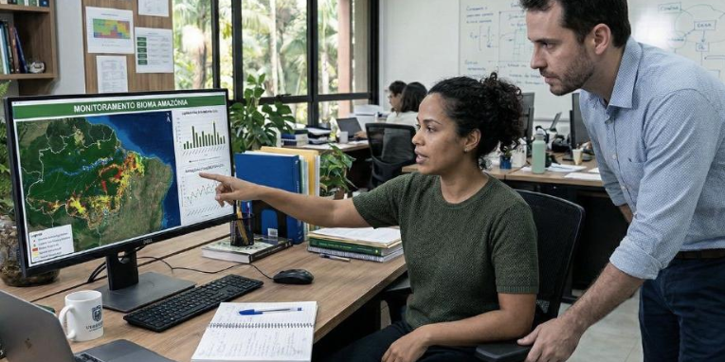
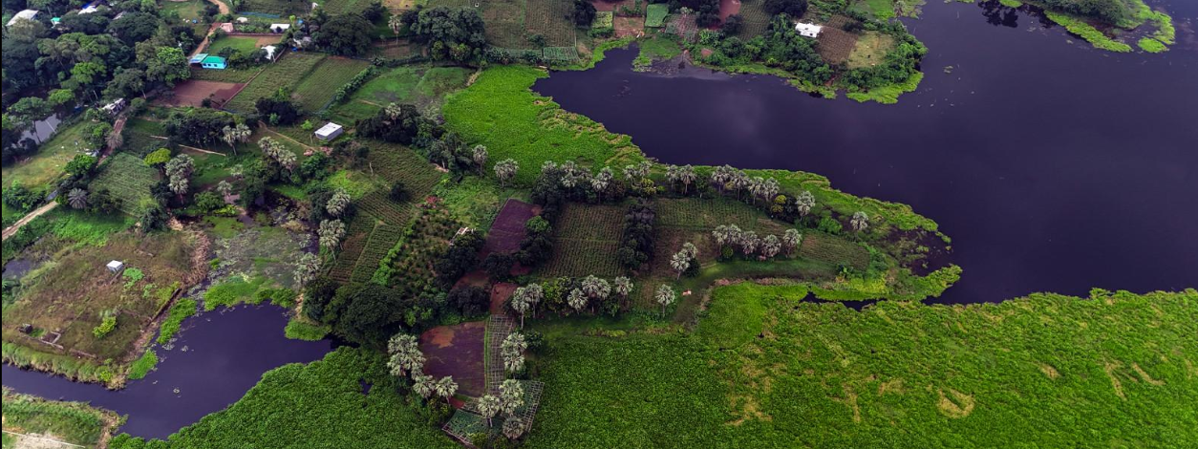
Expected Impact & Vision
Built for small NGO teams that protect wetlands. Local communities are the ones who benefit.
EXPECTED IMPACT
How will TerraLink help?
One shared record connects residents’ reports, satellite evidence, field work and expenses.
Managers see findings and pending work in one place.
Report and upload problems with a photo, and follow the result.
Responsibilities, deadlines and expenses are easy to track.
Reports go out by email as a PDF.
Actual impact will be evaluated through user feedback and project results.
A focused first step
Our vision
Five selected Dhaka ponds and wetlands, built on existing satellite data and free tools, with sample records where real data is not available.
A practical tool that turns satellite observations into organised, accountable wetland protection work.
Notes:
How TerraLink helps: managers get a clearer view of findings and pending work; residents can report and upload problems with a photo and follow the result; responsibilities, deadlines and expenses are easier to track; and reports are shared by email as a PDF. Actual impact will be evaluated through user feedback and project results. The first prototype is a focused first step: five selected Dhaka ponds and wetlands, built on existing satellite data and free tools, with clearly labelled sample records where real project data is not available. Our vision is a practical tool that turns satellite observations into organised, accountable wetland protection work.

Slide 9

Thank You
Questions are welcome.
TerraLink helps NGOs protect wetlands with clear evidence, clear responsibility and clear records.
Live demo
terralink-probah.vercel.app
Afrin Jahan Era · IUT
Notes:
Thank you. Questions are welcome. The live demo is at terralink-probah.vercel.app, or scan the QR code.

