Slide 1

Dynamic Rocking Cradle
Presented by,
Afrina Akter Mim(19202103310),
Md. Sakib Mia (19202103401), Tanvir Ahmed (19202103402), Afsana Azad Sarna (19202103414), Md. Shahin Alam (19202103340),
Rizvia Razzak Abani(19202103528)
Presented To,
Md. Reazul Islam, Lecturer,
Dept. of CSE
Bangladesh University of Business and Technology (BUBT)

Slide 2
Table of contents
01
02
03
04
05
Introduction
Objectives
Motivation
Features
06
07
08
Requirements
Implementation
Limitation
Future Work
09
Conclusion

Slide 3
Introduction
A dynamic rocking cradle is a type of baby cradle that uses a motion mechanism to produce a gentle back-and-forth motion.
It is used to soothe and comfort a baby because it can be handled dynamically.
It can also be used to detect baby’s pee.

Slide 4
Objectives
DRC is designed to provide soothing rocking motion that can help calm and relax a baby.
The rhythmic motion of a rocking cradle can also helpfull a baby to sleep.
DRC can also be a convenient choice for parents who want to keep their baby close by while they attend to other tasks.
It Provides a safe space for napping.
It provides a safe and secure sleeping environment.

Slide 5
Motivation
Meeting a need in the market since there is high demand of baby products in the market.
The development of a DRC can also be driven by a desire to innovative and creative products.
Improving safety and reducing the risk of Sudden Infant Death Syndrome (SIDS).
It is convenience and easy to use.
A DRC can be a valuable tool for working parents.

Slide 6
Features
WiFi and app connection check through LED.
Wet detection notification on phone and LED.
Swing angle, number and power control

Slide 7
Requirements
Hardware Requirements
Software Requirements
Servo Motors
Rain Sensor
Jumper wires
BreadBoard
LED
NodeMCU
Arduino Sketch
Blynk App

Slide 8
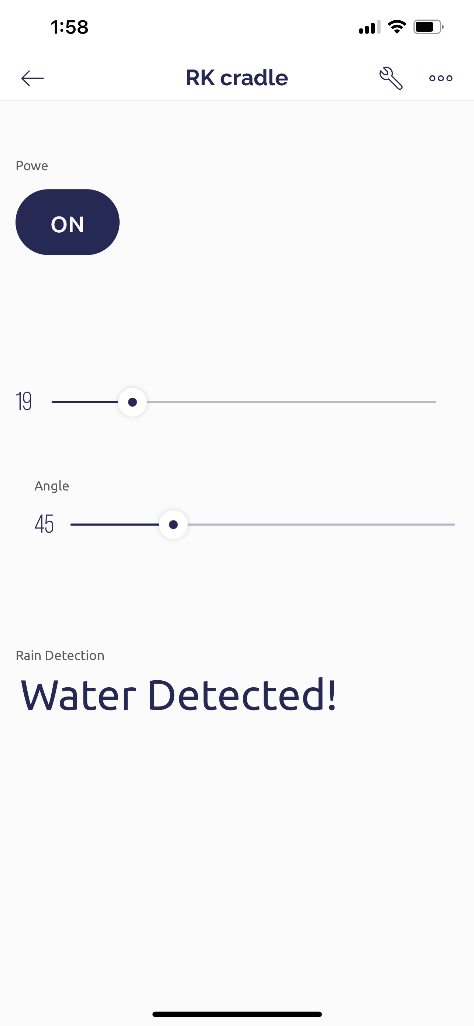

Implementation
Here we will discuss about the designs and works of our system

Slide 9
Limitation
Need huge investment to make this product level.
It is difficult to use since it has difficult mechanism.
It can have safety issues if machines do not work properly.
Baby can get electric shock if any leakage occurred on the wires.

Slide 10
Future Work
Future dynamic rocking cradle could be personalized to individual babies, taking into account factors such as age, weight, and sleep patterns to provide more accurate and effective monitoring and alerts.

Slide 11
Conclusion
The present work reduces the human effort and particularly mother’s stresses in working times.
The overall mechanism is mobile which allows easy movement from room to room.
The project affords plenty of scope for modifications for further improvements and operational efficiency which should make it commercially available and attractive.

Slide 12
Thank YOU

