Slide 1
Hypothesis Testing Exercise
A F&B manager wants to determine whether there is any significant difference in the diameter of the cutlet between two units. A randomly selected sample of cutlets was collected from both units and measured? Analyze the data and draw inferences at 5% significance level. Please state the assumptions and tests that you carried out to check validity of the assumptions.
Solution:
Assume Null hypothesis as Ho: μ1 = μ2 -There is no difference in diameters of cutlets between two units
Alternate hypothesis as H1: μ1 ≠ μ2 (There is significant difference in diameters of cutlets between two units)
2 Sample 2 Tail test applicable: Because Two samples in dataset UnitA & UnitB
Ttest_indResult(statistic=0.7228688704678063, pvalue=0.4722394724599501)
P value 0.47> (α = 0.05), so accept Null Hypothesis, reject Alternate hypothesis.
There is no difference in diameters of cutlets between two units
Minitab File : Cutlets.mtw

Slide 2
Hypothesis Testing Exercise
A hospital wants to determine whether there is any difference in the average Turn Around Time (TAT) of reports of the laboratories on their preferred list. They collected a random sample and recorded TAT for reports of 4 laboratories. TAT is defined as sample collected to report dispatch.
Analyze the data and determine whether there is any difference in average TAT among the different laboratories at 5% significance level.
Solution: This Anova FTest – Morethan two samples in dataset
H0=All samples TAT population means are same
H1=At least one sample TAT population mean is different
stats.f_oneway(TAT.iloc[:,0],TAT.iloc[:,1],TAT.iloc[:,0])
F_onewayResult(statistic=118.70421654401437, pvalue=2.1156708949992414e-57)
p-value> (α = 0.05 ) so choose null hypothesis & reject alternate hypothesis
Minitab File: LabTAT.mtw

Slide 3
Hypothesis Testing Exercise
Sales of products in four different regions is tabulated for males and females. Find if male-female buyer rations are similar across regions.
Solution:
 | East | West | North | South
Males | 50 | 142 | 131 | 70
Females | 550 | 351 | 480 | 350
Check p-value
If p-Value < alpha, we reject Null Hypothesis
H0
All proportions are equal
Ha
Not all Proportions are equal
Buyer Ratio.mtw

Slide 4
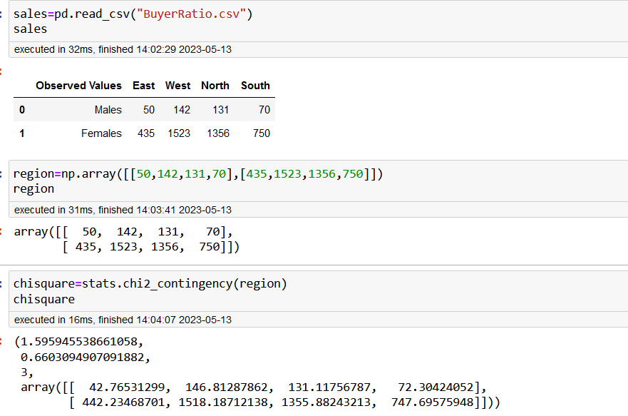
Solution:
H0= male-female buyer rations are similar across regions
H1= male-female buyer rations are different across regions
Here used chi-square method to calculate the p value since more than rgions proportions are given n data set
P-value 0.66 > (α = 0.05) so Accept null hypothesis and reject Alternate hypothesis.
male-female buyer rations are similar across regions

Slide 5
Hypothesis Testing Exercise
TeleCall uses 4 centers around the globe to process customer order forms. They audit a certain % of the customer order forms. Any error in order form renders it defective and has to be reworked before processing. The manager wants to check whether the defective % varies by centre. Please analyze the data at 5% significance level and help the manager draw appropriate inferences.
Solution:
H0: customer order forms defective % does not varies by centre
H1: customer order forms defective % varies by centre
array([[271, 267, 269, 280],
[ 29, 33, 31, 20]])
stats.chi2_contingency(array) - (3.858960685820355,
0.2771020991233135,3,
array([[271.75, 271.75, 271.75, 271.75],
[ 28.25, 28.25, 28.25, 28.25]]))
P value 0.2771> (α = 0.05), Accept null hypothesis and reject Alternate hypothesis.
customer order forms defective % does not varies by centre
Minitab File: CustomerOrderForm.mtw

