Slide 1
SOLEMATES
Developed Using Android Studio
2023-2024
AFRIN FARHAANA.R
III BCA COMPUTER APPLICATION
BATCH-’B’

Slide 2
PROJECT ABSTRACT
Solemates app is a social platform designed for shoe enthusiasts to connect, share, and explore their passion for footwear. Built using Android Studio, the app offers a user-friendly interface with features such as user profiles, a shoe collection showcase, discussion forums, and a marketplace for buying and selling shoes. It is created using android studio and uses firebase as its backend. In a busy world, Solemates allows you to purchase the shoes easily from their home. The app offers intuitive search and navigation functionalities, enabling users to quickly find specific shoes. The shoes are categorized in different types which allows the users to browse through a variety of shoes in the same type, providing users an organized form through which they can browse and but their favourite shoes, whether users seek adidas, nike, or puma, they can find an extensive selection to suit their tastes and interests. Solemates provides a vibrant community to engage with like-minded individuals and discover the latest trends in footwear. The main purpose of Solemates is to allow users to buy the shoes directly for the authorized such that shops there is little to no chance of getting rare shoes. The products are sold at an affordable price as this approach eliminates multiple middlemen. The shoes and the rightful owners also get many leads to sell their products. As we move forward, Solemates ensures user experience, making it the perfect digital companion for sneakerheads, collectors, and anyone with a love for shoes.

Slide 3
PROJECT INTRODUCTION
Android is a new, next-gen mobile operating system that runs on the Linux Kernel. Android Mobile Application Development is based on Java language codes, as it allows developers to write codes in the Java language. It is an important platform to develop mobile applications using the software stack provided in the Google Android SDK. Android mobile OS provides a flexible environment for Android Mobile Application Development as the developers can not only make use of Android Java Libraries but it is also possible to use normal Java IDEs. As of 2024, nearly 3.9 billion people are Android Smartphone users. Using Android studio and its rich libraries, Solemates is created. Solemates is a shoe shopping app which provides great user experience by having a broad collection of shoes which are categorized based on typical types .Android Studio-Utilized for app development, UI design using XML , and implementing Java code for functionalities. Java-Primary programming language for app logic, user interactions, data processing, and integrating with FireBase services. Integrated FireBase services such as Firestore Database, authentication.

Slide 4
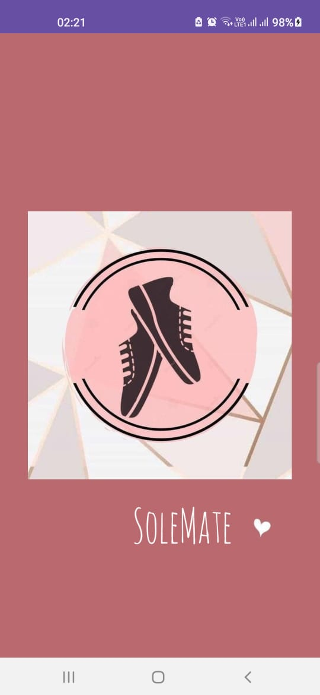
1. SPLASH SCREEN
PLATFORM USED-ANDRIOD STUDIO
-utilizing Java as the primary programming language to make to screen stay for 2000ms
-XML- for designing the user interface.

Slide 5
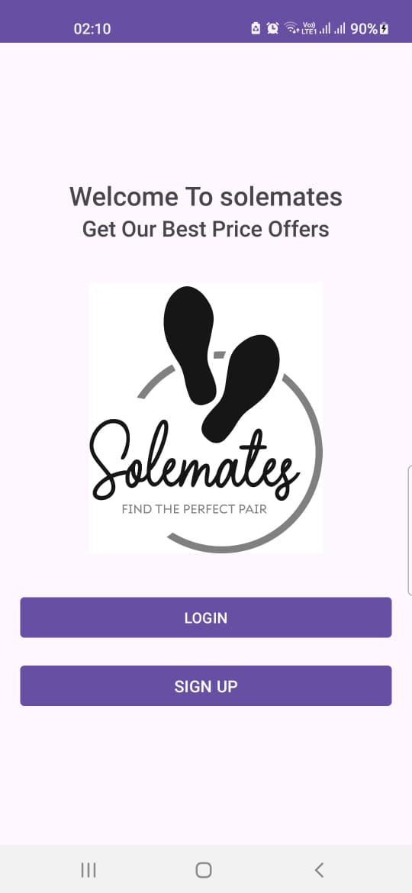
2. WELCOME SCREEN
PLATFORM USED-ANDRIOD STUDIO
The second screen of the app features a welcoming interface prompting users to either sign up if they are new or log in if they are existing users. The screen is designed using XML layout in Android Studio, incorporating intuitive buttons.

Slide 6
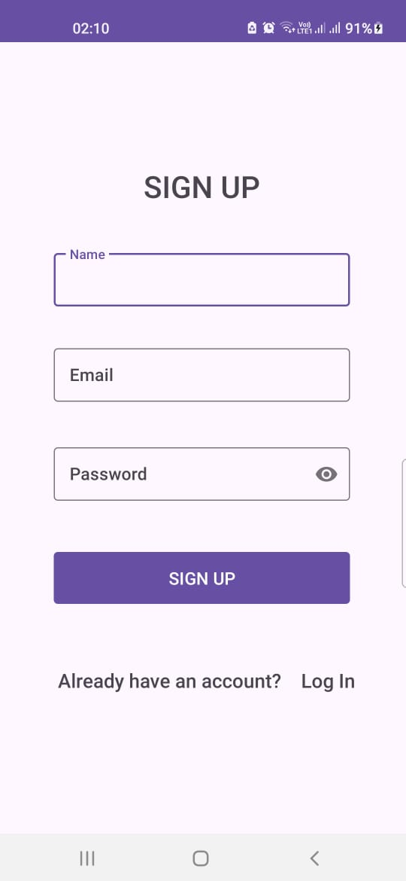
3. SIGNUP SCREEN
The screen is designed using XML layout in Android Studio, incorporating intuitive buttons and input fields for username, email and password. validation are included to ensure accurate user input.

Slide 7
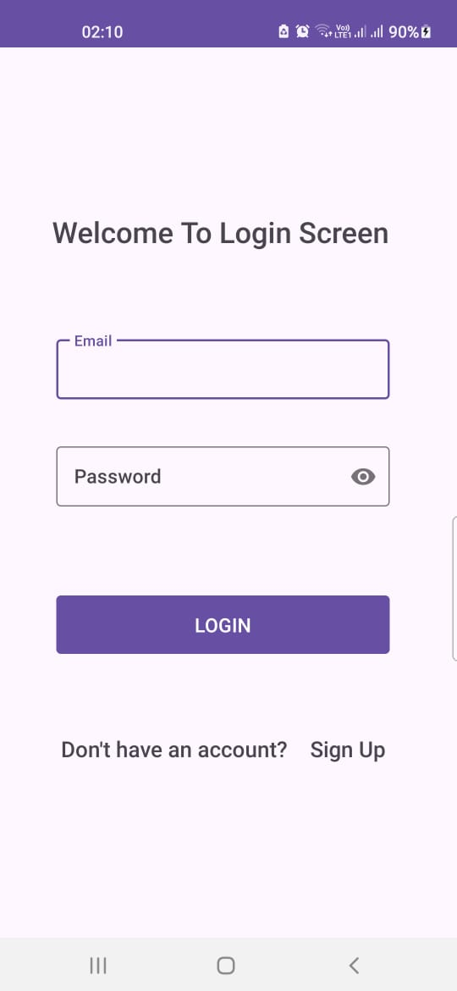
4. LOGIN SCREEN
The screen is designed using XML layout in Android Studio, incorporating intuitive buttons and input fields for email and password. The signup/login functionality is implemented using Firebase Authentication

Slide 8
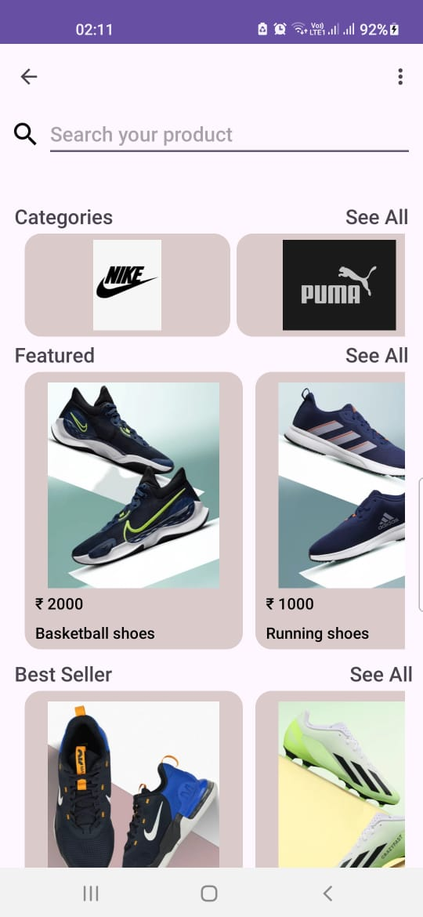
5. HOME SCREEN
The home screen of the app is designed with a user-friendly interface, featuring three main sections:
CATEGORY:
Each category is clickable, leading users to explore brands within their area of interest.
FEATURED:
These features are implemented using Recycler Views and custom adapters to display dynamic content efficiently.
BESTSELLER:
This section helps users discover trending items quickly. Product data is fetched from a backend database (such as Firebase Realtime Database or API calls) and displayed using appropriate layouts and designs.

Slide 9
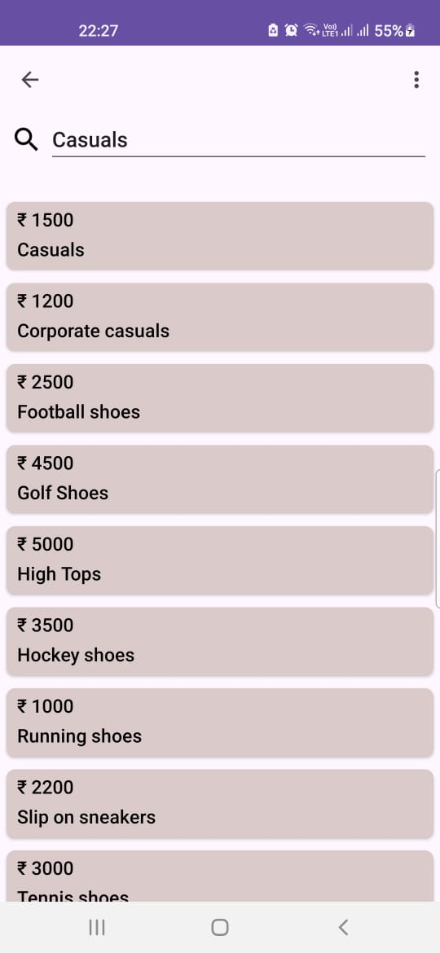
SEARCH IMPLEMENTATION
Search-Functionality: Implement search functionality using Edit Text listeners or Search View widget. As the user types, filter the product list based on the search query and update the Recycler View adapter accordingly.

Slide 10

MENU
We have two Menu options:
1) Cart
2) Log Out
1. CART IMPLEMENTATION:
Data Model: Define a data model for products including attributes like name, price, quantity, etc. Implement a data structure to manage the cart items.
Add to Cart: Implement functionality to add products to the cart. This could be triggered by a button click on the product item in the Recycler View.
2. LOG OUT:
The logout button is used for securely ending your current session, thereby ensuring the privacy and security of your account.

Slide 11
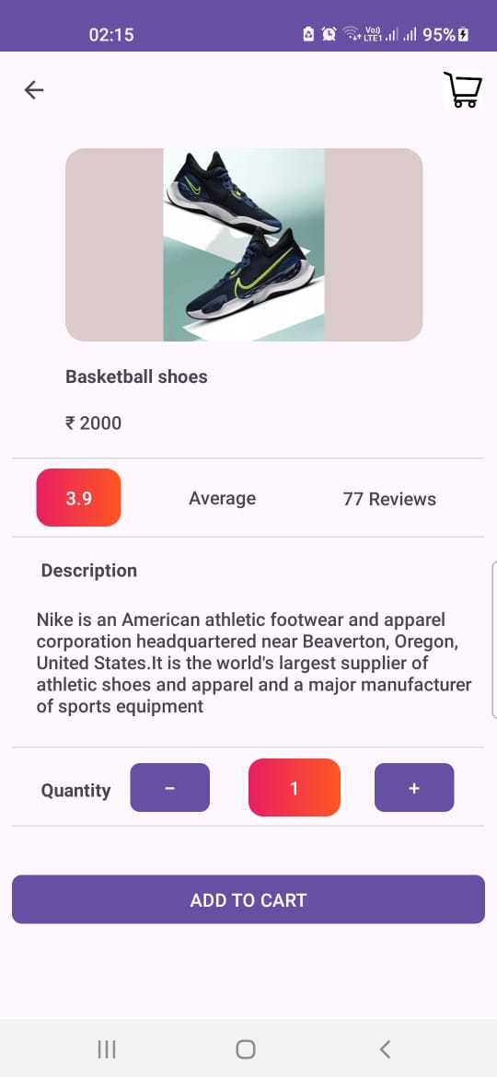
6.PRODUCT DETAILS
Layout Design: the cart activity layout is designed using XML, including Image View for product image, Text Views for product details (rating, quantity, description), and a button for adding to cart.
Data Passing: Pass product data (image URL, rating, quantity, description) from the previous activity (e.g., home screen) to the cart activity using Intent extras or a shared View Model.
Add to Cart Button: Implement onClickListener for the "Add to Cart" button. On click, add the product to the cart data structure (e.g., ArrayList) or update the cart in a database (local or remote).
Navigation: After adding to cart, navigate the user back to the previous screen or to a dedicated cart view.

Slide 12
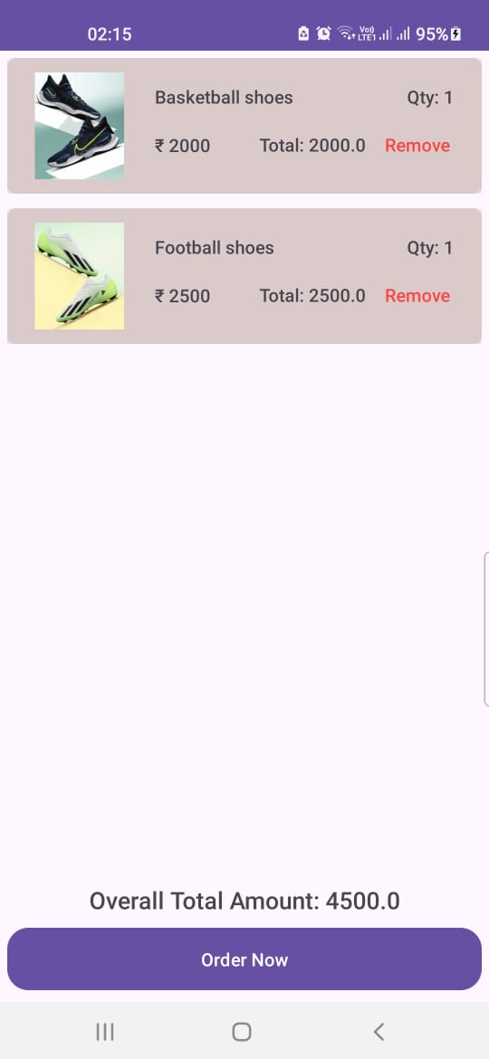
7.ORDER PLACEMENT
Order Summary: Show a summary section displaying total order amount, taxes (if applicable), and any additional charges like shipping fees.
Order Placement: Implement onClickListener for the “ORDER NOW“ button. Validate user inputs, process payment and navigates the screen to the next screen for processing the payment

Slide 13
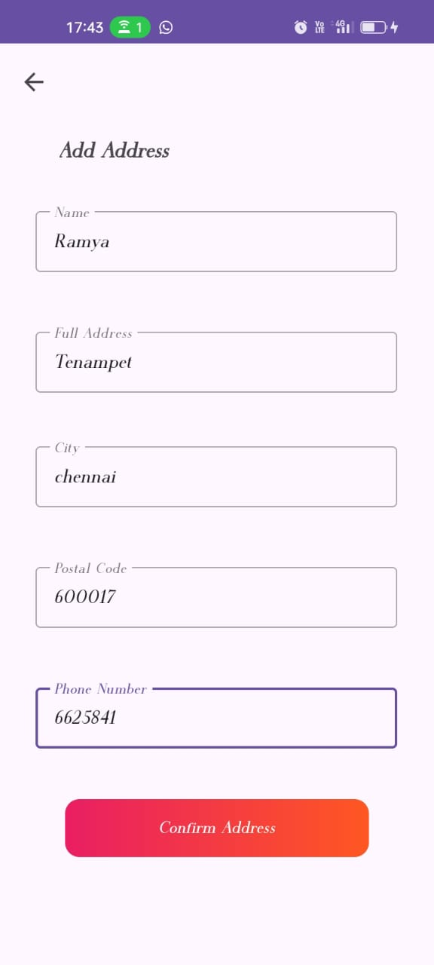
8.ADDRESS DETAILS
The "Add Address" screen in the app is a crucial step that enables users to input their accurate address details for seamless payment processing.
Users can enter their Name, Full address, city, postal/zip code, and phone number to ensure the delivery of their purchases to the correct location.
Once the address details are entered and saved, users can proceed confidently to the payment stage, knowing that their purchases will be shipped to the correct destination.
The "Confirm Address" button on the Add Address screen verifies and validates the entered address details for accuracy and completeness.
Upon clicking this button, users are smoothly redirected to the next screen in the payment process, ensuring a seamless transition and accurate delivery information for their purchases.

Slide 14
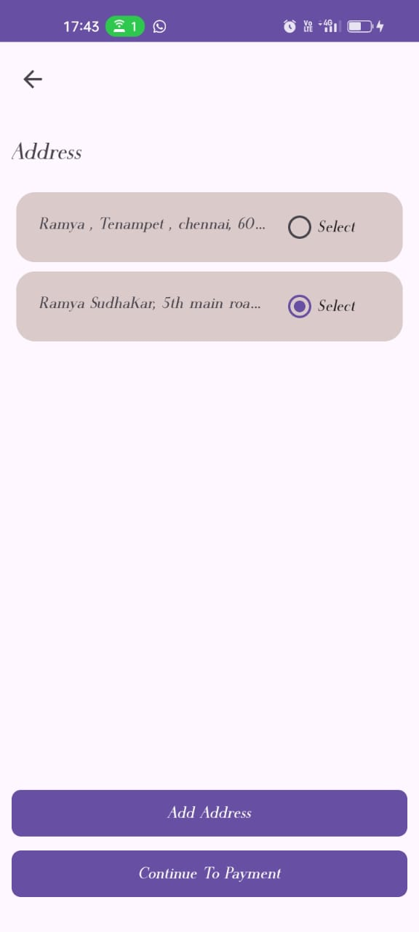
9.PROCEEDING TO PAYMET
1. After successful verification, users are seamlessly redirected to the next screen in the payment process, such as selecting a payment method or entering billing details.
2. This workflow ensures that users proceed through the payment process with confidence, knowing that their shipping address is accurately confirmed for delivery.

Slide 15
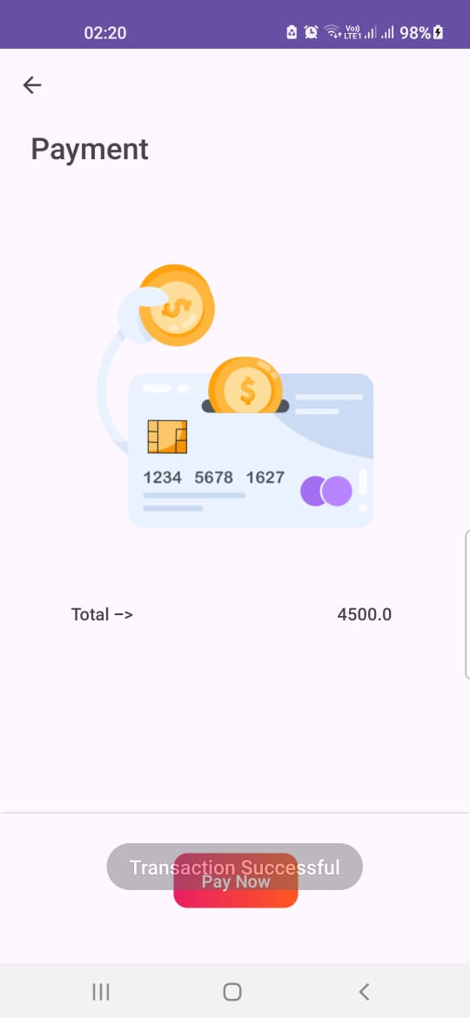
10.TRANSACTION-PAYMET
1. After clicking "Pay Now," users are promptly notified with a "Transaction Successful" message, confirming that the payment has been processed without issues.
2. This final screen provides users with immediate feedback, ensuring a seamless and reassuring experience as they complete their transactions.

Slide 16
THANK YOU

