Slide 1
Expense Manager
#ID: 16201064
16201058

Slide 2
Description:
Daily Expense Manager is a simple but powerful PHP script to manage our expenses .
Expense manager designed to help individual or business budget, track and possibly control our expenses.
It supports tracking of both our expenses and income.
This expense management system provides an integrated set of features to help us to manage our expenses and cash flow.
It provides the ability to group our income/expenses into categories and let us set a budget and track expenses in the category.

Slide 3
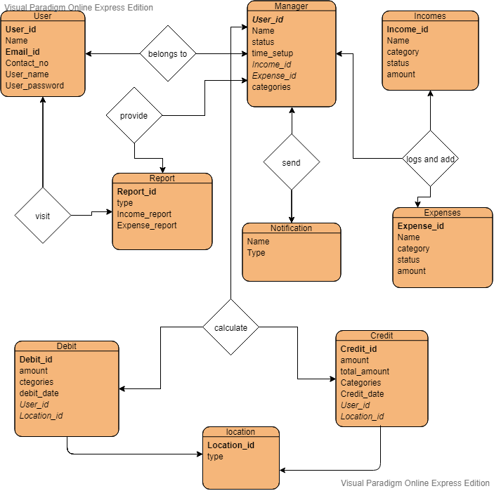
ER diagram for Expense management system:

Slide 4
Thank you

