Slide 1


Web App Scanners
Allan Brooks

Slide 2
Purpose
To emphasize the importance of using web application tools
To bring awareness of the free tools people can use to secure their web applications
To discuss the consequences of not securing their web applications

Slide 3
Outline
Tools
OWASP Zap
Wpscan
Nikto

Slide 4
What is Application Security???
The practice of protecting web applications from outside threats
Utilizing tools to address and mitigate vulnerabilities in a web application

Slide 5
OWASP ZAP
Open-source web application scanner
Made by the OWASP foundation

Slide 6
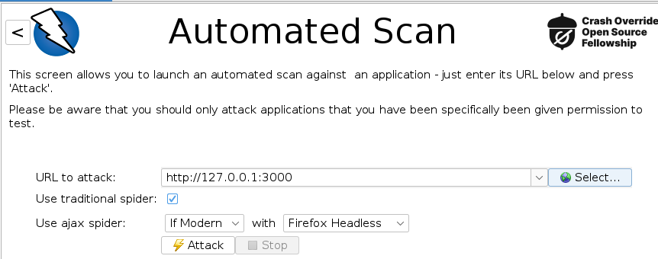
OWASP ZAP

Slide 7
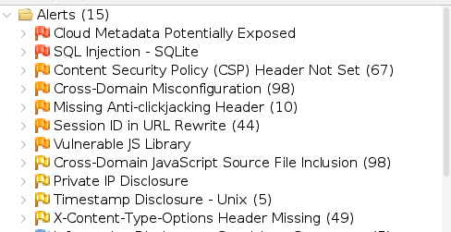
OWASP ZAP

Slide 8
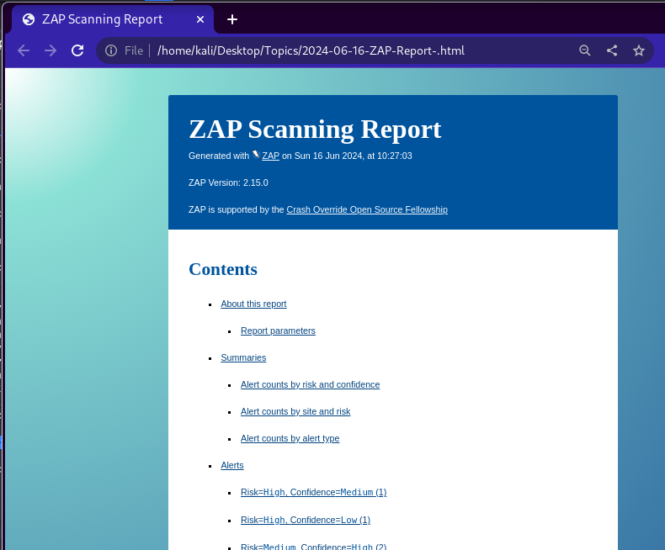
OWASP ZAP

Slide 9
WPSCAN
CLI tool that scan Wordpress sites for vulnerabilities

Slide 10
WPSCAN Commands
Enumerate plugins
Wpscan –url http://127.0.0.1/ --enumerate p
Vulnerability Scan
Wpscan –url http://127.0.0.1/ -enumerate vp

Slide 11
WPSCAN Commands
Enumerate for Installed themes
Wpscan –url http://127.0.0.1/ --enumerate t
Enumerate users
Wpscan –url http://127.0.0.1/ --enumerate u

Slide 12
WPSCAN Results
Enumerate for Installed themes
Wpscan –url http://127.0.0.1/ --enumerate t
Enumerate users
Wpscan –url http://127.0.0.1/ --enumerate u

Slide 13
Nikto
CLI tool that scan web applications for vulnerabilities

Slide 14
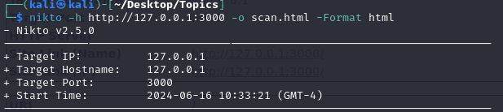
Nikto Scan

Slide 15
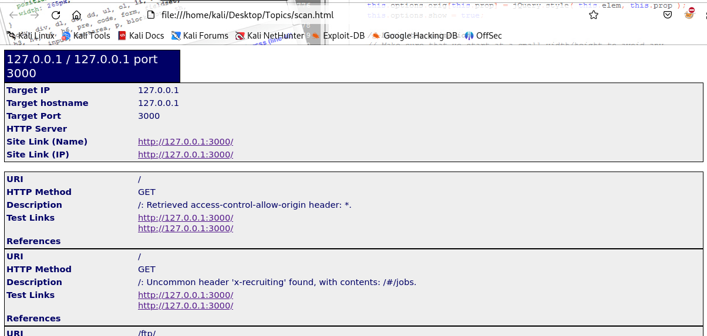
Nikto Scan Report

Slide 16
Consequences
Data exfiltration
Users cannot use the web application
Employee doing things they are not suppose to do

Slide 17
Resources
OWASP ZAP documentation
https://www.zaproxy.org/docs/
Wpscan
https://github.com/wpscanteam/wpscan/wiki/WPScan-User-Documentation
Nikto documentation
https://github.com/sullo/nikto

Slide 18

Questions

